Slide 1
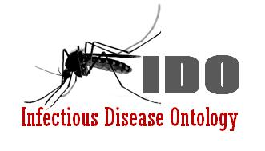
IDO-Staph:
An Ontology of Staphylococcus aureus Infectious Disease
Albert Goldfain, Ph.D.
Researcher, Blue Highway, Inc.
agoldfain@blue-highway.com
Problems in Ontology Invited Talk
November 5, 2012

Slide 2
Outline
Motivation: Disease ontologies for precision medicine
The IDO-Staph extension
Differentiating Staph aureus infectious diseases
A lattice of Staph aureus infectious diseases
A blocking-disposition account of antibiotic resistance
(Time permitting) Complimentary and collective dispositions in IDO.

Slide 3
Motivation: “Toward Precision Medicine: Building a Knowledge Network for Biomedical Research and a New Taxonomy of Disease”
Notes:
Personalization

Slide 4
International Classification of Diseases
Versions:
ICD-9 (1977)
ICD-10 (1992)
ICD-11 (2015)
Lag time in releases → lag time in incorporating new knowledge about disease
Not suited for continuous integration of molecular, genetic information…
…which is now being generated at an increasing pace
Coding-systems used for billing should not be repurposed for meaningful information interchange and clinical decision support
Notes:
Meaninful information exchange for clinical decision support
and evolve for

Slide 5
ICD 9: Catch-all Codes and Scattered Exclusions
041 Bacterial infection in conditions classified elsewhere and of unspecified site
Note: This category is provided to be used as an additional code to identify the bacterial agent in diseases classified elsewhere. This category will also be used to classify bacterial infections of unspecified nature or site.
Excludes: septicemia (038.0-038.9)
041.1 Staphylococcus
041.10 Staphylococcus, unspecified
041.11 Methicillin susceptible Staphylococcus aureus
MSSA
Staphylococcus aureus NOS
041.12 Methicillin resistant Staphylococcus aureus
Methicillin-resistant staphylococcus aureus (MRSA)
041.19 Other Staphylococcus
038 Septicemia
038.1 Staphylococcal septicemia
038.10 Staphylococcal septicemia, unspecified
038.11 Methicillin susceptible Staphylococcus aureus septicemia
MSSA septicemia
Staphylococcus aureus septicemia NOS
038.12 Methicillin resistant Staphylococcus aureus septicemia
038.19 Other staphylococcal septicemia
Notes:
No code system should be extended to do the job of an ontology. Not every taxonomy is a good ontology.
Additional Code: Good, a partial description.
Differentiation by drug resistance
Exclusions: septicemia
Coverage based: ‘other’ ‘unspecified’
Lacks any links to genotypic info.

Slide 6
ICD 9: Catch-all Codes and Scattered Exclusions
041 Bacterial infection in conditions classified elsewhere and of unspecified site
Note: This category is provided to be used as an additional code to identify the bacterial agent in diseases classified elsewhere. This category will also be used to classify bacterial infections of unspecified nature or site.
Excludes: septicemia (038.0-038.9)
041.1 Staphylococcus
041.10 Staphylococcus, unspecified
041.11 Methicillin susceptible Staphylococcus aureus
MSSA
Staphylococcus aureus NOS
041.12 Methicillin resistant Staphylococcus aureus
Methicillin-resistant staphylococcus aureus (MRSA)
041.19 Other Staphylococcus
038 Septicemia
038.1 Staphylococcal septicemia
038.10 Staphylococcal septicemia, unspecified
038.11 Methicillin susceptible Staphylococcus aureus septicemia
MSSA septicemia
Staphylococcus aureus septicemia NOS
038.12 Methicillin resistant Staphylococcus aureus septicemia
038.19 Other staphylococcal septicemia
[041.19] Other Staphylococcus
[041] Bacterial infection in conditions classified elsewhere and of unspecified site.
Notes:
No code system should be extended to do the job of an ontology. Not every taxonomy is a good ontology.
Additional Code: Good, a partial description.
Differentiation by drug resistance
Exclusions: septicemia
Coverage based: ‘other’ ‘unspecified’
Lacks any links to genotypic info.

Slide 7
Motivation: The Antibiotic Race
Year | Antibiotic Effectiveness
1943 | Penicillin available
1947 | First resistant strains reported
1960s | Switch to methicillin
1961 | Methicillin-resistant strain found in Cairo
1980s | Methicillin resistance rising, vancomycin used as a last resort
1992 | 15% methicillin-resistant
1996 | 35% methicillin-resistant
2000 | 50% methicillin-resistant
2002 | Vancomycin resistance reported
(from Knobler et al, 2003)

Slide 8
Motivation: IDO Extension ontologies in the BFO/OGMS/IDO framework
What makes ontologies like IDO and IDO-Staph interesting from the perspective of ontology development?
Host-Pathogen Interactions: The parts and processes of two organisms must be modeled.
Co-evolution of biological functions
Transmission processes and the chain of infection
Horizontal gene transfer and clonal nature of Staph aureus
Pace of scientific discoveries about pathogenic strains will stress test the universals.

Slide 9
IDO-Staph: Introduction
Initial Release Candidate: http://purl.obolibrary.org/obo/ido/sa.owl
Google Code Page: http://code.google.com/p/ido-staph/
Scope
Entities specific to Staphylococcus aureus (Sa) infectious diseases at multiple granularities
Biological and clinical terms describing host-Sa interactions
An IDO extension ontology
Extends IDO-Core, OGMS
BFO as an upper ontology
Built on OBO Foundry principles
Applications
Annotation of clinical case report forms
Lattice of infectious diseases

Slide 10
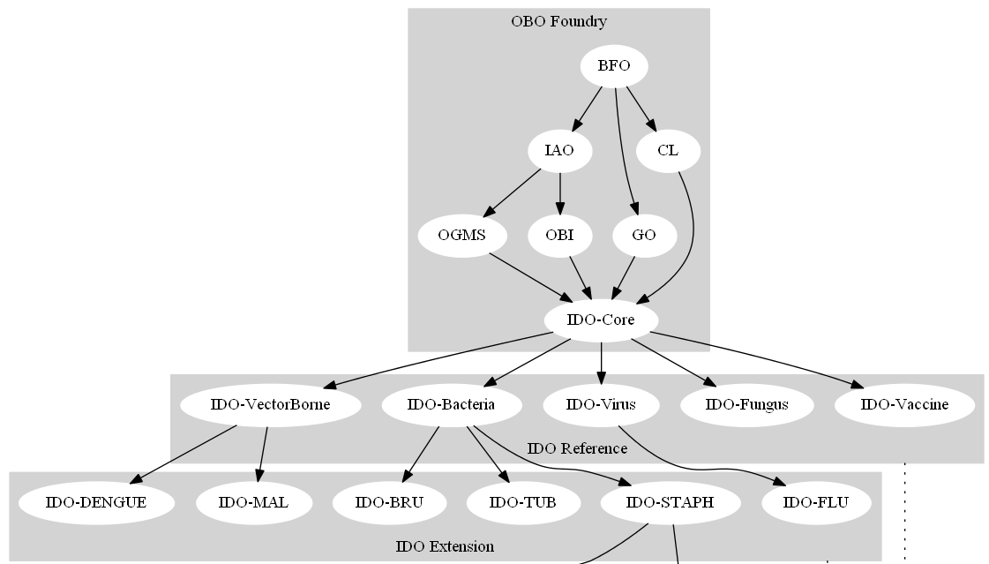
IDO: Core and Extensions Framework

Slide 11
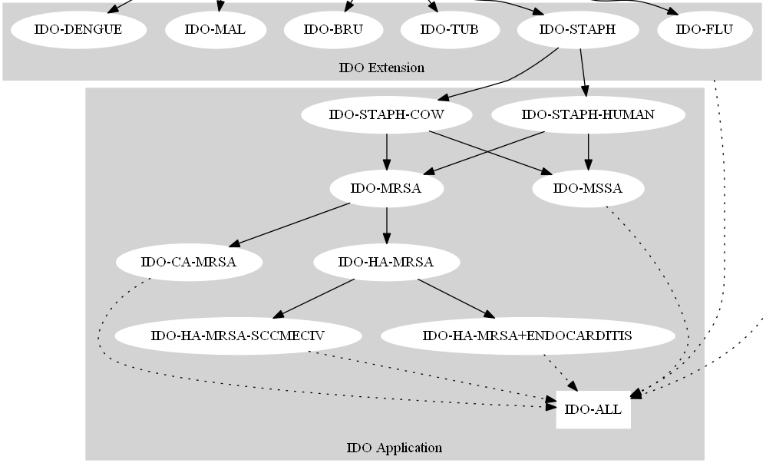
A Lattice of Lightweight Application-Specific Ontologies

Slide 12
The organism Staphylococcus aureus (Sa)
NCBITaxon:Staphylococcus aureus. IDO-Staph makes several assertions about this bacteria:
bearer_of SOME pato:‘spherical’ (quality)
has_disposition SOME (realized_by SOME go:‘aerobic respiration’)
has_disposition SOME (realized_by SOME go:’fermentation’)
has_part SOME go:‘gram-positive-bacterium-type cell wall’
has_part SOME (has_disposition SOME go:‘catalase activity’)

Slide 13
Sa Genes
IDO-Staph imports ‘gene’ from the Sequence Ontology
Sa-specific genes from NCIB Gene:
http://ido-staph.googlecode.com/svn/applications/NCBIGene/NCBISaGenes.owl
Gene results for Staph Aureus: 88625 entries
Removing genes with hypothetical, putative, pseudo, or unknown products: 54086 entries
SELECT DISTINCT gene names: 36096 entries
Essential genes of Sa as determined by Transposon-Mediated Differential Hybridization (Chaudhuri et al, 2009)
248 genes labeled as essential in all studies covered
Imported into IDO-Staph along with a GO annotation for their products.

Slide 14
Sa Genes
Some Sa genes are only part of Sa at some times
Example: lukF gene of the bacteriophage ‘Staphylococcal Phage PVL’ inserts itself into the Sa chromosome
lukF:
part_of SOME ‘Staphylococcal Phage PVL’ at all times
part_of SOME (‘chromosome’ AND
(part_of SOME ‘Staphylococcus aureus’)) at some time

Slide 15
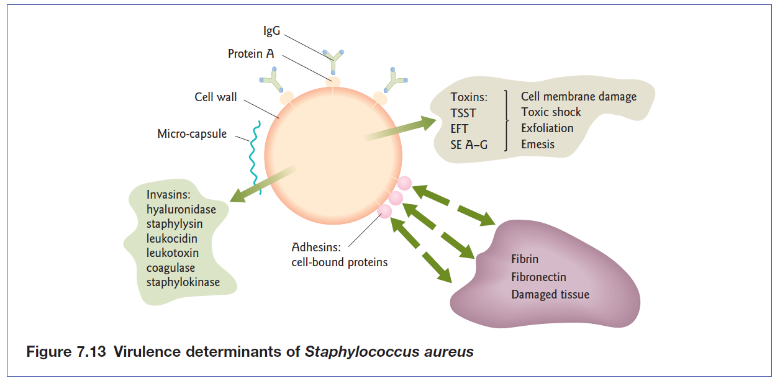
Sa Proteins: Parts and Products
Toxins, Invasins, Adhesins
from Shetty, Tang, and Andrews, 2009
Notes:
What determines the course of a disease

Slide 16
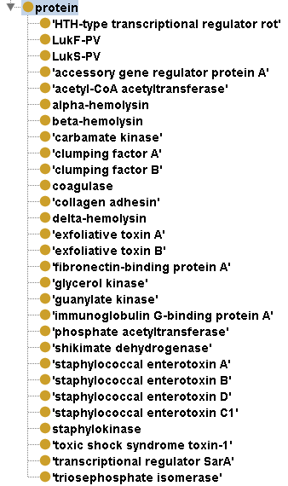
Sa Proteins
Asserted hierachy
PRO:Protein
Inferred Hierarchy
Adhesion factor
Invasion factor
Toxin
Exotoxin
Enterotoxin
Virulence factor

Slide 17
Regulatory networks
Proteins are both gene products and regulators of further protein production
Sa has two major gene regulation systems
Staphylococcal accessory regulator (SarA)
Accessory gene regulator (agr)
OWL-DL pattern:
[protein]: {positively|negatively}_regulates
SOME (ido:production AND (has_participant SOME [protein]))

Slide 18
Sa Diseases
“Staphylococcus aureus is a normal inhabitant of the skin and mucous membranes in the nose of a healthy human. Approximately 30% of the normal healthy population is affected by S. aureus as it asymptomatically colonizes human hosts” (http://microbewiki.kenyon.edu/index.php/Staphylococcus)
Whether or not a particular Sa organism is part of an infectious disorder depends, in part, on its anatomical location in its host.

Slide 19
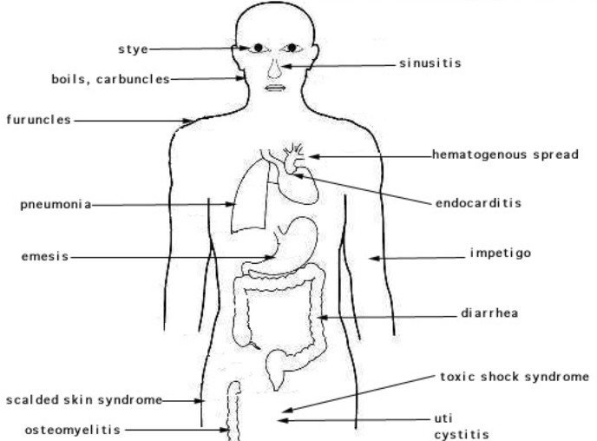
Source: http://textbookofbacteriology.net/themicrobialworld/staph.html

Slide 20
Toxic Shock Syndrome
Staphylococcal TSS is a ido:‘infectious disease’
has_material_basis SOME
(Sa infectious disorder AND (has_part SOME TSST)
TSST is a pr:protein
has_disposition SOME ‘exotoxin disposition’ [INF: is a exotoxin]
tstH is a so:gene
has_gene_product SOME TSST
part_of SOME (SaPI2 OR SaPI3)
SaPI2 is a so:‘pathogenic island’
SaPI3 is a so:‘pathogenic island’

Slide 21
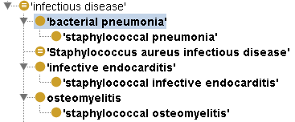
Sa Diseases: Asserted Hierarchy
Primary classification of staphylococcal diseases
These are first and foremost infectious diseases
Use DOIDs for disease terms
Assert ido:‘infectious disease’ as a parent term for these diseases

Slide 22
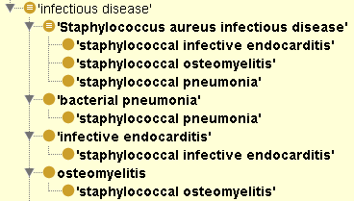
Sa Diseases: Inferred Hierarchy
Secondary classification as Sa Infectious Diseases

Slide 23
Ways of differentiating infectious diseases
High-level types
By host type (species)
By anatomical site of infection
By signs and symptoms
By mode of transmission
By (sub-)species of pathogen
Differentiation based on host features
Clinical phenotype
Strain (e.g. A/J)
Gene types (e.g. C5-deficient)
SNP alleles
Differentiation based on pathogen features
By phenotype (e.g. drug resistance)
By genotype
By banding patterns (e.g. PFGE)
By typing of house-keeping genes (e.g. MLST)
By virulence factor typing (e.g. spa, SCCmec)
By whole genome?
“Methicillin-Susceptible Staphylococcus aureus Endocarditis Isolates Are Associated with Clonal Complex 30 Genotype and a Distinct Repertoire of Enterotoxins and Adhesins”
Nienaber et al. 2011 J Infect Dis. 204(5):704-13.
Notes:
Now incorporating the isolate specific information can make the following inferences
Blue we have essentially done – at least proof of principle. Next step is red
By using common ontologies and nomenclatures and a common set of relations and structure, should be interoperable similar representations for other organism types

Slide 24
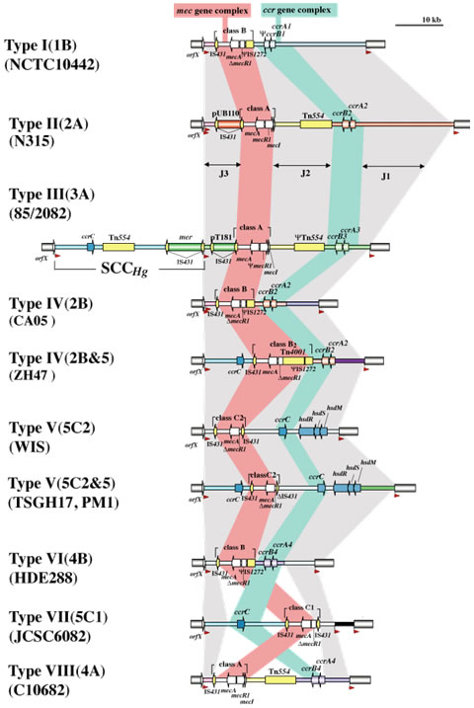
Ways of differentiating Staph aureus infectious diseases
Sa Infectious Disease
By SCCmec type
By ccr type
By mec class
By spa type
IWG-SCC
Maintains up-to-date SCCMec types
General guidelines for reporting novel SCCmec elements
http://www.sccmec.org/Pages/SCC_ClassificationEN.html
Notes:
Methods

Slide 25
SCCMec (Staphylococcal Chromosome Cassette)
A mobile genetic element in Staphylococcus aureus that carries the central determinant for broad-spectrum beta-lactam resistance encoded by the mecA gene and has the following features:
(1) carriage of mecA in a mec gene complex,
(2) carriage of ccr gene(s) (ccrAB or ccrC) in a ccr gene complex,
(3) integration at a specific site in the staphylococcal chromosome, referred to as the integration site sequence for SCC (ISS), which serves as a target for ccr-mediated recombination, and
(4) the presence of flanking direct repeat sequences containing the ISS.

Slide 26
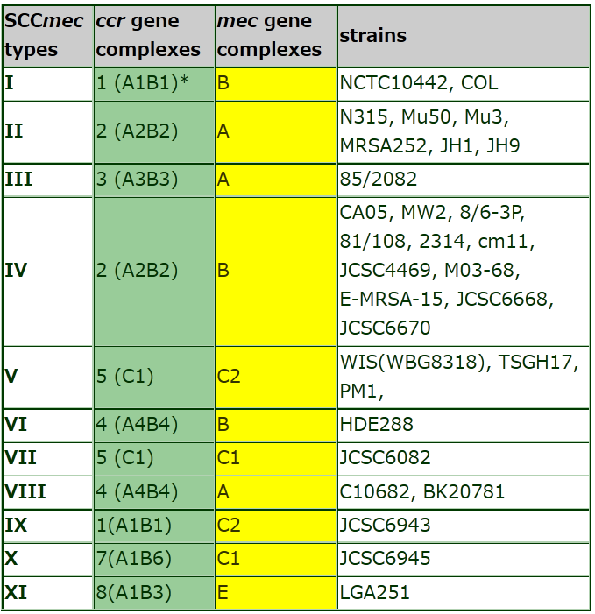

Slide 27
Representing SCCMec: IDO-Staph + SO
is a
gene group
pathogenic island
is a
is a
mec complex
SCCmec
ccr complex
has_part
has_part
is a
is a
is a
mec complex class B
SCCmec Type IV
ccr complex Type 2
has_part
has_part
has_part
has_part
has_part
has_part
IS1272
mecA
ccrA2
ccrB2
is a
is a
is a
insertion sequence
gene
is a

Slide 28
NARSA Isolate Data
Isolate data from the Network for Antimicrobial Resistance to Staph. Aureus
CDC Active Bacterial Core surveillance (ABCs) Isolates Subset
Known Clinically Associated Strains
101 Sa isolates
Isolate data
Culture source (e.g. bone/joint)
Antimicrobial profile (e.g. erythromycin resistant)
Virulence factors expressed (e.g. TSST-1+)
PFGE type (e.g. USA300)
Genomic typing (e.g. MLST type 8, SCCmec type IV))

Slide 29
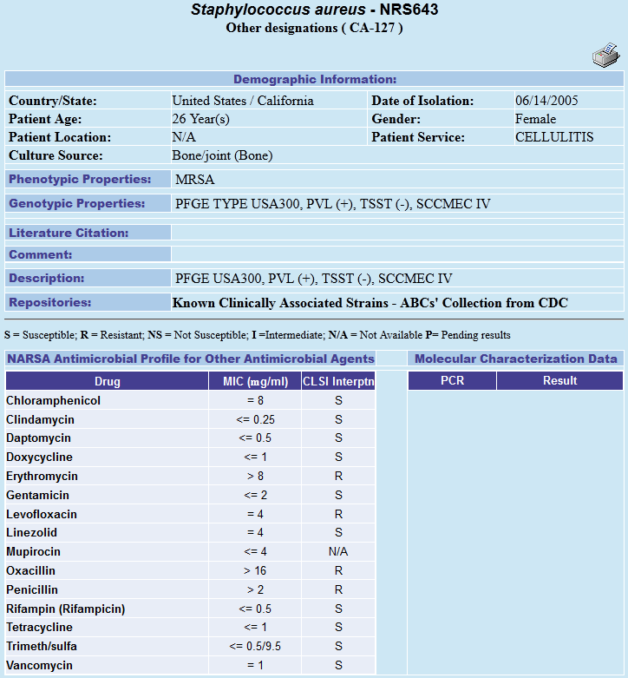
Notes:
MIC is the assay for resistance

Slide 30
Building a Lattice
For each NARSA Isolate we extract
SCCMec Type (IDO-STAPH)
TSST +/- (IDO-STAPH)
PVL +/- (IDO-STAPH)
Culture Source (FMA)
Antimicrobial Profile
Drug (CHEBI)
Minimum Inhibitory Concentration (OBI)
CLSI Interpretation of Resistance (IDO)
Each particular isolate can be part of a particular Staph aureus infectious disorder.
Each particular Staph aureus isolate can be the material basis for a particular Staph aureus infectious disease.

Slide 31
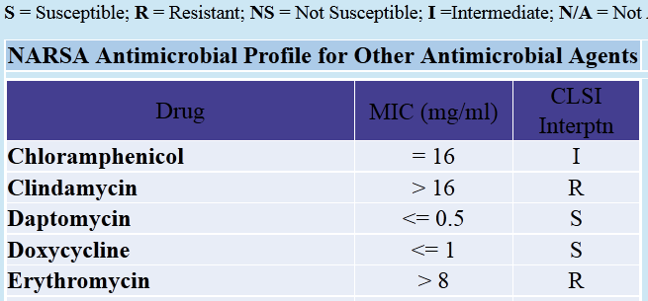
Resistance of NRS701 to clindamycin
resistance_of_Iso_to_D instanceOf resistance_to_D
Iso has_disposition ‘resistance_of_Iso_to_D’
Iso_D_MIC instanceOf ‘MIC data item’
Iso_D_MIC has_measurement_value M
+

Slide 32
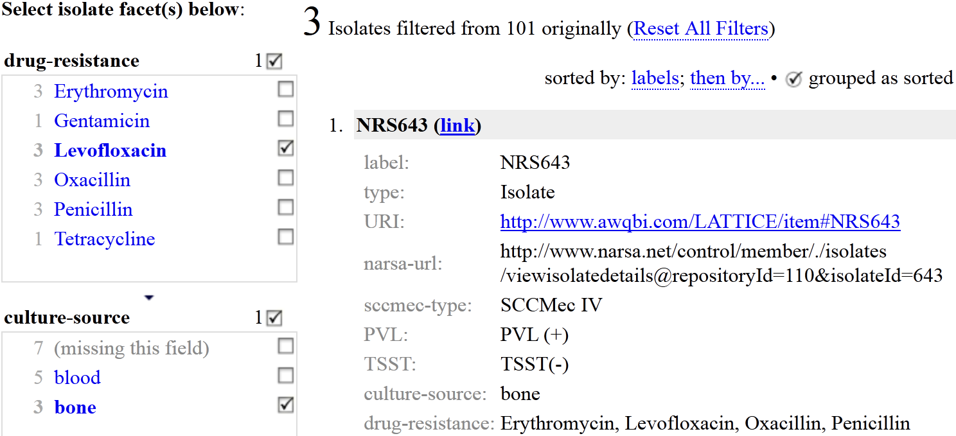
Faceted Browser
http://awqbi.com/LATTICE/narsa-complete.html
http://purl.obolibrary.org/obo/ido/sa/narsa-isolates.owl

Slide 33
Antibiotics in IDO-Staph
IDO-Staph currently supports:
antibiotics listed in the NARSA antibiotic profile
antibiotics listed in the Fowler CRF
antibiotics listed in the Lesse CRF
Imported from ChEBI and NDF-RT.
IDO-Staph is aligning with the Comprehensive Antibiotic Resistance Database (CARD)
Good coverage of terms and synonyms
Links between antibiotics and genetic determinants of resistance
Needs some work on the ontology side (ARO)

Slide 34
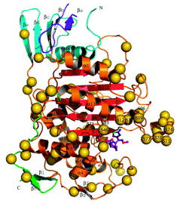
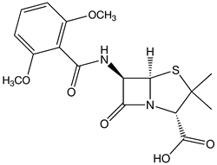
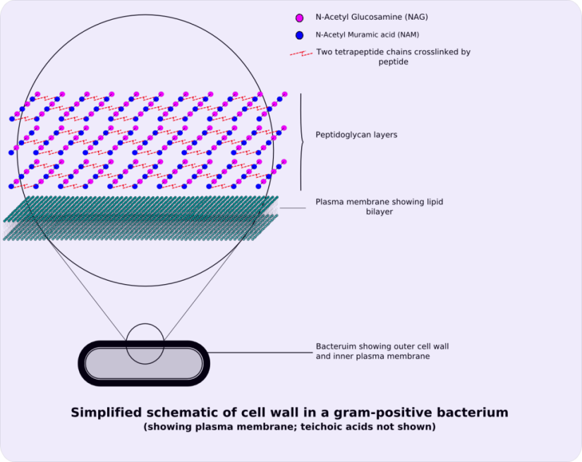
Why MRSa is Resistant to Methicillin
PBP2a
Methicillin
lacks
affinity_to_methicillin
Bacterial_Cell_Wall
No Methicillin_PBP_Binding_Process
Synthesis of Peptidoglycan
Peptidoglycan
part_of

Slide 35
BFO Dispositions
BFO 2.0 elucidation
b is a disposition means: b is a realizable entity and b’s bearer is some material entity and b is such that if it ceases to exist, then its bearer is physically changed and b’s realization occurs when and because this bearer is in some special physical circumstances, and this realization occurs in virtue of the bearer’s physical make-up.

Slide 36
Counterfactual Conditional Analysis of Dispositions
Counterfactual/Subjunctive Conditionals
: If x were A then x would be B
NOT the same as familiar material conditional
Example from Wikipedia:
Material Implication: If Oswald did not kill Kennedy, then someone else did.
Counterfactual Implication: If Oswald had not killed Kennedy, then someone else would have.
Conditional Analysis of Dispositions
‘D_{(S,M)}x’ = x is disposed to manifest M in response to stimulus S.
‘Sx’ = x receives stimulus S
‘Mx’ = x manifests M

Slide 37
Finks and Antidotes
Problems with counterfactual conditional analysis
Finkish Dispositions (Martin, 1994) :
Note: Realizing process takes time
Note: Dispositions can be gained or lost
E.g., “Some food might become infected with the bacterium Clostridium botulinum and thereby become poisonous. It can lose that disposition by cooking or irradiation” (Bird, 1998).
Antidote/Mask (Bird, 1998):
Even if the object retains its disposition, external conditions may prevent manifestation
E.g., A small forest fire that is contained still has the disposition to burn down the entire forest, but it doesn’t manifest that disposition because it is contained.

Slide 38
Background Conditions
Background conditions for dispositions (Mumford, 2003):
“α-conditions: being conditions that prevent the manifestation of a disposition though the disposition itself remains:
lack of oxygen prevents a struck match from lighting though it remains flammable
the lack of a mate prevents a man from breeding though he remains fertile
placing a vase in a sturdy glass prevents it from being broken though it remains fragile.”
“β-conditions: being conditions that prevent something from having a disposition:
a match being wet stops it being flammable
a zero or low sperm count stops a male from being fertile
a strengthening process stops a vase from being fragile.”

Slide 39
Further Analysis
Background conditions, external circumstances, and laws of nature can also be construed using dispositions.
Sometimes these dispositions
Block each other
Complement each other
Manifest in a collective way
Under this view, we have in nature an array of objects with a field of potentials. Dispositions “interact” through their realizations.
Notes:
A dispositions context can also be construed dispositionally

Slide 40
Blocking Dispositions
What is often preventing the manifestation of a disposition is the manifestation of another disposition. We will call the latter a blocking disposition.
If d2 is a blocking disposition for the disposition d1, then either
[Incompatible realizing processes] The realization of d1 is somehow incompatible with the realization of d2, meaning either that they cannot co-occur or that one negatively regulates the other.
[Incompatible qualities] The realization of d2 results in a quality inhering in a continuant that is incompatible with the quality of the same continuant that would have resulted from the realization of d1. That is, we have two qualities that cannot be simultaneously exhibited.

Slide 41
Protective Resistance (IDO-Core)
Protective Resistance =_{def} A disposition that inheres in a material entity (x) by virtue of the fact that the entity has a part (e.g. a gene product), which itself has a disposition (1) to ensure a physiologic response of a certain degree to an entity with the capability to damage x, or (2) to prevent the completion of some process caused by an entity with the capability to damage x.

Slide 42
Methicillin Resistance as Blocking Disposition
In the case of MRSa, we can argue for incompatible manifestations:
The process of cell wall construction (as a manifestation of the typical disposition of PBP) is incompatible with the process of methicillin binding (which is the manifestation of affinity to methicillin in the case of PBP2a).
We could also argue for incompatible qualities:
the molecular structure of a bacterial cell wall (i.e., a peptidoglycan lattice) is incompatible with the molecular structure of a methicilin-bound compound.
So protective resistance to methicillin is exhibited by MRSa in the process of cell wall construction by blocking the disposition of methicillin to bind to PBP.
Notes:
Queries answered in terms of blocking dispositions are explanatory

Slide 43
Conclusion
Good web resources on Staph aureus exist…
IWG-SCC
NARSA
Comprehensive Antibiotic Resistance Database (CARD)
…but currently in information siloes and flat HTML
The BFO-OGMS-IDO framework is well suited to model phenomena such as antibiotic resistance.
Disease specific application ontologies can be induced from isolate data
Each such application ontology
Has a well-defined place in the lattice beneath IDO-Core
Can be used to make Sa specific genetic-phenotypic assertions.
We believe an IDO-based lattice of application ontologies can contribute to a new taxonomy of (infectious) disease.

Slide 44
Acknowledgements
This work was funded by the National Institutes of Health through Grant R01 AI 77706-01. Smith’s contributions were funded through the NIH Roadmap for Medical Research, Grant U54 HG004028 (National Center for Biomedical Ontology).
Duke SABG
IDO Consortium
OBO Foundry

Slide 45
Extra Slides
Time Permitting

Slide 46
Complementary Dispositions
Motivating example:
A lock and a key
D1: Disposition of the key to transmit torque when rotated.
D2: Disposition of the lock to unlatch when pressure is placed on locking mechanism.
P: An unlocking process
BOTH D1 and D2 are realized in P.
But D1 ≠ D2. P can fail to occur because of a rusted lock or a worn down key.
Complementary dispositions can be characterized by:
a relation between the bearers (e.g., complementary shapes between lock and key)
The identity of manifestation between two dispositions
Analyses:
Martin: Reciprocal disposition partners (as replacement for cause and effect).
Bird: Dispositions always exist pairwise
Lock + Key as whole with a single disposition
Lock + Key as whole with collective disposition
has_disposition D1
has_dispositionD2
realized_by
realized_by
P
Notes:
Recip disp partners: evolved that way or designed that way

Slide 47
Complementary Dispositions in IDO
Pathogenic Disposition=def A pathogenic disposition that inheres in an organism and is a disposition for that organism to be transmitted to a host, (2) to establish itself in the host, and (3) to initiate processes that result in a disorder in the host, and (4) to become part of that disorder.
Infectious Disposition =def A pathogenic disposition to be transmitted from one organism to another and to establish a clinically abnormal colony in the second organism.
Capability to Play the Host Role =def A disposition to participate in symbiosis as host with another organism of a certain type.
(D1) Pathogenic disposition and (D2) capability to play the host role are complementary dispositions realized in the process of symbiosis (P).
Symbiosis can fail because the pathogen cannot survive in the host (e.g., not in host range) OR because the host is immune

Slide 48
Collective Dispositions
Motivating examples:
A crowd has the collective capability to do the wave
In virtue of each member’s individual capability to stand at the appropriate time.
Two people are capable of lifting more weight than each individual person.
In virtue of each person’s individual capability to lift weight.
IDO Motivations:
How to represent the dispositions of infectious organism populations
From a microbiological perspective, an infection is an aggregate
From a clinical perspective, an infection is an object
How to represent the dispositions of host populations

Slide 49
Collective Dispositions
Collective Disposition =def A disposition inhering in an object aggregate OA in virtue of the individual dispositions of the constituents of OA and that does not itself inhere in any part of OA or in any larger aggregate
Note: Individual dispositions of the constituents do not have to be realized in unison.

Slide 50
Herd immunity as collective disposition
Herd Immunity =def A collective disposition that inheres in an organism population by virtue of the fact that a sufficient number of members of the population have immunity to an infectious agent thereby reducing transmission and protecting nonimmune members from the infectious agent population.
Same disposition type can cross scales, same disposition instance cannot.
Two (potential) host populations can both have herd immunity to a type of infectious organism
A change in the size of the host population → a change in the herd immunity instance
Notes:
Simplified, “really host of pathogen role”

