Slide 1
Mental Functioning Ontology and the ICF
Barry Smith
October 1, 2012

Slide 2
Basic Formal Ontology
BFO:Entity
BFO
BFO:Continuant
BFO:Occurrent
BFO:Independent Continuant
BFO:Dependent Continuant
BFO:Process
BFO:Disposition
Notes:
Mental functioning related anatomical structure: an anatomical structure in which there inheres the disposition to be the agent of a mental process
Behaviour inducing state: a bodily quality inhering in a mental functioning related anatomical structure which leads to behaviour of some sort
Affective representation: a cognitive representation sustained by an organism about its own emotions
Cognitive representation: a representation which specifically depends on an anatomical structure in the cognitive system of an organism
Mental process: a bodily process which brings into being, sustains or modifies a cognitive representation or a behaviour inducing state

Slide 3
Basic Formal Ontology and Mental Functioning Ontology (MFO)
BFO:Entity
BFO
BFO:Continuant
BFO:Occurrent
MFO
BFO:Independent Continuant
BFO:Dependent Continuant
BFO:Process
Bodily Process
Organism
BFO:Disposition
Cognitive Representation
BFO:Quality
Mental Process
Mental Functioning Related Anatomical Structure
Behaviour inducing state
Affective Representation
Notes:
Mental functioning related anatomical structure: an anatomical structure in which there inheres the disposition to be the agent of a mental process
Behaviour inducing state: a bodily quality inhering in a mental functioning related anatomical structure which leads to behaviour of some sort
Affective representation: a cognitive representation sustained by an organism about its own emotions
Cognitive representation: a representation which specifically depends on an anatomical structure in the cognitive system of an organism
Mental process: a bodily process which brings into being, sustains or modifies a cognitive representation or a behaviour inducing state

Slide 4
Basic Formal Ontology and Mental Functioning Ontology (MFO)
BFO:Entity
BFO
BFO:Continuant
BFO:Occurrent
MFO
BFO:Independent Continuant
BFO:Dependent Continuant
BFO:Process
Bodily Process
Organism
BFO:Disposition
Cognitive Representation
BFO:Quality
Mental Process
Mental Functioning Related Anatomical Structure
Behaviour inducing state
Affective Representation
Notes:
Mental functioning related anatomical structure: an anatomical structure in which there inheres the disposition to be the agent of a mental process
Behaviour inducing state: a bodily quality inhering in a mental functioning related anatomical structure which leads to behaviour of some sort
Affective representation: a cognitive representation sustained by an organism about its own emotions
Cognitive representation: a representation which specifically depends on an anatomical structure in the cognitive system of an organism
Mental process: a bodily process which brings into being, sustains or modifies a cognitive representation or a behaviour inducing state

Slide 5
Functions vs. Functionings
Continuants vs. Occurrents
BFO:Entity
BFO
BFO:Continuant
BFO:Occurrent
MFO
BFO:Independent Continuant
BFO:Dependent Continuant
BFO:Process
Bodily Process
Organism
BFO:Disposition
Cognitive Representation
BFO:Quality
Mental Process
Mental Function
Mental Functioning
5

Slide 6
Aboutness (‘Intentionality’)
BFO:Entity
BFO
BFO:Continuant
BFO:Occurrent
MFO
BFO:Independent Continuant
BFO:Dependent Continuant
BFO:Process
Bodily Process
Organism
BFO:Disposition
BFO:Quality
Cognitive Representation
Mental Process
Mental Function
Mental Functioning
does all mental functioning involve cognitive representation (aboutness)?
what is aboutness?
6

Slide 7
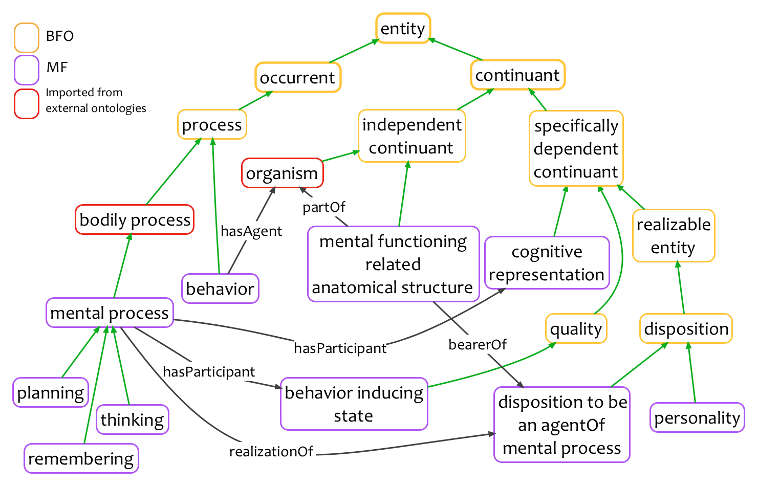
Mental Functioning Ontology (MF)
Notes:
Mental functioning related anatomical structure: an anatomical structure in which there inheres the disposition to be the agent of a mental process
Behaviour inducing state: a bodily quality inhering in a mental functioning related anatomical structure which leads to behaviour of some sort
Affective representation: a cognitive representation sustained by an organism about its own emotions
Cognitive representation: a representation which specifically depends on an anatomical structure in the cognitive system of an organism
Mental process: a bodily process which brings into being, sustains or modifies a cognitive representation or a behaviour inducing state

Slide 8
Linguistic Functioning Ontology (1. Speech and hearing)
BFO:Entity
BFO
BFO:Continuant
BFO:Occurrent
MFO
BFO:Independent Continuant
BFO:Dependent Continuant
BFO:Process
Bodily Process
BFO:Disposition
Cognitive Representation
BFO:Quality
Linguistic competence
Speech process
Behaviour inducing state
Speech competence of a population
= a [spoken] language
Speech-mediated cognitive representation
Hearing (registering) process
Speech competence of an individual
8

Slide 9
Linguistic Functioning Ontology (2. Reading and writing)
BFO:Entity
BFO
BFO:Continuant
BFO:Occurrent
MFO
BFO:Independent Continuant
BFO:Dependent Continuant
BFO:Process
Bodily Process
BFO:Disposition
Cognitive Representation
BFO:Quality
Linguistic competence
Writing process
Behaviour inducing state
Written linguistic competence of a population
= a [written] language
Written-language-mediated cognitive representation
Reading (registering) process
Written linguistic competence of an individual
9

Slide 10
Linguistic Functioning Ontology (the whole thing)
BFO:Entity
BFO
BFO:Continuant
BFO:Occurrent
MFO
BFO:Independent Continuant
BFO:Dependent Continuant
BFO:Process
Bodily Process
BFO:Disposition
Cognitive Representation
BFO:Quality
Linguistic competence
Speaking
Writing
Behaviour inducing state
Linguistic competence of a population
= a language
Language-mediated cognitive representation
Reading
Linguistic competence of an individual
10

Slide 11
How to build MF±Language
First idea:
Along what dimensions human beings can depart from normal (‘canonical’) mental and linguistic functioning?

Slide 12
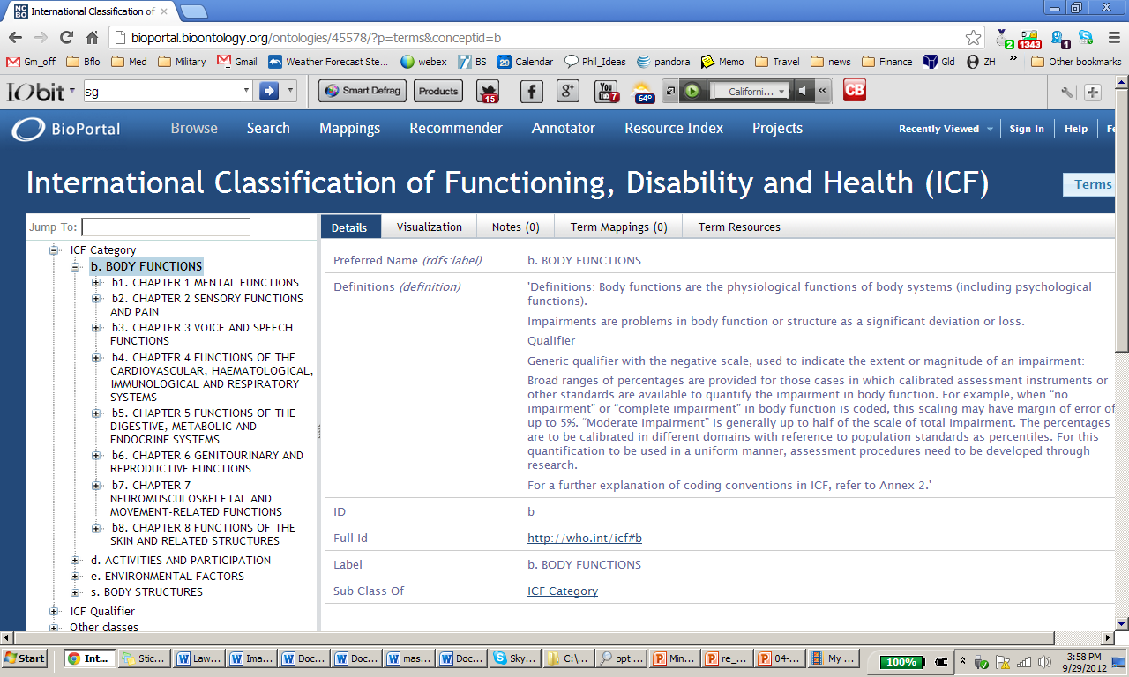
http://bioportal.bioontology.org/ontologies/45578/
from WHO | World Health Organization

Slide 13
For ICD mental function is a subtype of body function
ICD definition of ‘Body functions’: Body functions are the physiological functions of body systems (including psychological functions). Impairments are problems in body function or structure as a significant deviation or loss.

Slide 14
http://bioportal.bioontology.org/ontologies/45578/

Slide 15
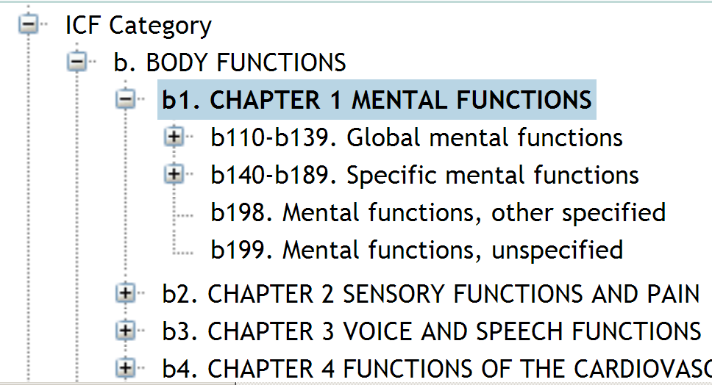
http://bioportal.bioontology.org/ontologies/45578/

Slide 16
Definition of ‘Mental Functions’
Definitions: 'This chapter is about the functions of the brain: both global mental functions, such as consciousness, energy and drive, and specific mental functions, such as memory, language and calculation mental functions.'

Slide 17
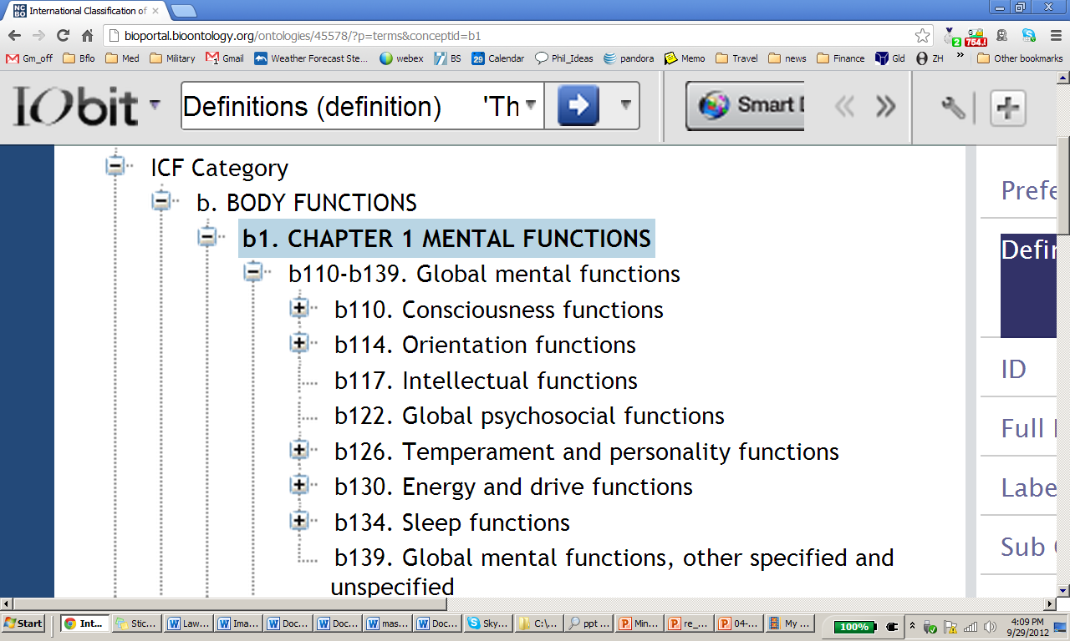

Slide 19
Quality ≠ Function

Slide 22
Dreaming?

Slide 23
http://apps.who.int/classifications/icd10/browse/2010/en#/F44.8

Slide 24
http://bioportal.bioontology.org/ontologies/45578/

Slide 25
http://bioportal.bioontology.org/ontologies/45578/

Slide 27
Ontological traffic rule: always use singular nouns

Slide 30
Mental Functioning Ontology (MF)
Notes:
Mental functioning related anatomical structure: an anatomical structure in which there inheres the disposition to be the agent of a mental process
Behaviour inducing state: a bodily quality inhering in a mental functioning related anatomical structure which leads to behaviour of some sort
Affective representation: a cognitive representation sustained by an organism about its own emotions
Cognitive representation: a representation which specifically depends on an anatomical structure in the cognitive system of an organism
Mental process: a bodily process which brings into being, sustains or modifies a cognitive representation or a behaviour inducing state

Slide 31
Mental Functioning Ontology (MF)
Notes:
Mental functioning related anatomical structure: an anatomical structure in which there inheres the disposition to be the agent of a mental process
Behaviour inducing state: a bodily quality inhering in a mental functioning related anatomical structure which leads to behaviour of some sort
Affective representation: a cognitive representation sustained by an organism about its own emotions
Cognitive representation: a representation which specifically depends on an anatomical structure in the cognitive system of an organism
Mental process: a bodily process which brings into being, sustains or modifies a cognitive representation or a behaviour inducing state

Slide 32
Definitions: 'Specific mental functions of focusing on an external stimulus or internal experience for the required period of time.'

Slide 34
Mental Functioning Ontology (MF)
brainin
endocrine gland
Notes:
Mental functioning related anatomical structure: an anatomical structure in which there inheres the disposition to be the agent of a mental process
Behaviour inducing state: a bodily quality inhering in a mental functioning related anatomical structure which leads to behaviour of some sort
Affective representation: a cognitive representation sustained by an organism about its own emotions
Cognitive representation: a representation which specifically depends on an anatomical structure in the cognitive system of an organism
Mental process: a bodily process which brings into being, sustains or modifies a cognitive representation or a behaviour inducing state

Slide 36
Mental Functioning Ontology (MF)
Notes:
Mental functioning related anatomical structure: an anatomical structure in which there inheres the disposition to be the agent of a mental process
Behaviour inducing state: a bodily quality inhering in a mental functioning related anatomical structure which leads to behaviour of some sort
Affective representation: a cognitive representation sustained by an organism about its own emotions
Cognitive representation: a representation which specifically depends on an anatomical structure in the cognitive system of an organism
Mental process: a bodily process which brings into being, sustains or modifies a cognitive representation or a behaviour inducing state

Slide 37
Mental Functioning Ontology (MF)
brainin
olfactory system
Notes:
Mental functioning related anatomical structure: an anatomical structure in which there inheres the disposition to be the agent of a mental process
Behaviour inducing state: a bodily quality inhering in a mental functioning related anatomical structure which leads to behaviour of some sort
Affective representation: a cognitive representation sustained by an organism about its own emotions
Cognitive representation: a representation which specifically depends on an anatomical structure in the cognitive system of an organism
Mental process: a bodily process which brings into being, sustains or modifies a cognitive representation or a behaviour inducing state

Slide 39
Mental Functioning Ontology (MF)
brainin
olfactory system
Notes:
Mental functioning related anatomical structure: an anatomical structure in which there inheres the disposition to be the agent of a mental process
Behaviour inducing state: a bodily quality inhering in a mental functioning related anatomical structure which leads to behaviour of some sort
Affective representation: a cognitive representation sustained by an organism about its own emotions
Cognitive representation: a representation which specifically depends on an anatomical structure in the cognitive system of an organism
Mental process: a bodily process which brings into being, sustains or modifies a cognitive representation or a behaviour inducing state

Slide 40
Again, confusion of function and quality

Slide 42
Integrative language functions
Definitions: 'Mental functions that organize semantic and symbolic meaning, grammatical structure and ideas for the production of messages in spoken, written or other forms of language.'

Slide 43
WHO ICF Pro
Performs an amazingly difficult task of unifying public data across the planet (Versions in 5 different languages, plus Youth Version)
Serves billing task in US
http://apps.who.int/classifications/icfbrowser/

Slide 44
http://cirrie.buffalo.edu/icf/

Slide 45
WHO ICF Con
Use of ‘other’ and other features make it is not future proof (will not evolve gracefully with advances in neuroscience
Poor or absent definitions will mean inconsistent annotation of data
Lack of logical definitions would mean poor support for computational reasoning with data that is annotated

Slide 46
Strategy for MF Ontology
Ensure that the ontology is developed in conformity with basic biology ontologies such as the Gene Ontology
Provide human-readable definitions for each term to ensure consistent annotation
Provide logical definitions to support reasoning with data

Slide 47
Examples from MF-Emotion Ontology
http://bioportal.bioontology.org/ontologies/49078/

Slide 48
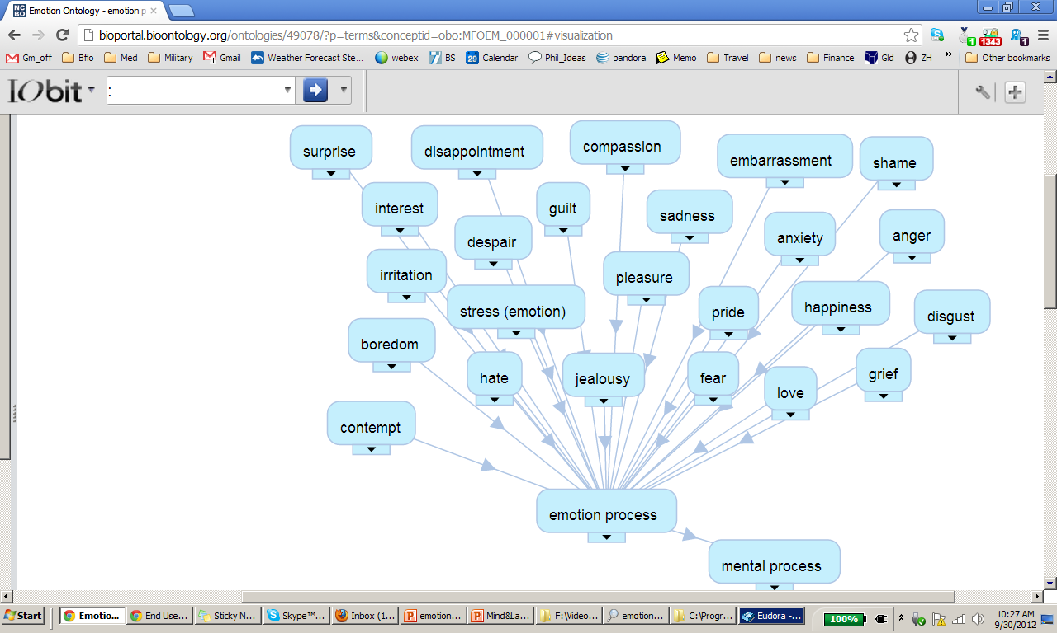
‘emotion
process’

Slide 49
‘physiological response to emotion’
need link to a physiology ontology

