Slide 1
Flow Cytometry Analysis for HIV/AIDS
Immunology Ontologies and Their Applications in Processing Clinical Data
June 11-13, Buffalo, NY
Director, Biostatistics and Computational Core, Duke CFAR

Slide 2
Overview
Basics of flow cytometry (optional)
Applications of flow cytometry for HIV/AIDS
Automated analysis
Potential for ontology contributions
Marriage of automated analysis and use of ontologies (to be continued by Ryan and Nikesh)

Slide 3
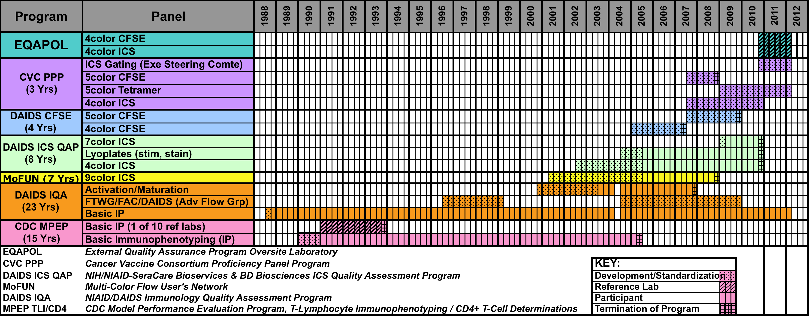
Duke Human Immune Profiling
Notes:
Currently, EQAPOL reference laboratory for flow cytometry

Slide 4
1989-1994; Duke Center for AIDS Research (CFAR) Flow Cytometry Core
1991-2000; Central Immunology Laboratory for the AIDS Vaccine Evaluation Group (AVEG)
2000-2005; Central Laboratory for the HIV Vaccine Trials Network (HVTN)
2001-2004; Creation of a GCLP-Compliant Immune Monitoring Environment
2006-2011; Duke Central Laboratory for the HVTN
2005-2015; Duke Center for AIDS Research (CFAR) Flow Cytometry Core
2005-2012; Center for HIV/AIDS Vaccine Immunology (CHAVI) Immune Monitoring Core
2006-2011; Duke Translational Research Institute (DTRI) Immune Monitoring Core
2011-present; Formation of the CFAR/DTRI Immune Profiling Core
2010-2017; External Quality Assurance Program Oversight Laboratory (EQAPOL) ICS/Polychromatic Flow Cytometry Component

Slide 6
Flow applications in hiv/aids

Slide 7
Applications in HIV/AIDS
Clinical
  CD45/CD4 for monitoring HIV+ patients on ART
  CD8/CD38 for monitoring ART compliance
    Cheaper supplement to VL assays
Research (drugs, vaccines, pathogenesis)
  Immunophenotyping (T, B, DC, NK, NKT)
  Memory/Maturation
  Cellular Function (cytokines, cytotoxicity, Ab production)
  Proliferative capacity (CFSE)
  Cell death (specific and non-specific assays)
  Antigen-specificity (peptide pool stimulation, multimers)
  Co-receptor usage
  Signaling (PhosFlow)
  Subcellular localization and conjugates (imaging cytometers)
Cell sorting (FACS)

Slide 8
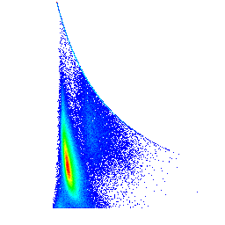
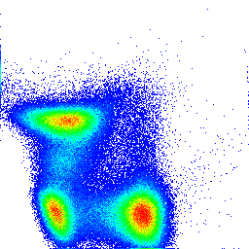
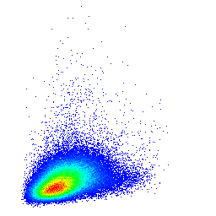
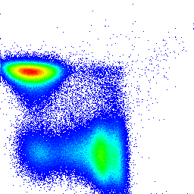
Immunophenotyping – basic T subsets
Basic Gates:
- 3 total
Ungated
Singlets
CD3+ Exclusion-
88.3
FSC-H
Exclusion (Violet H)
SSC-A
FSC-H
SSC-A
<Violet H-A>: vAmine CD14PB CD19 PB
99.3
41.4
FSC-W
CD3 AmCyan
FSC-A
FSC-W
<Violet G-A>: CD3 Amcyan
FSC-A
Scatter
57.8
CD4⁺CD8⁻
<G710-A>: CD4 CY55PE
0.79
CD4⁺CD8⁺
CD4 PerCP-Cy5.5
CD8⁺CD4⁻
36.3
CD8 Alexa700
<V705-A>: CD8 Q705
Duke University Medical Center

Slide 9
Immunophenotyping (B cells)
Naive/Memory
CD38-/IgD+
(CD23^{+/-}/CD27^{+/-})
Naïve
CD38+/IgD+
Transitional
CD38++/IgD+
(CD23⁺/CD27⁻)
Memory
CD38-/IgD-
Early Memory
CD38+/IgD-
(CD23⁻/CD27⁺)
Plasmablasts
CD38++/IgD-

Slide 10
Maturation/Memory (CD8)
ANTIGEN
Naive
CM
EM
E
TE
CD45RO⁻
CD27⁺
CD45RO⁺
CD27⁺
CD45RO⁺
CD27⁻
CD45RO⁺
CD57⁺
CD45RO⁻
CD57⁺
Proliferative
Capacity
Effector
Function

Slide 11
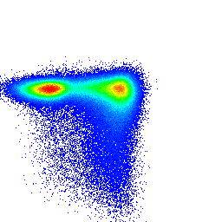
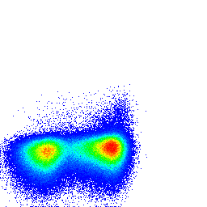
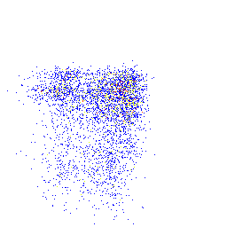
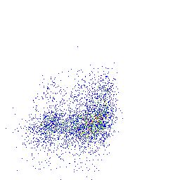
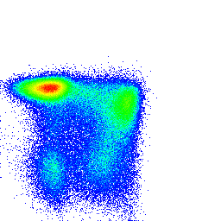
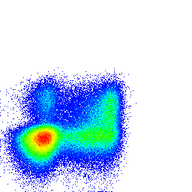
Maturation/Memory
Maturational Gates:
- 5 per basic subset
CD4⁺CD8⁻
CD4⁺CD8⁺
43
54.1
0.12
1.07
N
CM
TE
E
CD8⁺CD4⁻
CD27 APC-Alexa750
<G660-A>: CD27 CY5PE
<V545-A>: CD57 Q545
22
62.5
3.98
22.9
CD57 FITC
N
CM
TE
E
<G660-A>: CD27 CY5PE
<V545-A>: CD57 Q545
56.4
28.6
5.67
13.2
EM
CD27 APC-Alexa750
CD57 FITC
N
CM
TE
E
0.33
2.58
42.9
55.9
<G660-A>: CD27 CY5PE
<V545-A>: CD57 Q545
CD45RO ECD
EM
CD27 APC-Alexa750
CD57 FITC
3.98
11.7
21.5
51.7
EM
CD45RO ECD
6.55
8.46
56.9
24.2
CD45RO ECD
Naive
Central Memory
EffectorMemory
Terminal Effector
Effector
Naive
Central Memory
EffectorMemory
Terminal Effector
Effector
Naive
Central Memory
EffectorMemory
Terminal Effector
Effector
Duke University Medical Center

Slide 12
Functional Assays (ICS)
1. Thaw
2. Stimulate
3. Surface
Stain
4. Lyse/Fix
5. Permeabilize
6. IC Stain
7. Acquisition
8. Analysis
Brefeldin
Monensin
Rest
6 hrs
TNFα Alexa700
6 h
CD107
Wash
Wash
Wash
Wash
cytokine
lymphocyte
erythrocyte
IFN-γ PE-Cy7

Slide 13
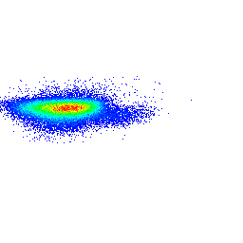
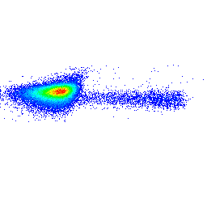
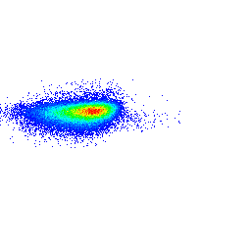
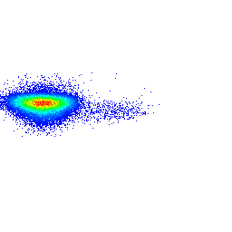
Functional T subsets
Polyfunctional (1: ++++)
Functional & Boolean Gates:
- 4 functional gates per maturational subset
- 16 boolean gates per maturational subset
Polyfunctional (4: +++)
CM: CD8⁺CD4⁻
CD107
2.59
<R710-A>: CD107a AX680
Bifunctional (6: ++)
IFN-γ
Boolean Gates
4.19
Key:
7 = CD107
g = IFN-γ
2 = IL-2
T = TNF-α
IL-2
0.31
Monofunctional (4: +)
TNF-α
1.14
Nonfunctional (1: ----)

Slide 14
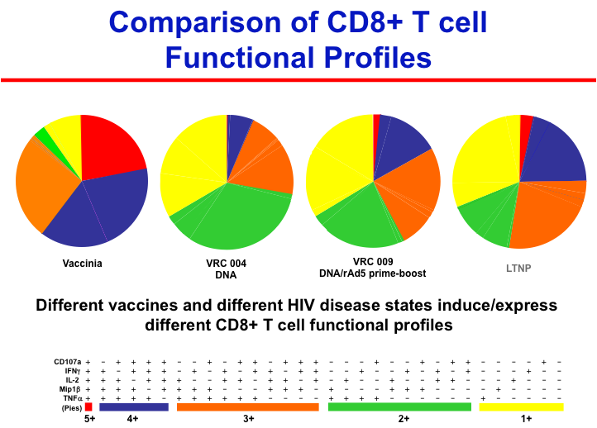
Boolean Gating Combinatorics

Slide 15
Proliferation Assays

Slide 16
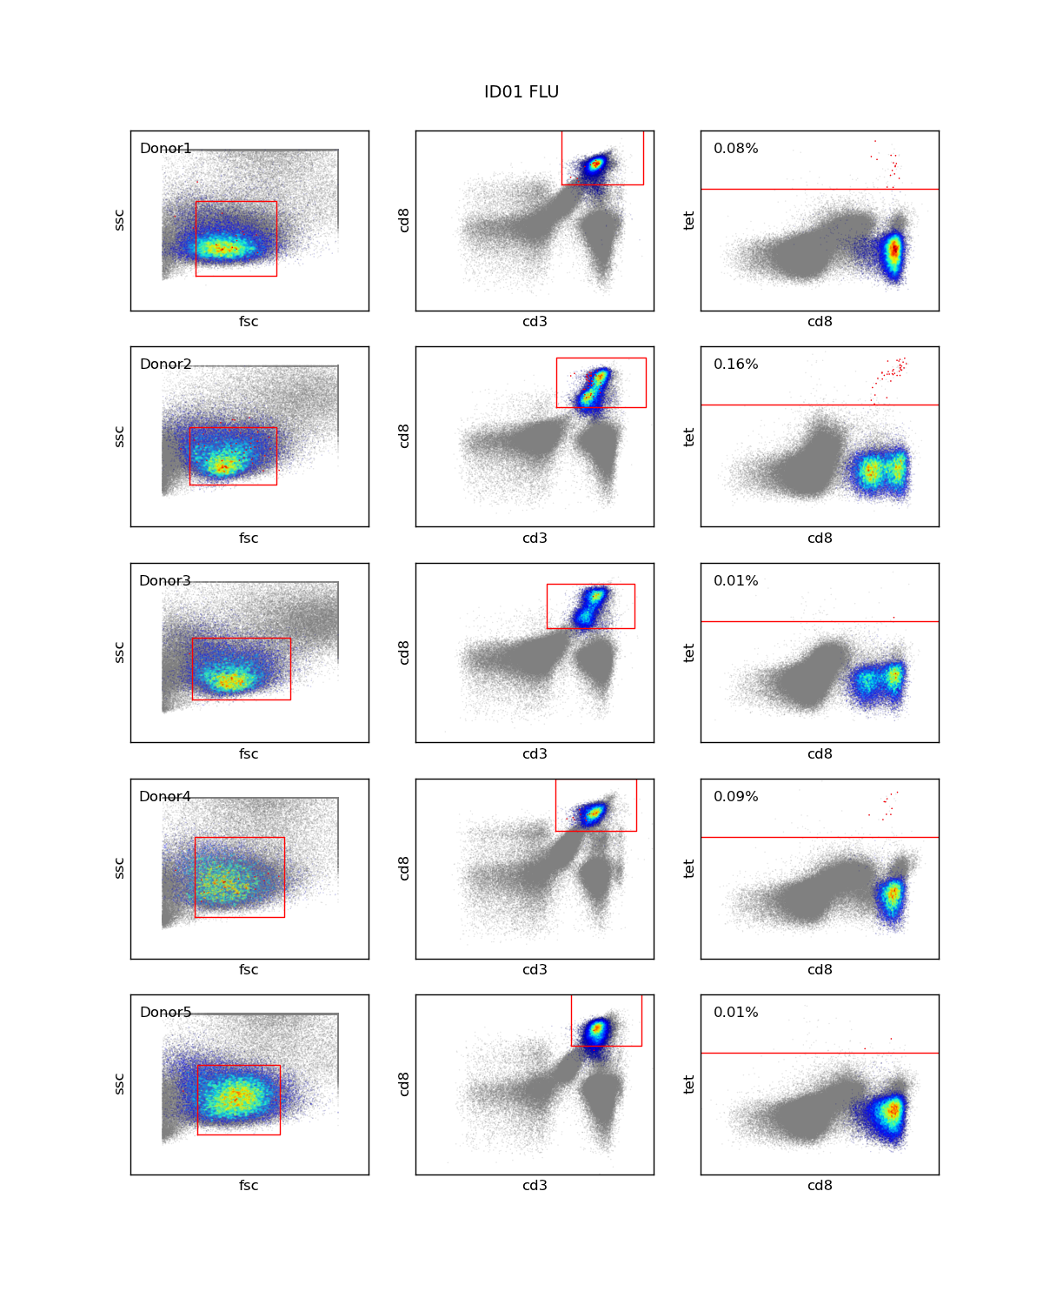
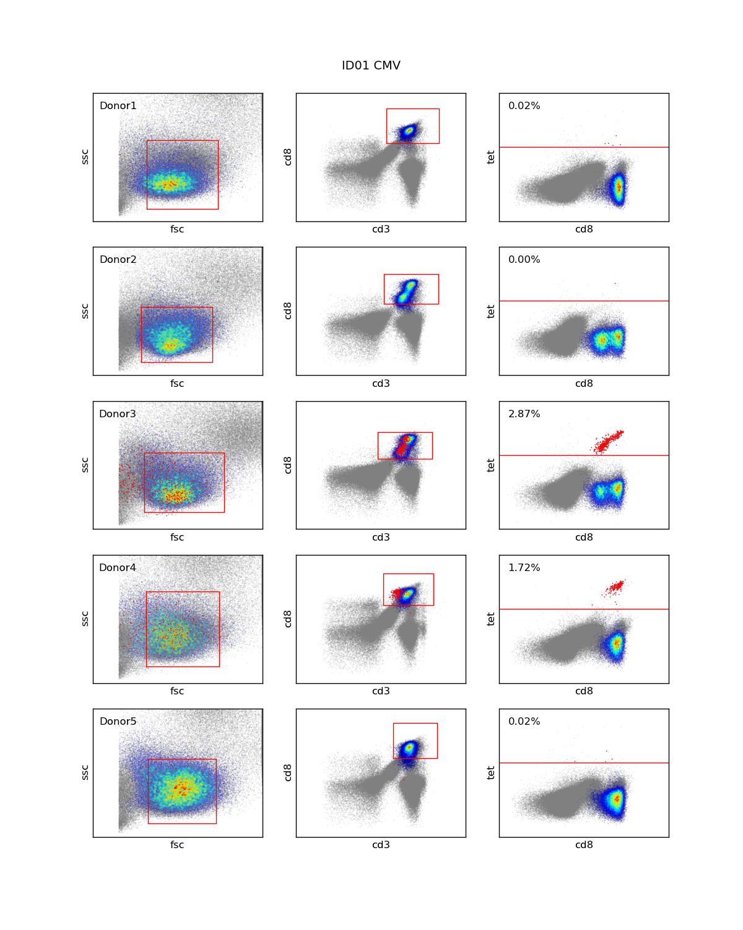
Tetramers

Slide 17
Automated analysis

Slide 18
Automated Analysis
Several groups pursuing possibility of automated flow analysis
Many approaches within large family of
  Statistical learning methods
  Machine learning methods
Typical pipeline for automated analysis
  Data pre-processing → QA/QC → Event labeling (“clustering”) → Subset alignment → Subset labeling → Automated summaries and manual review

Slide 19
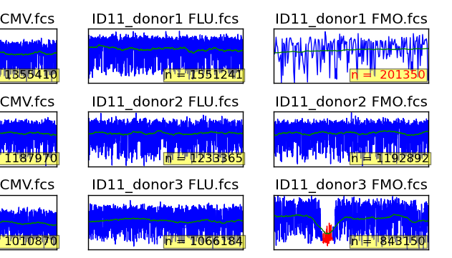
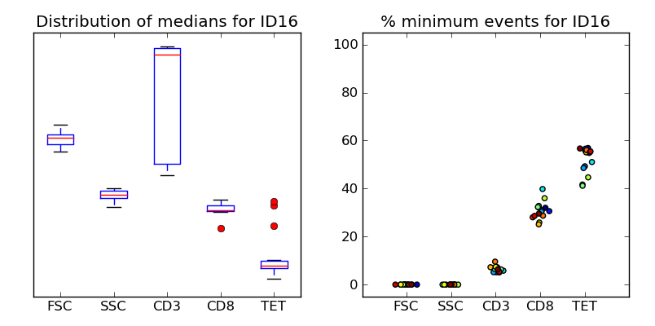
QA/QC
1
Flag potential errors
  (1) Too few events
  (2) Flow stream inconsistencies
  (3) Medians outside 95% bootstrap CI for lab
  (4) Excessive censoring
  (% events in min or max bin for marker channel)
2
3
4

Slide 20
New hierarchical DP model improves subset alignment and detection of rare cell subsets by borrowing strength across samples
Standard
Reference
Pooled
Hierarchical
Correct enumeration and labeling of rare event cluster in simulation

Slide 21
Hierarchical DP results in cell subset alignment, more consistent clustering and eliminates false positive events that arise with standard DP clustering
Spiked tetramer data analysis
SSC
CD8
TET
SSC
CD8
TET
FSC
CD45
CD8
FSC
CD45
CD8

Slide 22
Marker usefulness, equivalence, redundancy

Slide 23
EQAPOL program
Flow analysis of same sample may give very different results in different centers
EQAPOL program sponsored by NIAID to standardize approach (mandatory for centers conducting NIH-funded HIV research)
Automated analysis component to EQAPOL program introduced for first 4C sendout
Plan calls for 4C → 7C → 12C ICS sendouts
Room to integrate an HIV immune ontology?

Slide 24
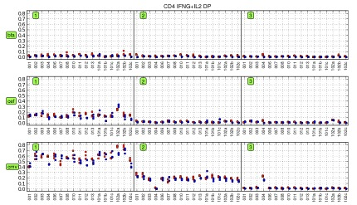
Manual/Automated comparison of cytokine+ve CD4 from EQAPOL sendout #1

Slide 25
Potential for ontology contributions to flow

Slide 26
Ambiguities in flow analysis
What markers define a subset?
How many subsets?
Dynamic changes
Context dependence
Higher order relationships
Standardization/Harmonization of assays
  Standardized panels are not the complete answer – even with lyophilized reagents and prescribed SOPs, we still get significant site-to-site variability

Slide 27
Types of “markers”
Physical characteristics
  FSC, SSC
Non-specific reporters
  Viability stains, CFSE (or PKH26, SNARF)
Cell surface molecules (e.g. CD3, CD4, CD8)
Intracellular molecules (e.g. TNFa, IL-2, IFNg)
Intranuclear molecules (e.g. FoxP3)
Activation targets (e.g. PhosFlow)
Other features (e.g. imaging cytometers)

Slide 28
Marker equivalence?
CD45RO and CD45RA

Slide 29
Definition and number of cell subsets
More markers = more subsets
Especially true with unbiased statistical/machine learning approaches
  Can often find several discrete clusters of events that have no obvious biological label
The “same” cell type may have multiple alternative phenotypic characterizations (e.g. memory T cells – various combinations of CD45RA, CD45RO, CD27, CD57, CCR7, CD62L, Bcl-2, Ki67 used in human studies; CD28, CD95 used in NHP studies)

Slide 30
Transitional memory cells
Notes:
In non-human primates, entirely different scheme based on CD28 and CD95 used to distinguish CM and EM cells.

Slide 31
3 cytokines versus 1 or 2 cytokines

Slide 32
Dynamic changes
Definition of a viable cell
  Depending on what method is used, may get very different numbers
  Matters because
    Non-viable cells → non-specific binding → FP++
    Cell death is the object of study
  PI, EMA, amine, anti-caspase 3 …
  Detect different stages of cell death
Down-regulation of receptors
  CD3 following antigenic stimulation
  MHC following HIV infection

Slide 33
Changes with activation

Slide 34
Changes with Proliferation

Slide 35
Context dependence
Stimulation conditions
  SEB, Costim, specific peptide pools (e.g. IE1 and pp65 CMV pools), mitogens
  Time of assay (minutes in Phosflow, hours to days for cytokine expression, weeks to months for vaccine studies)
Fresh or frozen?
  Some receptors are labile and unstable under cryopreservation e.g. CCR7
  Cannot use Sekaly gating strategy to identify transitional memory cells with cryopreserved samples

Slide 36
Fresh vs Cryo
CD4 Subsets

Slide 37
Normal vs HIV+: CD4 maturational subsets
197 vs 27, 57, 62L, 197, RA, 28
Notes:
CCR7 divides CM and EM into further maturational subsets (CCR7+/CCR7)-; suggesting CCR7 may add information to our existing definitions of maturational subsets for CM and EM.

Slide 38
CD62L
CD197 (CCR7)
Fresh
Cryopreserved
Fresh
Cryopreserved

Slide 39
Higher order relationships
Immune cells in context
  Cell networks
  Temporal profiles
  Tissue dependence
  Disease state

Slide 40
Marriage of automated approaches and ontology?

Slide 41
Potential applications of ontology
Improve statistical/machine learning algorithms
  Patterns of expression
  Higher order relations to constrain assignment
  Machine inference – e.g. report HIV status via information in IDO about temporal changes in HIV infection
  Automated annotation of cell subsets
Automated report generation (e.g. MiFlowcyte, MIATA requirements)

Slide 42
Acknowledgements
Theoretical
  Mike West, Andrew Cron, Lynn Lin, Fernando Bonassi, Adam Richards, Jacob Frelinger, Quanli Wang, Thomas Kepler, Lindsay Cowell, Anna Maria Masci
Experimental
  Kent Weinhold, Janet Staats, Jennifor Enzor, Sarah Sparks, Guido Ferrari, John Whitesides, Tony Moody, Thad Gurley, David Murdoch, Tom Denny, Scott Palmer, Doug Tyler, CIP.
Funding
  NIAID, NHLBI, WCF, BMF, MRA

