Slide 1
The Gene Ontology and Immune System Processes
Alexander D. Diehl
6/11/12

Slide 2
Gene Ontology Background
Started 1998, FlyBase, SGD, MGI
GO Consortium funded by NIH 2001
At least 20 MODs, databases, societies, and institutes are Consortium Members.
A GO Editorial Office is maintained at EBI, and other GO developers are found elsewhere.
Multiple GOC meetings occur yearly, including general meetings, content meetings, and annotation training meetings.

Slide 3
Gene Ontology Background
Developed for the annotation of gene products, primarily proteins, but also RNAs of various types, to provide a common language for representing protein properties.
Predates BFO and the OBO Foundry, and is still being improved to match recent best practices in ontology building.

Slide 4
Gene Ontology Background
GO ontology development is focused on “normal” aspects of an organism’s biology.
Includes defense and immune responses.
Includes processes of symbiosis, encompassing mutualism through parasitism, in which processes originating from one organism affect another organism or organisms.
Excludes pathogenic processes, such as tumorigenesis induced by an organism’s own mutated proteins.

Slide 5
GO represents three biological domains
Molecular Function = elemental activity/task
the tasks performed by individual gene products; examples include carbohydrate binding and ATPase activity.
Cellular Component = location or complex
subcellular and extracellular structures, locations, and macromolecular complexes including protein complexes; examples include
nucleus, endoplasmic reticulum lumen, and activin complex
Biological Process = a series of events accomplished by one or more ordered assemblies of molecular functions
broad biological goals, examples include
mitosis or purine base metabolic process

Slide 6
GO represents three biological domains
Molecular Function = elemental activity/task
the tasks performed by individual gene products; examples include peptide antigen binding and cytidine deaminase activity.
Cellular Component = location or complex
subcellular and extracellular structures, locations, and macromolecular complexes including protein complexes; examples include
lysosome, phagocytic vesicle lumen, and NLRP1 inflammasome complex
Biological Process = a series of events accomplished by one or more ordered assemblies of molecular functions
broad biological goals, examples include
immune response or somatic diversification of immune receptors via gene conversion

Slide 7
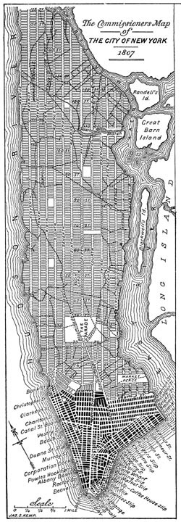
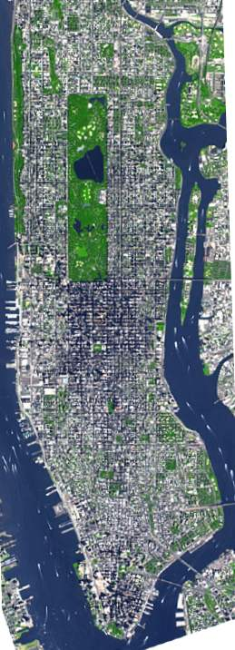
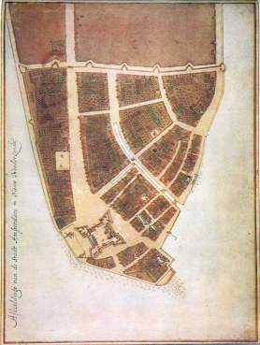
The GO is a work in progress
1660
1807
2012

Slide 8
The GO is a work in progress
2012
2007
2004
2001
1998

Slide 9
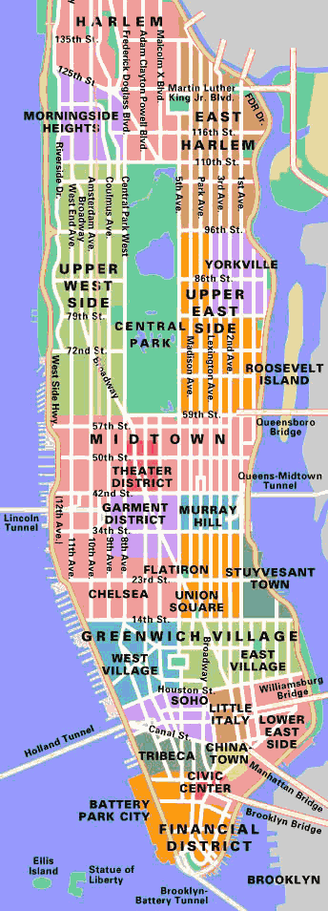
2012

Slide 10
Transcription
Translation
Mitosis
Signal Transduction
Programmed Cell Death
Development
Neurobiology
2012

Slide 11
Transcription
Translation
Mitosis
Signal Transduction
Programmed Cell Death
Development
Neurobiology
2012
Immunology

Slide 12
GO Term Development
Top-Down and Bottom-Up.
Top-Down represents focused efforts to represent an entire sub-field of biology; usually led by a GO Editor with the help of expert biologists.
Bottom-Up development largely driven by needs of annotators.

Slide 13
GO Term Development
Muscle Development – 2007
Heart Development – 2009
Kidney Development – 2010
Electron Transport – 2008
PAMGO – 2006-2008
Transcription – 2010
Signal Transduction – 2009-2012
Virus Terms – 2009 – present
Immunology – 2006

Slide 14
GO Term Development
Muscle Development – 2007
Heart Development – 2009
Kidney Development – 2010
Electron Transport – 2008
PAMGO – 2006-2008
Transcription – 2010
Signal Transduction – 2009-2012
Virus Terms – 2009 – present
Immunology – 2006

Slide 15
Revision of Immunology Terms in Biological Process Ontology
November 2005 GO Content Meeting at TIGR.
Meeting of outside experts (immunologists) and GO Consortium members (ontologists) to discuss proposals.
Winter-Spring-Summer 2006
Additional term development and public discussions.
September 18, 2006
New immunology terms incorporated into the official Gene Ontology.
(Diehl et al., Bioinformatics. 2007 Apr 1;23(7):913-5.)

Slide 16
Overview of Changes
726 new GO biological process terms created for immunological processes.
Large scale rearrangements of existing terms performed to improve logical consistency.
Is_a links provided for all primary terms.
Structure allows for addition of new terms in a consistent fashion.

Slide 17
Additional Improvements
• Created separate term hierarchies for processes involved in activation of the immune system and effector mechanisms of the immune system.
• Improved the representation of innate immunity and incorporated plant innate immunity terms.
• Improved the representation of immune cell differentiation, particularly for T and B cells.
• Improved the inflammatory response hierarchy.

Slide 18
Top Level Structure
(Not all terms shown)

Slide 19
Areas Well Represented
T and B cell selection
Antigen processing and presentation
Somatic diversification of immune receptors
General processes of inflammation
Complement activation

Slide 20
Areas that need additional work
Innate immune response regulation of the adaptive immune response.
Better clarification of what an inflammatory response is and the relationship of inflammatory responses to immune responses.
Better representation of T cell subset differentiation/development.
Better integration with terms from the GO PAMGO project (Plant-Assorted Microbe Gene Ontology).

Slide 21
PAMGO Terms
Encompass multi-organismal processes such as:
adhesion to host
interspecies quorum sensing
induction by virus of host apoptotic process
pore formation in membrane of other organism
induction by symbiont in host of tumor, nodule, or growth

Slide 22
Cellular Extravasation
Rolling Activation Arrest
Diapedesis/
Transmigration

Slide 23
Cellular Extravasation

Slide 24
Cellular Extravasation
[Term]
id: GO:0050901
name: leukocyte tethering or rolling
namespace: biological_process
def: "Transient adhesive interactions between leukocytes and endothelial cells lining blood vessels mediated primarily by selectins and which are typically the first step in cellular extravasation." [ISBN:0781735149, PMID:14680625, PMID:14708592, PMID:7507411, PMID:8600538]
is_a: GO:0007159 ! leukocyte cell-cell adhesion
relationship: part_of GO:0045123 ! cellular extravasation

Slide 25
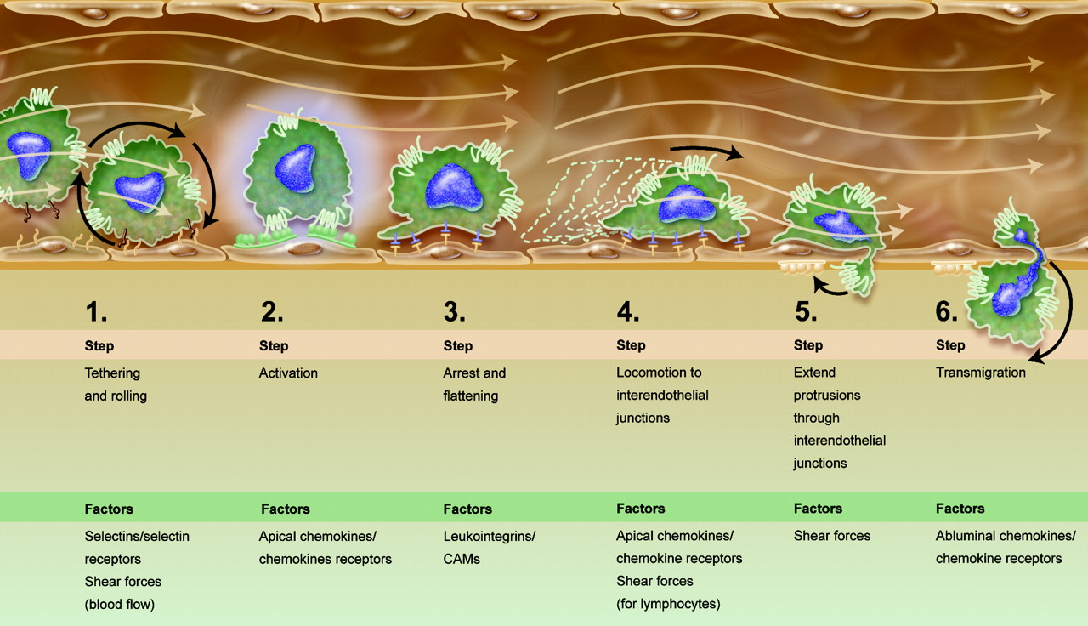
Cellular Extravasation
Blood 109:1342

Slide 26
What is a GO Annotation?
An annotation is the statement of a connection between a type of gene product and the types designated by terms in the GO.
This statement is created on the basis of observations of the instances of such types made in experiments and of the inferences drawn from such observations.
Hill, DP, et al., BMC Bioinformatics. 9 Suppl 5:S2.

Slide 27
Example of GO Annotation 1
Lankar D, “Dynamics of major histocompatibility complex class II compartments during B cell receptor-mediated cell activation,” J Exp Med. 2002 Feb 18;195(4):461-72.
Mouse H2-DMa annotated to
GO:0005771 multivesicular body, as an “inferred from direct evidence” (IDA) annotation of EM data.

Slide 28
Example of GO Annotation 2
Negishi I et al., “Essential role for ZAP-70 in both positive and negative selection of thymocytes,” Nature. 1995 Aug 3;376(6539):435-8.
Mouse Zap70 Annotated to
GO:0045059 positive thymic T cell selection as an “inferred from mutant phenotype” (IMP) annotation
and
GO:0045060 negative thymic T cell selection as an “inferred from mutant phenotype” (IMP) annotation
based flow cytometry data of thymocytes from wildtype and mutant mice.

Slide 29
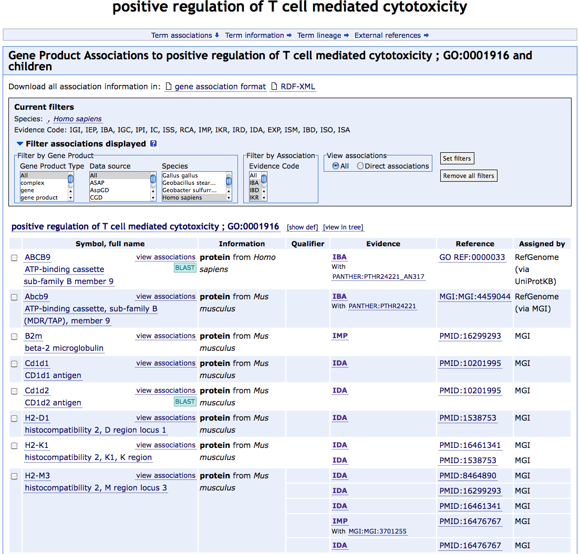
amigo.geneontology.org

Slide 30
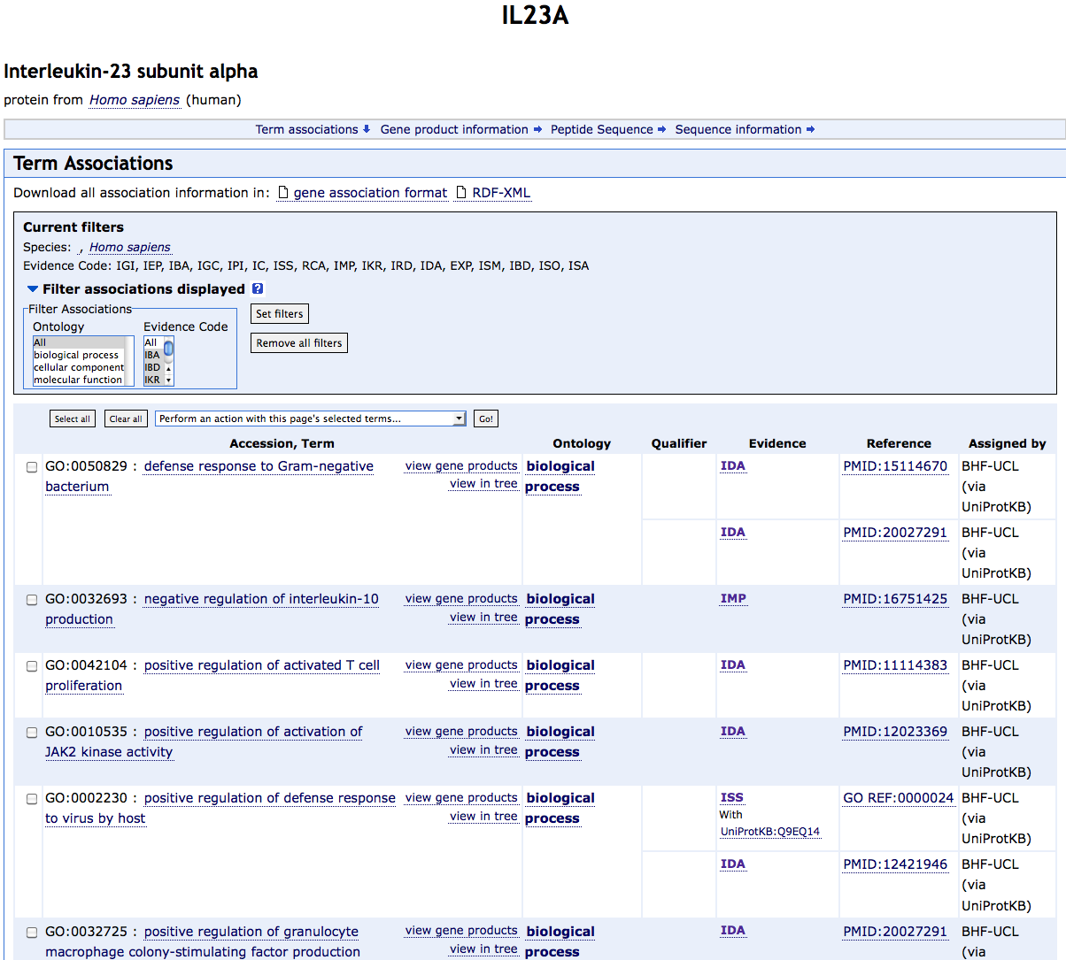
amigo.geneontology.org

Slide 31
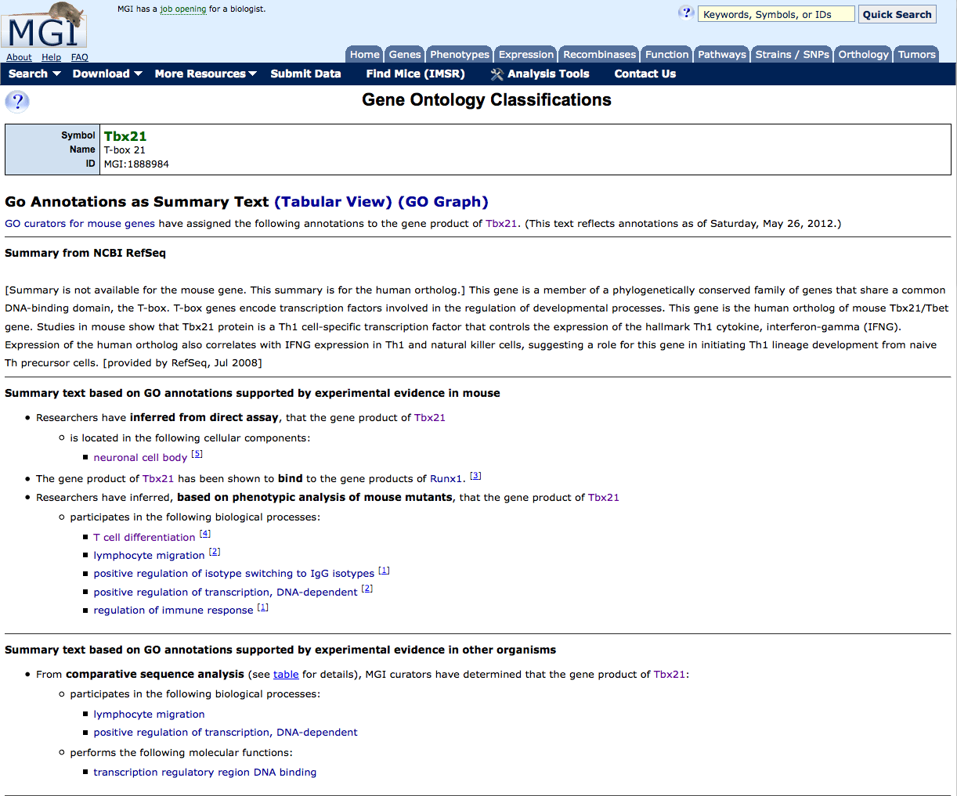
informatics.jax.org

Slide 32
informatics.jax.org

Slide 33
GO Annotation Counts for Immune System Process (2007)
amigo.geneontology.org

Slide 34
GO Annotation Counts for Immune System Process (2012)
amigo.geneontology.org

Slide 35
GO Annotation Counts for Immune System Process (2012 human-mouse)
amigo.geneontology.org

Slide 36
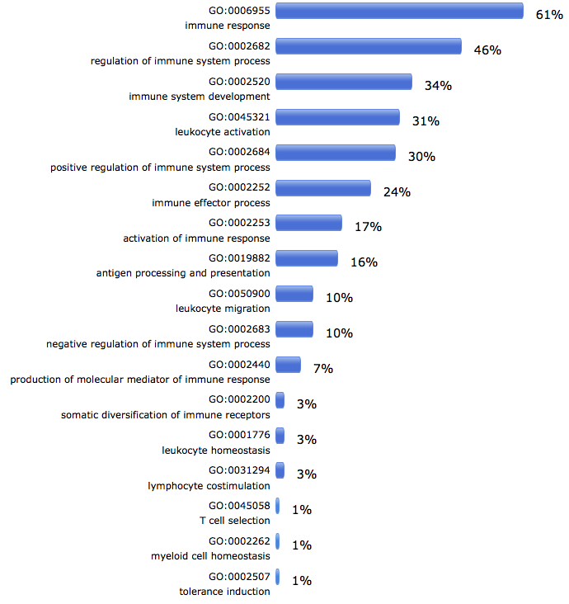
Gene Product Annotation to Immune System Process
amigo.geneontology.org

Slide 37
Immunology Annotation Progress is Slow
Manual annotation is time-consuming.
GOC annotation efforts mostly focused on other areas of biology.
Immunology is complex: Complicated experimental data require expert annotators to assign granular annotations.

Slide 38
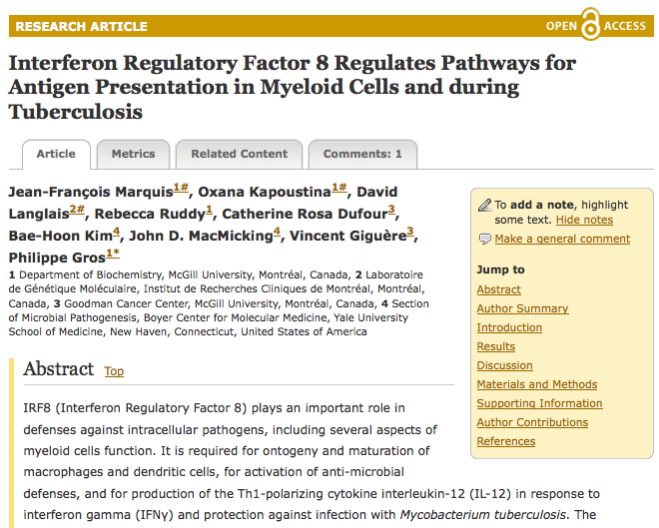
Use of GO Annotations in Microarray Analysis
PLoS Genet. 2011 Jun;7(6):e1002097

Slide 39
Use of GO Annotations in Microarray Analysis
PLoS Genet. 2011 Jun;7(6):e1002097

Slide 40
Immunology Ontology
Includes as key components
GO BP terms for immune system processes
GO MF terms for molecular functions that play a part in the function of the immune system
GO CC terms for cellular components and protein complexes

Slide 41
Immunology Ontology
Includes representation of pathological immune system processes
allergy
autoimmunity
chronic inflammatory responses
These can be described as faulty regulation of normal immune system processes.

Slide 42
Immunology Ontology
Immune cell types
Immune epitope types
Immune signaling pathway representations
Immunology assays, etc.

Slide 43
Acknowledgments
MGI, The Jackson Laboratory
Judy Blake
Mary Dolan
Harold Drabkin
David Hill
EBI-GOA
Evelyn Camon
EBI-GO Editorial Office
Jennifer Clark
Midori Harris
Amelia Ireland
Jane Lomax
UT Southwestern Medical Center and ImmPort
Jamie Lee
Richard Scheuermann
Lindsay Cowell
All Participants in the November 2005 GO Content Meeting and others who helped at all steps

Slide 44
End

Slide 45
Cellular Extravasation

