Slide 1


Contributions of the Vaccine Ontology (VO) to Immunology Research and Public Health
(Buffalo Presentation, 6/11/2012)
http://www.bioontology.org/wiki/index.php/Immunology_Ontologies_and_Their_Applications_in_Processing_Clinical_Data
Yongqun “Oliver” He
University of Michigan Medical School
Ann Arbor, MI 48109
Notes:
Yongqun “Oliver” He, University of Michigan
http://www.bioontology.org/webinar-series
Title: Vaccine Ontology (VO) and its application in literature mining of vaccine-gene interaction networks
Abstract:
The Vaccine Ontology (VO, http://www.violinet.org/vaccineontology) is a community-based biomedical ontology in the domain of vaccine and vaccination. As of April 29, VO contains 5,578 ontology terms including 5,145 VO-specific terms, and the other terms are imported from over ten existing ontologies. VO represents over 1,000 licensed vaccines and vaccine candidates in clinical trials and in research. These vaccines have been developed against infections of various bacterial, viral, and parasitic pathogens as well as cancers in over 20 animal species. VO also represents all types of vaccine components (e.g., vaccine antigens and adjuvants) and vaccine preparations. In addition, various vaccine-induced immune responses and protection against specific disorders are being modeled in VO. We have developed VO-based natural language processing (NLP) approaches to retrieve and analyze vaccine-specific interaction networks of host or pathogen genes. Our use case studies demonstrated: (1) VO and centrality-based literature mining dramatically increased the identification of interferon-gamma (IFNG) and vaccine-associated human genes and gene interactions; (2) a NLP literature mining method based on VO and the Interaction Network Ontology (INO) allows the detection of significantly over- and under-represented gene-gene interactions in the IFNG network and IFNG-vaccine subnetwork; and (3) VO-based literature mining provided better performance than the MeSH-based PubMed approach in retrieving the interactions between vaccines and genes from Brucella (a bacterial pathogen). Novel scientific hypotheses have been generated through these ontology-based literature mining studies.
SPEAKER BIO:
Yongqun “Oliver” He is an associate professor in the Unit for Laboratory Animal Medicine, Department of Microbiology, Center for Computational Medicine and Bioinformatics, and Comprehensive Cancer Center of the University of Michigan Medical School, Ann Arbor, MI, USA. He has initiated and led the development of several biomedical ontologies, including the community-based Vaccine Ontology (VO; http://www.violinet.org/vaccineontology) and Ontology of Adverse Events (OAE; http://www.oae-ontology.org). His group, through collaborations with others, has developed several ontology-oriented software programs including OntoFox (http://ontofox.hegroup.org) for importing and reusing individual ontology terms and Ontobee (http://www.ontobee.org) as a linked RDF data server for ontology term information retrieval and display. His group has also developed and applied ontology-based literature mining tools to study biological pathways with an emphasis on vaccine-associated gene interaction networks among host and pathogen genes.
5/2/2012

Slide 2
Outline
√
Development of the Vaccine Ontology (VO)
  Introduction of VO
  Define vaccine, vaccination, and vaccine protection in VO
  Reuse terms by OntoFox & generate many terms by Ontorat
Contributions of VO to immunology research and public health
  Vaccine immunology data integration
  Literature mining of vaccine immune networks
Summary and discussion

Slide 3

Vaccine Ontology (VO)
VO: A biomedical ontology in the domain of vaccine and vaccination
Utilize the Basic Formal Ontology (BFO) as the top-level ontology.
Follow OBO Foundry principles, e.g., openness, collaboration, and use of a common shared syntax
Reference: Smith et al. (2007). The OBO Foundry: coordinated evolution of ontologies to support biomedical data integration. Nat Biotechnol 25 (11): 1251-5.
http://www.violinet.org/vaccineontology

Slide 4
Acknowledgement of Collaborations
VO is developed as a collaborative effort
My research lab at the University of Michigan
  Asiyah Yu Lin (Research fellow)
  Allen Zuoshuang Xiang (Bioinformatician)
  Yongqun “Oliver” He (it’s me)
Infectious Disease Ontology (IDO)
  Lindsay Cowell (UT Southwestern Medical Center)
  Barry Smith (U Buffalo, also BFO developer)
IAO: Information Artifact Ontology
  Alan Ruttenberg (also OBI developer)
OBI: Ontology for Biomedical Investigation
  Menalie Courtot (University of British Columbia, Canada)
  Bjoern Peters (La Jolla Institute for Allergy & Immunology)
  Richard H. Scheuermann (UT Southwestern Medical Center)
GO: Gene ontology
  Alexander Diehl (U Buffalo)
  Chris Mungall (Lawrence Berkeley National Laboratory)
Many others …

Slide 5
Methods for VO Development
Default format: OWL/RDF
OWL editor: Protégé 4.x
Development technologies:
  Imports ontologies: BFO, RO, IAO-core
  Imports terms from existing OBO foundry ontologies using OntoFox (http://ontofox.hegroup.org/), which follows MIREOT strategy
  Adds a large number of ontology terms at once using Ontorat (http://ontorat.hegroup.org), which uses design patterns and follows QTT (Quick Term Templates) strategy
Linked data server for VO terms: Ontobee (http://www.ontobee.org).
Deposits in NCBO Bioportal
Listed as an OBO foundry library candidate ontology

Slide 6
VO Statistics (as of May 1, 2012)
# | Class | Object Property | Subtotal
VO | 4800 | 7 | 4807
BFO 2 | 22 | 38 | 60
RO | 0 | 4 | 4
CARO | 9 | 0 | 9
CHEBI | 20 | 0 | 20
DOID | 57 | 0 | 57
GO | 19 | 0 | 19
OBI | 36 | 11 | 47
OGMS | 1 | 0 | 1
PATO | 17 | 0 | 17
FMA | 2 | 0 | 2
IAO | 18 | 2 | 20
IDO | 2 | 0 | 2
NCBITaxon | 397 | 0 | 397
PRO | 2 | 0 | 2
UBERON | 8 | 0 | 8
UO | 1 | 0 | 1
Subtotal | 5411 | 62 | 5473
VO reuses
terms from other 16 ontologies
VO includes >1000 vaccines for >20 host spp. against various diseases

Slide 7
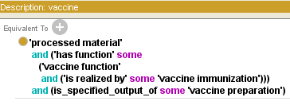

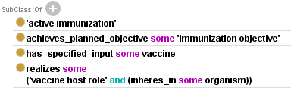
Define ‘vaccine’ in VO
Definition: a OBI:processed material with the function that when administered, it prevents or ameliorates a OGMS:disorder in a target organism by inducing or modifying adaptive immune responses specific to the antigens in the vaccine.

Slide 8
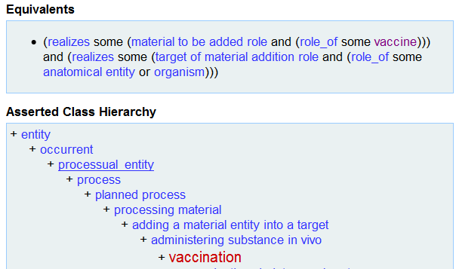
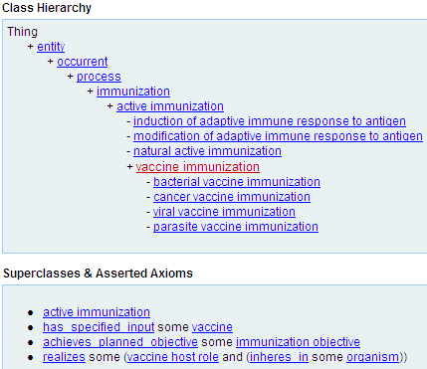
Define and differ ‘vaccination’ and
‘vaccine immunization’ in VO
Both are processes
Vaccination: administrating vaccine to inside host
Immunization: priming or modifying adaptive immune
response to an antigen.
Some vaccination may not result in immunization

Slide 9
Example: Afluria Influenza Vaccine

Slide 10
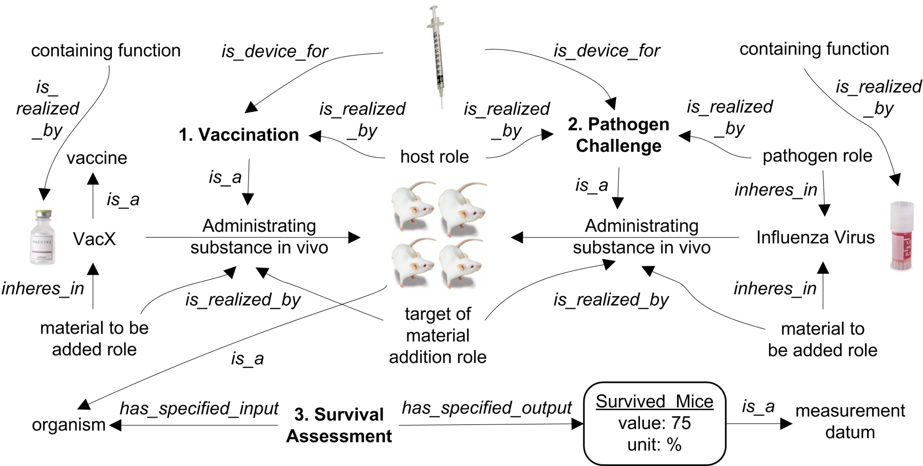
VO and OBI Modeling of
“Vaccine Protection Assay”
3 steps: 1. Vaccination; 2. Pathogen Challenge; 3. Survival Assessment
Reference: Brinkman et al. (2007). Modeling biomedical experimental processes with OBI. Journal of Biomedical Semantics. 2010, 1(Suppl 1):S7. PMID: 20626927.

Slide 11
Outline
Development of the Vaccine Ontology (VO)
  Introduction of VO
  Define vaccine, vaccination, and vaccine protection in VO
  Reuse terms by OntoFox & generate many terms by Ontorat
Contributions of VO to immunology research and public health
  Vaccine immunology data integration
  Literature mining of vaccine immune networks
Summary and discussion
√

Slide 12
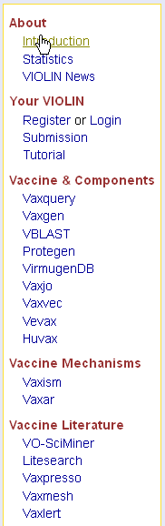
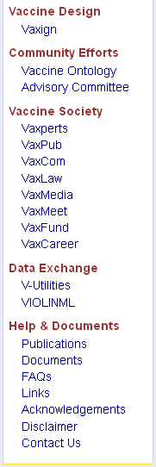
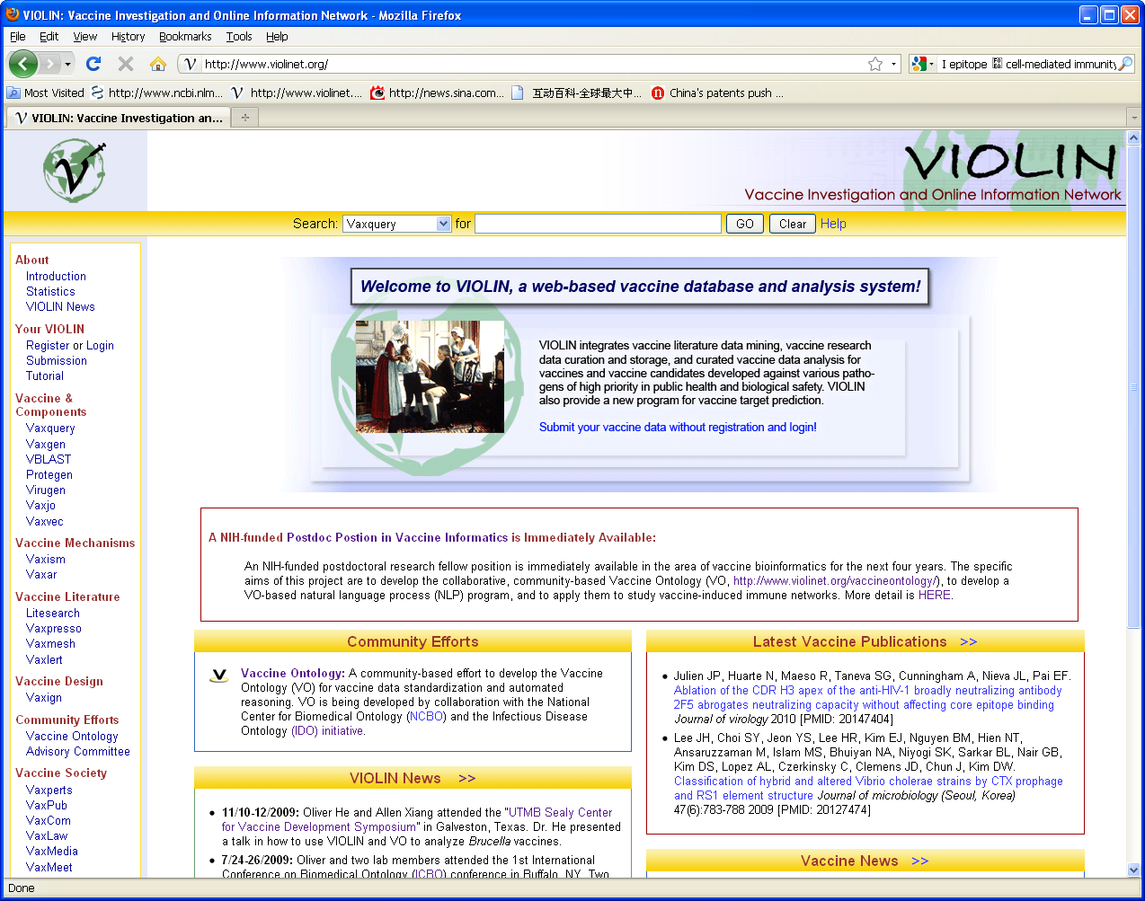
VIOLIN: has complex vaccine data
VIOLIN: Vaccine Investigation and Online Information Network
A vaccine research database and vaccine data analysis system. Example components:
  ~3000 vaccines (licensed, in trial, and in research)
  Huvax: licensed human vaccines
  Vevex: licensed veterinary vaccines
  Other research vaccines or vaccines in trial
  Protegen: protective antigens. ~600
  Vaxjo: vaccine adjuvants: > 100
  Vaxvec: vaccine vectors
  Vaxign: vaccine design
How to integrate all these?
Publically available: http://www.violinet.org/

Slide 13
VO-supported immunology data integration
Transfer VIOLIN vaccine data to VO directly.
Use VO to integrate different VIOLIN components.
The VO IDs more like primary keys in VIOLIN relational database.
VIOLIN links its data contents to VO data
VO contents provide ports to integrate with other existing data resources such as GO

Slide 14
VO-based literature mining of gene interaction networks
IFN-γ Case 3 Levels:
Brucella Case:
gene network centrality analysis of IFN-γ
VO term indexing
from literature
VO and centrality analysis
Brucella gene-VO interaction analysis
Enrichment of gene-gene interactions

Slide 15
IFN-γ: one most important immune factor
PubMed Abstracts
Sentence Splitting
Interferon-gamma (IFN-γ; Gene symbol: IFNG): Regulates various immune responses that are often critical for vaccine-induced protection.
Search “Interferon-gamma OR IFNG” in PubMed: 69816 hits (~2 years ago) → 5/2/2012:73696 hits.
Question: How can we identify the generic IFNG interaction network and a specific IFNG and vaccine-mediated sub-network using all PubMed publications?
Gene Name Tagging and
Normalization
Sentence Filtering
Interaction Extraction
(Dependency Parsing and
Machine Learning)
Network Centrality
Analysis
IFNG and Vaccine
Related Genes

Slide 16
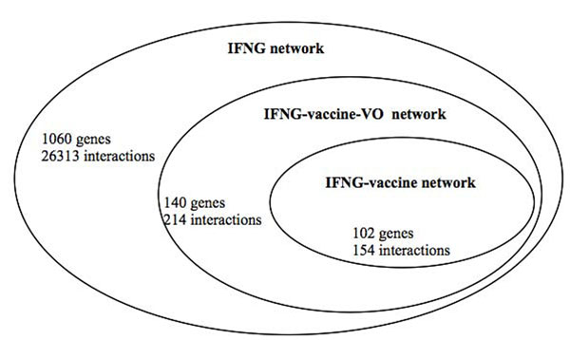
Increased Literature Discovery of IFNG-vaccine Interaction Network using VO
Adding 186 specific vaccine names and their semantic relations in VO improves the searching power
References: Ozgur A, Xiang Z, Radev D, He Y. Literature-based discovery of IFN-γ and vaccine-mediated gene interaction networks. Journal of Biomedicine and Biotechnology. Volume 2010 (2010), Article ID 426479, 13 pages. [PMID: 20625487]
Ozgur A, Xiang Z, Radev D, He Y. Mining of vaccine-associated IFN-γ gene interaction networks using the Vaccine Ontology. Journal of Biomedical Semantics. 2011, 2(Suppl 2):S8. PMID: 21624163.

Slide 17
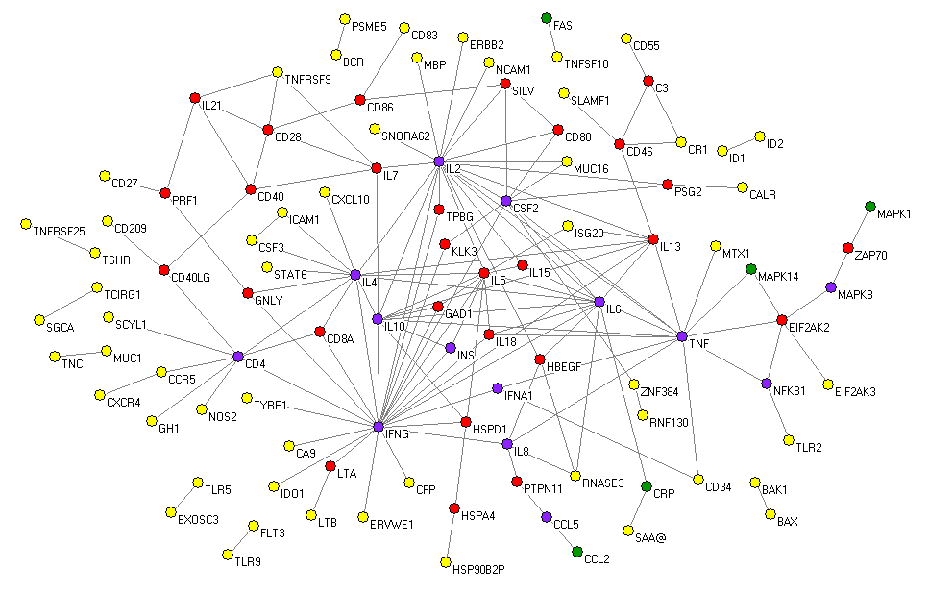
The IFNG-vaccine Subnetwork
102 nodes (genes) and 154 edges (interactions).
Purple nodes: genes that are central in both generic and IFNG-vaccine networks.
Red nodes: genes that are central only in the IFNG-vaccine network.
Green nodes: genes that are central only in the generic IFNG network.
Comparison of the subnetwork with generic network generated interesting results and hypotheses

Slide 18
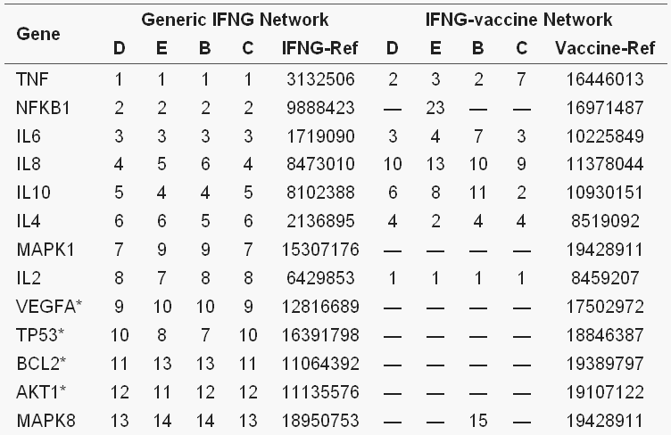
Selected Predicted Genes
Comparison of top ranked genes in the two networks generated interesting results and hypotheses
D: Degree centrality; E: Eigenvector centrality;
B: Betweenness centraility; C: Closeness centrality.

Slide 19
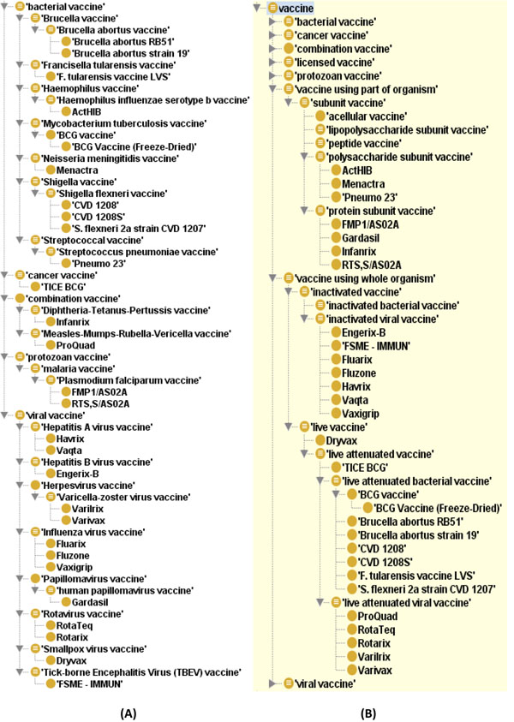
Asserted vs. inferred VO hierarchies
Asserted hierarchy:
By ontology editors
Inferred hierarchy:
Inferred by ontology
reasoner
Asserted Inferred

Slide 20
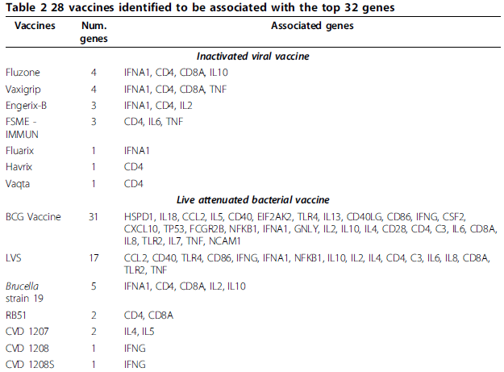
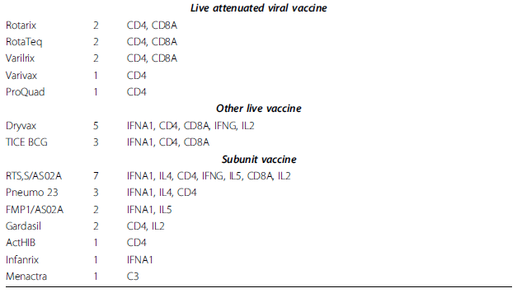
Inferred VO hierarchies
allowed vaccine and interaction classification
e.g.,
CD4 is associated with all viral vaccines
IFNA1 is not associated with live attenuated bacterial or viral vaccines; But is with most of others do

Slide 21
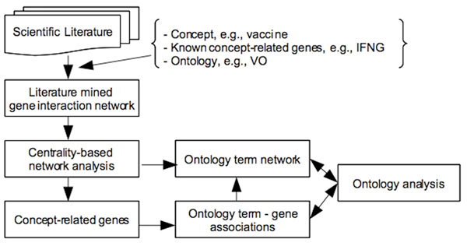
CONDL Strategy:
Centrality and Ontology-based
Network Discovery using Literature data

Slide 22
Room to Improve
Interactions between genes in sentences were detected by >800 interaction words (e.g., interacts, regulated, binds, phosphorylated, …)
These words were not classified, so we don’t know what types of interactions, and how they are associated.
This prevents us from finding more specific molecular interaction mechanisms.
Solution:
Classify these interaction words in the Interaction Network Ontology (INO) and apply the classification for advanced literature mining

Slide 23
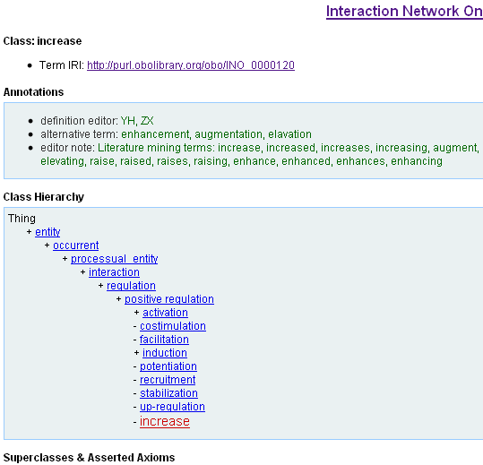
Interaction Network Ontology
Re-organize >800
interaction keywords
into ontology terms,
term synonyms, and
hierarchy.
Semantic relations
Among these terms
are also assigned.

Slide 24
INO-based interaction type identification in Ignet
http://ignet.hegroup.org

Slide 25
INO-based Enrichment of
Gene-gene Interactions
INO ontology hierarchy of interaction words
literature mined gene-verb-gene interaction results
Fisher’s exact test
Enrichment of gene-gene interactions
Differ from GO-based enrichment analysis: the input is a list of gene-gene interactions, not a list of gene.
Ref. Hur J, Özgür A, Xiang Z, Radev DR, Feldman EL, He Y. Ontology-based Enrichment Analysis of Gene-Gene Interaction Terms and Application on Literature-derived IFN-γ network. To be presented in Bio-Ontologies 2012.

Slide 26
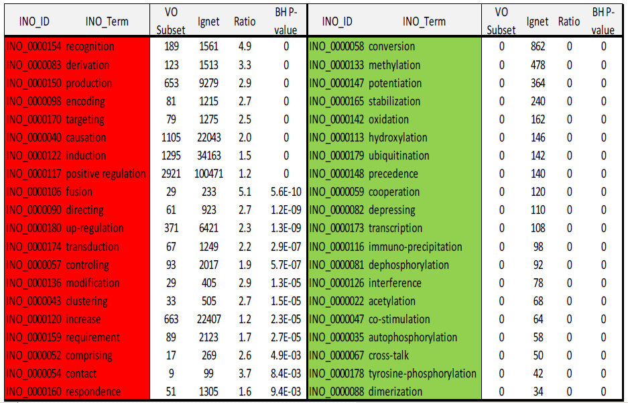
Vaccine-associated IFN-γ network was enriched with general interaction terms like ‘recognition’, ‘derivation’, ‘production’ and ‘induction’, while specific biochemical interactions such as ‘hydroxylation’, ‘methylation’ and ‘oxidation’ are under-represented.

Slide 27
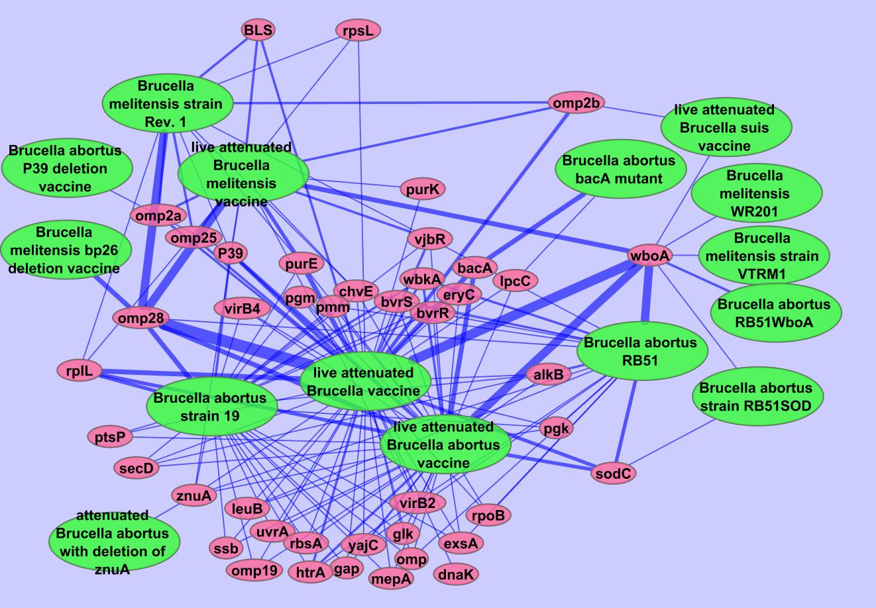
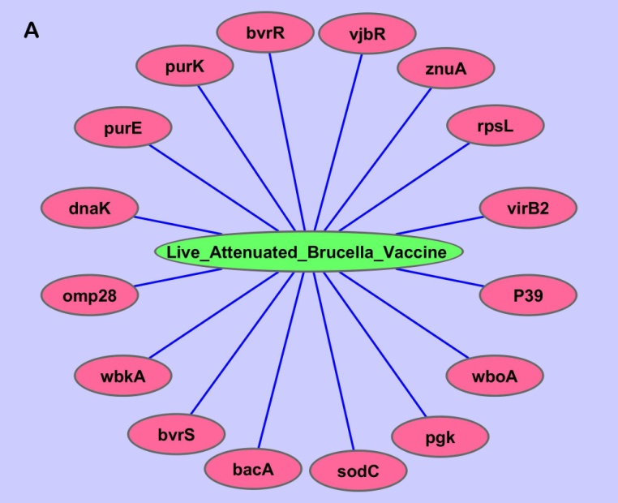
VO-based literature mining identifed more genes interacting with “live attenuated Brucella vaccine”
PubMed VO-SciMiner

Slide 28
Summary
VO can be used to integrate vaccine data and support advanced ontology-based literature mining of vaccine-mediated gene interaction networks.
Challenges
How to use VO, OBI, GO, and other ontologies to integrate and analyze vaccine instance data, including microarray data?
How to use VO to support vaccine design?

Slide 29
Acknowledgements
Oliver He Group Dry Lab
at U of Michigan:
Zuoshuang “Allen” Xiang
“Asiyah” Yu Lin
Sirarat Sarntivijai
Samantha Sayers
Literature Mining Collaborators
at U of Michigan:
Arzucan Özgür, Dragomir R. Radev
Junguk Hur, Eva Feldman
NCIBI: Integrative Biomed. Informatics
  Alex Ade, Brian Athey
OBI: Ontology of Biomedical Investigations
Vaccine Ontology Collaborators:
Menalie Courtot, Alan Ruttenberg, Bjoern Peters, Alexander Diehl,
Linsday Cowell, Barry Smith
… More seen in a previous slide in the talk …
Funding:
NIH grants R01AI081062 & U54-DA-021519 (NCIBI)
U of Michigan Rackham Pilot Research Grant

