Slide 1
The Immune Epitope Database - Representing Experiments Using the Ontology of Biomedical Investigations
Bjoern Peters,
La Jolla Institute for
Allergy and Immunology
10/21/2011, UCSD

Slide 2
Presentation Overview
The Ontology of Biomedical Investigations (OBI)
The Immune Epitope Database (IEDB)
Representing IEDB experiments using OBI
Flow cytometry in OBI

Slide 3
OBI – a user driven project
19 communities that recognized they were trying to solve the same / related problems
Members typically have one or more applications that drive OBI development
6 year effort, 1+ phone calls per week, 1-2 meetings per year
first stable release (Philly / 1.0) in Oct. 2009
→ Open project with constant addition of new communities, please consider joining!

Slide 4
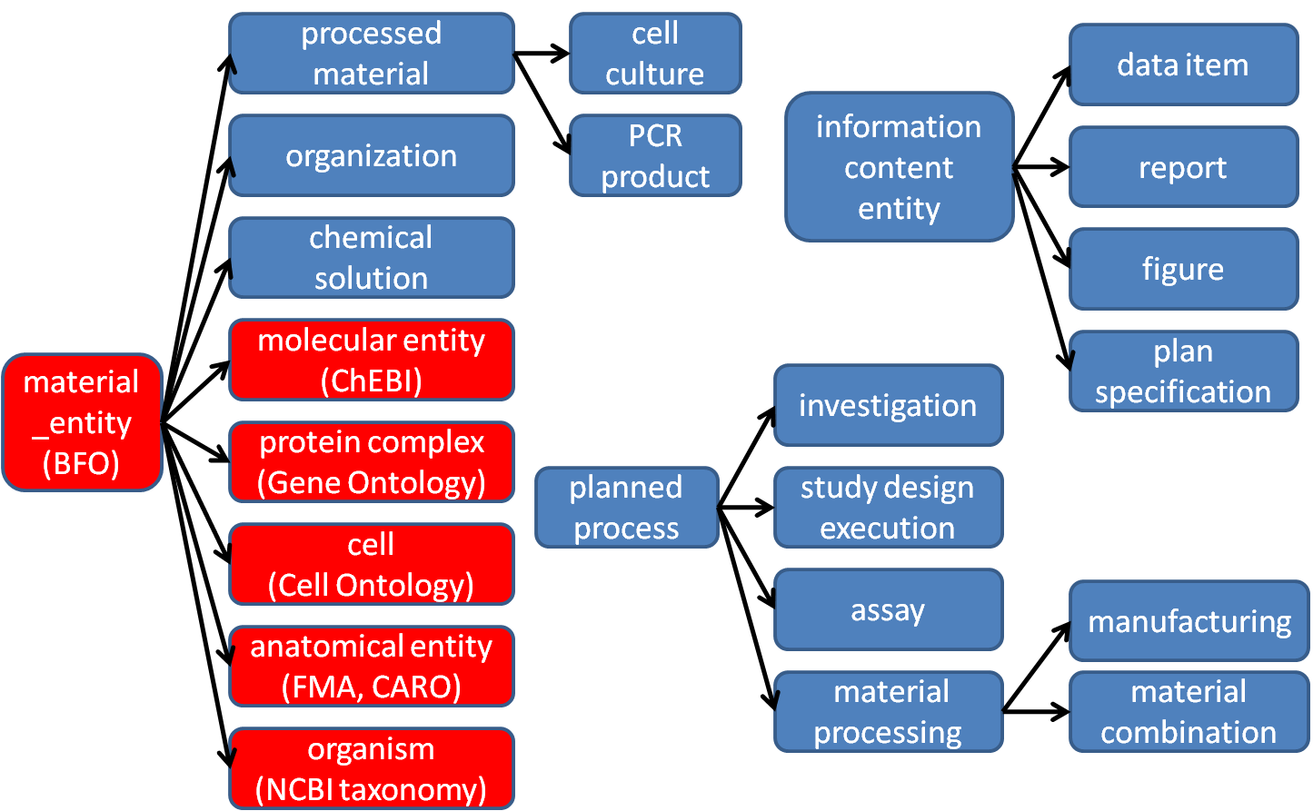
High level class hierarchy (partial)
Notes:
Remove planning

Slide 5
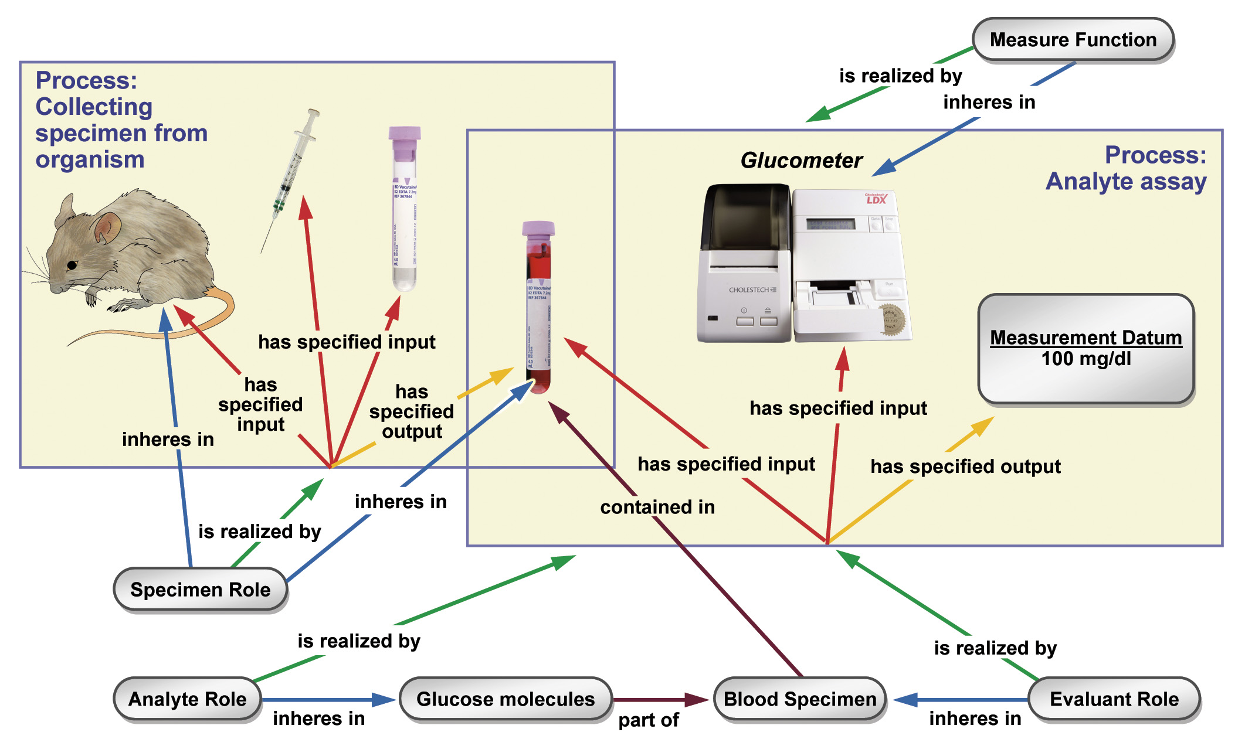

Slide 6
OBI – Recent Development
eagle-i project has/is integrating large vocabulary of research resources into OBI
Evidence Ontology (ECO) codes are being mapped 1:1 to OBI classes to allow ‘round-tripping’ between simple codes (‘direct assay evidence’) and expressive OWL
Finalization of OBI-core:
  Subset of OBI with extra promises for stability and quality
  Education tool for both users (where to look) and developers (where to add stuff)

Slide 7
OBI inner core
planned process
  investigation
  study design execution
  acquisition
  specimen collection
  human subject enrollment
  material transformation
  assay
  data transformation
  documenting
information content entity
  document
  study design
  hypothesis textual entity
  protocol
  independent variable specification
  dependent variable specification
  measurement datum
  data item
  conclusion textual entity
dependent continuant
  measure function
  investigation agent role
  study subject role
  specimen role
material entity
  device
  population
  specimen

Slide 8
OBI outer core
biological_process from the Gene Ontology (GO)
cell from the Cell Ontology (CL)
cellular_component from the Gene Ontology (GO)
environmental material from the Environment Ontology (EnVO)
geographical location from Gazetteer
gross anatomical part from the Common Anatomy Reference Ontology (CARO)
Homo sapiens from the National Center for Biotechnology Information Taxonomy (NCBITaxon)
measurement unit label, included to connect to the Ontology of Units of Measurement (UO)
molecular entity from Chemical Entities of Biological Interest (ChEBI)
organism, included to connect to the National Center for Biotechnology Information Taxonomy (NCBITaxon)
quality, included to connect to the Phenotypic Quality Ontology (PATO)
The following two terms are not in OBI yet:
disease course from the Ontology for General Medical Science (OGMS)
molecular_function from the Gene Ontology (GO)

Slide 9
Presentation Overview
The Ontology of Biomedical Investigations (OBI)
The Immune Epitope Database (IEDB)
Representing IEDB experiments using OBI
Flow cytometry in OBI

Slide 10
Immune Epitope Definition
An immune epitope is a part of a molecule
that is directly recognized by
adaptive immune receptors, specifically by
antibodies, B cell receptors, or T cell receptors

Slide 11
CD8⁺ T cell epitopes in viral infection
Mouse
Virus
MHC-I
APC

Slide 12
CD8⁺ T cell epitopes in viral infection
Mouse
T
Proliferation
T
Cytokine Release
T
Virus
TCR
CD8
MHC-I
Cytotoxicity
APC

Slide 13
Goals of the Immune Epitope Database and Analysis Resource (IEDB)‏
To catalog, organize and make accessible immune epitope related information
  B and T cell epitopes, MHC binding, MHC ligand elution
  Scope: infectious diseases, allergy, autoimmunity , transplantation. (HIV → LANL database; no cancer)
Develop new methods to predict and model immune responses (→ IEDB Analysis Resource)
www.iedb.org

Slide 14

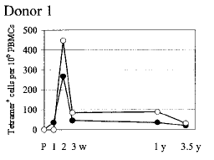
Populating the IEDB
Part II: Document categorization
Part III: Data representation
Epitope discovery
contract submission
Literature curation
IEDB
www.iedb.org

Slide 15
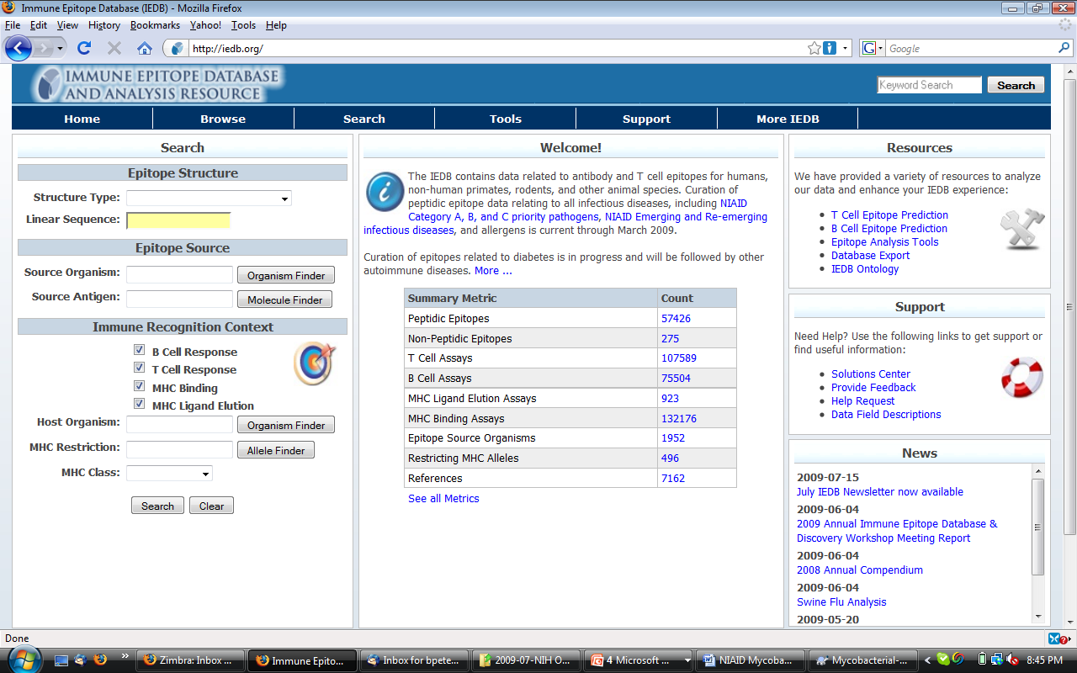

Slide 16
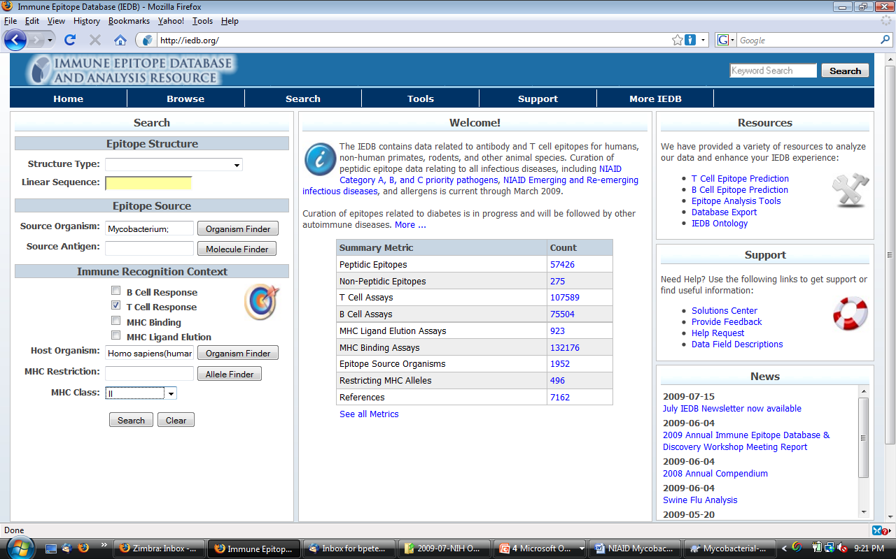

Slide 17
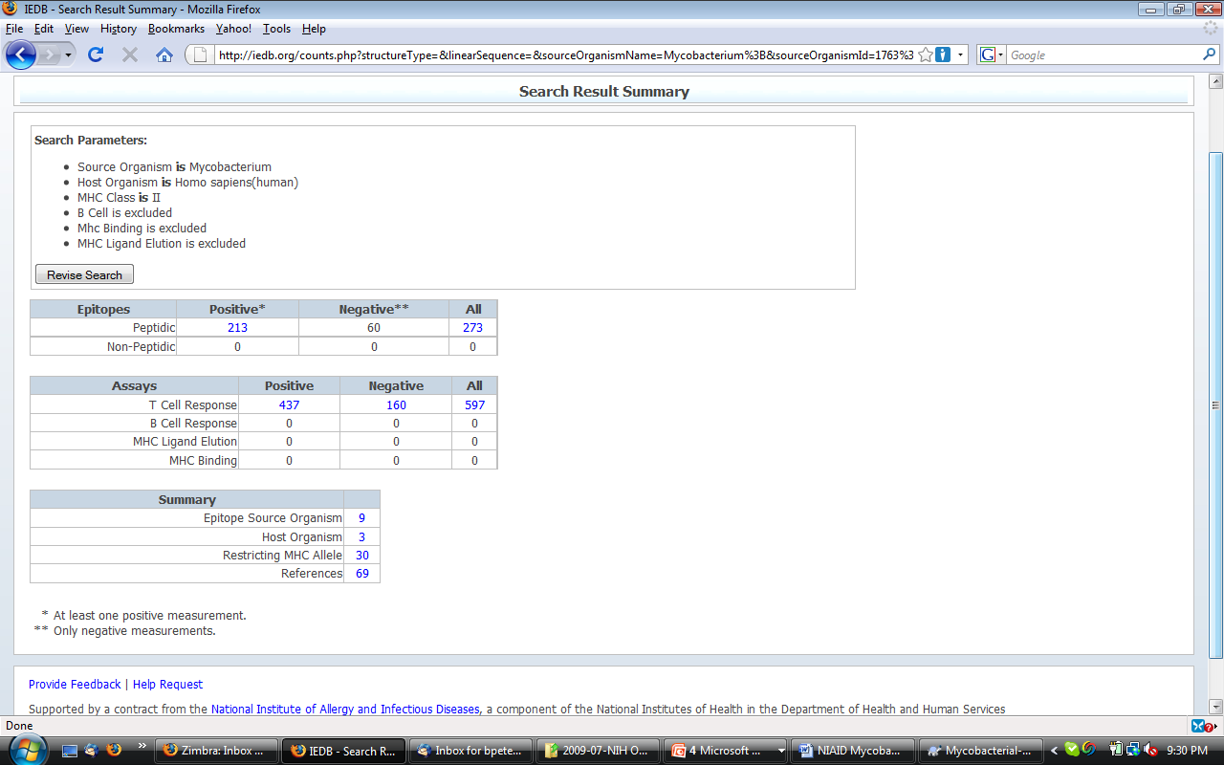

Slide 18
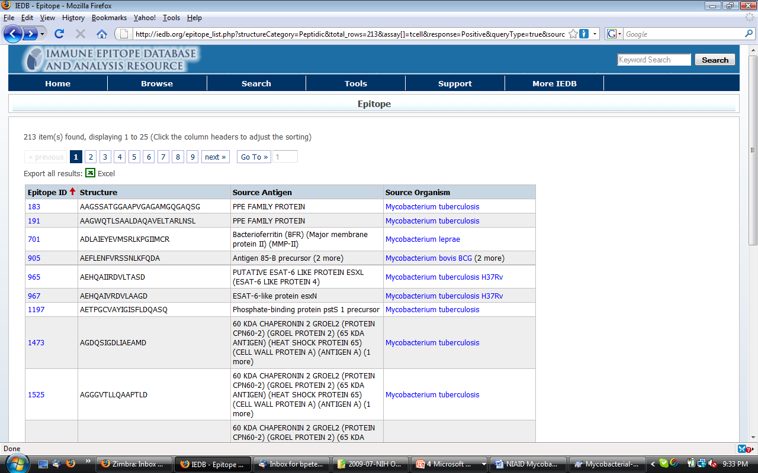

Slide 19
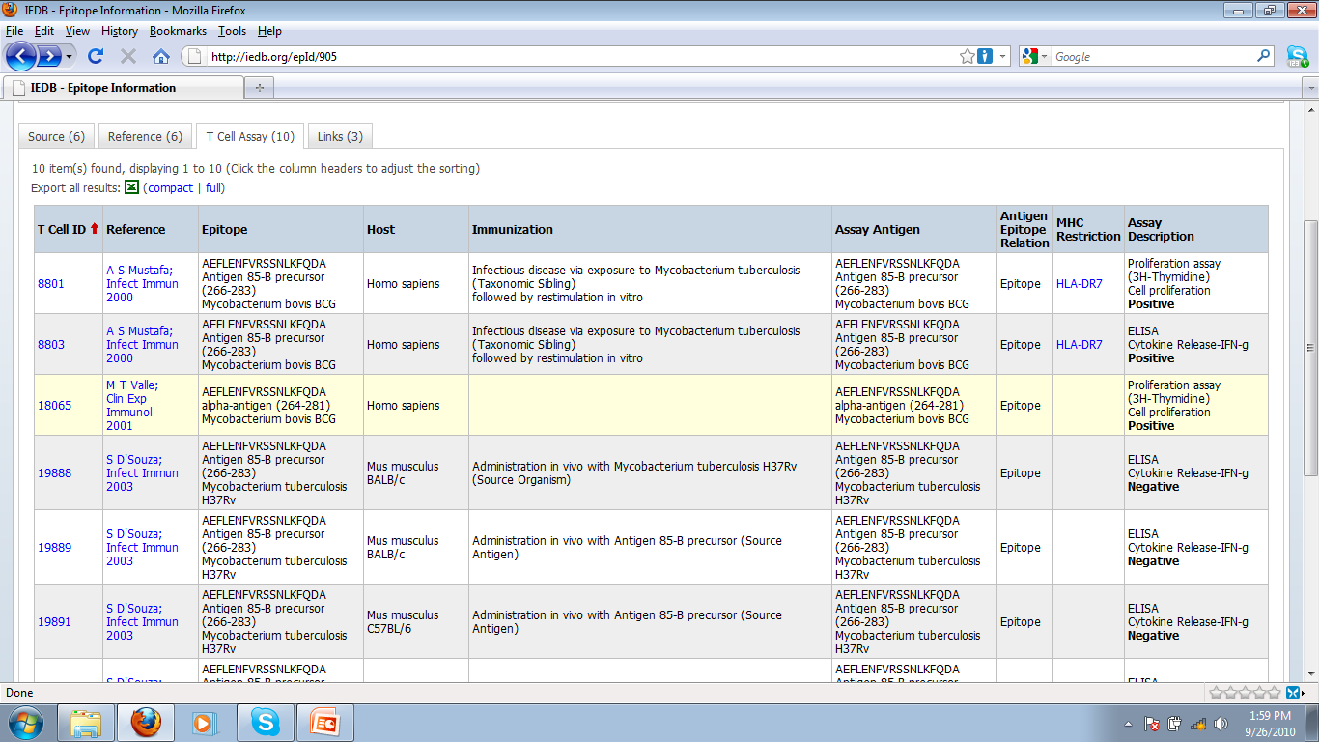

Slide 20
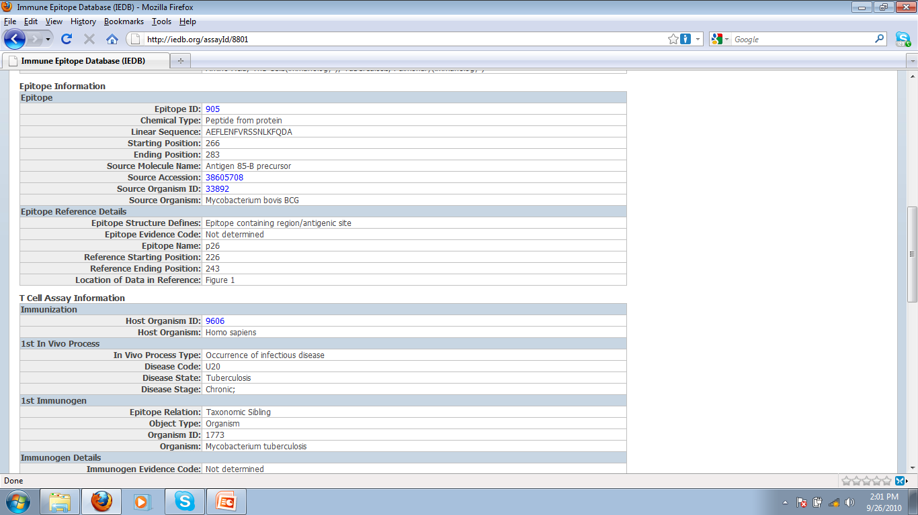

Slide 21
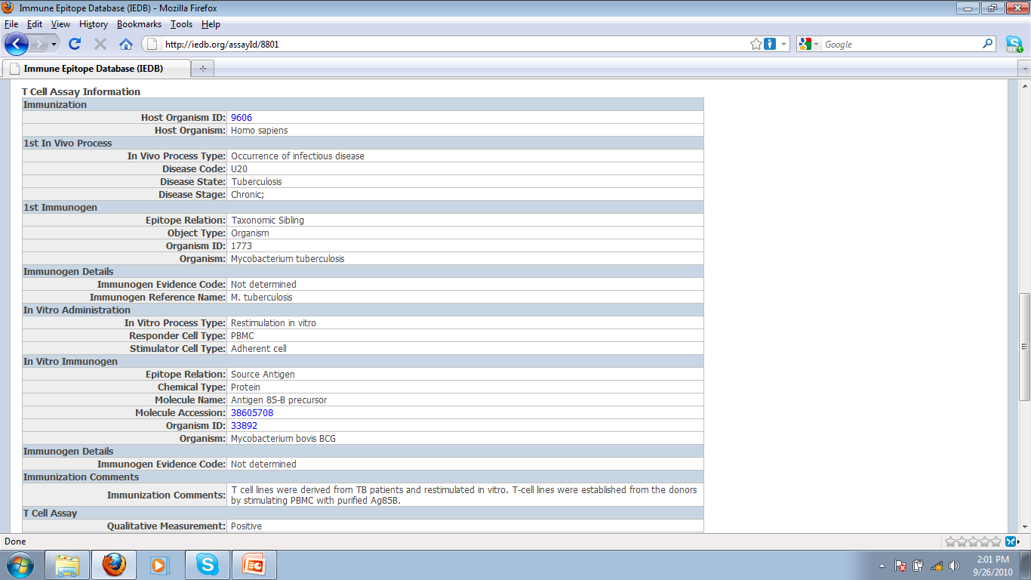

Slide 22
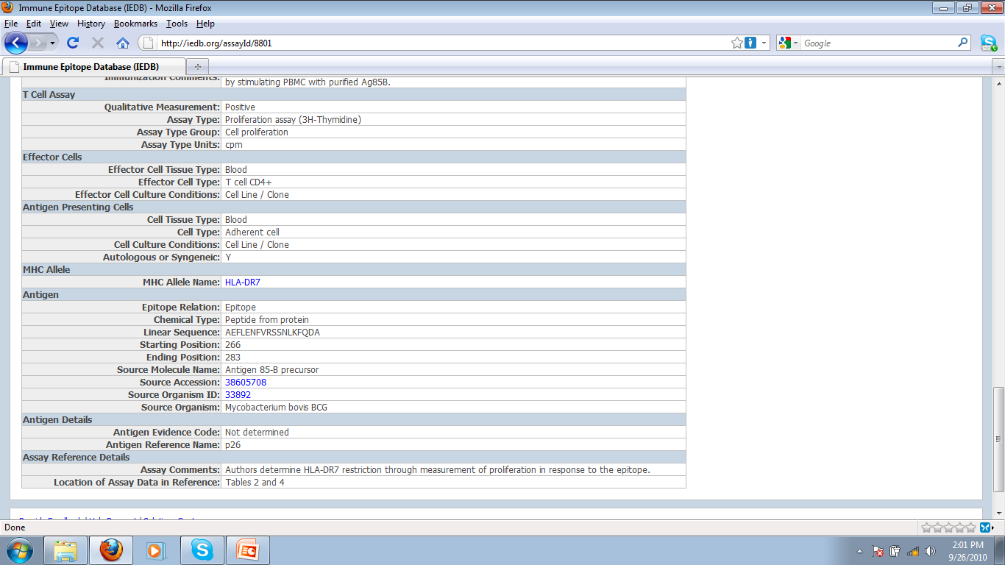

Slide 23
Literature Curation Status
Category | #Relevant articles | Percent completed
Infectious disease | 10,260 | 99.5%
Allergy | 1,639 | 99.1%
Autoimmunity | 5,160 | 99.1%
Transplant | 977 | 99.3%
Total | 18,036 | 99.3%
>99% in all categories since 2011
Notes:
Update; show non peptidic

Slide 24

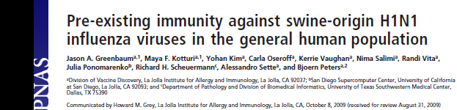
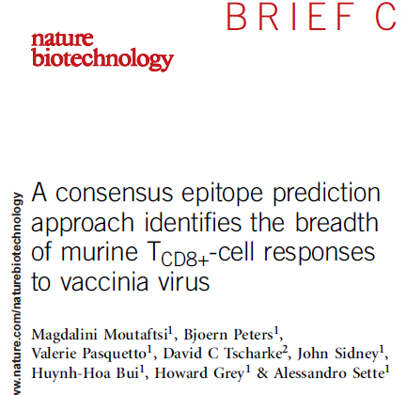
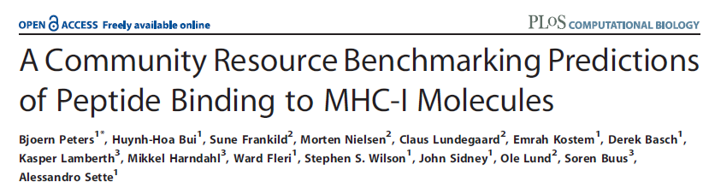
IEDB applications
Meta-Analyses
Prediction tool development

Slide 25
Presentation Overview
The Ontology of Biomedical Investigations (OBI)
The Immune Epitope Database (IEDB)
Representing IEDB experiments using OBI
Flow cytometry in OBI

Slide 26
Using OBI to represent experiments in the IEDB

Slide 27
epitope mapping experiments
T
T
B
APC
T Cell Response
B Cell Response

Slide 28
High level database structure
epitope source (material entity)
organism
protein
protein complex
has part
peptide
journal article
epitope structure
(material entity)
discontinuous protein residues
reference (document)
is about
author submission
carbohydrate
has participant
immune recognition assay (process)
B cell response
immunization (process)
Natural Infection
preceded by
T cell response
Administered Immunization
MHC binding

Slide 29
Replacing IEDB controlled vocabularies with OBI classes
Benefits:
  Increase consistency in data curation
  Avoid duplicates
  Improve documentation to external users
  Enhance search capabilities

Slide 30
Original approach: controlled vocabularies
Used existing external ontologies as source where possible
(none available for epitope specific T cell assays)
Maintain list of assays; if a publication uses an assay that is different, add to this list → 140 T cell assays
Challenges :
  Ensure curators pick the right assays
  Communicate to external users what each assay is
  Avoid introducing duplicates (“MCP-1 IFA” = “CCL-2 histostain”)
In addition we want to
  Search for groups of related assays
  Interoperability (lots of it)
→ Create an OBI class for each entry in our list of assay types

Slide 31
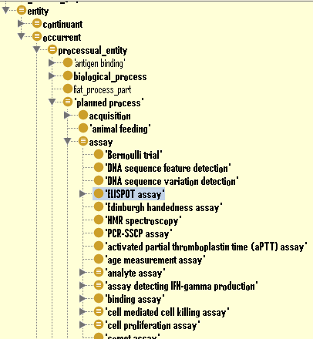
OBI hierarchy
Assay definition:
A planned process with the objective to produce information about an evaluant
OWL (partial):
has_specified_input some
(material_entity
and (has_role some 'evaluant role'))
has_specified_output some
('information content entity'
and ('is about' some
(continuant
and (has_role some 'evaluant role'))))

Slide 32
T cell epitope assay design pattern
Majority of assays could be defined with N&S conditions after specifying two variables:
<parent assay type> and has_specified_output some
'measurement datum‘ and 'is about' some
(<GO process Y> and 'process is result of' some 'MHC:epitope complex binding to TCR')
For example: “IL-17 ELISPOT” in the IEDB is logically defined as
= 'ELISPOT assay‘ and has_specified_output some
'measurement datum‘ and 'is about' some
(‘IL-17 production’ and process is result of' some 'MHC:epitope complex binding to TCR')
Required expanding parent assay types (OBI) and GO process

Slide 33
Adding parent assay types to OBI
label: cytometric bead array assay
definition: An assay in which a series of beads coated with antibodies specific for different analytes and marked with discrete fluorescent labels are used to simultaneously capture and quantitate soluble analytes using flow cytometric analysis.
alternative term: multiplexed bead assay, CBA assay
example of usage: Using a Luminex machine to detect IFN-gamma and IL-10 in the supernatant of a cell culture
“Parent” assay definitions are discussed in OBI as a group and derived by consensus, to ensure exactness and ability to re-use.
Child terms that follow design patterns are added without group discussion

Slide 34
Modifying external ontologies
Requests for new / modified terms are made through their respective trackers
(sometimes additional prodding is needed)
Often results in email discussions that clarify issues and result in improved definitions (but take time)
Succeeded with GO, ChEBI, PRO, OGMS, IDO, PATO, UO, …
Resulting terms are imported into OBI to reference them in logical definitions
(Using MIREOT mechanism)
Some terms have no ‘natural home ontology’, and are kept in OBI until they can be moved

Slide 35
Mapping IEDB assay types to OBI classes
Spreadsheet based template

Slide 36
Benefits of using OBI classes for IEDB assay types internally
Formal definitions of assay types serve as curation rules
Issues arising in curation are reflected 1:1 by issues in writing definitions
Linking to GO identified duplicate assay types (introduced in the IEDB controlled vocabulary as a result of changes in nomenclature over time)
The same could have been achieved by carefully writing definitions for our controlled vocabulary terms, but ontologies can do more…

Slide 37
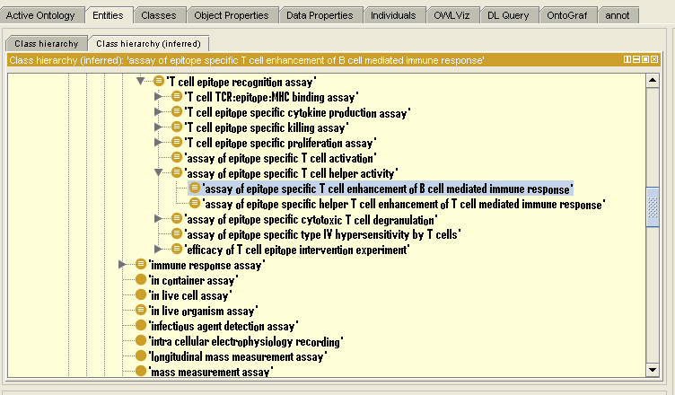
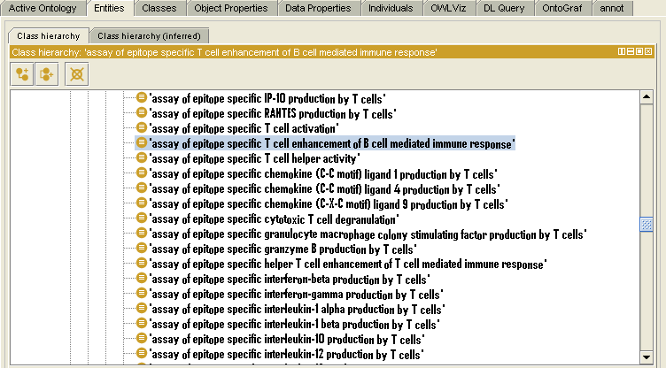
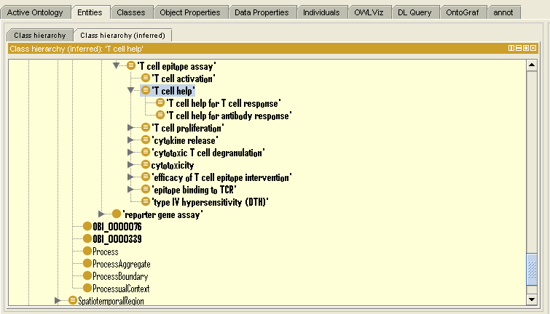
Reasoning introduces hierarchy
Display with community specific
“IEDB alternative label”

Slide 38
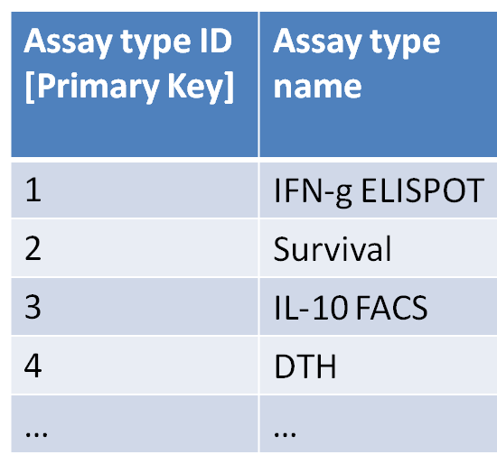
Benefits of using OBI for external users
Required (minimal) modification of the assay type table
Assay type ID [Primary Key] | Assay type name | Ontology ID [could be more than just OBI]
1 | IFN-g ELISPOT | http://purl.obolibrary.org/obo/OBI_0001414
2 | Survival | http://purl.obolibrary.org/obo/OBI_0001334
3 | IL-10 FACS | http://purl.obolibrary.org/obo/OBI_0000414
4 | DTH | http://purl.obolibrary.org/obo/OBI_0002114
… | … | …
→ This allowed us to use OBI

Slide 39
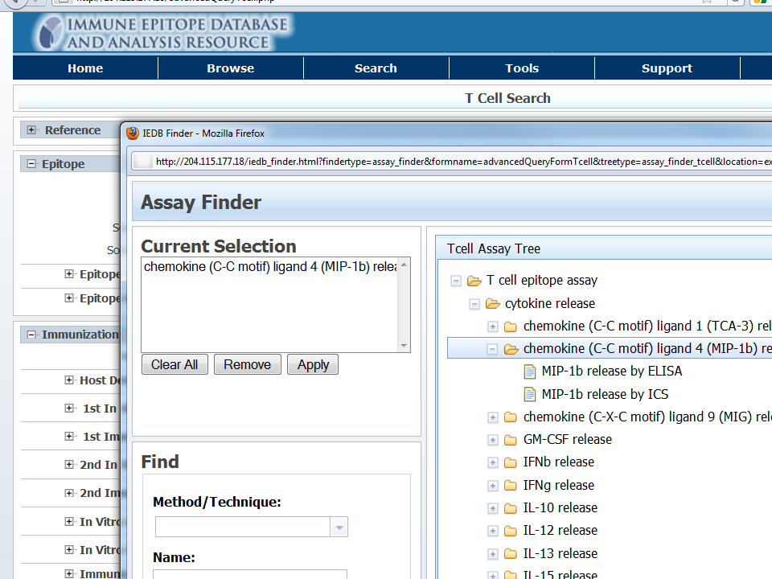
Ontology driven search interface
Search for groups of related assays
Search using synonyms
Use IEDB specific labels

Slide 40
Future work
Export IEDB data into triple store, enabling Sparql queries
→ seamless interoperability
Integration into rule based validation system

Slide 41
Overall Conclusions
The IEDB catalogs and organizes experimental data characterizing immune epitopes
We implemented a machine learning pipeline to identify and triage journal articles relevant for subject areas of interest
OBI provides a framework to represent experimental information in an interoperable and semantically rich format that has immediate benefits for database resources such as the IEDB

Slide 42
Flow cytometry for IEDB
IL-10 production (GO)
Epitope specific IL-10 production by T cells (OBI helper term).
  Textual Definition: “A biological process where T cells produce IL-10 resulting from the recognition of a T cell epitope”
  Logical definition:
  “'interleukin-10 production‘ and ('process is result of' some 'MHC:epitope complex binding to TCR')”
Intracellular cytokine staining assay (OBI)
T cell epitope intracellular cytokine staining IL-10 assay (OBI, term that really just the IEDB wants)
→ Tie to cells, cell populations

Slide 43
Immunology terms in OBI
There is no ‘immune epitope ontology’
→ merged into OBI
These terms are looking for a new home:
  disposition to be bound by immune receptor
  binding
  Epitope, antigen, immunogen, allergen, host
  ‘epitope specific cytokine production by T cells’
  Environmental exposure / proximity to infectious agent (IDO)

Slide 44
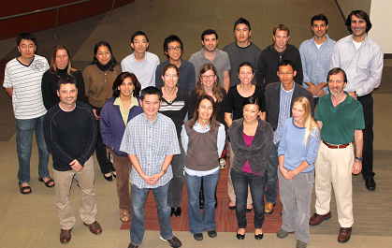
Thanks!
SAIC
Stephen Greenlee
Jason Cantrell
Jason Buell
Robert Hinman
Kelly Wheeler
Eric Gutt
San Diego Supercomputer Center
Phil Bourne
Julia Ponomarenko
Technical University of Denmark
Ole Lund
Morten Nielsen
University of Copenhagen
Søren Buus
La Jolla Institute for Allergy & Immunology

