Slide 1
The Six Category Ontology: BFO and Its Applications
Barry Smith
Durham, May 21, 2013

Slide 3
Fantology
The doctrine, usually tacit, according to which ‘Fa’ (and ‘Rab’) is the key to the ontological structure of reality
The syntax of first-order predicate logic is a mirror of reality (a Leibnizian universal characteristic)
http://ontology.buffalo.edu/bfo/Against_Fantology.pdf

Slide 4
For the fantologist
“F(a)”, “R(a, … , b)” is the language for ontology
This language reflects the structure of reality
The fantologist sees reality as being made up of individuals (a, b, c, …) plus abstract (1- and n-place) ‘properties’ or ‘attributes’

Slide 5
Fantology
Wittgenstein: Propositions show the logical form of reality. They display it. (4.121)
Russell: logic is concerned with the real world just as truly as zoology, though with its more abstract and general features. (1919)
Armstrong: the spreadsheet ontology*
* “Vérités et vérifacteurs” (2004)

Slide 6
 | F | G | H | I | J | K | L | M | N | O | P | Q | R | S | T | U | V
a
b
c
d
e
f
g
h
i
j
k

Slide 7
 | F | G | H | I | J | K | L | M | N | O | P | Q | R | S | T | U | V
a |  |  | x |  | x |  |  |  | x | x | x
b
c
d
e
f
g
h
i
j
k

Slide 8
 | F | G | H | I | J | K | L | M | N | O | P | Q | R | S | T | U | V
a |  |  | x |  | x |  |  |  | x | x | x
b |  | x | x |  |  |  |  |  |  |  | x | x |  |  |  | x
c
d
e
f
g
h
i
j
k

Slide 9
 | F | G | H | I | J | K | L | M | N | O | P | Q | R | S | T | U | V
a |  |  | x |  | x |  |  |  | x | x | x
b |  | x | x |  |  |  |  |  |  |  | x | x |  |  |  | x
c |  | x | x |  |  |  |  |  |  |  |  |  | x | x | x
d |  |  |  |  |  | x |  |  |  |  |  |  |  |  |  | x
e
f
g
h
i
j
k
and so on …

Slide 10
Fantology
tends to make you believe in some future state of ‘total science’
when the values of ‘F’ and ‘a’, all of them,
will be revealed to the elect
All true ontology is the ontology of a future perfected physics of ultimate atoms
(Armstrong: all examples proving my ontology is wrong will be shown to belong merely to the ‘manifest image’)

Slide 11
Varieties of fantology
‘F’ stands for a property
‘a’ stands for an individual
Platonistic: the Fs belong to something like the Platonic realm of forms
Set-theoretic: the Fs are sets of individuals which F
Nominalistic: ‘F’ is just a predicate

Slide 12
The Spreadsheet Ontology
 | Substances | Attributes
Universals |  | Properties
Particulars | Particulars

Slide 13
A slightly more sophisticated Armstrongian view
 | Substances | Attributes
Universals |  | Properties and Relations
Particulars | Particulars

Slide 14
Generic Fantology
 | Individuals | Attributes
 |  | Attributes F( ), G( ), R( , ... , )
 | Individuals a, b, c this, that
Universal
Particular

Slide 15

Quine
 | Individuals | Attributes
 |  | Attributes F( ), G( ), R( , ... , ) (no ontological status)
 | Individuals a, b, c this, that
Universal
Particular

Slide 16
Nominalist Fantology (1CO)
To understand properties is to understand predication
If John is white, there is no extra entity, John‘s whiteness
If John is a man, there is no extra entity, John‘s humanity
-- modes and kinds and attributes are all ontologically in the same boat

Slide 17
Bicategorial Nominalism
(Peter Simons)
 | Substantial | Accidental
 | First substance this man this cat this ox | Tropes this headache this sun-tan this dread
Universal
Particular

Slide 18
Aristotle’s Ontological Square
(Husserl, Lowe, …)
 | Substantial | Accidental
 | Second substance man cat ox | Second accident headache sun-tan dread
 | First substance this man this cat this ox | First accident this headache this sun-tan this dread
Universal
Particular

Slide 19
Aristotle’s two kinds of predication
Predication in the category of substance:
John is a man, Henry is an ox
Predication in the category of accident:
John is hungry, Henry is asleep, John is wise

Slide 20
For Fantology
these two types of predication are often confused
For Armstrong: property universals are all we need
no need for kind universals
(Armstrong’s four-dimensionalism implies that there are no substances)

Slide 21
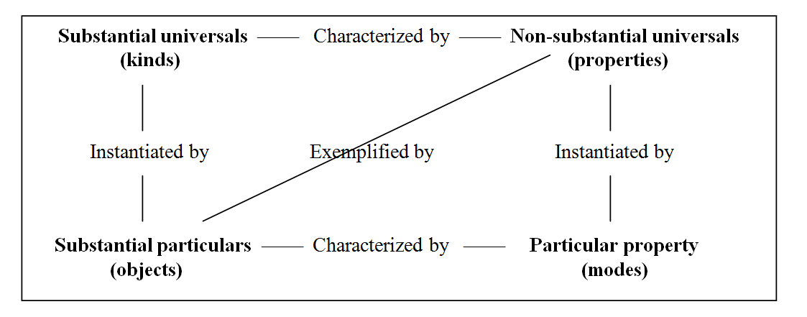
Husserl, Lowe, etc., tell us that there is a third kind of predication
John is a man
John is hungry
John has a headache (John has this headache)

Slide 22
Husserl, Lowe, etc., tell us that there is a third kind of predication
John is a man
John is hungry
John has a headache (John has this headache)

Slide 23
Husserl, Lowe, etc., tell us that there is a third kind of predication
John is a man
John is hungry
John has a headache (John has this headache)

Slide 24
Husserl, Lowe, etc., tell us that there is a third kind of predication
John is a man
John is hungry
John has a headache (John has this headache)

Slide 25
From 4CO to 6CO

Slide 26
Three FOL ways of treating temporally indexed predication
‘F holds of a at t’:
(1) F holds-at-t of object a (the copula is indexed by times; F holds t-ly) (adverbial view)
(2) F is a relation between object a and time t;
(3) F holds of a new special entity called ‘a_{t}’or ‘a-at-t’ (an object stage or phase or slice) (four-dimensionalism)

Slide 27
I agree with Jonathan in accepting the adverbial alternative (1)
Lowe*: (1) has “been overlooked, at least by philosophers trained to think in terms of the categories of modern quantification or predicate logic, as it is called. For such logic simply has no place for adverbs.”
* A Survey of Metaphysics, 2002, p. 47

Slide 28
But now Jonathan himself seems to do too little justice to the ways adverbs, other than t-ly, are used in natural language

Slide 29
4CO plus temporal indexing still cannot deal with adverbs
Consider a simple change of property in an ordinary object:
a ball undergoes a change of shape.
At t₁ there is one shape-mode
At t₂ there is another shape-mode.
Cf. Johansson, Review of Lowe, Dialectica 60 (4)

Slide 30
4CO cannot deal with change
Lowe can assert: both these modes instantiate shape universals and inhere in the same ball, and as a two-plurality the modes instantiate the temporal relation ‘coming after’.
But more must be said: a simple sum of relations of instantiations of shapes, inherences of shape modes, and the external relation of coming-after lacks the temporal unity characteristic of changes and other processes (such as squeezings, surgical procedures, heart attacks, conversations, ontology lectures …).

Slide 31
4+2CO
Event talk is common in natural language
… but there is no fundamental category of being called ‘event’
… if events exist at all, then they supervene on talk about objects and modes changing
The two extra categories in what follows should be interpreted by Lowe-ists in this spirit

Slide 32
A better view
6CO = there are objects, qualities and processes at the level of both universals and instances
Processes, like qualities, are dependent on substances
one-place processes:
getting warmer, getting hungrier
relational processes:
kissings, thumpings, conversations, dances

Slide 33
6CO (Ellis, BFO)
 | Substances | Quality entities | Processes
Universals | Substance-universals | Quality-universals | Process-universals
Particulars | Individual Substances | Quality-instances (Tropes…) | Process-instances
provides resources to understand important ontological alternatives

Slide 34
Process nominalism
(Heraclitus, Whitehead, …)
 | Substances | Qualities | Processes
Universals
Particulars |  |  | Flux

Slide 35
Trope nominalism
(Simons, again)
 | Substances | Qualities | Processes
Universals
Particulars |  | Tropes, bundles

Slide 36
Quine
 | Individuals | Attributes
 |  | Predicates F( ), G( ), R( , ... , )
 | Individuals a, b, c this, that
Universal
Particular

Slide 37
Davidson
 | Substances | Qualities | Processes
Universals |  | Predicates (including adverbial predicates): F( ), G( ), R( , ... , )
Particulars | Objects |  | Events

Slide 38
Lowe: Two different kinds of change
Substantial change (=object coming into and going out of existence)
Qualitative change (=mode coming into and going out of existence)
“Once you’ve got modes, I don’t think you need events”

Slide 39
Lowe on Dispositions
Lowe: An object possesses a disposition to F just in case it instantiates a kind which is characterized by the property of being F.
An object is occurrently F just in case it possesses a mode which is an instance of the property of being F (a mode of the universal F-ness).

Slide 40
Fantology
When we regiment language by using the forms ‘F(a)’ and ‘R(a, ... , b)’ then all generality belongs to the predicate ‘F’
‘a’ is a mere name (a mere identifier)
· a is a bare particular (Tractatus: an atom)
Contrast this with the way scientists use names:
the DNA-binding requirement of the yeast protein Rap1p as selected in silico from ribosomal protein gene promoter sequences

Slide 41
names used by scientists
  DNA-binding
  DNA-binding requirement
  yeast protein Rap1p
  ribosomal protein
  gene promoter
  gene promoter sequence

Slide 42
For extreme fantologists ‘a’ leaves no room for ontological complexity
From this it follows:
that fantology cannot do justice to the existence of different levels of granularity of reality
more generally, that fantology is conducive to and conduced by reductionism in philosophy

Slide 43
Fantology
How, then, to deal with time?
Can simple particulars gain and lose properties?
If not, how is change possible?

Slide 44
The application of the fantological approach
to a subject-domain thus presupposes the isolation of some basic level of atoms
but then brings the additional task of simulation of all structures appearing on higher levels by means of logical constructions. (Cf. Carnap’s Aufbau)

Slide 45
Fantology
Fa
The particular corresponds to a ‘bare name’, leading to a noumenal view of ‘bare particulars’
Cf. Wittgenstein’s Tractatus doctrine of simples – and his inability to name even one example
But then in virtue of what could it be the case that Fa, rather than ∼Fa

Slide 46
Properties are abstract entities
They are timeless (they do not change)
How can they be connecting up with the real entities with which they are in different ways associated.

Slide 47
Fantology
All form is logical form
All necessity is logical necessity
Cf. Wittgenstein’s doctrine of the independence of states of affairs
also the Wittgenstein/Armstrong view that all probability is combinatoric

Slide 48
the same form F(a)
can be used to express more or less any kind of content
  a is a human being
  a is negatively charged
  a is remote from Witwatersrand
  a swims regularly
  a is distinct from b

Slide 49
There is only one form of states of affairs
Fa
thus no distinction between, for example, predication in the category of substance and predication in the category of accident
John is human
John is suntanned

Slide 50
Fantology
Fa:
This should be the form of laws of nature (things + universal powers)
(not, for instance, differential equations)
Therefore, again, a noumenal view of science
Armstrong not able to name even one example of a really existing univeral
or of a really existing particular
Compare again Wittgenstein

Slide 51
Fantology
leads not only to Armstrong’s atoms + properties view of the basic ingredients of reality
but also to trope bundle views
(where the a is deleted, and the F, G, H… are seen as having particularity)
Compare: Leibniz’s monadology (each monad is a bundle of concepts)

Slide 52
For Aristotelians, universals are parts of reality
If redness is a universal, and squareness is a universal, this does not imply that there exist universals
not-redness
redness or squareness
redness and squareness
if exemplifies redness, then exemplifies squareness

Slide 53
Booleanism
if F stands for a property and G stands for a property
then
F&G stands for a property
FvG stands for a property
not-F stands for a property
F→G stands for a property
and so on

Slide 54
Strong Booleanism
There is a complete lattice of properties:
self-identity
FvG
F G
F&G
non-self-identity

Slide 55
Strong Booleanism
There is a complete lattice of properties, which exactly parallels the structure of the world of sets
self-identity
FvG
not-F F G not-G
F&G
non-self-identity

Slide 56
Fantology implies a poor treatment of relations
R(a,b)
in terms of adicity
What is the adicity of your headache (A relation between your consciousness and various processes taking place in and around your brain) ?

Slide 57
Fantology implies a poor treatment of environments
John kisses Mary
always in some environment
(= roughly, in some spatial region: a room, a car …)
Spatial regions are, like substances, three-dimensional continuants

Slide 58
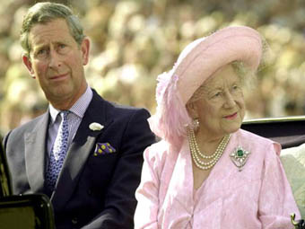
Fantology leads you to talk nonsense about family resemblances

Slide 59
The limitations of fantology
lead one into the temptations of possible world metaphysics
Definition: A possible world W is a pair (L,D) consisting of a set of first-order propositions L and a set of ground-level assertions D. … (John Sowa)

Slide 60
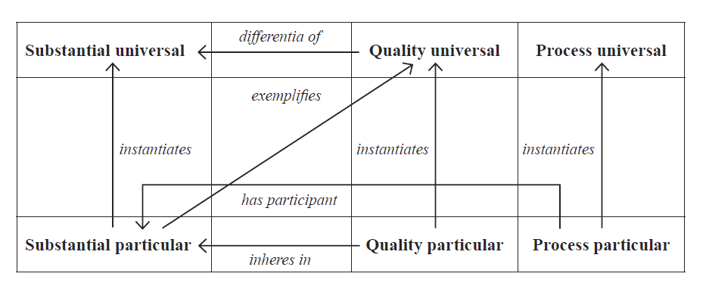
from “Against Fantology”, in: M. E. Reicher, J. C. Marek (Eds.), Experience and Analysis, 2005, Vienna: ÖBV-HPT, 153-170

Slide 61
one problem with 4CO

Slide 62
“Against Fantology”, in: M. E. Reicher, J. C. Marek (Eds.), Experience and Analysis, Vienna, 2005, http://ontology.buffalo.edu/bfo/Against_Fantology.pdf

Slide 63
The 6 categories of entity are related together
via formal relations such as
instantiation
part-whole
exemplification
inherence
participation

Slide 64
A better syntax
variables x, y, z … range over
universals and particulars in all 6 categories
predicates stand only for one or other of these relations such as instantiates, part-of, connected-to, is-a-boundary-of, is-a-niche-for, etc.
the formal relations are not extra ingredients of being

Slide 65
This suggests a new syntax:
=(x,y)
Part(x,y)
Inst(x,y)
Dep(x,y)
Isa(x,y)
John is wise: Inst(John, wisdom)
John is a man: Isa(John, man)
FOLWUT (first order logic with universal terms)

Slide 66
Compare the syntax of first order logic with identity
The interpretation of identity is fixed
(does not vary with semantics)

Slide 67
Compare the syntax of set theory
∈(x,y)
=(x,y)
two (formal) primitive relational predicates
plus further defined predicates such as
⊂(x,y)
⊆(x,y)

Slide 68
New syntax:
=(x,y)
Part(x,y)
Inst(x,y)
Dep(x,y)
Compare Davidson’s treatment of events
Did(John,e)

Slide 69
Types of Formal Relation
Intracategorial
  Part_of
  Boundary_of
  Dependent_on
Intercategorial
  Inheres_in
  Located_in
  Participates_in
  Transcendental
Identity
Barry Smith, et al., “Relations in Biomedical Ontologies”, Genome Biology (2005), 6 (5), R46.

Slide 70
FOLWUT
is still first order logic
but it allows quantification over universals exactly analogous to traditional quantification over individuals (and to Davidsonian quantification over events)
in this way it can simulate some of the expressive power of second order logic

Slide 71
For BFO
three kinds of attributes
qualities
dispositions
roles

Slide 72
For 4CO dispositions like occurrences are treated adverbially on ‘characterized by’

Slide 73
6CO Applied
Basic Formal Ontology

Slide 74
Applied Ontology 1. Biology
Plant Ontology
“Ontologies as Integrative Tools for Plant Science”, American Journal of Botany, 99(8): 2012.
Protein Ontology
“The Protein Ontology: A Structured Representation of Protein Forms and Complexes”, Nucleic Acids Research, 39: 2011.
Cell Ontology
“Logical development of the Cell Ontology”, BMC Bioinformatics 12(6): 2011.

Slide 75
Anatomical Space
Anatomical
Structure
Organ Cavity
Subdivision
Organ
Cavity
Organ
Organ Part
Serous Sac
Cavity
Subdivision
Serous Sac
Cavity
Serous Sac
Organ
Component
Organ
Subdivision
Tissue
is_a
Pleural Sac
Pleura(Wall
of Sac)
Pleural
Cavity
Parietal
Pleura
part_of
Visceral
Pleura
Interlobar
recess
Mediastinal
Pleura
Mesothelium
of Pleura
FMA
Foundational Model of Anatomy

Slide 76
Applied Ontology 2. Medicine
Infectious Disease Ontology
“Infectious Disease Ontology”, in Sintchenko (ed.), Infectious Disease Informatics, Springer, 2009.
Foundational Model of Anatomy
“A Reference Ontology for Bioinformatics: The Foundational Model of Anatomy”, Journal of Biomedical Informatics, 36, 2003.
Mental Disease Ontology
“Foundations for a Realist Ontology of Mental Disease”, Journal of Biomedical Semantics, 1(10), 2010

Slide 77
Applied Ontology 3. Finance
XBRL = eXtensible Business Reporting Language
government mandated syntax for all reports to SEC
extensibility defeats comparability of data
http://financialreportontology.wikispaces.com/

Slide 78
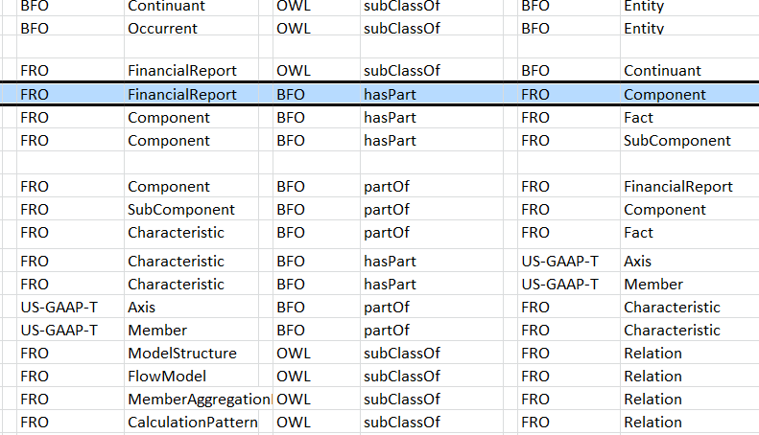
Financial Report Ontology (FRO)

Slide 79
Applied Ontology 4. Defense
  US Army Intelligence and Information Warfare Directorate (I2WD)
    “Ontology for the Intelligence Analyst”, CrossTalk: The Journal of Defense Software Engineering, November/December, 2012, 18-25.

Slide 80
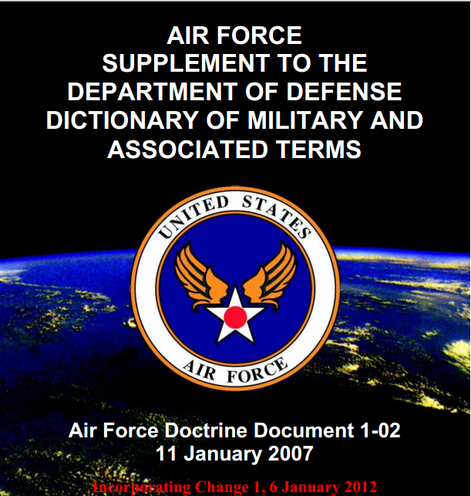

Slide 81
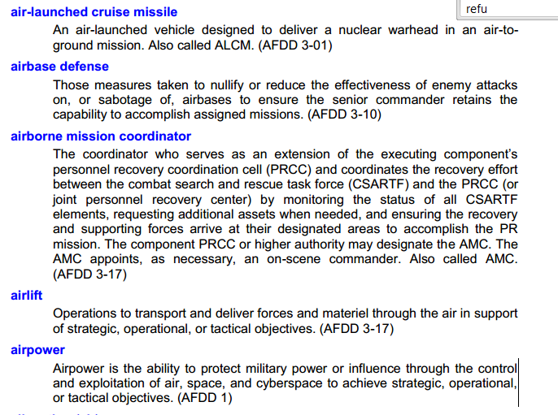

Slide 82
Why do people in the military think they need lexicons
Training
Compiling lessons learned from former engagements
Compiling results of testing, e.g. of proposed new doctrine
Collective inferencing
Official reporting
Doctrinal development
Joint operations
Standard operating procedures
People need to share data
People need to (ensure that they) understand each other

Slide 83
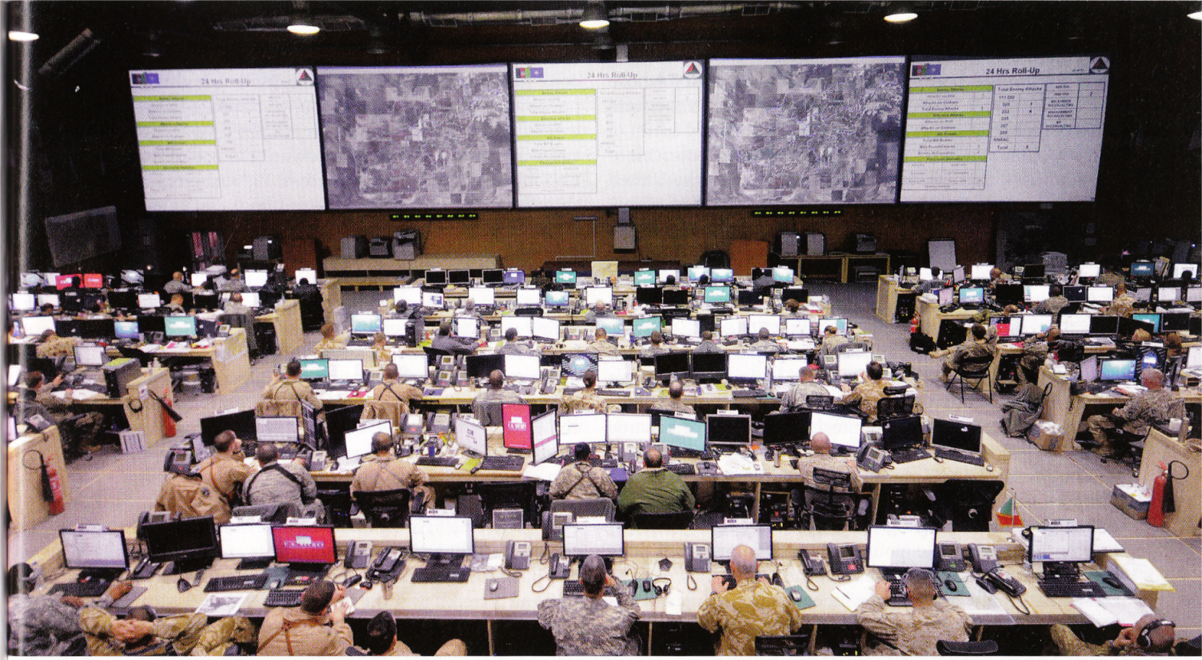
But each community produces its own ontology,
this will merely create new, semantic siloes
Intelligence
Fire Support
Targeting
Maneuver &
Blue Force Tracking
Air Operations
Civil-Military Operations
Logistics

Slide 84
The problem with (actually existing) lexicons
They promote the development of silos (roach motels for data)
They do not allow us to exploit today’s technologies
They do not combine natural language understandability with computational adequacy
They do not scale

Slide 85
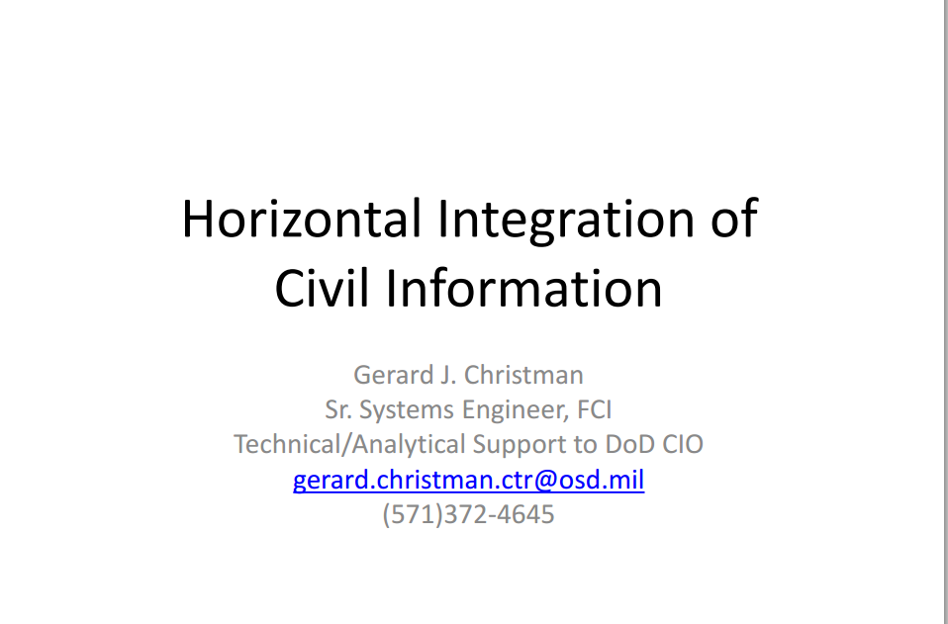

Slide 86
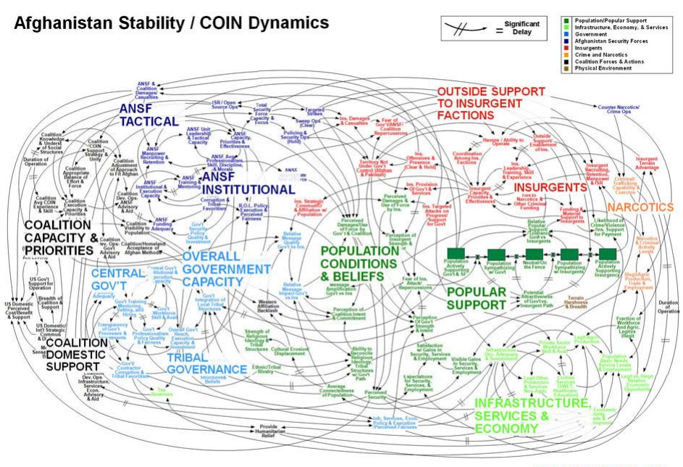

Slide 87
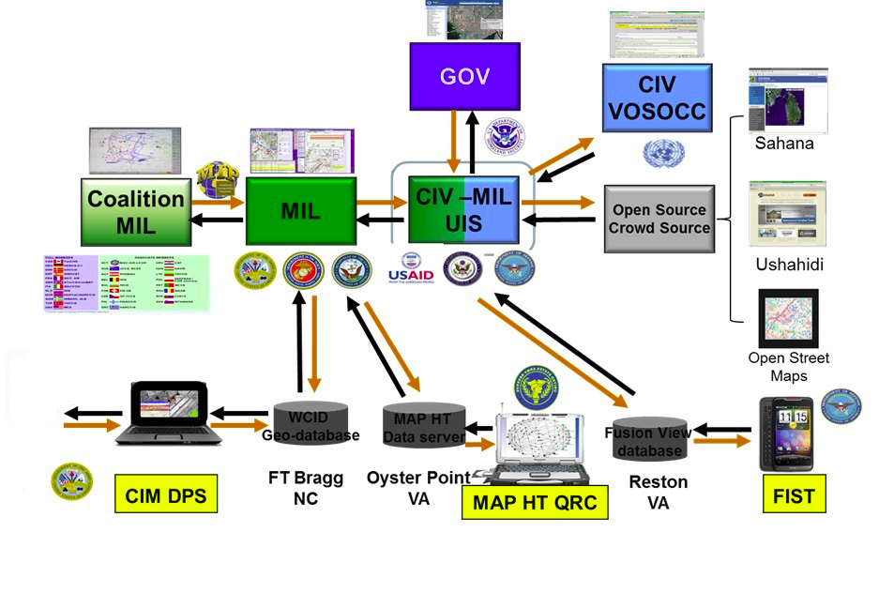
US DoD Civil Affairs strategy for non-classified information sharing
Notes:
from Gerard Christman

Slide 88
Military is 10 years behind the times when it comes to resolving data interoperability problems
– where the problems of Big Data in biomedicine were recognized already in 1998

Slide 89
The Gene Ontology (1999)
response to the massive opportunities created by the success of the Human Genome Project
  for cross-organism biology
  for intra-organism biology
  for the biology of environments

Slide 90
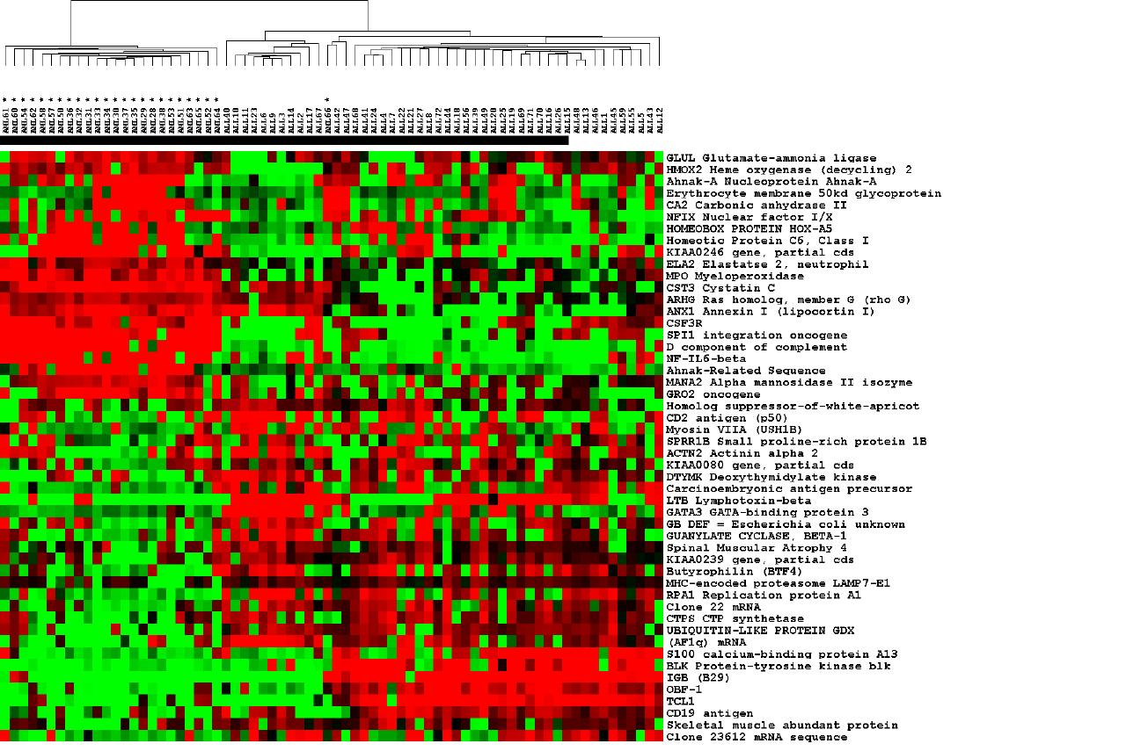
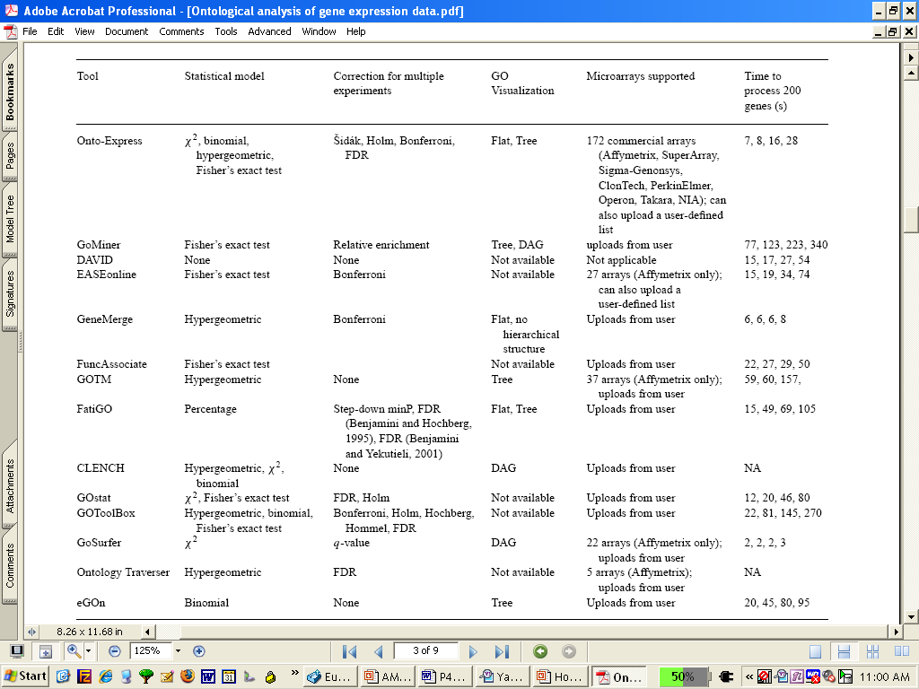
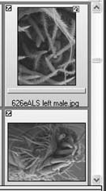
The Gene Ontology
MouseEcotope
GlyProt
DiabetInGene
GluChem

Slide 91
The Gene Ontology
MouseEcotope
GlyProt
sphingolipid
transporter
activity
DiabetInGene
GluChem

Slide 92
The Gene Ontology
MouseEcotope
GlyProt
Holliday junction
helicase complex
DiabetInGene
GluChem

Slide 93
The Gene Ontology
MouseEcotope
GlyProt
sphingolipid
transporter
activity
DiabetInGene
GluChem

Slide 94
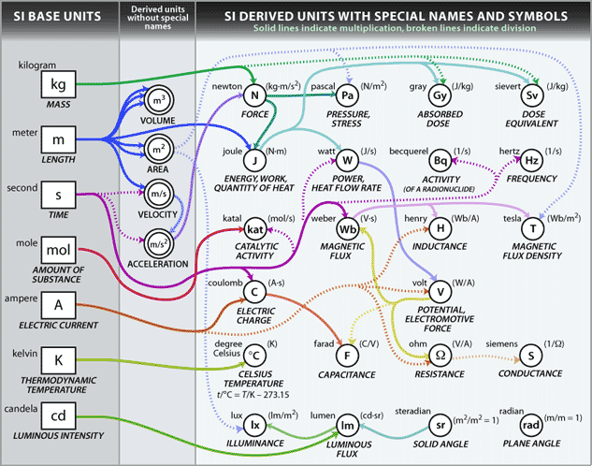
International System of Units

Slide 95
How to find your data?
How to reason with data when you find it?
How to understand the significance of the data you collected 3 years earlier?
How to integrate with other people’s data?
Part of the solution must involve consensus-based, standardized terminologies and coding schemes

Slide 96
Making data (re-)usable through standard terminologies
Standards provide
  common structure and terminology
  single data source for review (less redundant data)
Standards allow
  use of common tools and techniques
  common training
  single validation of data

Slide 97
Unifying goal: integration of biological and clinical data
  within and across domains
  across different species
  across levels of granularity (organ, organism, cell, molecule)
  across different perspectives (physical, biological, clinical)

Slide 98
Ontologies
are computer-tractable representations of types in specific areas of reality
are more and less general (upper and lower ontologies)
  upper = organizing ontologies
  lower = domain ontologies

Slide 99
Ontologies must be comparable
if we have multiple, redundant ontologies for a given domain, then this will recreate the very problem of siloes which ontology technology was designed to
to ensure non-redundancy, ontologies must be comparable
to enhance comparability ontologies should share a common upper level architecture

Slide 100
top level
mid-level
domain level
Basic Formal Ontology (BFO)
Information Artifact Ontology (IAO) | Ontology for Biomedical Investigations (OBI) | Spatial Ontology (BSPO)
Anatomy Ontology (FMA*, CARO) |  | Environment Ontology (EnvO) | Infectious Disease Ontology (IDO*) | Biological Process Ontology (GO*)
Cell Ontology (CL) | Cellular Component Ontology (FMA*, GO*)
 |  |  | Phenotypic Quality Ontology (PaTO)
Subcellular Anatomy Ontology (SAO)
Sequence Ontology (SO*) |  |  | Molecular Function (GO*)
Protein Ontology (PRO*)
Extension Strategy + Modular Organization
Notes:
* = dedicated NIH funding

Slide 101
Basic Formal Ontology
Continuant
Occurrent
biological process
Independent
Continuant
Dependent
Continuant
cell component
molecular function

Slide 102
top level
mid-level
domain level
Basic Formal Ontology (BFO)
Information Artifact Ontology (IAO) | Ontology for Biomedical Investigations (OBI) | Spatial Ontology (BSPO)
Anatomy Ontology (FMA*, CARO) |  | Environment Ontology (EnvO) | Infectious Disease Ontology (IDO*) | Biological Process Ontology (GO*)
Cell Ontology (CL) | Cellular Component Ontology (FMA*, GO*)
 |  |  | Phenotypic Quality Ontology (PaTO)
Subcellular Anatomy Ontology (SAO)
Sequence Ontology (SO*) |  |  | Molecular Function (GO*)
Protein Ontology (PRO*)
OBO Foundry: Downward Population from BFO
Notes:
* = dedicated NIH funding

Slide 103
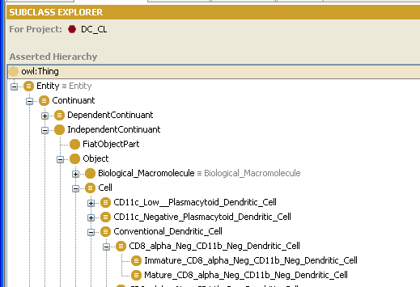
Example: The Cell Ontology

Slide 104
BFO:continuant
continuant
independent continuant
portion of material
dependent continuant
spatial region
object boundary
site
specifically dependent continuant
generically dependent continuant
realizable entity
quality
disposition
function
role
3D-region
0D-region
1D-region
2D-region
object
object aggregate
fiat object part
information artifact

Slide 105
BFO:occurrent
occurrent
processual entity
process
spatiotemporal region
temporal region
process aggregate
process boundary
processual context
connected spatiotemporal region
scattered spatiotemporal region
spatiotemporal instant
spatiotemporal interval
temporal interval
connected temporal region
scattered temporal region
temporal instant
fiat process part

Slide 106
More than 100 Ontology projects using BFO
http://www.ifomis.org/bfo/users
One argument against 4CO and 8CO: BFO has more users

Slide 107
Some Ontologies Built from BFO
AFO Foundational Ontology
US Army Biometrics Ontology
BioTop: A Biomedical Top-Domain Ontology
Cell Ontology (CL)
Chemical Entities of Biological Interest (ChEBI)
Common Anatomy Reference Ontology (CARO)
Drug Interaction Ontology (DIO)
Foundational Model of Anatomy (FMA)
Gene Ontology (GO)
Infectious Disease Ontology (IDO)
Neuroscience Information Framework Standard (NIFSTD) Ontology
Ontology for Biomedical Investigations (OBI)
Protein Ontology (PRO)
Sequence Ontology (SO)
Universal Core Semantic Layer (UCore SL)
Subcellular Anatomy Ontology (SAO)
Zebrafish Anatomical Ontology (ZAO)

Slide 108
DOLCE, SUMO, Cyc
DOLCE: 6CO (largely) compatible with BFO, but built to support ‘linguistic and cognitive engineering’ – there to describe people’s assumptions people have about reality (ethno-Quineanism)
SUMO: 2CO (no diabetes, no temperature instances); SUMO has its own tiny biology (‘body-covering’, ‘fruit-Or-vegetable’); not a true top level
Cyc: Allows inconsistent microtheories (embraces chaos)

Slide 109
Cyc:ConceivingSomething_Biological
ReproductionEvent =def a collection of events; a sub-collection of BiologicalReproductionEvent. In each conceivingSomething_BiologicalReproduction Event, someone becomes pregnant.
Cyc:The immaculate conception =def. The ConceivingSomething_BiologicalReproductionEvent in which Mary_MotherOfJesus was conceived. Catholic dogma holds that Mary (unlike Jesus) was conceived by conventional biological means, but that GodOfAbrahamIsaacAndJacob interceded at the time of her conception to keep her free from the stain of original sin, or ‘immaculate’.

Slide 110
Basic Formal Ontology
types
Continuant
Occurrent
process, event
Independent
Continuant
thing
Dependent
Continuant
quality
3
1
2
.... .... .......
4
5
6
instances

Slide 111
Blinding Flash of the Obvious
Continuant
Occurrent
process, event
Independent
Continuant
thing
Dependent
Continuant
quality
quality depends
on bearer
.... ..... .......

Slide 112
Blue Force Overwatch
Continuant
Occurrent
process, event
Independent
Continuant
thing
Dependent
Continuant
quality, …
event depends
on participant
.... ..... .......

Slide 113
Occurrents depend on participants
instances
15 May bombing
5 April insurgency attack
occurrent types
bombing
attack
participant continuant types
explosive device
terrorist group

Slide 114
General rules for ontology development incorporated into BFO
Common traffic laws
Lessons learned and disseminated as common guidelines – all developers are doing it the same way
Tools built for BFO ontologies can be re-used by others
Expertise developed in working with one BFO ontology can be-used with others

Slide 115
Basic Formal Ontology (Top Level) http://www.ifomis.org/bfo/
Continuant
Occurrent
Process
Stage
Independent
Continuant
Dependent
Continuant
Anatomical Structure
Quality

Slide 116
the universal red
the universal eye
instantiates
instantiates
this particular case of redness (of a particular fly eye)
an instance of eye (in a particular fly)
depends_on
Phenotype Ontology (PATO)

Slide 117
color
anatomical structure
is_a
is_a
red
eye
instantiates
instantiates
the particular case of redness (of a particular fly eye)
an instance of an eye (in a particular fly)
depends on

Slide 118
independent
continuant
dependent
continuant
occurrent
quality
process
organism
life of an organism
temperature
John
John’s
temperature
John’s
life

Slide 119
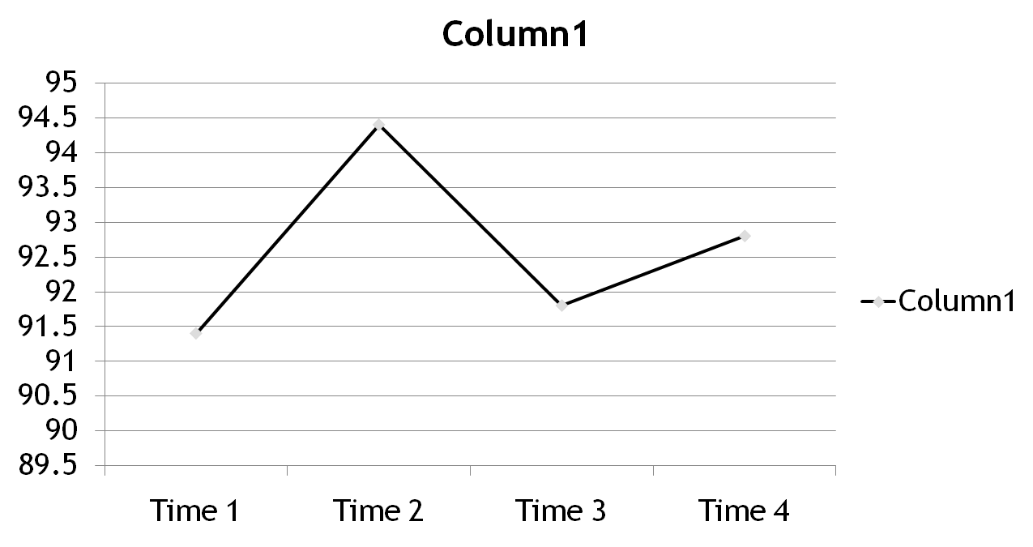
A chart representing how John’s temperature changes

Slide 120
A chart representing how John’s temperature changing

Slide 121
temperature
37ºC
37.1ºC
37.2ºC
37.3ºC
37.4ºC
37.5ºC
instantiates at t₁
instantiates at t₂
instantiates at t₃
instantiates at t₄
instantiates at t₅
instantiates at t₆
John’s temperature

Slide 122
temperature
in nature, no sharp boundaries here
in nature, no sharp boundaries here
37ºC
37.1ºC
37.2ºC
37.3ºC
37.4ºC
37.5ºC
instantiates at t₁
instantiates at t₂
instantiates at t₃
instantiates at t₄
instantiates at t₅
instantiates at t₆
John’s temperature (exists continuously)

Slide 123
realizable
dependent continuant
disposition
disease
genetic heart disease
coronary heart disease
infective endocarditis

Slide 124
coronary heart disease
early lesions and small fibrous plaques
asymptomatic (‘silent’) infarction
surface disruption of plaque
unstable angina
stable angina
instantiates at t₁
instantiates at t₂
instantiates at t₃
instantiates at t₄
instantiates at t₅
John’s coronary heart disease (exists continuously)
time

Slide 125
independent
continuant
dependent
continuant
occurrent
process
disposition
organism
heart disease course
heart disease
John
John’s
heart disease
John’s
heart disease course

Slide 126
So why not 8CO (à la Schneider)?
 | Substances | Qualities | Processes | Process qualities
Universals | Substance-universals | Quality-universals | Process-universals | Process qualities
Particulars | Individual Substances | Quality-instances (Tropes…) | Process-instances | Process quality instances

Slide 127
independent
continuant
dependent
continuant
occurrent
process
process pattern
disposition
organism
heart disease course
heart disease
John
John’s
heart disease
John’s
heart disease course

Slide 128
independent
continuant
dependent
continuant
occurrent
?
process
process pattern
disposition
organism
heart disease course
heart disease
John
John’s
heart disease
John’s
heart disease
course
John’s
heart disease
course pattern

Slide 129
occurrent
independent
continuant
dependent
continuant
process pattern
process
disposition
chronic process pattern
organism
heart disease course
heart disease
chronic heart disease course pattern
John
John’s
heart disease
John’s
heart disease course

Slide 130
occurrent
occurrent
process pattern
process pattern
process
process
chronic process pattern
chronic process pattern
heart disease course
heart disease course
chronic heart disease course pattern
chronic heart disease course pattern
John’s
heart
disease
course
John’s chronic
heart
disease
course pattern
John’s
heart disease course
130

Slide 131
occurrent
occurrent
process
process profile
process profile
process
chronic process profile
chronic process profile
heart disease course
heart disease course
chronic heart disease course profile
chronic heart disease course profile
John’s
heart
disease
course
John’s chronic
heart
disease
course profile
John’s
heart disease course
131

Slide 132
occurrent
occurrent
process
process profile
process
heart disease course
chronic disease course
chronic process profile
heart disease course
chronic heart disease course profile
chronic heart disease course
John’s
heart
disease
course
John’s chronic
heart
disease
course profile
John’s
heart disease course
132

Slide 133
occurrent
occurrent
process quality
process quality
process
process
chronic process quality
chronic process quality
heart disease course
heart disease course
chronic heart disease course quality
chronic heart disease course quality
John’s
heart
disease
course
John’s chronic
heart
disease
course quality
John’s
heart disease course

Slide 134
Different subtypes of
BFO:dependent continuant
Dependent
Continuant
Quality
Realizable
disposition
role
function

Slide 135
Roles pertain not to what a thing enduringly is, but to the part it plays, e.g. in some operation
Continuant
Occurrent
process, event
realization-of
Independent
Continuant
thing
Realizable
Dependent
Continuant
(e.g. chef role)
.... ..... .......

