Slide 1
Ontology Bootcamp AFRL Rome July 7, 2015
Barry Smith and Ron Rudnicki

Slide 2
Morning agenda
9:00 Reviews of TrackableObject and PheonixPrime ontologies
9:30 Traffic laws for ontology building (from BOBFO book) and why we need them
10:00 Coffee
10:30 Overview of Common Core Ontologies
10:45 Introduction to Basic Formal Ontology
11:15 MAMA Mission Ontology
12:00 Lunch

Slide 3
Trackable Object Ontology

Slide 5
TO:Physical Entity

Slide 7
TO:Contractor

Slide 8
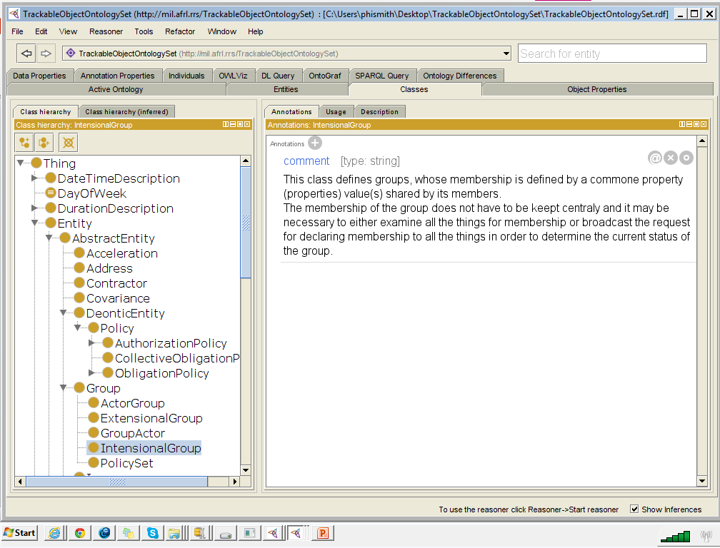

Slide 10
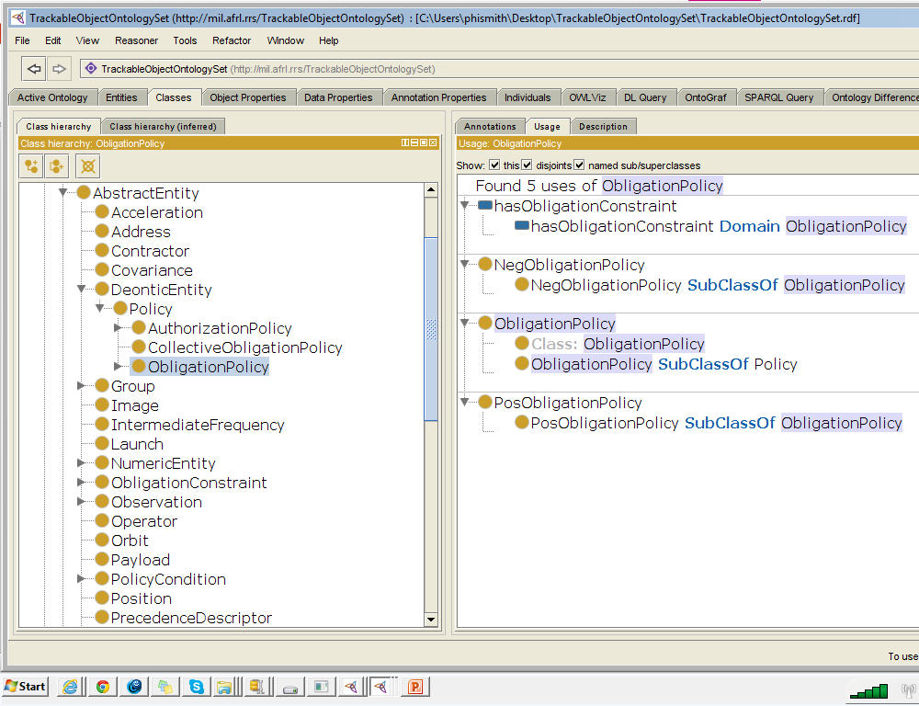

Slide 11
PP:Abstract Entity

Slide 14
Building Ontologies with BFO
Division of labor (modularity)
Reusability
Secondary uses
Need for a common benchmark
Common principles
Shared expertise
Traffic rules
Common upper level (BFO)
Cumulation of lessons learned

Slide 15
Building Ontologies with BFO, ch. 5
Principles for Terminology
Gather and Select Terminology
1. Include in the terminology terms used by scientists
2. Strive to ensure maximal consensus with the scientists’ usage
3. Identify areas of disciplinary overlap where terminological usage is not consistent
4. In terminology construction and ontology design, make use of as many existing resources (terminologies and ontologies) as possible.
Formatting Terminology
5. Use singular nouns.
6. Use lowercase for common nouns.
7. Avoid acronyms.
8. Associate each term in the ontology with a unique alphanumeric identifier.
9. Ensure univocity of terms.
10. Ensure univocity of relational expressions.
11. Avoid mass terms.
12. Distinguish the general from the particular.
Principles for Definitions
13. Provide all nonroot terms with definitions
14. Use Aristotelian definitions
15. Use essential features in defining terms.
16. Start with the most general terms in your domain.
17. Avoid circularity in defining terms.
18. To ensure the intelligibility of definitions, use simpler terms than the term you are defining.
19. Do not create terms for universals through logical combination.
20. Definitions should be unpackable (Term-definition intersubstitutability)
Principles for Taxonomies
21. Structure every ontology around a backbone is_a hierarchy.
22. Ensure is_a completeness.
23. Ensure asserted single inheritance.
24. Both developers and users of an ontology should respect the open-world assumption.
25. Adhere to the rule of objectivity, which means: describe what exists in reality, not what is known about what exists in reality

Slide 16
Principles for Terminology
1. Include in the terminology terms used by scientists
2. Strive to ensure maximal consensus with the scientists’ usage
3. Identify areas of disciplinary overlap where terminological usage is not consistent
4. In terminology construction and ontology design, make use of as many existing resources (terminologies and ontologies) as possible.
5. Use singular nouns.
6. Use lowercase for common nouns.
7. Avoid acronyms.
8. Associate each term in the ontology with a unique alphanumeric identifier.
9. Ensure univocity of terms.
10. Ensure univocity of relational expressions.
11. Avoid mass terms.
12. Distinguish the general from the particular.

Slide 17
Principles for Definitions
13. Provide all nonroot terms with definitions
14. Use Aristotelian definitions
15. Use essential features in defining terms.
16. Start with the most general terms in your domain.
17. Avoid circularity in defining terms.
18. To ensure the intelligibility of definitions, use simpler terms than the term you are defining.
19. Do not create terms for universals through logical combination.
20. Definitions should be unpackable (Term-definition intersubstitutability)

Slide 18
Principles for Taxonomies
21. Structure every ontology around a backbone is_a hierarchy.
22. Ensure is_a completeness.
23. Ensure asserted single inheritance.
24. Both developers and users of an ontology should respect the open-world assumption.
25. Adhere to the rule of objectivity, which means: describe what exists in reality, not what is known about what exists in reality
crop

Slide 19
Building Ontologies with BFO
Division of labor (modularity)
Reusability
Secondary uses
Need for a common benchmark
Common principles
Shared expertise
Traffic rules
Common upper level
Cumulation of lessons learned

Slide 21
GO is amazingly successful in overcoming problems of balkanization, especially for retrieval of data
but it covers only generic biological entities of three sorts:
cellular components
molecular functions
biological processes
and it does not provide representations of diseases, symptoms, anatomy, pathways, …

Slide 22
RELATION TO TIME GRANULARITY | CONTINUANT |  |  |  | OCCURRENT
 | INDEPENDENT |  | DEPENDENT
ORGAN AND ORGANISM | Organism (NCBI Taxonomy) | Anatomical Entity (FMA, CARO) | Organ Function (FMP, CPRO) | Phenotypic Quality (PaTO) | Biological Process (GO)
CELL AND CELLULAR COMPONENT | Cell (CL) | Cellular Component (FMA, GO) | Cellular Function (GO)
MOLECULE | Molecule (ChEBI, SO, RnaO, PrO) |  | Molecular Function (GO) |  | Molecular Process (GO)
Original OBO Foundry ontologies
(Gene Ontology in yellow)

Slide 23
RELATION TO TIME GRANULARITY | CONTINUANT |  |  |  |  | OCCURRENT
 | INDEPENDENT |  |  | DEPENDENT
ORGAN AND ORGANISM | Organism (NCBI Taxonomy) | Anatomical Entity (FMA, CARO) |  | Organ Function (FMP, CPRO) | Phenotypic Quality (PaTO) | Biological Process (GO)
CELL AND CELLULAR COMPONENT | Cell (CL) | Cellular Component (FMA, GO) |  | Cellular Function (GO)
MOLECULE | Molecule (ChEBI, SO, RnaO, PrO) |  |  | Molecular Function (GO) |  | Molecular Process (GO)
Environments
Environment Ontology (EnvO)

Slide 24
BFO 2.0

Slide 25
domain ontologies created by specialization from BFO
top level
mid-level
domain
level
Basic Formal Ontology (BFO)
Information Artifact Ontology (IAO) | Ontology for Biomedical Investigations (OBI) | Spatial Ontology (BSPO)
Anatomy Ontology (FMA*, CARO) |  | Environment Ontology (ENVO) | Infectious Disease Ontology (IDO*) | Biological Process Ontology (GO*)
Cell Ontology (CL) | Cellular Component Ontology (FMA*, GO*)
 |  |  | Phenotypic Quality Ontology (PATO)
Subcellular Anatomy Ontology (SAO)
Sequence Ontology (SO*) |  |  | Molecular Function (GO*)
Protein Ontology (PRO*)
Notes:
* = dedicated NIH funding

Slide 26
domain ontologies created by specialization from BFO
Basic Formal Ontology (BFO)
core nodes
 | Independent continuants | Dependent continuants | Occurrents
Classes | Object types | Attribute types | Process types
Particulars | Individual objects | Individual attributes | Individual processes
Notes:
* = dedicated NIH funding

Slide 27
top level
mid-level
domain level
Basic Formal Ontology (BFO)
Information Artifact Ontology (IAO) | Ontology for Biomedical Investigations (OBI)
Anatomy Ontology (FMA*, CARO) |  | Environment Ontology (EnvO) | Ontology for General Medical Science (OGMS) | Biological Process Ontology (GO*)
Cell Ontology (CL) | Cellular Component Ontology (FMA*, GO*)
 |  |  | Phenotypic Quality Ontology (PaTO)
CHEBI
Sequence Ontology (SO*) |  |  | Molecular Function (GO*)
Protein Ontology (PRO*)
Strategy of Modularity & Downward Population
Notes:
* = dedicated NIH funding

Slide 28
OGMS
Cardiovascular Disease Ontology
Genetic Disease Ontology
Cancer Disease Ontology
Genetic Disease Ontology
Immune Disease Ontology
Environmental Disease Ontology
Oral Disease Ontology
Infectious Disease Ontology
IDO Staph Aureus
IDO MRSA
IDO Australian MRSA
IDO Australian Hospital MRSA
…

Slide 29
BFO and Common Core Ontologies
Relation Ontology (RO)
Basic Formal Ontology (BFO)
RO BFO Bridge 1.1
Extended Relation Ontology
Agent Ontology
Event Ontology
Information Entity Ontology
Time Ontology
Artifact Ontology
Geospatial Ontology
Quality Ontology
AIRS Mid-Level Ontology

Slide 30
http://obofoundry.org
CHEBI: Chemical Entities of Biological Interest
GO: Gene Ontology
OBI: Ontology for Biomedical Investigations
PATO: Phenotypic Quality Ontology
PO: Plant Ontology
PATO: Phenotypic Quality Ontology
PRO: Protein Ontology
XAO: Xenopus Anatomy Ontology
ZFA: Zebrafish Anatomy Ontology
http://www.ifomis.org/bfo/

Slide 31
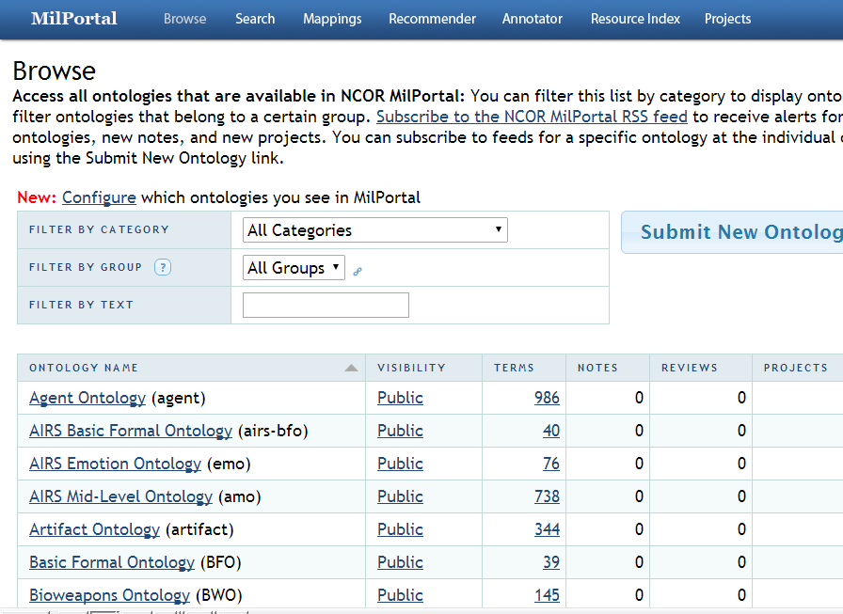

Slide 32
OBO Foundry approach extended into other domains
NIF Standard | Neuroscience Information Framework
IDO Consortium | Infectious Disease Ontology
cROP | Common Reference Ontologies for Plants
MilPortal.org | Military Ontology
AIRS Ontology Suite / Common Core | Actionable Intelligence Retrieval System
UNEP Ontology Framework | United Nations Environment Programme

Slide 33
Ontologies | Benchmarks
OBO Foundry | Oxford Dictionary of Molecular Biology
NIF Standard | Neuroscience published literature
IDO | Textbook Immunology
cROP | Plant genomics
MilPortal.org
AIRS Ontology Suite / Common Core
UNEP Ontology Framework | UN documents, outcomes of Millennium Development Goal

Slide 34
Ontologies | Benchmarks
OBO Foundry | Oxford Dictionary of Molecular Biology
NIF Standard | Neuroscience published literature
IDO | Textbook Immunology
cROP | Plant genomics
MilPortal.org | Joint doctrine
AIRS Ontology Suite / Common Core
UNEP Ontology Framework | UN documents, outcomes of Millennium Development Goal

Slide 35
RELATION TO TIME | CONTINUANT |  |  |  |  | OCCURRENT
GRANULARITY | INDEPENDENT CONTINUANT |  |  | DEPENDENT CONTINUANT
ORGAN AND ORGANISM | Organism NCBI Taxonomy | Anatomical Entity (FMA, CARO) |  | Organ Function (FMP, CPRO) |  | Biological Process (GO) | Ontology for Biomedical Investigations (OBI)
CELL AND CELLULAR COMPONENT | Cell (CL) | Cellular Component (FMA, GO) |  | Cellular Function (GO)
MOLECULE | Molecule (ChEBI, SO, RnaO, PrO) |  |  | Molecular Function (GO) |  | Molecular Process (GO)
Phenotypic Quality (PATO)
Environment Ontology (ENVO)
Recognizing a new family of protocol-driven processes (investigation, assay, …)

Slide 36
Basic Formal Ontology (BFO)
Independent Continuant (~Thing)) | Dependent Continuant (~Attribute) | Occurrent (~Process)
Anatomy Ontology (FMA*, CARO) | Disease Ontology (OGMS, IDO, HDO, HPO) | Bio-logical Process | Protocol-driven process (OBI)
Cell Ontology (CL)
Subcellular Anatomy Ontology (SAO) | Phenotypic Quality Ontology (PATO)
Sequence Ontology (SO) | Molecular Function Ontology (GO)
Protein Ontology (PRO)
Extension Strategy + Modular Organization
Notes:
* = dedicated NIH funding

Slide 37
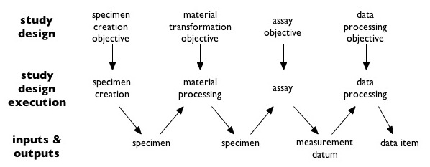
The Ontology for Biomedical Investigations
Structure of a typical investigation as viewed by OBI (from http://obi-ontology.org/page/Investigation)

Slide 38
RELATION TO TIME | CONTINUANT |  |  |  |  |  | OCCURRENT
GRANULARITY | INDEPENDENT CONTINUANT |  |  | DEPENDENT CONTINUANT |  | INFORMATION ARTIFACT
ORGAN AND ORGANISM | Organism NCBI Taxonomy | Anatomical Entity (FMA, CARO) |  | Organ Function (FMP, CPRO) |  | IAO Software, Algorithms, … Sequence Data, EHR Data … | Biological Process (GO) | OBI
CELL AND CELLULAR COMPONENT | Cell (CL) | Cellular Component (FMA, GO) |  | Cellular Function (GO)
MOLECULE | Molecule (ChEBI, SO, RnaO, PrO) |  |  | Molecular Function (GO) |  | Images, Image Data, Flow Cytometry Data, … | Molecular Process (GO) | OBI: Imaging
Phenotypic Quality (PATO)
Environment Ontology (ENVO)
Recognizing a new family of information entities: data, publications, images, algorithms …

Slide 39
Basic Formal Ontology (BFO)
Independent Continuant (~Thing)) | Dependent Continuant (~Attribute) | information Artifact (~Data) | Occurrent (~Process)
Anatomy Ontology (FMA*, CARO) | Disease Ontology (OGMS, IDO, HDO, HPO) | Data | Biological Process | Assays
Cell Ontology (CL)
Subcellular Anatomy Ontology (SAO) | Phenotypic Quality Ontology (PATO)
Sequence Ontology (SO) | Molecular Function Ontology (GO)
Protein Ontology (PRO)
Extension Strategy + Modular Organization
Notes:
* = dedicated NIH funding

Slide 40
MAMA
The Mission Awareness for Mission Assurance (MAMA) program has the goal of enhancing
“… cyber situational awareness by the automated assessment of mission execution through the analysis of network traffic flows.”

Slide 41
Military Doctrine
facilitates readiness by allowing common ways of training
a guide to action, rather than hard and fast rules
provides a common frame of reference across the military that helps standardize operations by establishing common ways of accomplishing military tasks and a common language for planning and communicating orders

Slide 42
Military Doctrine feeds into Military Planning
Doctrine provides an authoritative body of consistent* statements on
how military forces conduct (joint) operations
how military plans are to be constructed
provides a common lexicon
which must be used by military planners and leaders
which will be what those charged with execution of military plans will anticipate and understand
*ideally

Slide 46
Why does DoD need a dictionary?
For people (people need to understand each other)
Training (Developing doctrine, …)
Planning (Joint operations, SOPs, …)
Executing (C2, …)
Reporting, Outcomes evaluation, lessons learned
For machines
Compiling data (e.g. results of testing …)
Sharing of data (Compiling lessons learned …)
Collective inferencing

Slide 47
Digitalizing doctrine (the ideal)
associate with each term in JP 1.0 a URL
formulate authoritative definitions of each term in OWL
use these terms as basis for computational definitions of terms at lower levels in the hierarchy, incorporating hyperlinks to the JP 1.0 URLs
use OWL reasoners for computer-aided consistency checking

Slide 48
‘mission’ in doctrine
1. The task, together with the purpose, that clearly indicates the action to be taken and the reason therefore.
2. In common usage, especially when applied to lower military units, a duty assigned to an individual or unit; a task.
3. The dispatching of one or more aircraft to accomplish one particular task.

Slide 49
‘mission’ in doctrine
mission command --- The conduct of military operations through decentralized execution based upon mission-type orders.
mission statement --- A short sentence or paragraph that describes the organization's essential task(s), purpose, and action containing the elements of who, what, when, where, and why.
mission type order
1. An order issued to a lower unit that includes the accomplishment of the total mission assigned to the higher headquarters.
2. An order to a unit to perform a mission without specifying how it is to be accomplished.

Slide 50
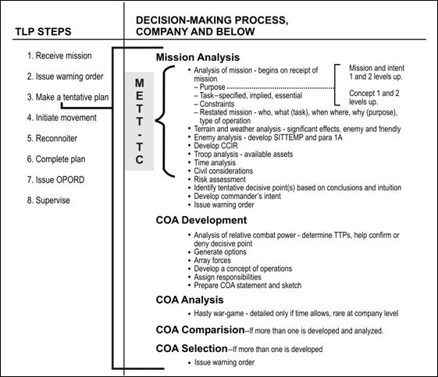
Army Planning Process (FM 3-21.10)

Slide 52
Make a tentative plan via mission analysis

Slide 53
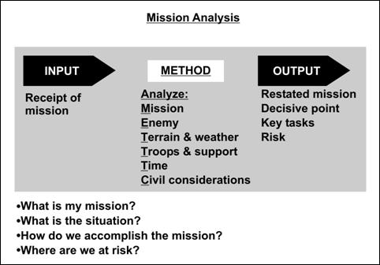
F
Figure 2-5. Analysis of mission using METT-TC.
Analysis of Mission
Notes:
FM 3-21-10

Slide 54
Restated mission in terms of 5 Ws
EXAMPLE C Company/1-87 IN (who) Attacks to seize (what) OBJ FOX (NB123456) (where) NLT 010200 October ___ (when) To prevent enemy forces from counterattacking into the battalion's decisive operation (why) Who? C Company/1-87 IN What? Essential task: seize, type of operation–attack Where? OBJ Fox (NB123456) When? 010200 October ___ (attack time) Why? To prevent enemy forces from counterattacking into the battalion's decisive operation

Slide 55
Basic Formal Ontology 1.0 http://www.ifomis.org/bfo/
Continuant
Occurrent
Independent
Continuant
Dependent
Continuant
Spatial
Region
Process
Temporal
Region

Slide 56
Basic Formal Ontology 1.0 http://www.ifomis.org/bfo/
Continuant
Occurrent
Independent
Continuant
Dependent
Continuant
Spatial
Region
Process
Temporal
Region
Time
Object
Attribute
Space
Action

Slide 57
Continuant
Independent
Continuant
Dependent
Continuant
TYPES
Non-realizable
Dependent
Continuant
(quality)
Realizable
Dependent
Continuant
(function, role,
disposition)
..... .....
INSTANCES

Slide 58
depends_on
Continuant
TYPES
example:
temperature depends
on bearer
Independent
Continuant
thing
Dependent
Continuant
quality
.... .....
INSTANCES

Slide 59
the universal red
the universal eye
instantiates
instantiates
the particular case of redness (of a particular fly eye)
an instance of an eye (in a particular fly)
depends on

Slide 60
color
anatomical structure
is_a
is_a
red
eye
instantiates
instantiates
the particular case of redness (of a particular fly eye)
an instance of an eye (in a particular fly)
depends on

Slide 61
Dependent
Continuant
Quality
Realizable Dependent
Continuant
Disposition
Function
Role
of banana, to ripen
of gun, to fire bullets
of employee, to work for pay

Slide 62
process of realization depends_on realizable
Continuant
Occurrent
Independent
Continuant
bearer
Realizable
Dependent
Continuant
disposition
Process of
realization
.... ..... .......

Slide 63
BFO-based Ontology Development
Basic Formal Ontology (BFO)
Information Artifact Ontology (IAO)
IAO-Intel | Email Ontology | IAO-Science
Notes:
* = dedicated NIH funding

Slide 64
Information artifact
an entity created through some deliberate act or acts by one or more human beings, and which endures through time, potentially in multiple (for example digital or printed) copies
Examples: a diagram on a sheet of paper, a document specifying three alternative courses of action for a commander, a recipe book, a recipe in a recipe book

Slide 65
Continuant
Occurrent
Independent
Continuant
Dependent
Continuant
Quality
Realizable
Dependent
Continuant
Process
Disposition
Role

Slide 66
BFO 1.1: Specifically Dependent Continuant
Specifically
Dependent
Continuant
if any bearer ceases to exist, then the quality or function ceases to exist
the color of my skin
the function of my heart
Quality,
Role, Disposition
Realizable
Dependent
Continuant

Slide 67
Specifically Dependent Continuant
Red color
of my skin
Red color
of your skin
Accidents do not migrate from one substance to another
depends_on
depends_on
You
Me
Notes:
http://www.catholicapologetics.info/catholicteaching/philosophy/axiomata.htm; see also http://x.co/2oDWp

Slide 68
Generically Dependent Continuant
Generically
Dependent
Continuant
if one bearer ceases to exist, then the entity can survive, because there are other bearers
(copyability)
the pdf file on my laptop
the DNA (sequence) in this chromosome
pdf file
jpg file
Gene
Sequence

Slide 69
Information artifacts
pdf file
email
poem
symphony
algorithm
symbol
– can migrate from one physical information bearer to another

Slide 70
Continuant
BFO 1.1
Independent
Continuant
Specifically
Dependent
Continuant
Generically
Dependent
Continuant
Quality
Realizable
Dependent
Continuant
Gene
Sequence
Information
Artifact
Disposition
Role

Slide 71
Continuant
Independent
Continuant
Specifically
Dependent
Continuant
Generically
Dependent
Continuant
Material
Entity
Quality
Gene
Sequence
Information
Artifact
Information
Bearing
Entity

Slide 72
Continuant
Independent
Continuant
Specifically
Dependent
Continuant
Generically
Dependent
Continuant
Material
Entity
Quality
Information
Artifact
Information
Bearing
Entity (your
hard drive
Information
Quality Entity
(pattern on
your hard drive)
depends_on

Slide 73
Continuant
BFO
IAO
Independent
Continuant
Specifically
Dependent
Continuant
Generically
Dependent
Continuant
Material
Entity
Quality
Information
Content
Entity
Information
Bearing
Entity
Information
Quality
Entity
depends_on
concretized_by

Slide 74
Independent
Continuant
Specifically
Dependent
Continuant
Generically
Dependent
Continuant
Material
Entity
Quality
Information
Content
Entity
Information
Bearing
Entity
Information
Quality
Entity
depends_on
concretized_by
universals
this hard drive,
that book
this excitation
pattern,
that pattern
of piles of ink
this pdf file,
that Target Value Matrix
instances

Slide 75
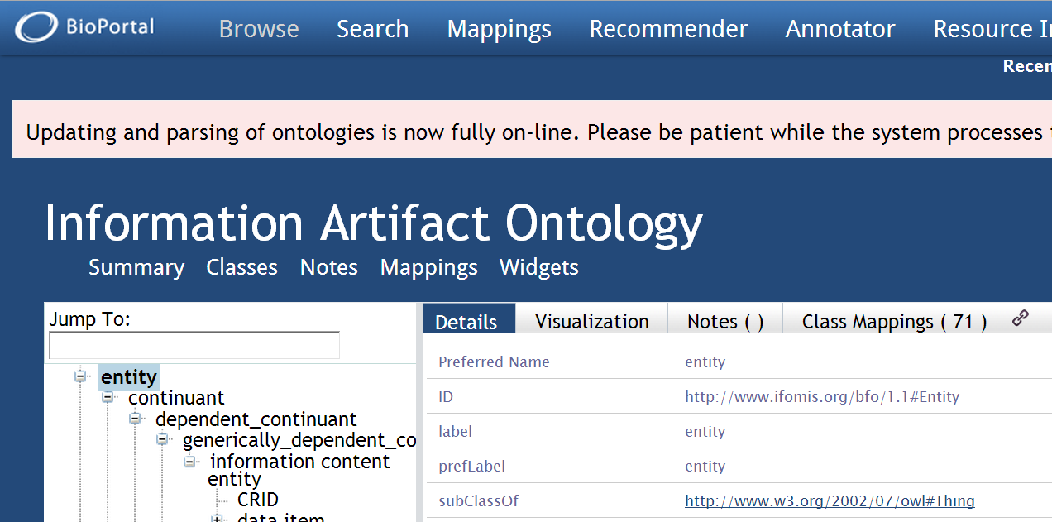
http://bioportal.bioontology.org/ontologies/IAO
Notes:
http://bioportal.bioontology.org/ontologies/IAO/?p=classes&conceptid=http%3A%2F%2Fwww.ifomis.org%2Fbfo%2F1.1%23Entity

Slide 76
Generically dependent continuants such as plans, laws …
are concretized in specifically dependent continuants
(the plan in your head, the protocol being realized by your research team, the law being implemented by this government agency)
But these involve more than just aboutness, they also involve oughtness

Slide 77
The issue we are trying to address here
How to understand the deontic aspect of plans
(The oughtness of plans: I have made a plan, I am in some sense committed to the plan, some parts of the plan are compulsory, other parts of the plan are optional; I have authority to command others to realize the plan …)

Slide 78
Plan specification vs. Plan
Recipe in a book vs. Recipe in your head when you start to cook

Slide 79
Elements of the planning process (early phases)
Plan development has_output plan specification
Commander performs review of alternative plan specifications
Commander commits_to plan specification #1
Commander’s act of commitment has_output plan #1
Commander has_commitment to realize plan #1 by following the actions specified in the plan specification
Plan is_a disposition
Plan realized_in plan execution
Plan has_goal: future world-state F

Slide 80
Elements of the planning process Information artifact elements
Plan development has_output plan specification
Commander performs review of alternative plan specifications
Commander commits_to plan specification #1
Commander’s act of commitment has_output plan #1
Commander has_commitment to realize plan #1 by following the actions specified in the plan specification
Plan is_a disposition
Plan realized_in plan execution
Plan has_goal: future world-state F

Slide 81
Elements of the planning process (mental elements)
Plan development has_output plan specification
Commander performs review of alternative plan specifications
Commander commits_to plan specification #1
Commander’s act of commitment has_output plan #1
Commander has_commitment to realize plan #1 by following the actions specified in the plan specification
Plan is_a disposition
Plan realized_in plan execution
Plan has_goal: future world-state F

Slide 82
Elements of the planning process (external action-related elements)
Plan development has_output plan specification
Commander performs review of alternative plan specifications
Commander commits_to plan specification #1
Commander’s act of commitment has_output plan #1
Commander has_commitment to realize plan #1 by following the actions specified in the plan specification
Plan is_a disposition
Plan realized_in plan execution
Plan has_goal: future world-state F

Slide 83
What should be the framework for understanding how these elements hang together?
http://ncor.buffalo.edu/plan-ontology

