Slide 1
Need for common standard upper ontology
Barry Smith

Slide 2
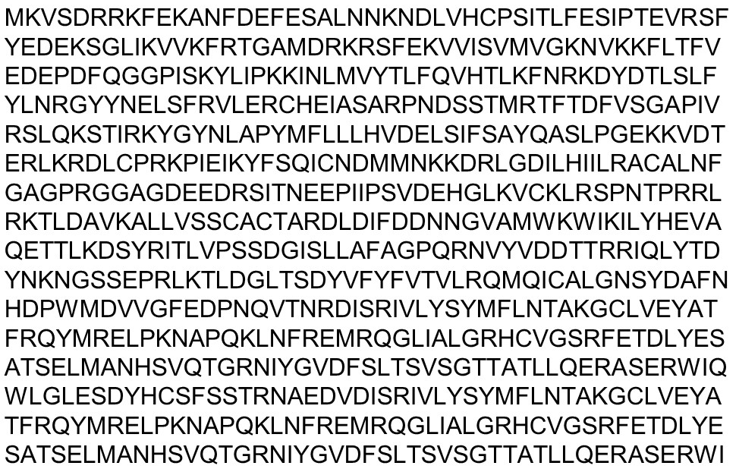
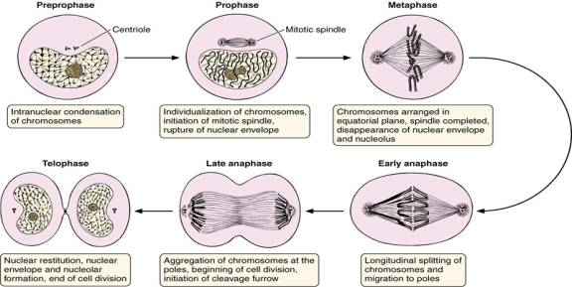
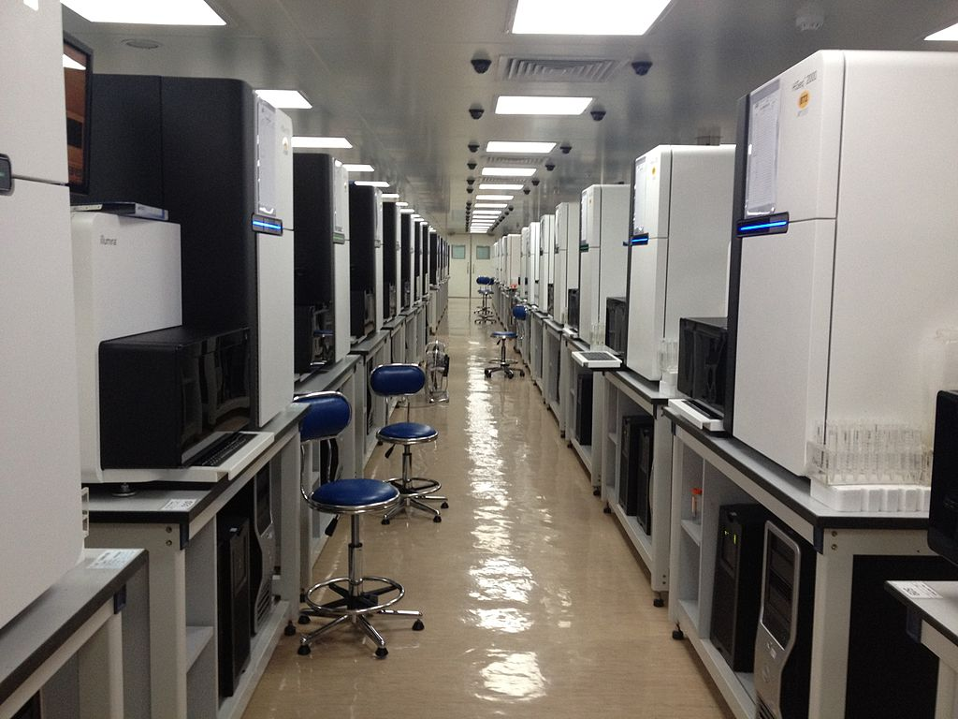
Old biology data New biology (Big, omics) data
The 1000 Human Genomes Project
Cancer Genome Project
1,000 Plant and Animal Reference Genomes Project
Extreme-Environment Animal Genomes Project
International Big Cats Genome Project
Ten Thousand Microbial Genomes Project
The sequencing floor in BGI Hong Kong, showing the Illumina Hiseq 2000 sequencers

Slide 3
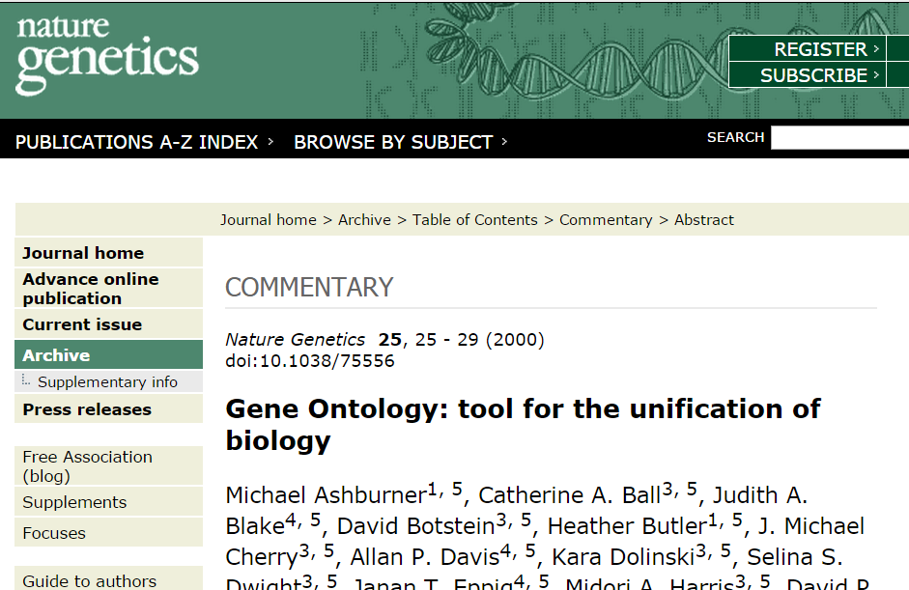
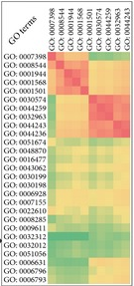
How to link the two kinds of data?
Answer: The Gene Ontology (GO)

Slide 4
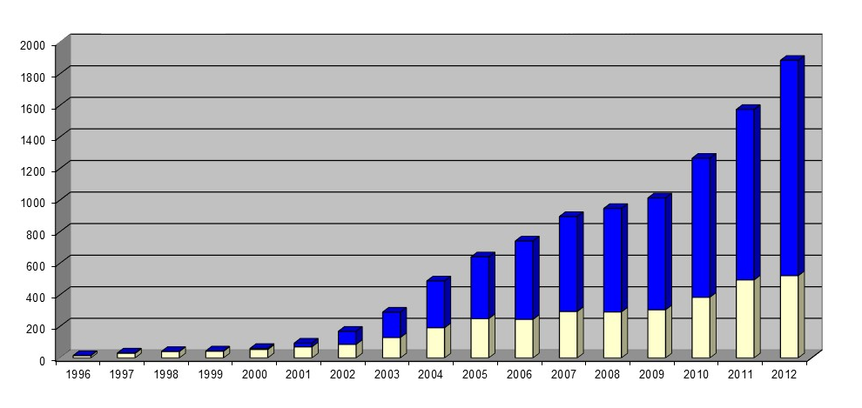
A new kind of information-driven biomedical research
The Gene Ontology (GO) is a controlled, logically structured vocabulary consisting of terms representing types of
cellular components
molecular functions
biological processes
to be used for consistent tagging omics data and literature to make these data discoverable, combinable and analyzable with the aid of computers
Uses of ‘ontology’ in PubMed abstracts
Notes:
http://ehealthadvice.info/what-is-crohns-disease/

Slide 5
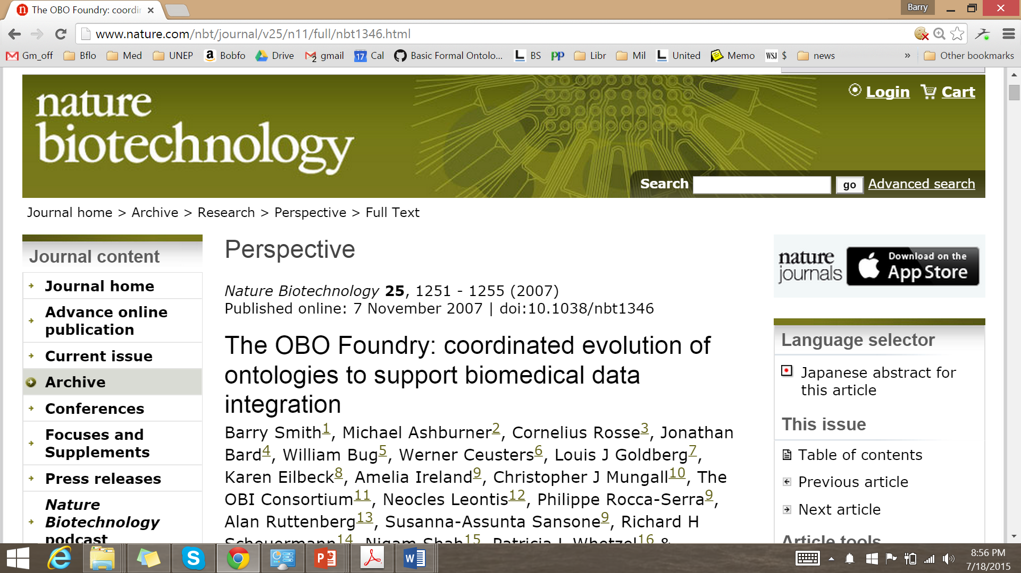
2004: GO extended by new ontologies to provide representations of further sorts of biological entities
  proteins, species, populations, diseases, sequences, metabolism, symptoms, anatomy, experimental processes, behavior …

Slide 6
RELATION TO TIME GRANULARITY | CONTINUANT |  |  |  | OCCURRENT
 | INDEPENDENT |  | DEPENDENT
ORGAN AND ORGANISM | Organism (NCBI Taxonomy) | Anatomical Entity (FMA, CARO) | Organ Function (FMP, CPRO) | Phenotypic Quality (PaTO) | Biological Process (GO)
CELL AND CELLULAR COMPONENT | Cell (CL) | Cellular Component (FMA, GO) | Cellular Function (GO)
MOLECULE | Molecule (ChEBI, SO, RnaO, PrO) |  | Molecular Function (GO) |  | Molecular Process (GO)
Original OBO Foundry ontologies
(Gene Ontology in yellow)

Slide 7
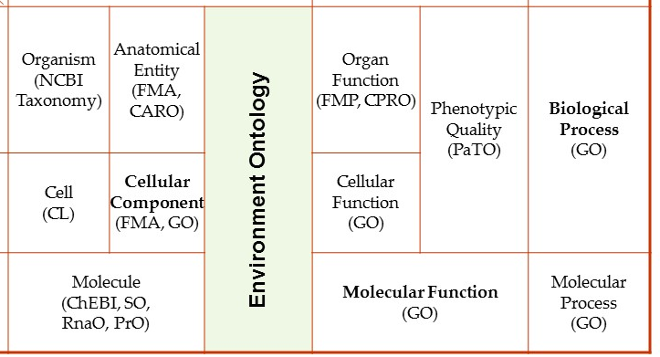
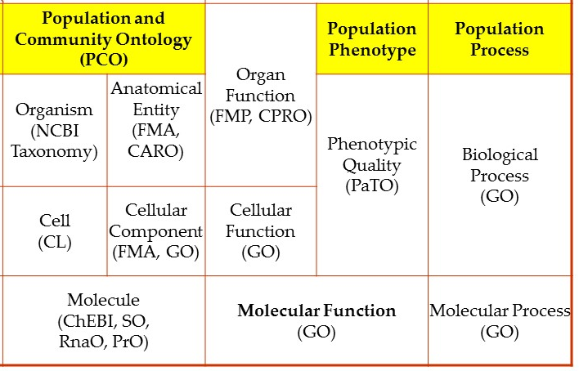
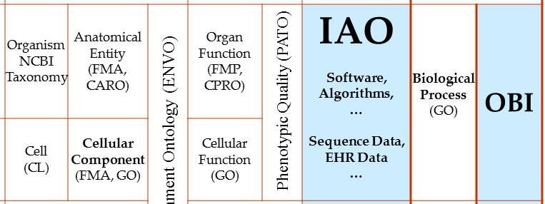
OBO Foundry grows to encompass further domains
Environments (ENVO)
Populations, Communities (PCO)
Information Artifacts (IAO)
Experiments and Investigations (OBI)

Slide 8
Basic Formal Ontology (BFO)
Anatomy Ontology (FMA*, CARO) |  | Environment Ontology (EnvO) | Infectious Disease Ontology (IDO*) | Biological Process Ontology (GO*)
Cell Ontology (CL) | Cellular Component Ontology (FMA*, GO*)
 |  |  | Phenotypic Quality Ontology (PaTO)
Subcellular Anatomy Ontology (SAO)
Sequence Ontology (SO*) |  |  | Molecular Function (GO*)
Protein Ontology (PRO*)
Notes:
* = dedicated NIH funding

Slide 9
all of these ontologies are created by downward population from a common upper level ontology
Basic Formal Ontology (BFO)
domain neutral upper-level
ontology
domain-level
ontologies
Anatomy Ontology (FMA*, CARO) | Disease Ontology (OGMS, IDO, HDO, HPO) | Information Artifact Ontology (IAO) Database, Document, Publication, Citation … | Biological Process Ontology (GO) | Ontology of Biomedical Invesigations (OBI) Experiment, Assay, Measurement Process, …
Cell Ontology (CL)
Subcellular Anatomy Ontology (SAO) | Phenotypic Quality Ontology (PATO)
Sequence Ontology (SO) | Molecular Function Ontology (GO)
Protein Ontology (PRO)
Notes:
* = dedicated NIH funding

Slide 10
BFO now being used in many other areas to ensure interoperability by providing common domain neutral starting point for distributed ontology creation
NIF Standard | Neuroscience Information Framework
eagle-I / VIVO | VIVO consortium
cROP / Planteome | Common Reference Ontologies for Plants
UNEP Ontology Framework | United Nations Environment Programme
USGS National Map | United States Geological Survey
Joint Doctrine Ontologies | US Air Force Research Labs
Common Core Ontologies (CCO) | US Army / I2WD and ARL, IARPA, JIDO, ONR, AFRL
TRIP Ontologies | Federal Highway Administration (FHWA) Transportation Research Informatics Platform (TRIP)

Slide 11
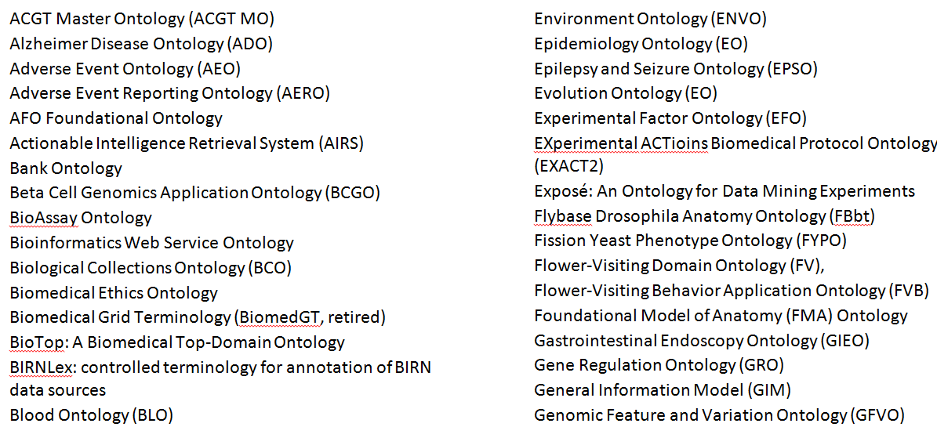
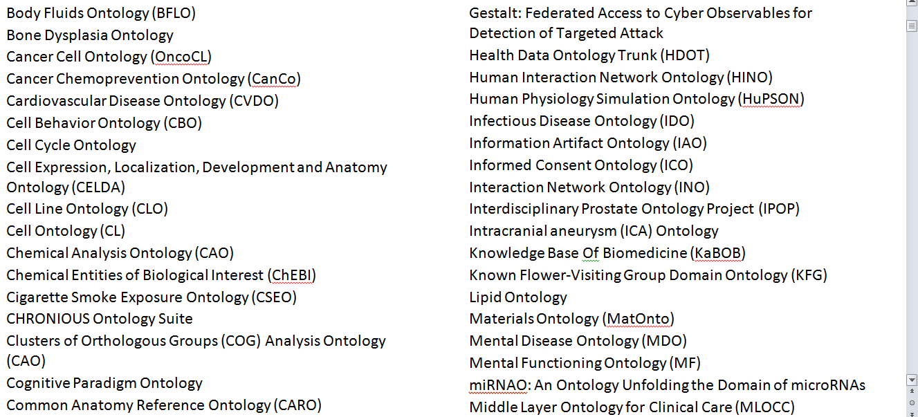
158 ontologies using BFO as starting point listed at: http://ifomis.uni-saarland.de/bfo/users

Slide 12
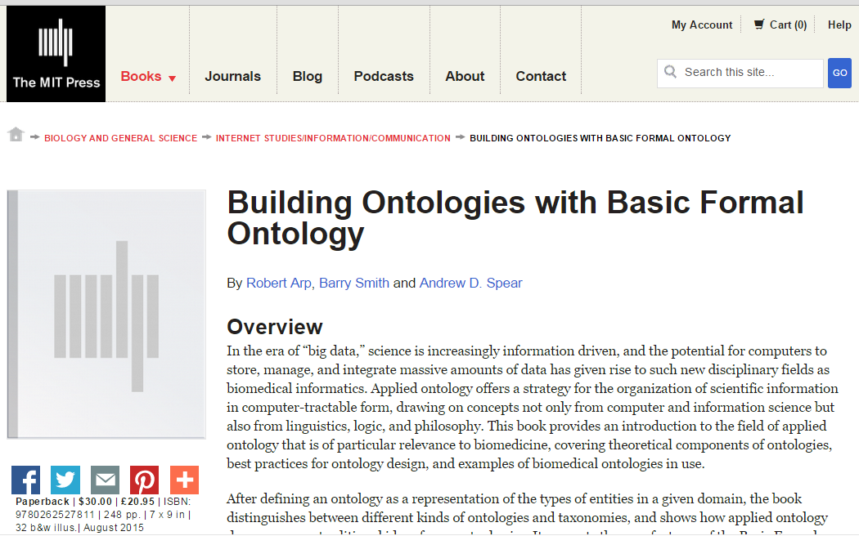
Guide to use of BFO published August 2015
http://ontology.buffalo.edu/BOBFO

Slide 13
BFO, DOLCE, SUMO
BFO: A small ontology that is strictly domain neutral (contains only terms of application to all domains without restriction, such as ‘object’, ‘role’, ‘function’)
DOLCE: Closely related to BFO in size, goals, and structure, but with some domain-specific terms such as ‘society’, ‘achievement’, ‘accomplishment’
SUMO: Much larger than BFO and with many domain specific terms (for instance ‘body-covering’, ‘fruit-Or-vegetable’ from biology)

Slide 14
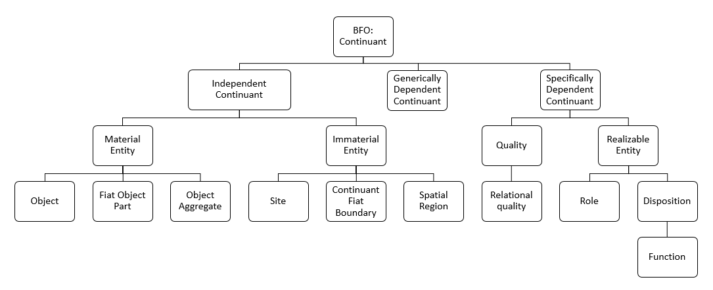
BFO two ontologies

Slide 15
BFO maintenance
https://groups.google.com/forum/#!forum/bfo-discuss
  169 members
  including prominent subject-matter experts in a variety of domains, including biomedicine, military, intelligence
  representatives of standards initiatives in logic and computing
  prominent ontologists from academia, industry and government
Decision-making is through consensus, which is made possible by the fact that BFO is very small (just 34 terms) and changes very slowly (just two revisions in over 10 years)

Slide 16
BFO implementatios
BFO 2.0 OWL (W3C Web Ontology Language 2)
BFO 2.0 OBO (Open Biomedical Ontologies format)
BFO 2.0 CLIF (draft) (Common Logic (CL) standard ISO 24707)
See: https://github.com/BFO-ontology/BFO

Slide 17
What makes BFO unique
Very large user base of ontology experts
BFO most widely reused ontology
BFO used in a wide variety of ontology projects as a starting point for domain ontology development
BFO is very small, and correspondingly easy to learn and easy to use
BFO can be applied in the same way to many different kinds of problem case

Slide 18
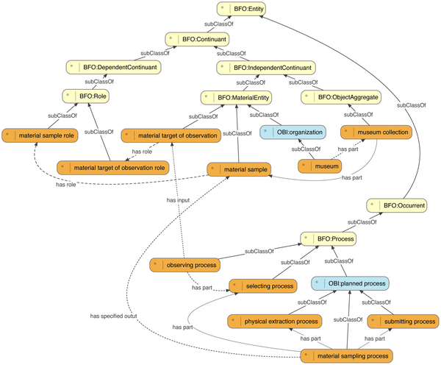

Walls RL, Deck J, Guralnick R, Baskauf S, Beaman R, et al. (2014) Semantics in Support of Biodiversity Knowledge Discovery: An Introduction to the Biological Collections Ontology and Related Ontologies. PLoS ONE 9(3): e89606. doi:10.1371/journal.pone.0089606
http://127.0.0.1:8081/plosone/article?id=info:doi/10.1371/journal.pone.0089606

Slide 19
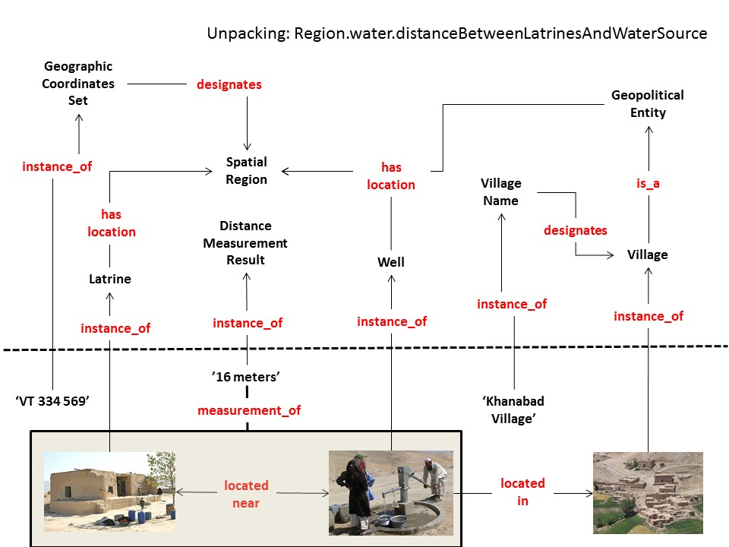
Civil Military Operations Village Target Database

Slide 20
IAO: Information Artifact
BFO: Spatial Region
IAO: Information Artifact
BFO: Site
BFO:
Material
Entity

