Slide 1
VT

Slide 2
How the NIH Plans to Solve the Replication Crisis
Barry Smith
Dec 20, 2016

Slide 3
Charles Sidney Burwell (Dean, Harvard Medical School, 1935-1949)
"Half of what we are going to teach you is wrong, and half of it is right. …

Slide 4
Charles Sidney Burwell (Dean, Harvard Medical School, 1935-1949)
"Half of what we are going to teach you is wrong, and half of it is right. Our problem is that we don't know which half is which."

Slide 5
99.93% of what we think is true is true

Slide 6
99.93% of what we think is true is true
People have one nose in the middle of their face
People have two ears and one mouth
The human body uses and loses water every day
Human beings are sometimes asleep and sometimes awake
There is a distinction between disease and diagnosis
There is a distinction between truth and falsehood

Slide 7
Most truths are boring
The interesting truths often pertain to what is changing (either in reality or in our knowledge of reality)
There is little reward for discovering boring (trivial) truths
(Pascal: “Trop de vérité nous étonne”)
Discovery of interesting truths will presuppose inimate knowledge of complex frameworks of boring truths

Slide 8
There is a distinction between interesting truths and boring truths
Is there an objective distinction between interesting truths and boring truths?

Slide 9
Notes:
http://journals.plos.org/plosmedicine/article?id=10.1371/journal.pmed.0020124

Slide 10
Notes:
http://journals.plos.org/plosmedicine/article?id=10.1371/journal.pmed.0020124

Slide 11
a published research finding is less likely to be true
when the studies conducted in a field are smaller
when effect sizes are smaller
when there is a greater number and lesser preselection of tested relationships
when there is greater financial and other interest and prejudice
Notes:
http://journals.plos.org/plosmedicine/article?id=10.1371/journal.pmed.0020124

Slide 12
But then also:
a published research finding is less likely to be true
when it is interesting
(≈ when it calls into question what we think we already know)

Slide 13
But then also:
a published research finding is less likely to be true
when it is interesting
(≈ when it calls into question what we think we already know)
(and does this in a way that is not so complex that it move once again into the territory of the boring)

Slide 14
The Replication Crisis
triggered by work of Ioannidis and others
scientists from about 2010 onwards discovered that the results of many scientific experiments are difficult or impossible to replicate
A series of scandals, particularly in social and behavioral psychology

Slide 15
P-hacking …
Collect a lot of data and keep re-sorting until you find a result that has a P-value that makes it statistically significant
Post-hoc storytelling
P-value rounding, manipulation of outliers …
Publication bias: Do lots of experiments until you find an experiment with a statistically significant result, then only publish this one

Slide 16
The Reproducibility Project
sought to replicate 100 different studies, all published in 2008 in
Psychological Science
Journal of Personality and Social Psychology
Journal of Experimental Psychology
with the collaboration of the original investigators.

Slide 17
The Reproducibility Project
Social Psychology 2014; Vol. 45(3):142–152
Notes:
http://psycnet.apa.org/journals/zsp/45/3/142.pdf

Slide 18
Replication vs Reproducibility
replication: This is the act of repeating an entire study, independently of the original investigator without the use of original data (but generally using the same methods).
reproducibility: A study is reproducible if you can take the original data and the computer code used to analyze the data and reproduce all of the numerical findings from the study. This may initially sound like a trivial task but experience has shown that it’s not always easy to achieve this seemly minimal standard.
Notes:
http://simplystatistics.org/2016/08/24/replication-crisis/

Slide 20
Results of the Reproducibility Project
Of 100 studies
only 36% replicated
even among these replications, effects were smaller than in the initial studies

Slide 21
Examples of experiments that did not replicate
Currency priming: merely exposing participants to money increases their endorsement of the current social system
Imagined contact: merely imagining contact with members of ethnic outgroups is sufficient to reduce prejudice toward those groups

Slide 22
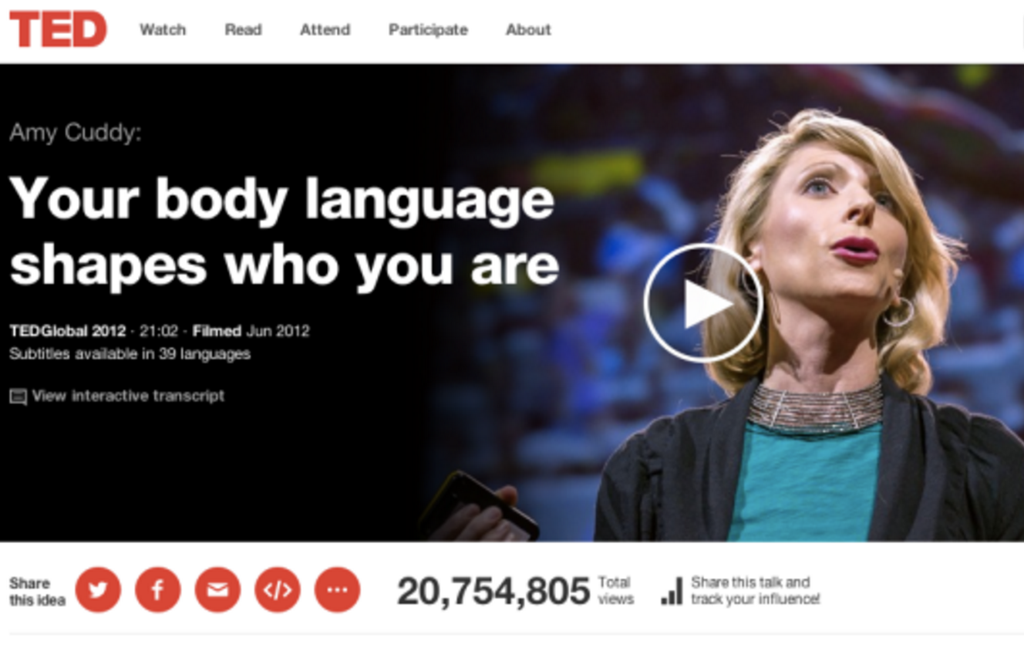

Slide 23
Amy Cuddy Harvard Business School Social Psychologist
a free no-tech life hack for anyone heading into a job interview, a first date or a public speaking event
Notes:
http://blog.ted.com/ted-weekends-teaches-you-easy-life-hacks-in-body-language/

Slide 24
power posing: a free no-tech life hack

Slide 25
Stephen Colbert practices power posing

Slide 26
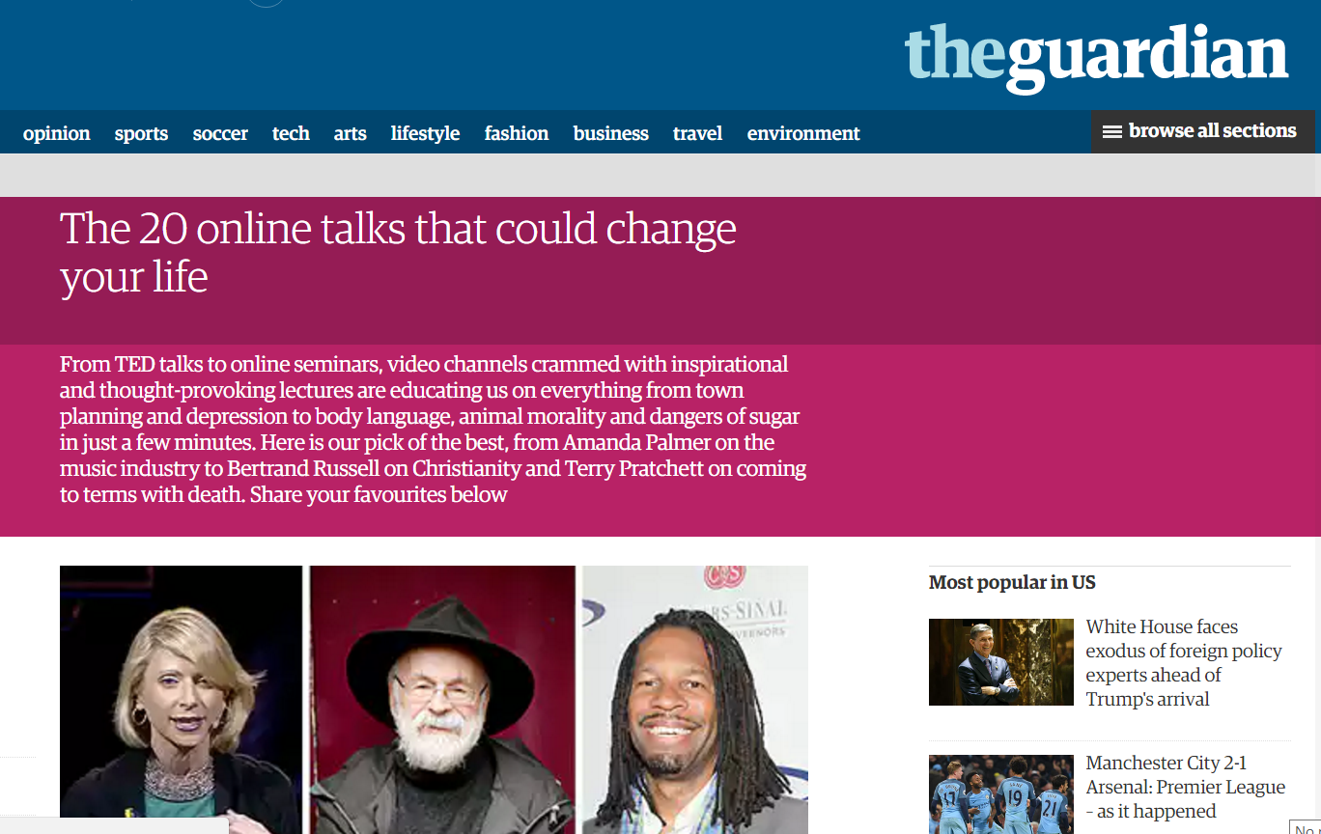
Notes:
https://www.theguardian.com/technology/2013/aug/27/20-online-talks-change-your-life

Slide 30
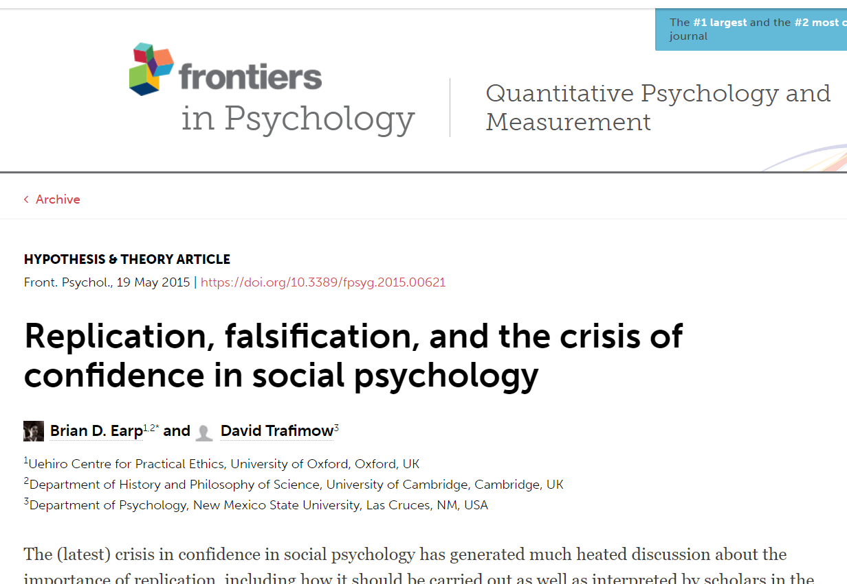
FZ

Slide 32
From social psychology to medicie
earlier study found that around $28 billion worth of research per year in medical fields is non-reproducible.^{[7]}
around $28 billion worth of research per year in medical fields is non-reproducible
Notes:
http://journals.plos.org/plosbiology/article?id=10.1371/journal.pbio.1002165

Slide 33
Goal: to replicate a subset of experimental results from a number of high-profile papers in the field of cancer biology published between 2010-2012
https://osf.io/e81xl/

Slide 34
https://obssr.od.nih.gov/about-us/strategic-plan/
Notes:
https://obssr.od.nih.gov/about-us/strategic-plan/

Slide 35
BSSR Scientific Priorities
1. Basic & Applied Research Synergy
2. Methods, Measures & Data Infrastructures
Research infrastructure needed to support a more cumulative and integrated approach to behavioral and social sciences research
3. Application & Adoption of BSSR Research
Notes:
https://obssr.od.nih.gov/about-us/strategic-plan/

Slide 36
Why a cumulative and integrated approach?
evaluation of behavioral and social interventions is greatly influenced by the characteristics that the individual or system brings to the intervention and the context in which the intervention is delivered
such differences cause problems in the replication of psychological studies
Notes:
https://obssr.od.nih.gov/about-us/strategic-plan/

Slide 37
Objective 2.1: Encourage data integration and replication in the behavioral and social sciences
Coordinate the development of behavioral and social sciences research taxonomies and phenotypes including construct mapping, common data elements, and ontology development
Assist in the development and coordination of research collaborations that facilitate data sharing, linking, and integration across existing datasets
Notes:
https://obssr.od.nih.gov/about-us/strategic-plan/

Slide 39
What is Scientific Misconduct?
Fabrication
Falsification
Plagiarism
Idiosyncracy of reporting
Data-dredging / P-hacking
Holding back data (selective reporting inflates the published discovered effects)
Secrecy of methods

Slide 40
Statistics packages don’t always work in the same way
Notes:
http://blog.revolutionanalytics.com/2014/10/introducing-rrt.html

Slide 41
P-hacking and publication bias thrive:
where there is flexibility in designs, terminologies, definitions, outcomes, and analytical modes
where methods are kept secret (black arts), where data is published but using codes no third party can understand
Notes:
http://journals.plos.org/plosmedicine/article?id=10.1371/journal.pmed.0020124

Slide 42
Notes:
http://www.slideshare.net/RightToResearch/open-data-and-the-social-sciences-opencon-community-webcast

Slide 43
What does the registry specify
1. all hypotheses
2. all outcomes to be measured
3. all statistical models, techniques, tests, control variables, inclusion/exclusion rules, software …
Goals:
Create an audit trail to solve the File Drawer problem
Cut down redundancy in science
Guarantee reproducibility

Slide 44
Problem
How do you describe a hypothesis in a way that allows replication?

Slide 45
One idea
Can Electronic Lab Notebooks help?

Slide 46
Different labels for one protein used in different research communities

Slide 47
Different labels for monoclonal antibodies used in different labs
CD3 vs. CD3e (protein names)
HIT3e vs. UCHT1 (antibody clones for CD3e)
550367 vs. 300401 (catalog numbers for anti-CD3e antibody reagents)
5A6 vs. 5A6 (clone names for anti-CD81 and anti- CD91/LRP, respectively)
With thanks to Alex Diehl

Slide 48
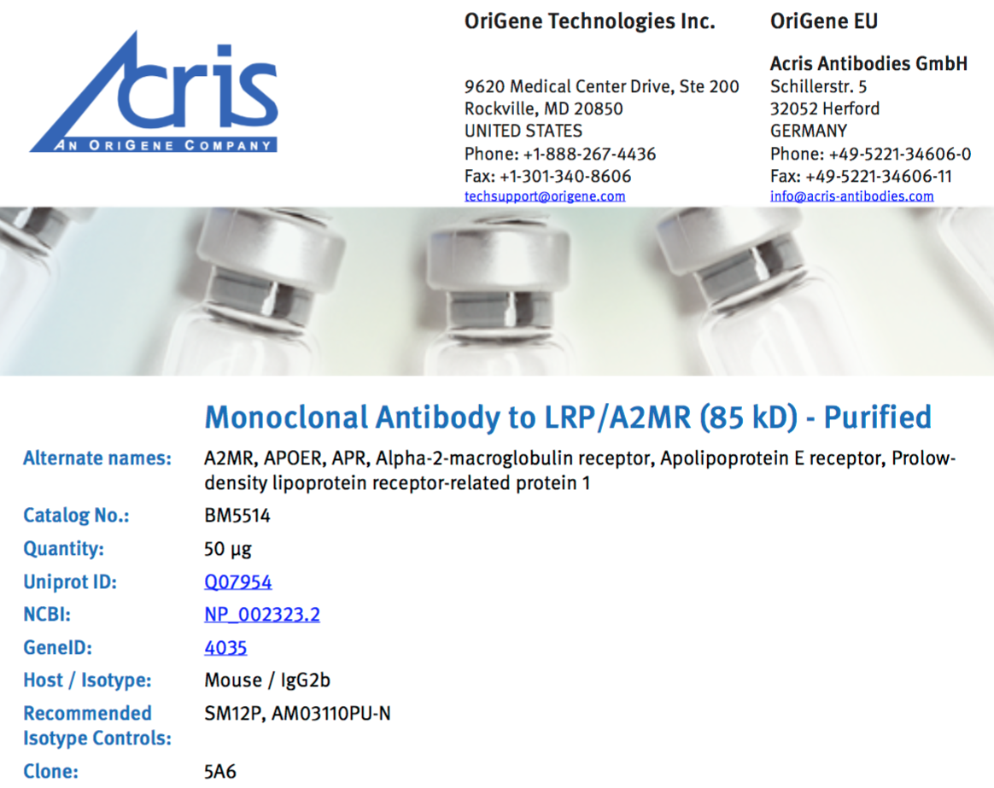
Notes:
These manufacturers data sheets show how the same name, 5A6, is used to refer to two different monoclonal antibodies.

Slide 49
Two Steps to aid Antibody identification and reproducibility
Step 1: The NIF Antibody Registry provides stable identifiers for antibody products, which can be used in papers, as metadata, etc.
Notes:
The NIF Antibody Registry maintains IDs associated with product information for 2.4 million antibodies.

Slide 50
Notes:
The vendor BioLegend is now including NIF IDs in their product information. Good step. But the information in the NIF antibody registry is not fully standardized, which decreases its searchability.

Slide 51
Two Steps to Aid Antibody Identificaton and Reproducibility
Step 2: The Antibody Ontology provides standardized representation of
monoclonal antibody names
antibody targets
species specificity
conjugations
vendors and catalog numbers
experimental usage

Slide 52
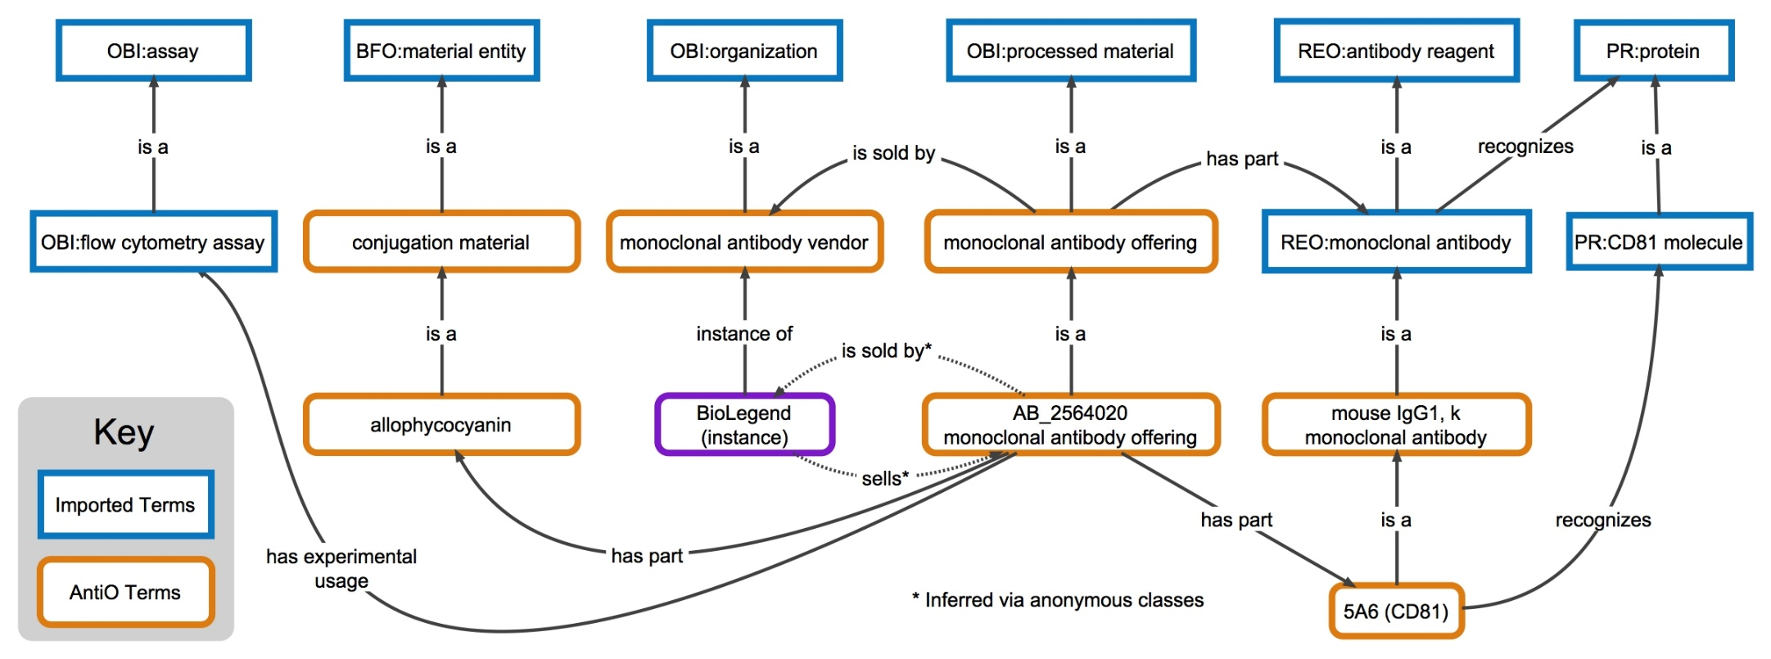
Antibody Ontology Representation of 5A6 (CD81)
Notes:
‘5A6 (CD81)’ is the official name in AntiO to distinguish it from ‘5A6 (CD91)’. Every class in orange is a standardized AntiO term. The next set of slides discuss as an example, the standardization of conjugation information taken from the NIF Antibody Registry.

Slide 53
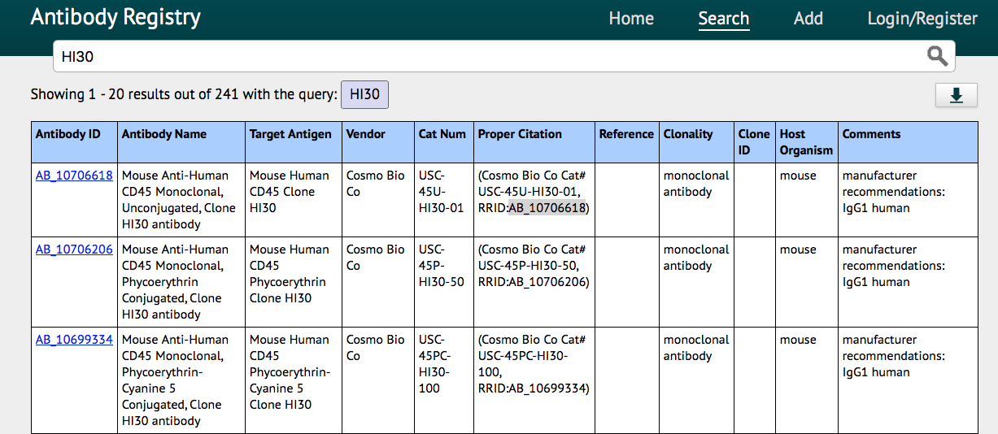
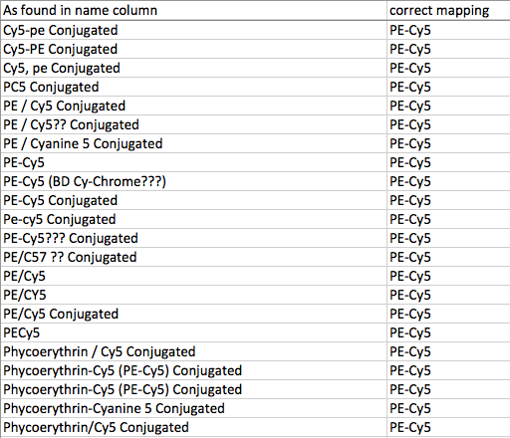
Value Added to NIF AR: Conjugations
Notes:
For many antibody products, NIF provides conjugation info, but it is presented with a variety of abbreviations.

Slide 54
Value Added to NIF AR: Conjugations
In the 63,000 NIF entries downloaded
69 different types of conjugations
Fluorochromes, biotin, horse radish peroxidase, etc.
unconjugated
unknown
written in over 400 different ways
Too complex for regular expression rules
Required hours of manual curation

Slide 55
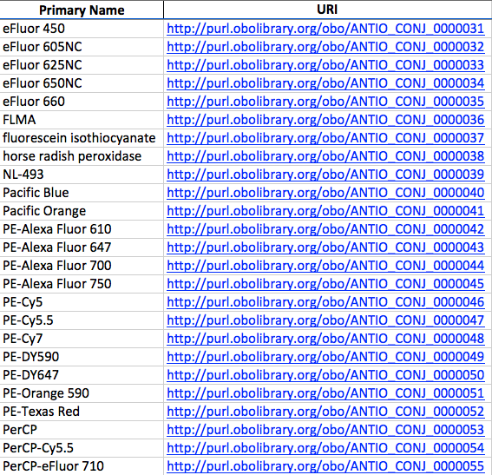
Value Added to NIF AR: Conjugations
Notes:
We now have standardized names and IDs for each conjugation type.

Slide 56
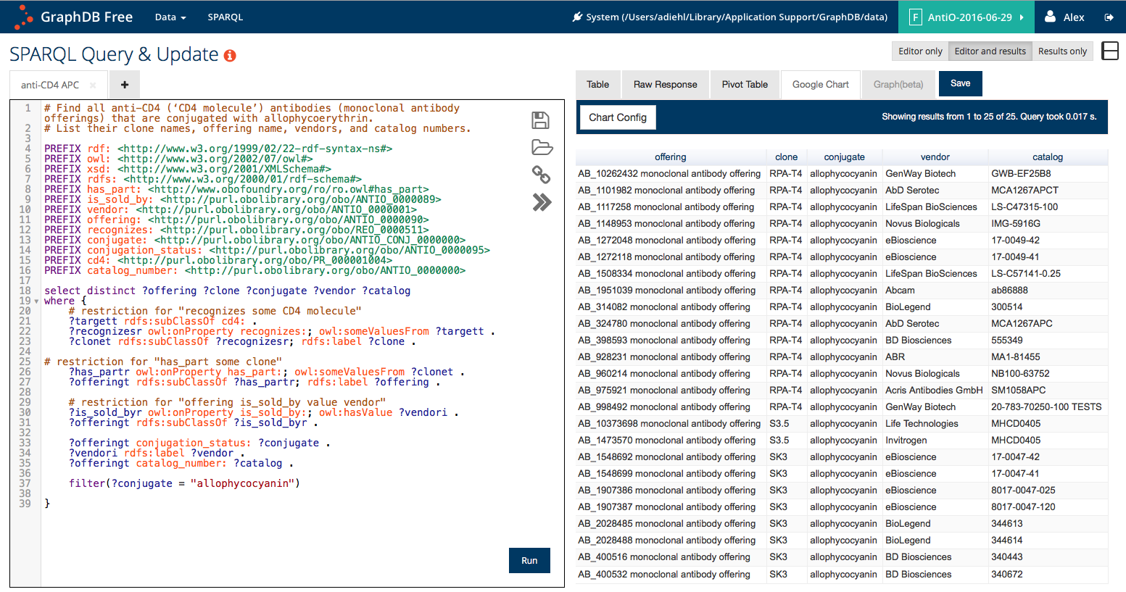
Complex Logical Queries
Find all anti-CD4 antibodies that are conjugated with allophycoerythrin
Notes:
The results include clone names, NIF IDs (offering name), vendors, and catalog numbers.

Slide 57
Antibody Ontology Summary
Working Name: AntiO
941 antibodies
80 vendors
~30,000 monoclonal antibody offerings based on NIF Antibody Registry entries linked to clones in ontology

Slide 58
Useful for flow cytometry and CyTOF standardization.
Standardized panels can be generated and queried in a variety of ways.

Slide 59
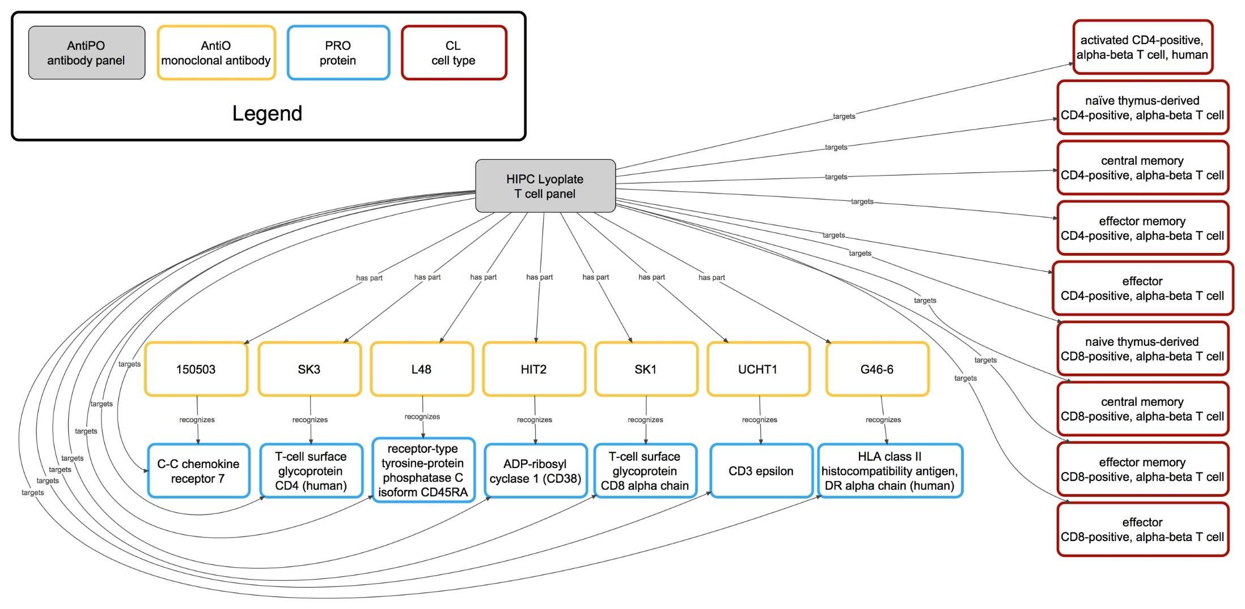
Step 3: Extend to Antibody Panels used in labs
Notes:
Having the Antibody Ontology enables us to develop and Antibody Panel Ontology

Slide 60
Notes:
http://journals.plos.org/plosone/article?id=10.1371/journal.pone.0154556

Slide 61
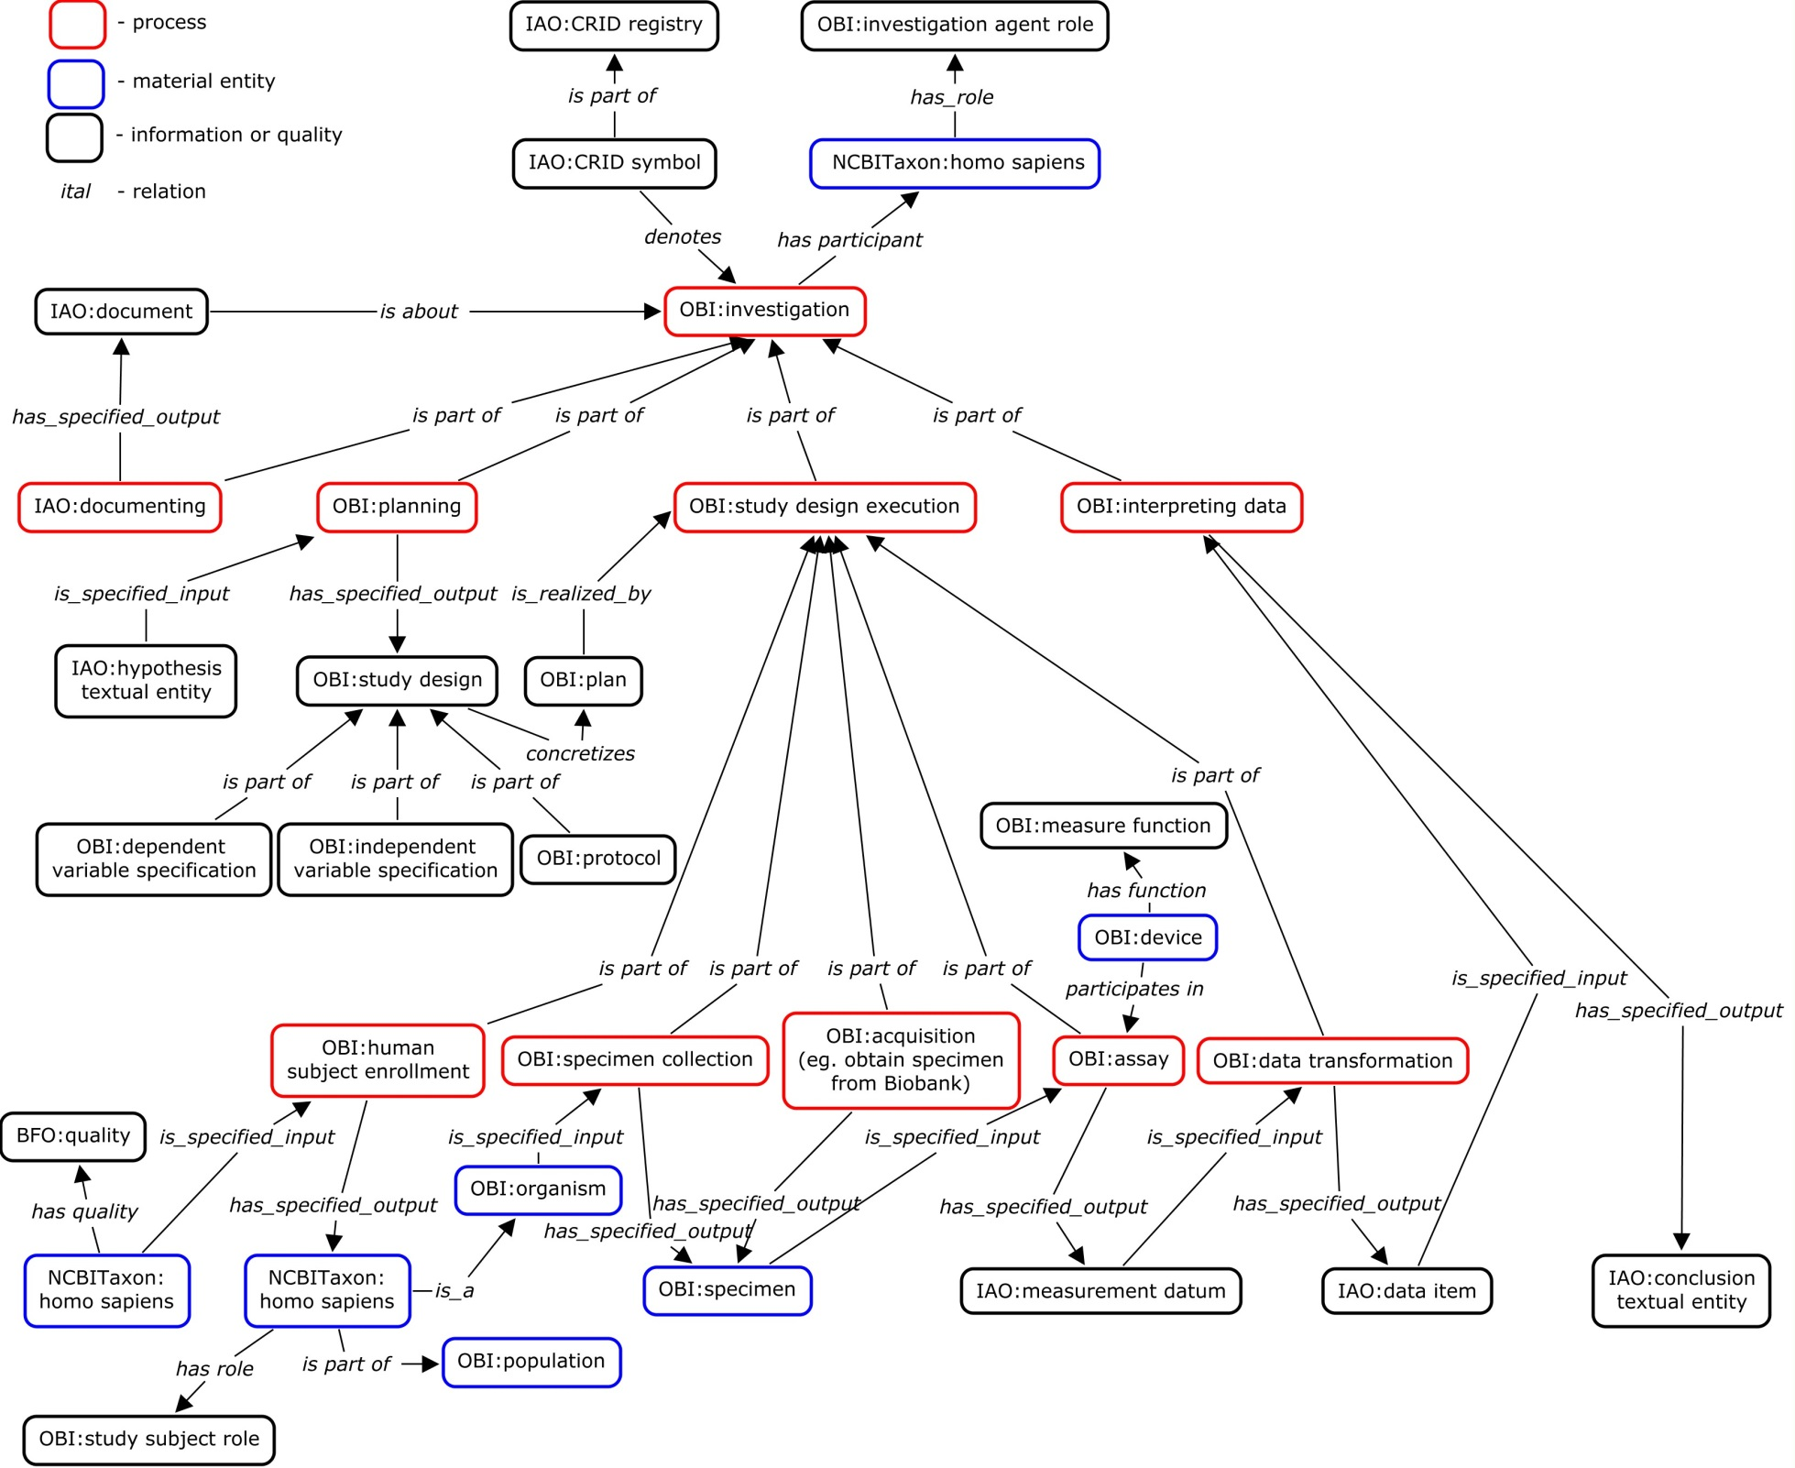
OBI: Overview
Core terms

Slide 62
\]
OBI: Overview
Core terms

Slide 64
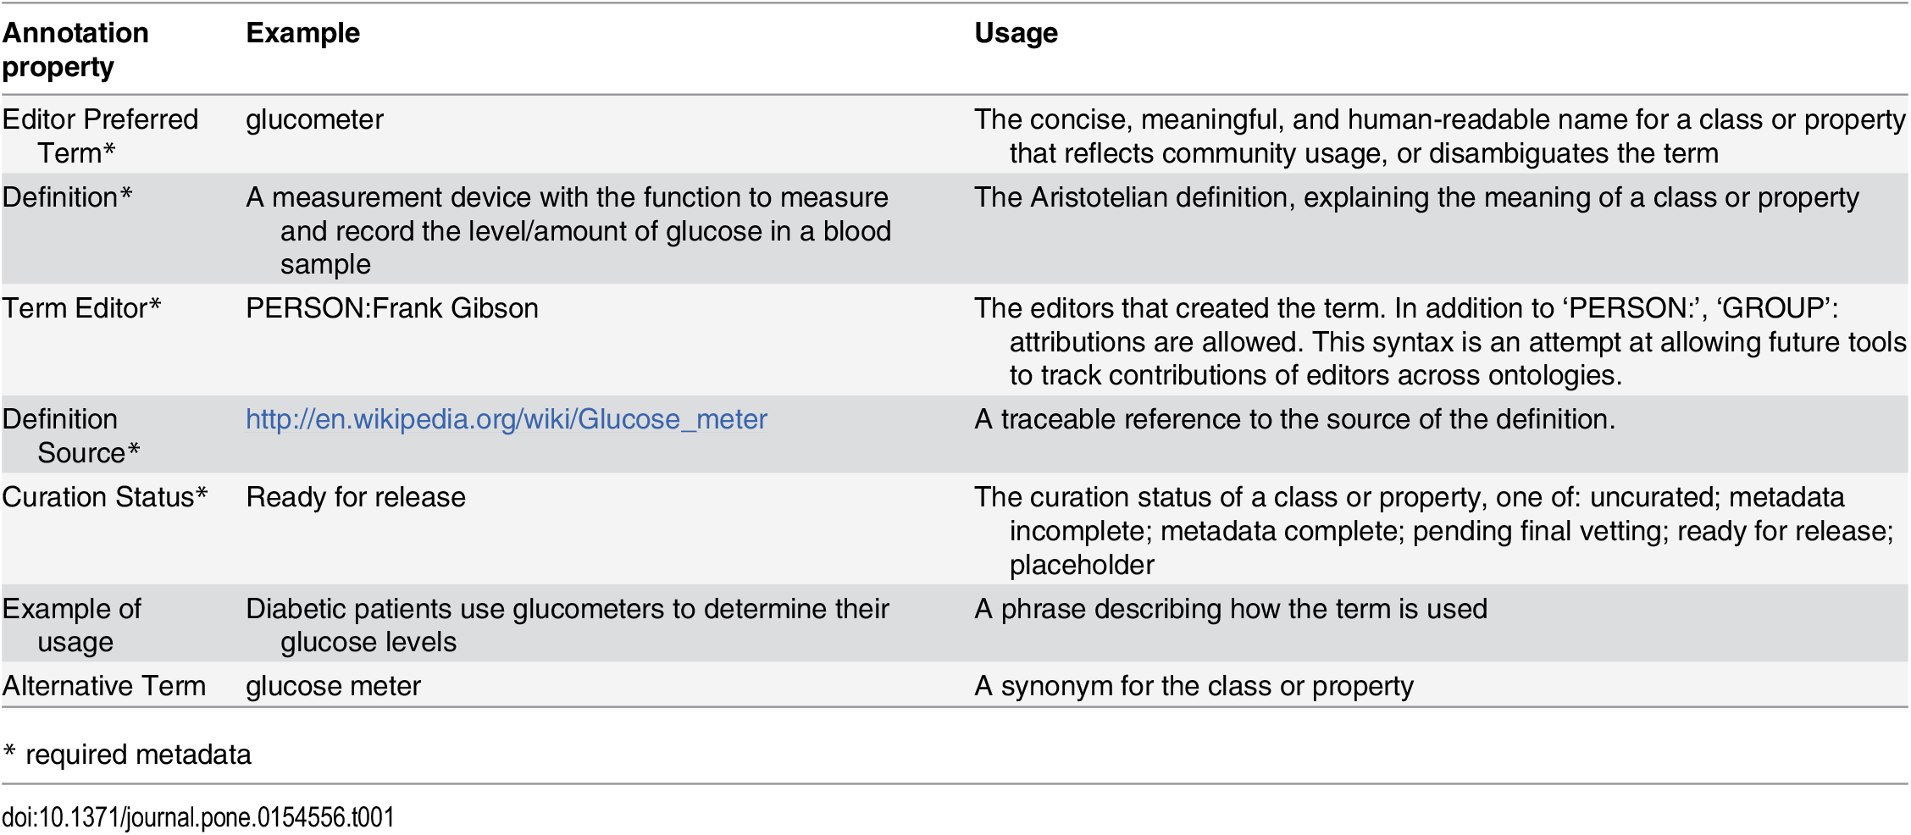

Slide 65
ONTOLOGY FOR BIOLOGICAL AND CLINICAL STATISTICS (OBCS)
BMI 508 Final Presentation Sarah Mullin
1

Slide 66
Why an Ontology for Biological and Clinical Statistics?
published results in literature make it difficult to reproduce the statistical analyses performed in achieving those results because of inadequate documentation

Slide 67
Objective: To determine the conditions under which the impact of hospital nurse staffing, nurse education, and work environment are associated with patient outcomes.
Statistical Analysis Methods: . Logistic regression models were used to estimate the effects of nurse staffing, nurse work environment, and nurse education on patient mortality
_{a}N_{nd}o_{i}t_{n}e_{a}:_{liq}S_{u}t_{e}a_{t} t_{n}is_{is}t_{l} ical Analysis was simplified for this presentation
et a umis varius.
Note: neque digni
8

Slide 69
Ontologies re-used by OBCS
Top Level
Basic Formal Ontology (BFO)
Information Artifact Ontology (IAO) and Ontology of Biological Investigations (OBI)
Mid-Level
Statistics Ontology (STATO)
Chemical Entities of Biological Interest (CHEBI) Phenotype Quality Ontology (PATO) Sequence Ontology (SO)
Domain Level

Slide 70
Developing the Quantitative Histopathology Image Ontology (QHIO): A case study using the hot spot detection problem
Metin N. Gurcan, John Tomaszewski, James A. Overton, Scott Doyle, Alan Ruttenberg, Barry Smith
DOI 10.1016/j.jbi.2016.12.006

Slide 71
Developing the Quantitative Histopathology Image Ontology (QHIO): A case study using the hot spot detection problem
https://goo.gl/ijf3I1
an ontology to represent the data and methods used in pathological imaging and analysis to foster organized, cross-disciplinary, information-driven collaborations in the pathological imaging field,

Slide 72
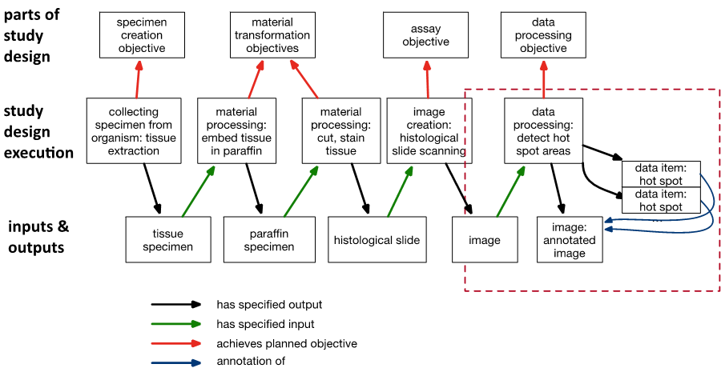
From specimen to hot spot detection. Overview of types and relationships in QHIO. Types are taken from OBI. More specific types from QHIO noted after colon.

Slide 73
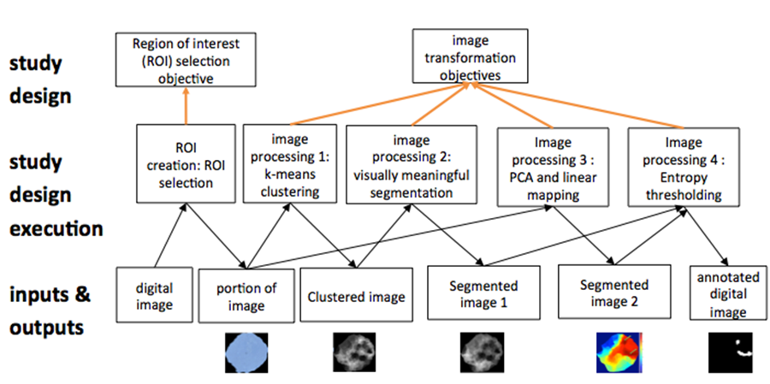
Sample workflow represented through QHIO and OBI terms. (PCA = Principal Component Analysis)

Slide 74
OBCS: inferential statistical data analysis
Class/Universal
OBCS: regression analysis method
OBCS: confidence interval
Has_specified_input
OBCS: logit regression
Is_specified_output_of
OBI: drawing a conclusion based on data
OBCS: odds ratio
Is_specified
Has_specified_input
_output_of
OBCS: dependent variable
Has_specified_output
OBI: conclusion based on data
Is_a relation
IAO: data item
Has_member
Is_about
IAO: dataset
IAO: data item
OBCS: independent
variable
Instance_of at t
6
Instance_of at t₁
Instance_of at t₂ Instance_of at t₃
Conclusion: increased workloads increase the odds on patient deaths by a factor of 1.03
Instance_of at t₄
Instance_of at t
5
Nurse Survey and Patient Discharge Dataset
Note: neque digni and in aliquet nisl et a umis varius.
30-Day Inpatient Mortality
Data item _{Nurse}
Staffing Data Item
Odds Ratio for Nurse Staffing:
Instance
1.033
Odds Ratio CI for Nurse Staffing: (1.011, 1.056)
9

Slide 76
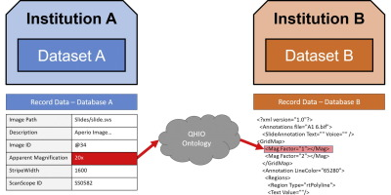
Hypothesis: Enforcing use of common terms from the very start can help to reduce the black arts factor in imaging analysis

Slide 77
http://retractionwatch.com/

Slide 78
Problems with the strategy 1. Journals
Journals don’t like to publish replications
Role of Science / Nature as combinations of science, journalism and politicking

Slide 79
2. NIH Data Sharing Policy
NIH expects investigators seeking more than $500K in direct support in any given year to submit a data sharing plan with their application or to indicate why data sharing is not possible.

Slide 80
3. Researcher incentives
Tenure
Promotion
Nobel prize
…

