Slide 1



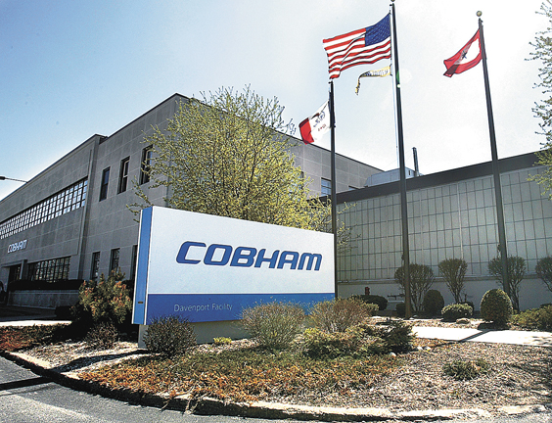

Slide 2
Coordinated Holistic Alignment of Manufacturing Processes (CHAMP)
University at Buffalo
National Center for Ontological Research
Barry Smith (PI)
Department of Mechanical and Aerospace Engineering
Venkat Krovi
Andrew Olewnik
Rahul Rai
CUBRC
Ron Rudnicki, CUBRC Chief Ontologist
Wiliam Tagliaferri, Program Manager, Director, CUBRC Rome NY
Cobham Mission Systems
Jim Talty, Senior Director of Engineering
Lucas Mesmer, Senior Design Engineer

Slide 3
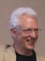

Barry Smith
Director, National Center for Ontological Research, University at Buffalo, NY
William Tagliaferri
Director, CUBRC, Rome, NY
Lucas Mesmer
Senior Design Engineer at Cobham Mission Systems, Orchard Park, NY

Slide 4
How we read the DMDII 15-11 call
From the call:
MBD still focused on shape
Must find a coherent way to address information relating to behavior, manufacturing life cycle context …
The problem:
Each organization collects information in its own way in each phase of the life cycle.
Information siloes block incorporation of enhanced informatics into manufacturing workflows.
MBD fails.

Slide 5
Underlying rationale
If you can’t find information then you can’t quantify what you’re doing and assemble critical reports
Inconsistent naming conventions will foster
inconsistent documentation
variability in how jobs are performed
increased costs and inefficiencies when employees assume new roles.
How do create a CAD-agnostic framework for consistently naming and characterizing similar things, attributes and processes across the manufacturing life cycle?

Slide 6
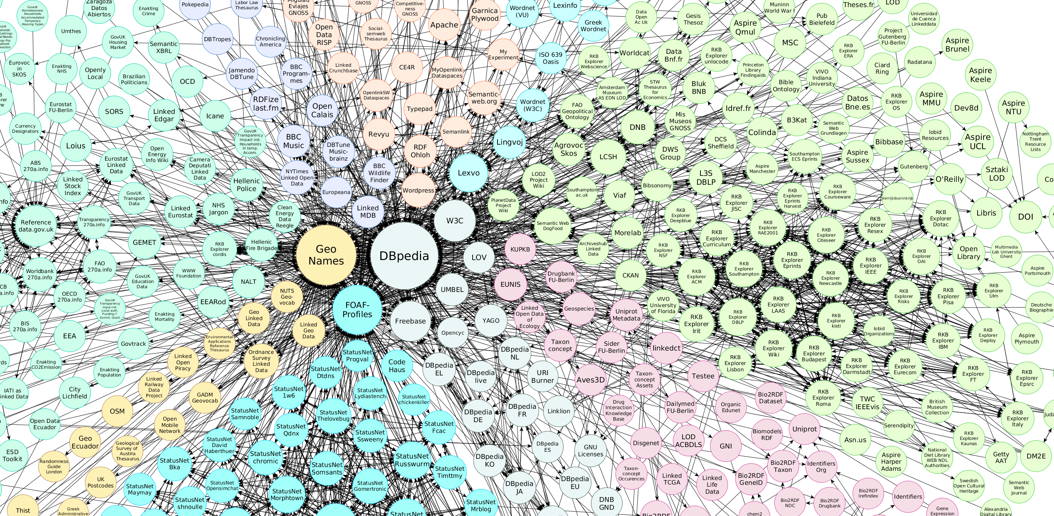
One Solution: Linked Open Data

Slide 7
Buffalo solution: Coordinated Modular Ontology Develoment
Pioneered in some 200 ontology development efforts
Tested through 15 years of R&D with > $300 m. NIH, DoD and industry funding
For DMDII: Create consensus-based ontology modules to provide consistent ways of describing the things, attributes and processes involved in the manufacturing life cycle

Slide 8
AFMC Digital Thread Ontology Levels
Using a bottom-up / top-down approach
Creates stratified layers
Anchored in data to domain
Grounded in formal ontology
Disciplined approach
Proven multi-domain ontologies – ex. Med, DoD Ops
Agile extensibility – Sharing
Multiple digital thread use cases
FORMAL & DOCTRINAL ONTOLOGIES
PM & Logistics
Legacy
Next Gen
Supply
mx
S&T + RDT&E
Strategic
Use Cases
Operational
Use Cases
Tactical
Use Cases
Database 1
Database 2
Database 3
Database 4
Database 5
Database 6
Database 7
Actionable Data Needs Correlation to Weapon System …Otherwise Just Generate Another Stovepipe

Slide 9
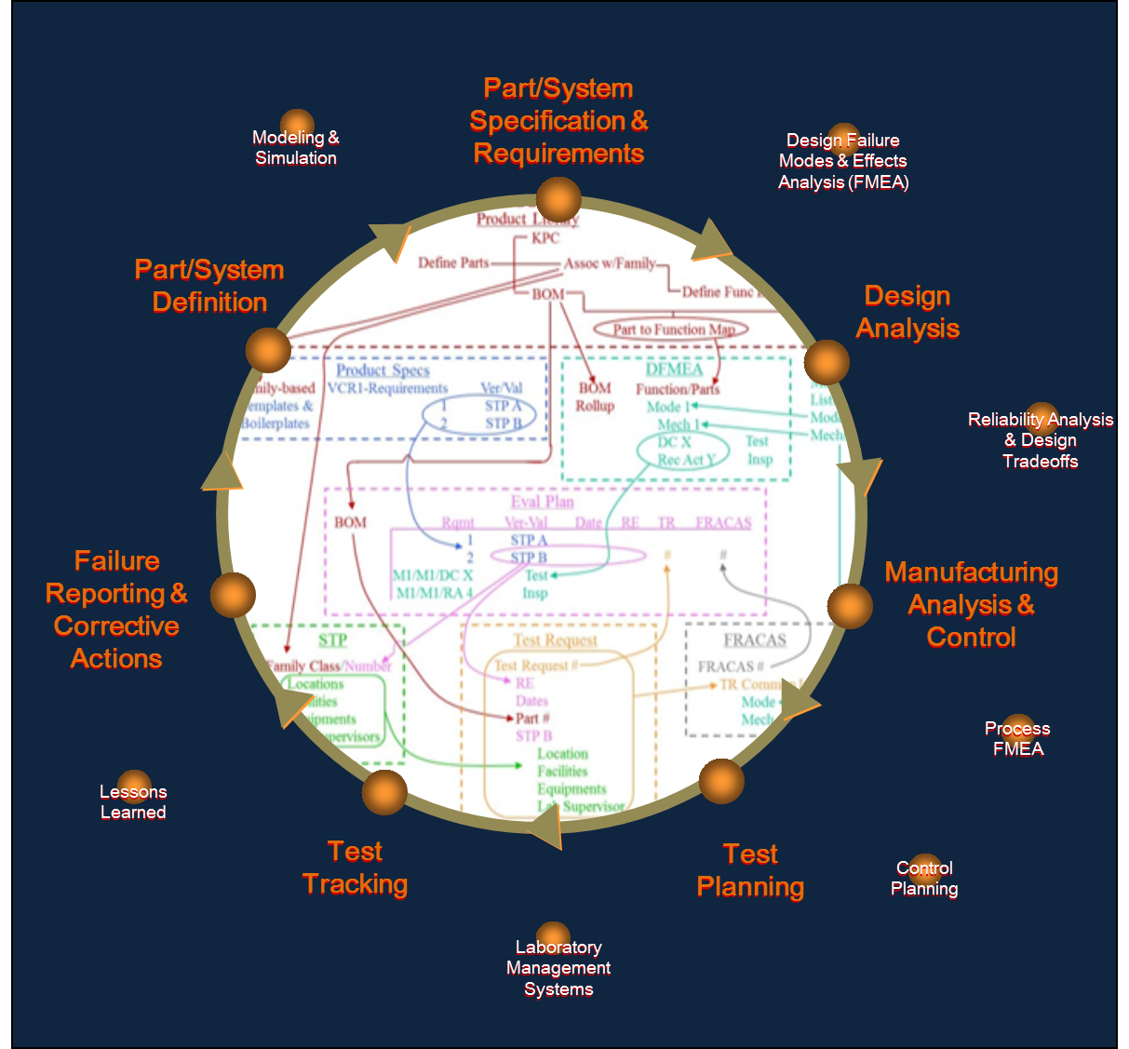
Coordinated Holistic Alignment of Manufacturing Processes (CHAMP)
What Will CHAMP Accomplish?
Understand existing and planned products
Understand production processes, identify problems and generate useful reports for analysis and remediation
Ensure effective communication across the enterprise and across different life cycle phases
How Will CHAMP Accomplish It?
Create a common vocabulary
Use the vocabulary to align and associate disparate data
Facilitate “smart” queries across semantically aligned data sources

Slide 10
The CCO and Example Domain Ontologies
Basic Formal Ontology (BFO)
Upper Ontology:
Common Core Ontology:
Extended Relation Ontology
Domain Ontology:
Event Ontology
Agent Ontology
Quality Ontology
Artifact Ontology
Geospatial Ontology
Time Ontology
Ethnicity Ontology
Hydrographic Feature Ontology
Information Entity Ontology
Curriculum Ontology
Occupation Ontology
Physiographic Feature Ontology
Currency Unit Ontology
Citizenship Ontology
Units of Measure Ontology
Emotion Ontology
Sensor Ontology
Watercraft Ontology
Agent Information Ontology

Slide 11
CHAMP Holistic Overview
Ontological Semantic Concept Alignment and Refinement (OSCAR) facilitates the alignment of siloed data stores to the ontologies enabling analytics and reporting mechanisms to uniformly reference data across the enterprise.
Integrated Data Management System (IDMS) uses the common ontology modules to enhance the data generated by and used throughout the product development process, including information about products, parts, functional capabilities, failure modes, tests, test equipment and locations, failures, root causes, and corrective actions.

Slide 12

CHAMP Holistic Overview
Raw Sensor Data
Post Processed Data
Sensors/Data Providers
Cobham Systems
Data to be aligned
Direct Data Feed
Data Curation
Data Alignment and Ingestion
IDMS
OSCAR
- Generate Data Mappings
Data Injection Services
- Apply Mappings to Generate RDF
Data Homogenization
- Data Association and Scoring
- Event/Entity Resolution
Big Data Store
Data Access/Query
Data Analysis
Data Reporting
Structured RDF
Reduced Data
e.g. Cloud, HIVE, Rya
Multi-Tiered Ontology
- OWL formatted ontology
- Tiered domains for disparate data sources

Slide 13
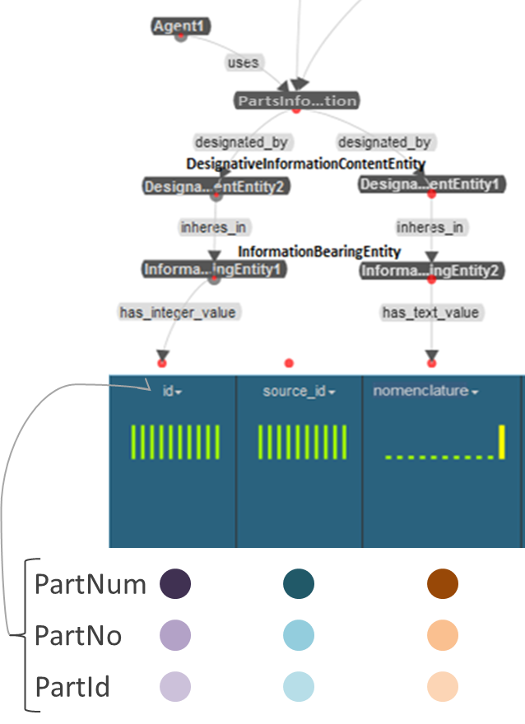
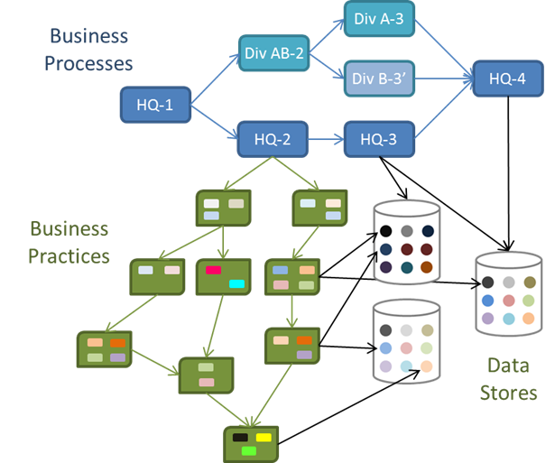
Current State to Semantic Model Alignment

Slide 14
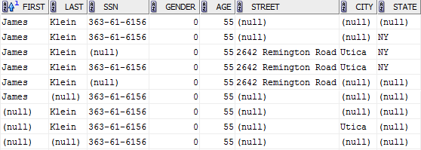
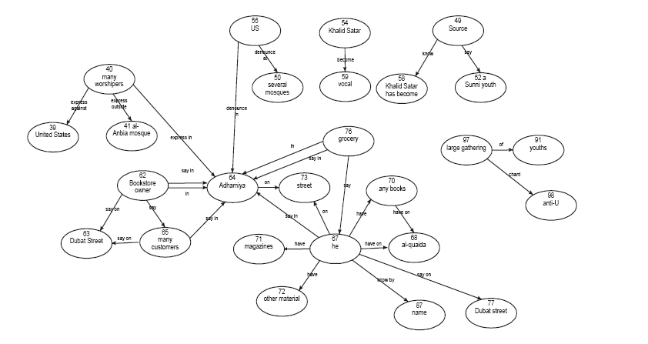



Data Association
Aligned Data Received
Computation of Similarity Scores
Association Problem Formulated
Association Problem solved
Solution used to cluster entities for Evidentiary Graph representation
Smart Graph Merge
Approach
  Select a set of aligned multi-source data
  Calculate similarity between entities
  Formulate graph association problem and heuristically solve for an optimal solution

Slide 15
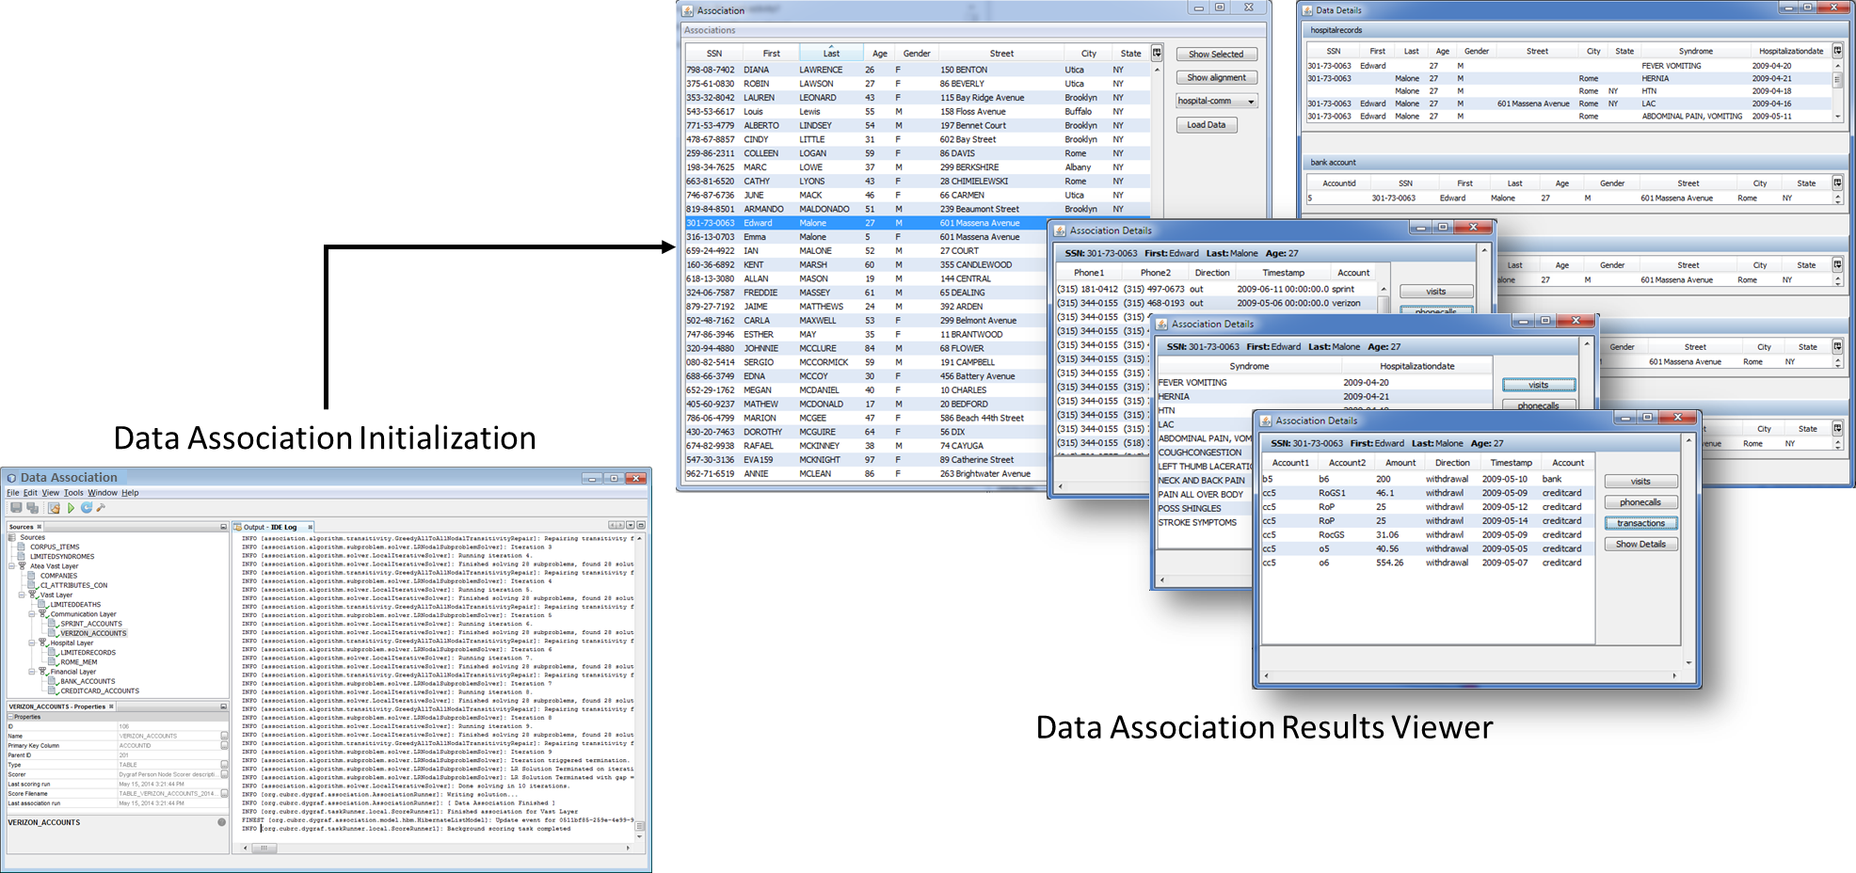
Sample Data Association Interface

Slide 16
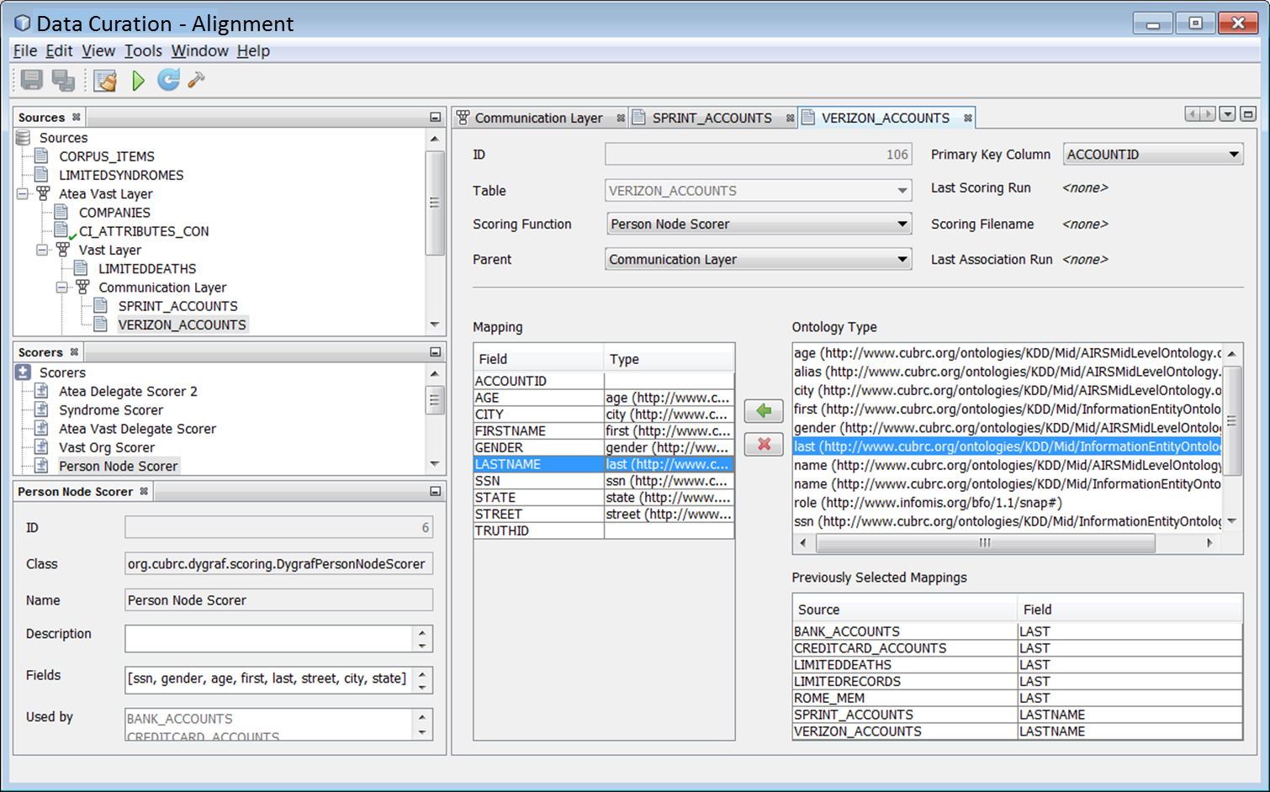
Sample Data Alignment Interface

