Slide 1
The OBO Foundry approach to ontologies and standards with special reference to cytokines
Barry Smith
ImmPort Science Talk / Discussion
June 17, 2014

Slide 2
A common problem: Use of terminology in immunology research is poorly standardized
Two approaches to this problem:
text-mining, creation of synonym lists
ontology-based standardization
Both have the same goal: common IDs for entity types described in immunology literature and data
Thesis: the two approaches can benefit from collaboration within ImmPort

Slide 3
Synonym lists: three examples
NIF Antibody Registry
ImmPort Antibody Registry
Cytokine Names and Synonyms List

Slide 4
ImmPort Science talk, 1/16/2014
Anita Bandrowski
The NIF Antibody Registry, fighting dark data, one antibody at a time

Slide 5
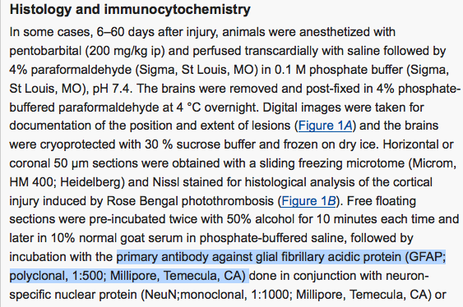
The problem
Paz et al,
J Neurosci, 2010
with thanks to Anita Bendrowski

Slide 6
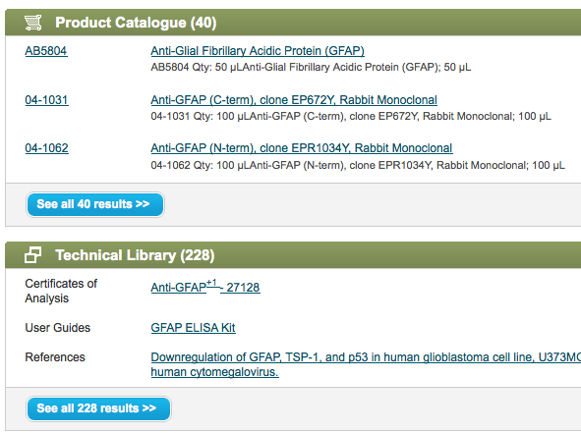
Now, go find the antibody
http://www.millipore.com/searchsummary.do?tabValue=&q=gfap Nov 12, 2010
with thanks to Anita Bendrowski

Slide 7
Classes of problems
Insufficient data
Which of the antibodies in the catalog was used in the research reported in the paper?
Time dependency of data
only some antibodies are listed in the catalog, others that were sold last year no longer listed
Vendor transition
If the vendor goes out of business tomorrow, will anyone be able to reproduce the findings in the paper?
Text mining tools of little use under these conditions
with thanks to Anita Bendrowski

Slide 8
To solve these problems
Hitherto: authors have identified antibodies by means of company name, city and state
Authors need to change their ways and identify the antibodies themselves!
Publishers, journal editors, funders need to change their ways by requiring such identification (bullying)
But what does it mean to identify the antibodies themselves?
with thanks to Anita Bendrowski

Slide 9
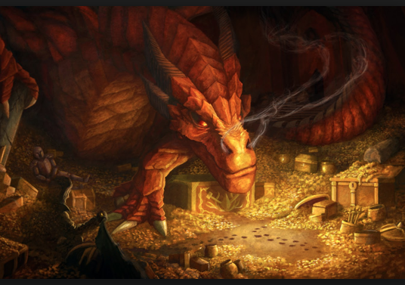
antibodyregistry.org
Gather all available data from vendors
Assign unique identifiers and keep them stable
antibodyregistry.org/AB_12345
Remove redundant identifiers
Propagandize to bring about a situation where authors use AB_ IDs in papers
with thanks to Anita Bendrowski

Slide 10
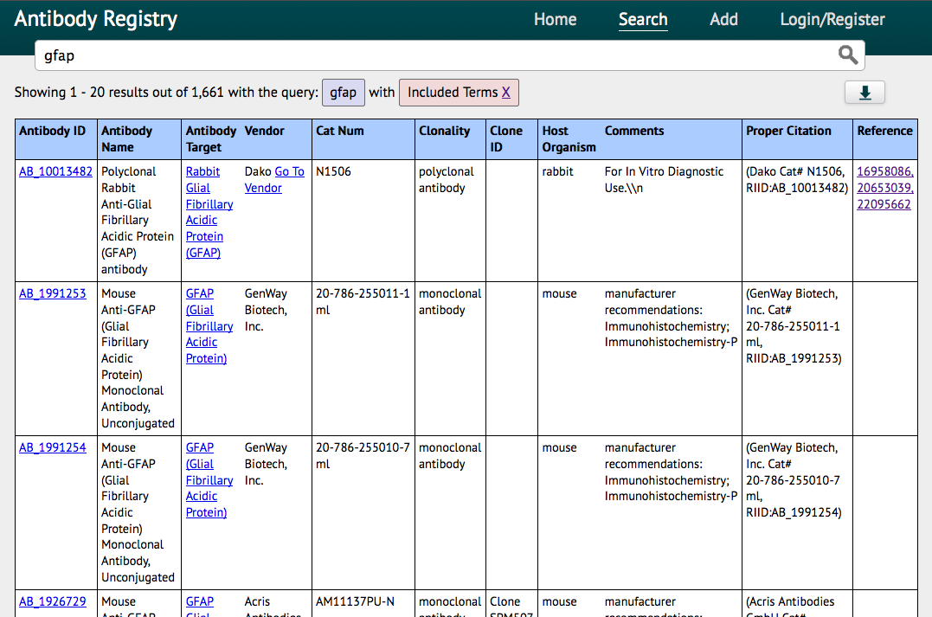
with thanks to Anita Bendrowski

Slide 11
http://scicrunch.com/resources

Slide 12
Organisms Antibodies Software Tools How to extend this idea across all areas of immunology of importance to ImmPort? For example: cytokines

Slide 13
Problems to avoid
redundancy
how many cytokine lists are being created?
roach motel
how do we ensure the work we’ve done so far does not lose its value over time
denetworking
A builds a protein list …; B builds a cytokine list – can’t reason from one to the other; can’t use data from one to help you build / validate the other
forking
A builds a tissue list for cancer research, B builds a tissue list for enzyme research …

Slide 14
Thesis
If the Antibody Registry is build against an ontology background, then these problems will be mitigated
An ontology will tell us what it means ‘to identify the antibodies themselves’
But not just any ontology will do.
Many ontologies are themselves based on term mining – and they just recreate the same problems (of redundancy, forking, …)

Slide 15
This holds for many of the ontologies in the NCBO Bioportal and in the UMLS Metathesaurus
Each justifies its acceptance of high levels of redundancy by arguing that redundant entries will be linked by post-hoc mappings
but maintaining mappings is expensive
where the sources on either side of the mapping develop independently mappings are fragile and over time forking is inevitable

Slide 16
An alternative approach
the OBO (Open Biomedical Ontologies) Foundry
rooted in the Gene Ontology

Slide 19
By far the most successful: GO (Gene Ontology)

Slide 20
GO shares some of the features of the SI System of Units: it provides the base for coordination
Gene Ontology (b. 1998) only covers three kinds of entity
biological processes
molecular functions
cellular components
How build on the success of the GO to other domains?

Slide 21
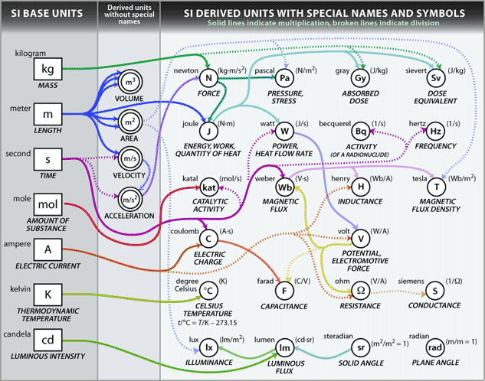

Slide 22
RELATION TO TIME GRANULARITY | CONTINUANT |  |  |  | OCCURRENT
 | INDEPENDENT |  | DEPENDENT
ORGAN AND ORGANISM | Organism (NCBI Taxonomy) | Anatomical Entity (FMA, CARO) | Organ Function (FMP, CPRO) | Phenotypic Quality (PaTO) | Biological Process (GO)
CELL AND CELLULAR COMPONENT | Cell (CL) | Cellular Component (FMA, GO) | Cellular Function (GO)
MOLECULE | Molecule (ChEBI, SO, RnaO, PrO) |  | Molecular Function (GO) |  | Molecular Process (GO)
Building out from the GO (2005)

Slide 23
 | CONTINUANT |  |  |  | OCCURRENT
 | INDEPENDENT |  | DEPENDENT
ORGAN AND ORGANISM | Organism (NCBI Taxonomy) | Anatomical Entity (FMA, CARO) | Organ Function (FMP, CPRO) | Phenotypic Quality (PaTO) | Organism-Level Process (GO)
CELL AND CELLULAR COMPONENT | Cell (CL) | Cellular Component (FMA, GO) | Cellular Function (GO) |  | Cellular Process (GO)
MOLECULE | Molecule (ChEBI, SO, RnaO, PrO) |  | Molecular Function (GO) |  | Molecular Process (GO)
RELATION TO TIME
GRANULARITY
Hierarchical organization along two dimensions

Slide 24
The strategy for creating the OBO Foundry
First:
Establish a small number of starter ontologies built in tandem with each other around the GO = the initial OBO Library (GO, CL, …)
Second: advertize the existence of this library as an attractor for re-use
Third: invite others to join, but only if they accept certain principles

Slide 25
OBO Foundry Principles
1. Must be open
2. Formulated in a recognized formal syntax (OWL …)
3. Have a unique ID space.
4. Terms are logically defined.
5. Must be orthogonal to other Foundry ontologies to ensuring community convergence on a single controlled vocabulary for each domain

Slide 26
Principles (contd.)
6. Collaborative development (treaty negotations to resolve border disputes)
7. Consistent versioning principles based on permanent URLs
8. Common top-level architecture (BFO)
9. Locus of authority for editorial decisions, help desk, submission of term requests and error and bug reports

Slide 27
top level
mid-level
domain level
Basic Formal Ontology (BFO)
Information Artifact Ontology (IAO) | Ontology for Biomedical Investigations (OBI)
Anatomy Ontology (FMA*, CARO) |  | Environment Ontology (EnvO) | Disease, Disorder and Treatment (OGMS) | Biological Process Ontology (GO*)
Cell Ontology (CL) | Cellular Component Ontology (FMA*, GO*)
 |  |  | Phenotypic Quality Ontology (PaTO)
CHEBI
Sequence Ontology (SO*) |  |  | Molecular Function (GO*)
Protein Ontology (PRO*)
Strategy of Downward Population
Notes:
* = dedicated NIH funding

Slide 28
OGMS
Cardiovascular Disease Ontology
Genetic Disease Ontology
Cancer Disease Ontology
Genetic Disease Ontology
Immune Disease Ontology
Environmental Disease Ontology
Oral Disease Ontology
Infectious Disease Ontology
IDO Staph Aureus
IDO MRSA
IDO Australian MRSA
IDO Australian Hospital MRSA
…

Slide 29
Minimum Information Checklists
MIBBI: ‘a common resource for minimum information checklists’ analogous to OBO / NCBO BioPortal
MIBBI Foundry: will create ‘a suite of self-consistent, clearly bounded, orthogonal, integrable checklist modules’ *
Taylor, et al. Promoting coherent minimum reporting guidelines for biological and biomedical investigations: the MIBBI project, Nature Biotechnology 26 (8),

Slide 30
Transcriptomics (MIAME Working Group / MGED)
Proteomics (Proteomics Standards Initiative)
Metabolomics (Metabolomics Standards Initiative)
Genomics and Metagenomics (Genomic Standards Consortium)
In Situ Hybridization and Immunohistochemistry (MISFISHIE Working Group)
Phylogenetics (Phylogenetics Community)
RNA Interference (RNAi Community)
Toxicogenomics (Toxicogenomics WG)
Environmental Genomics (Environmental Genomics WG)
Nutrigenomics (Nutrigenomics WG)
Flow Cytometry (Flow Cytometry Community)
MIBBI Foundry communities

Slide 31
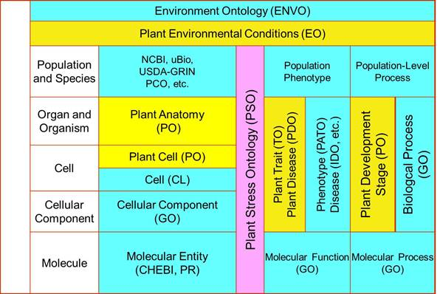
cROP (Common Reference Ontologies for Plants)

Slide 32
How reproduce this approach to building registries to support terminology standardization in immunology research
First, survey the field and create a draft list of primary targets
Antibodies
Cells
Proteins
Cytokines
what else?
Notes:
http://grants.nih.gov/grants/guide/rfa-files/RFA-HG-14-020.html

Slide 33
Principles for inclusion
Public domain.
Unique ID space.
Orthogonality with other registries.
Collaborative development.
Consistent versioning principles based on permanent URLs.
Include IDs from overarching ontologies.
Include IDs from official sources where they exist
Include immunology-relevant synonyms
Include PMIDs documenting usage
Establish locus of authority for editorial decisions, help desk, submission of term requests and error and bug reports
Include links to ImmPort Study Numbers
Advertise the existence of the registry as widely as possible
Notes:
http://grants.nih.gov/grants/guide/rfa-files/RFA-HG-14-020.html

Slide 34
Problems to avoid
redundancy – for each type of biological entity there must be at most one registry and one ID for that type
roach motel – all researchers must be able to easily identify what registries exist; registries must provide a single target for bullying, bargaining, training; versioning
denetworking – sibling types under a given parent are maintained together; representations of child types build on representations of parent types
forking – registries must be maintained consistently over time under a single authority, the approach to registries must be consistent

Slide 35
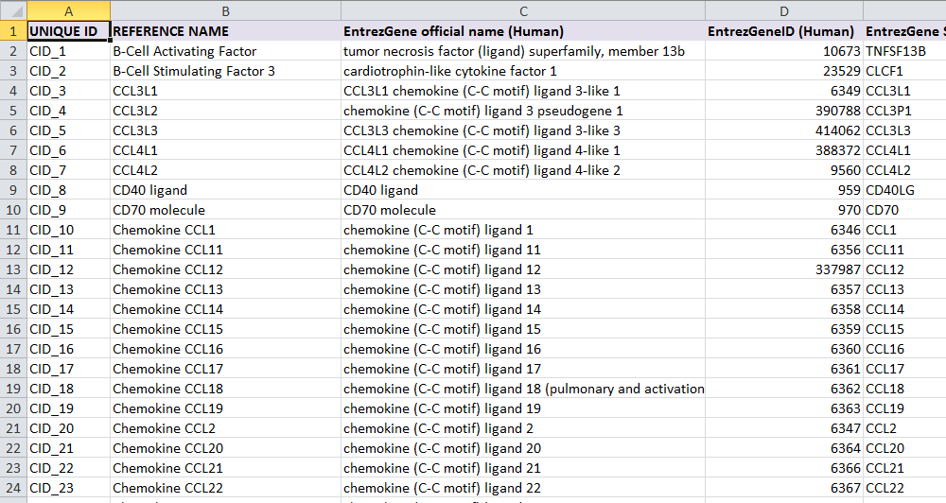
The Cytokine Names and Synonyms List

Slide 36
Principles
Public domain.
Unique ID space.
Orthogonality with other registries.
Collaborative development.
Consistent versioning principles based on permanent URIs.
Include IDs from overarching ontologies.
Include IDs from official sources where they exist
Include immunology-relevant synonyms
Include PMIDs documenting usage
Establish locus of authority for editorial decisions, help desk, submission of term requests and error and bug reports
Include links to ImmPort Study Numbers
Advertise the existence of the registry as widely as possible

Slide 37
4. Collaborative Development
Benefits already from interaction with the PRO
PRO cytokine representation improved
PRO helped to identify other cytokine lists
How many cytokine synonym lists have been created so far?

Slide 38
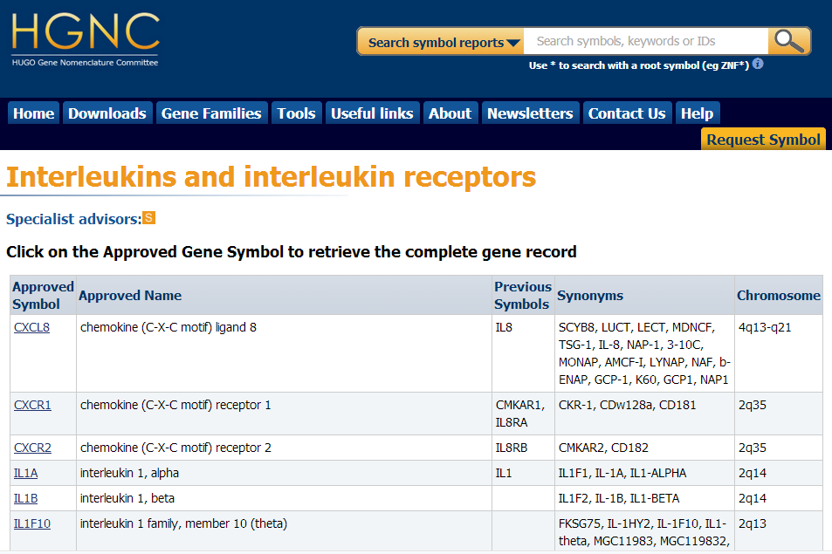

Slide 39
4. Orthogonality with other registries
http://www.copewithcytokines.org/cope.cgi

Slide 40
SUBDICTIONARIES: Angiogenesis | Apoptosis | CD Antigens | Cell lines | Eukaryotic cell types | Chemokines | CytokineTopics | Cytokine Concentrations in Body Fluids | Cytokines Interspecies Reactivities | Dual identity proteins | Hematology | Innate Immunity Defense Proteins | Metalloproteinases | Modulins | Protein domains | Regulatory peptide factors | Virokines | Viroceptors | Virulence Factors

Slide 41
5. Consistent versioning principles based on permanent URIs.
“CID_6” needs to be part of a URI that points always to the most updated version
Cytokine pages?
All previous versions should continue to exist and to be retrievable via version-specific URIs

Slide 42
6. Include IDs from overarching ontologies
Consider developing an Inter-Cellular Signaling Ontology as a joint effort of Buffalo and Tel Aviv

Slide 43
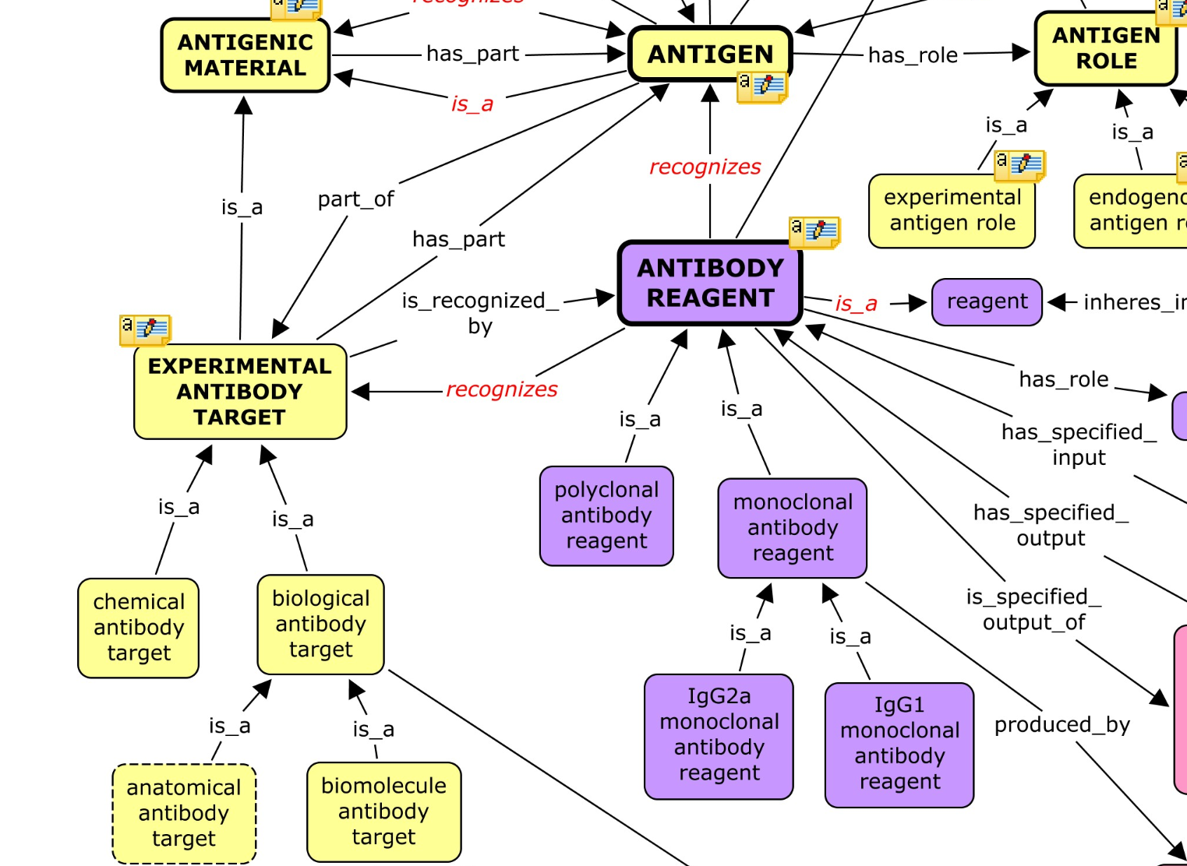
ideally via reuse – as ImmPort Antibody ontology reuses the Reagent Ontology

Slide 45
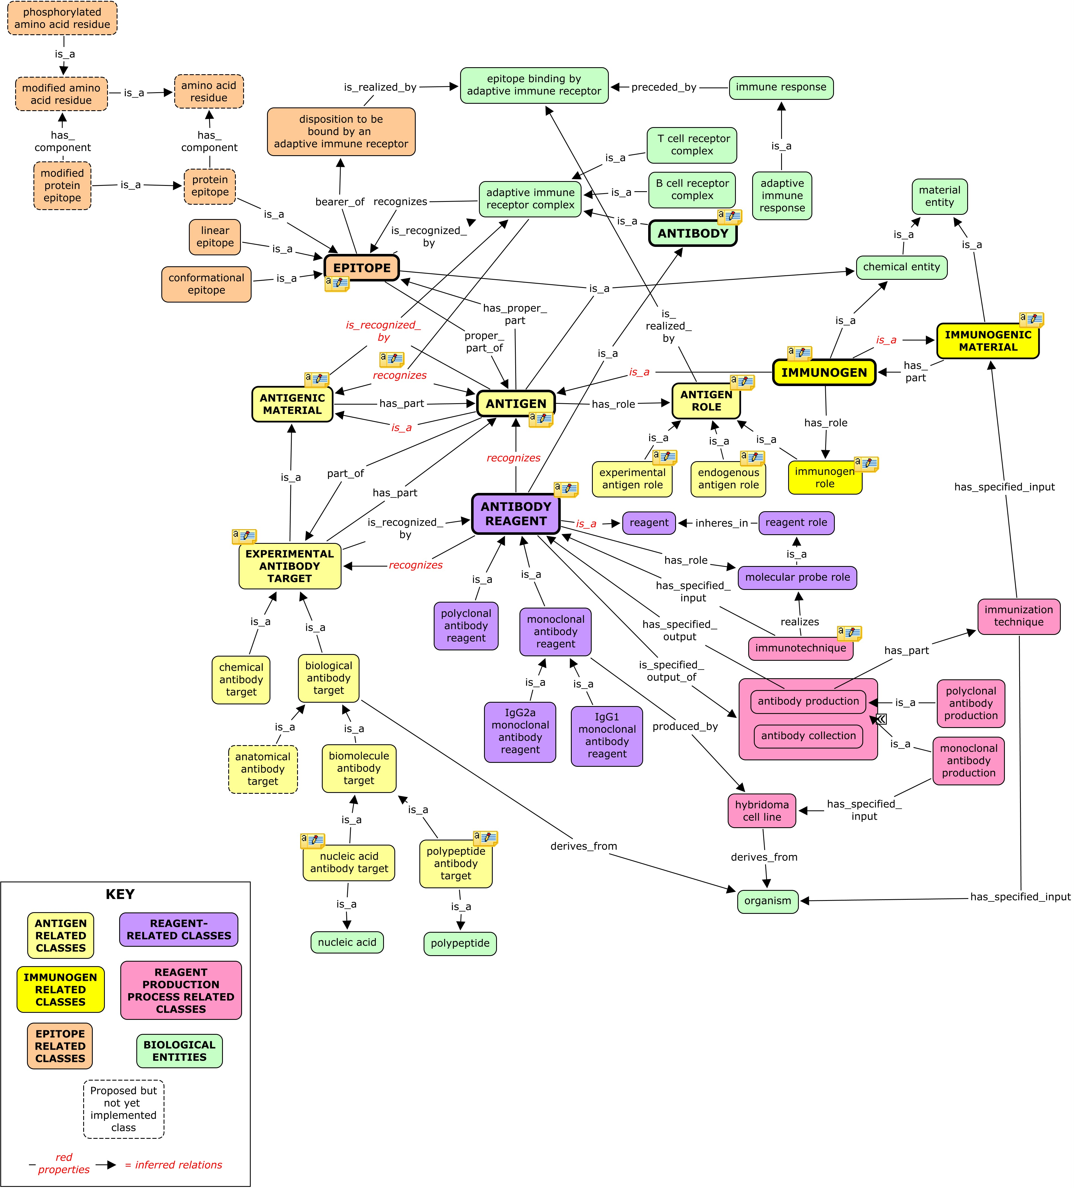
http://code.google.com/p/reagent-ontology/wiki/Antibodies

Slide 46
7. Include IDs from official sources where they exist
Recommendation: Use HGNC and MGI rather than Entrez Gene
HGNC provides official names: http://www.genenames.org/genefamilies/a-z including cytokines from Copewithcytokines resource, tumor necrosis factor superfamily cytokines , etc.
MGI provides coordinated official nomenclature for mouse Protein names not standardized in the same way – PRO / UniProt collaboration on-going

Slide 47
12. Advertise the existence of the registry as widely as possible
Give the artifact a name which will give people confidence that this is a target which will survive through time (e.g. ‘Registry’ rather than ‘List’)
How to create a vehicle suitable for bullying publishers, editors, authors …?

