Slide 1
Space, Time, BFO
Barry Smith

Slide 2
Proposal re Patterns
Acknowledge process pattern universals (e.g. relapsing remitting) and process pattern instances, e.g. this relapsing remitting pattern instantiated by Mary's MS course
BFO 2.0 would remain neutral as to whether process patterns are parts of the correspondingly patterned hosts
Process patterns are generically dependent occurrents (where continuant patterns are generically dependent continuants)

Slide 3
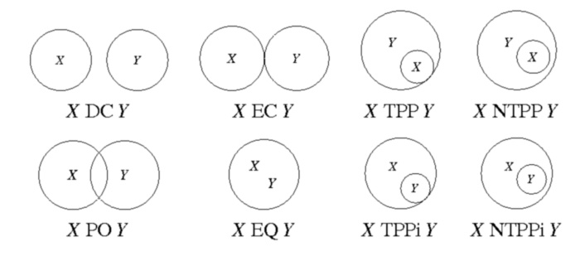
RCC (Region Connection Calculus)
disconnected (DC) | externally connected (EC)
equal (EQ) | partially overlapping (PO)
tangential proper part (TPP) | tangential proper part inverse (TPPi)
non-tangential proper part (NTPP) | non-tangential proper part inverse (NTPPi)

Slide 4
objects occupy space – they are located in BFO: spatial regions

Slide 5
Example: joint anatomy
joint HAS-HOLE joint space
joint capsule IS-OUTER-LAYER-OF joint
meniscus
IS-INCOMPLETE-FILLER-OF joint space
IS-TOPO-INSIDE joint capsule
IS-NON-TANGENTIAL-MATERIAL-PART-OF joint
joint
IS-CONNECTOR-OF bone X
IS-CONNECTOR-OF bone Y
synovia
IS-INCOMPLETE-FILLER-OF joint space
synovial membrane IS-BONAFIDE-BOUNDARY-OF joint space

Slide 6
Example: physiology
BMC Bioinformatics. 2013 Apr 16;14(1):131. [Epub ahead of print]
Eliciting candidate anatomical routes for protein interactions: a scenario from endocrine physiology.
Grenon P, de Bono B.
ApiNATOMY: a novel toolkit for visualizing multiscale anatomy schematics with phenotype-related information.
Bernard B de Bono, Pierre P Grenon, and Stephen John SJ Sammut
Hum Mutat 33(5):837-48 (2012), PMID 22616108

Slide 7
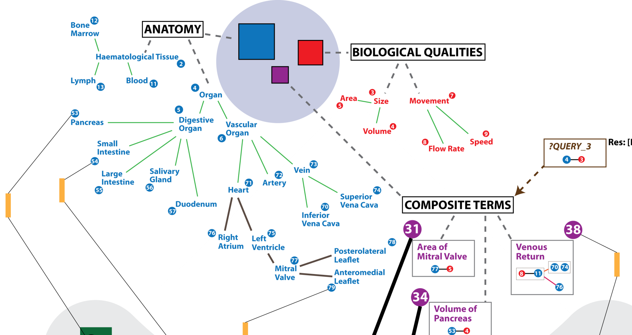
Virtual Physiological Human Ontologies
Bernard de Bono, ICBO 2011

Slide 8
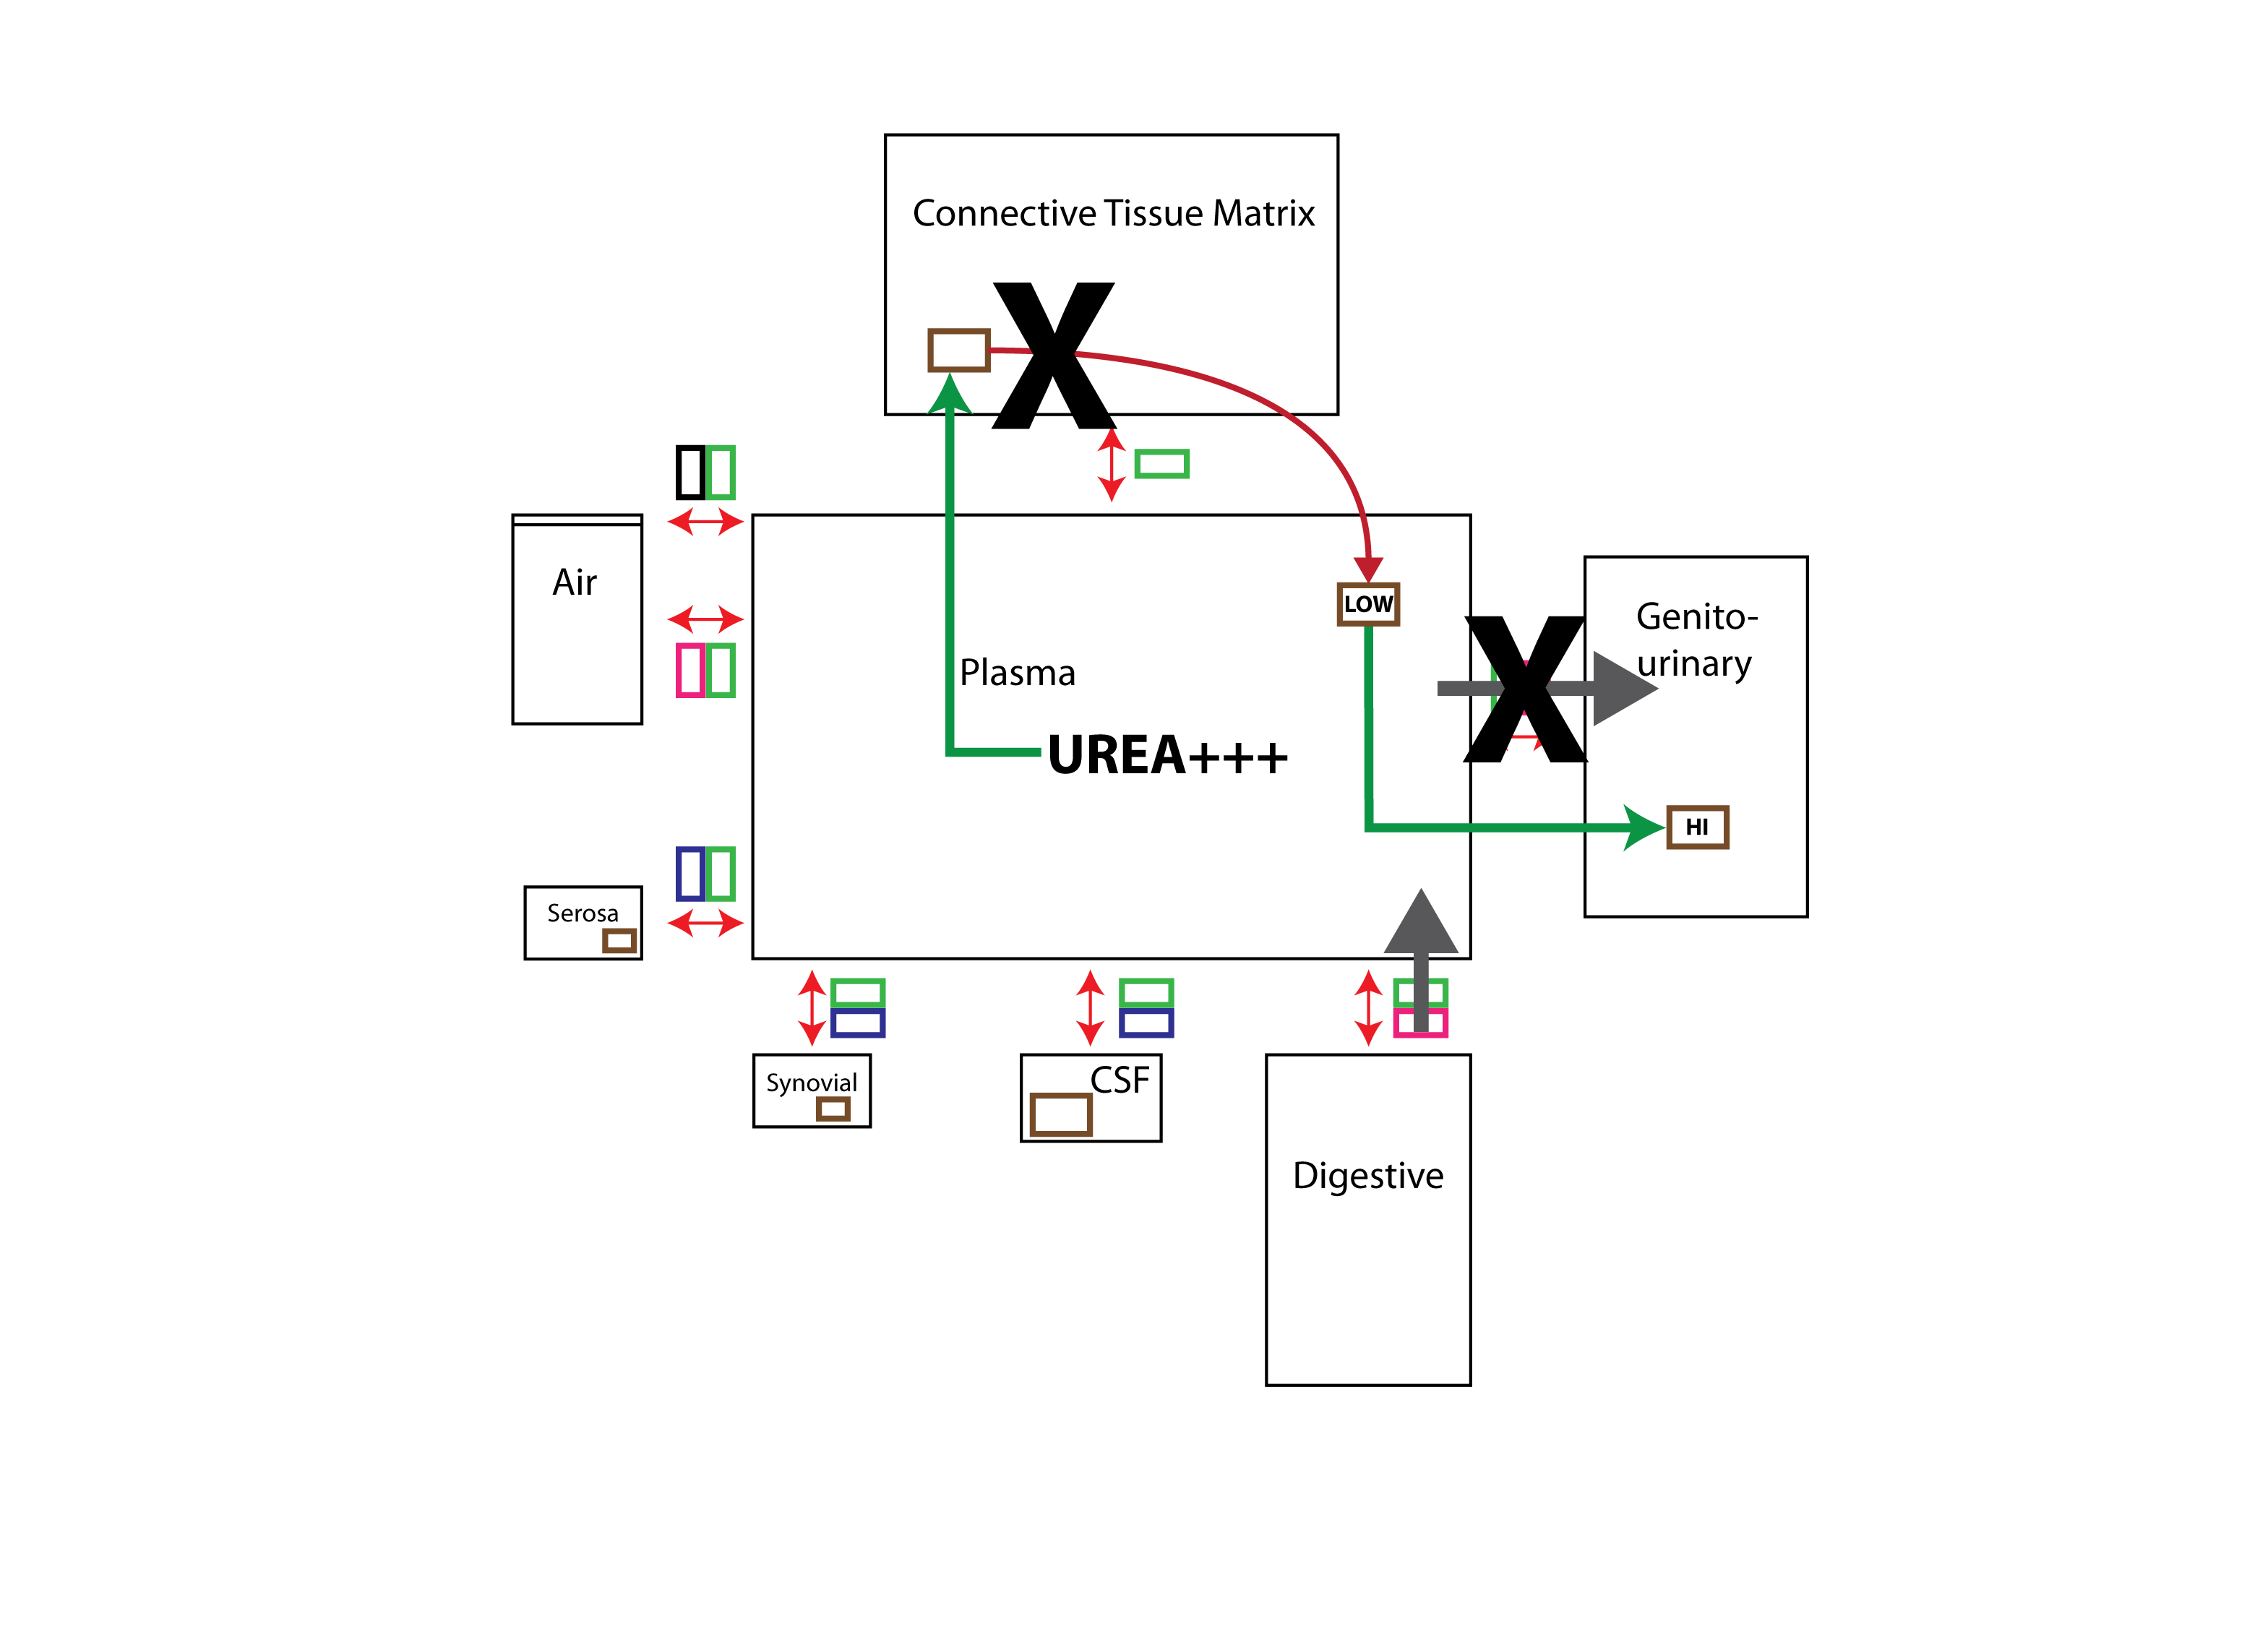
Compartments
Bernard de Bono, ICBO 2011

Slide 9
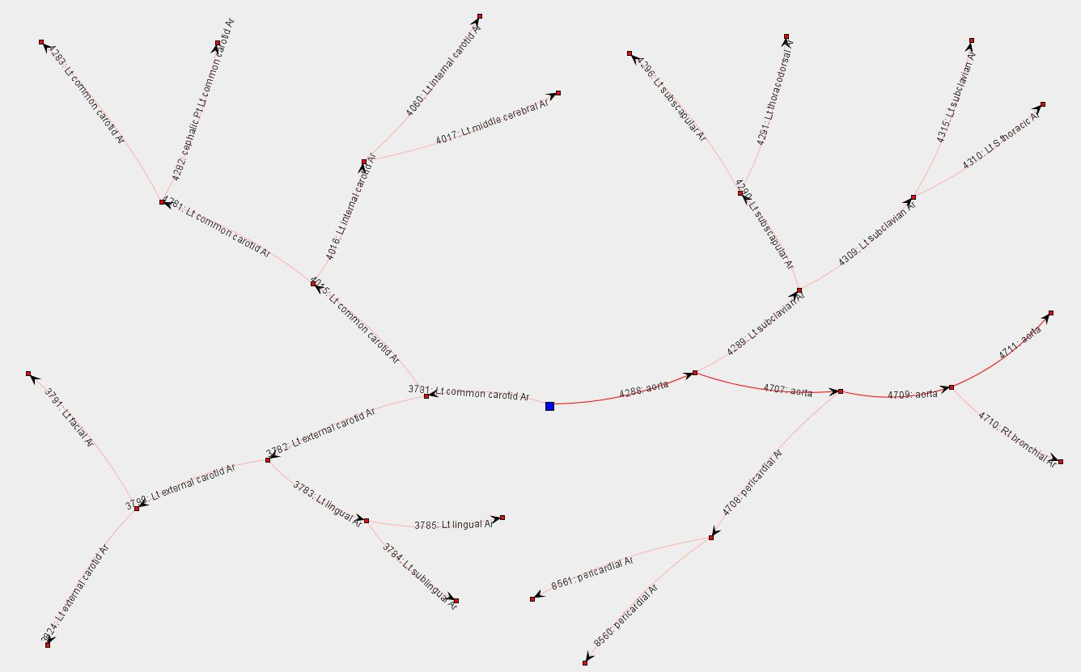
Connections Bernard de Bono, ICBO 2011

Slide 10
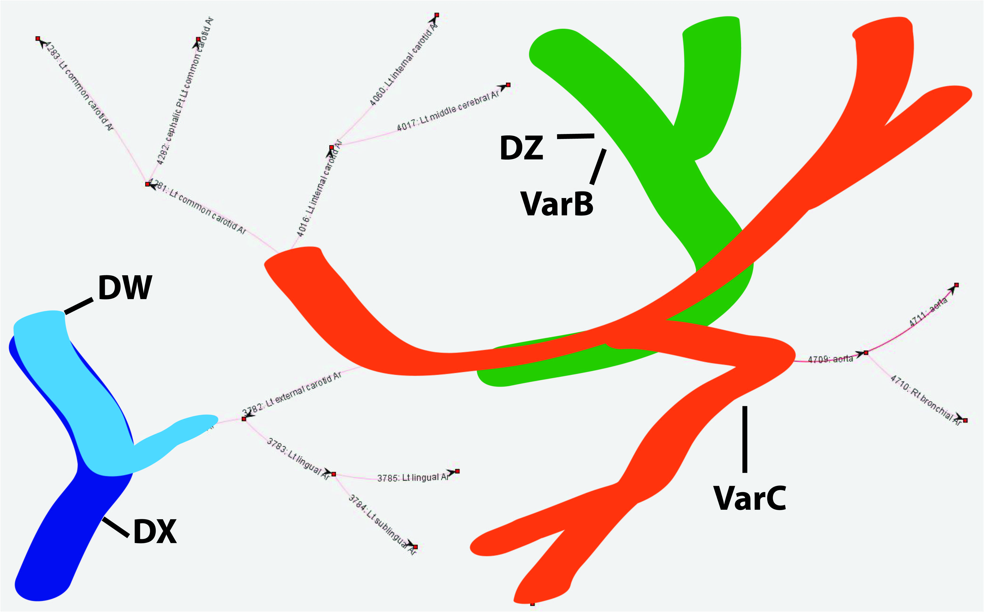
Bernard de Bono, ICBO 2011

Slide 11
The Allen Interval Calculus
Notes:
http://en.wikipedia.org/wiki/Allen's_interval_algebra

Slide 12
Processes take time: they are located in BFO:temporal regions
Notes:
http://en.wikipedia.org/wiki/Allen's_interval_algebra

Slide 13
How to deal with shapes?
Shapes seem to be qualities of spatial regions as well as of independent continuants, but BFO says all qualities are qualities of independent continuants

Slide 14
How to deal with shapes?
Shapes seem to be qualities of spatial regions as well as of independent continuants, but BFO says all qualities are qualities of independent continuants
Sites have qualities of size and shape. But spatial regions, like regions in general, do not have qualities (they are not the sorts of things which can be bearers of s-dependent continuants, just as they are not the sorts of things that can be participants in processes – in the strict BFO sense of ‘s-dependence’ and ‘participant’). Rather, spatial regions instantiate corresponding universals. Thus a spherical spatial region of diameter 3 meters instantiates the universal 3-meter-diamter spherical spatial region.

Slide 15
Material entities have qualities of shape and size because they are located at spatial regions which instantiate corresponding shape and size universals.
Axiom: Every material entity is located at some three-dimensional spatial region at every time at which it exists

Slide 16
Object boundaries and sites are distinguished from the spatial regions which they occupy at any given time as follows:
(1) Object boundaries and sites move when their material host moves, and they change shape or size when their material host changes shape or size.
(2) Spatial regions are, by definition, at rest relative to the pertinent coordinate frame.

Slide 17
Why are sites needed in addition to 3-D spatial regions?
Because a site, e.g. the hold of a ship, can move through space (and thus occupy successively different spatial regions)
Sites are in this respect, too, analogous to material entities.

Slide 18
In BFO 2.0 focus is on fiat boundaries
when we talk about e.g. 2-dimensional surfaces of material objects, then we are talking about fiat boundaries
= boundaries for which there is no assumption that they coincide with physical discontinuities.

Slide 19
Continuant boundaries go together with (0-,1-, and 2-D) spatial regions

Slide 20
as sites go together with 3-D spatial regions

Slide 21
and material entities go together with 3-D spatial regions

Slide 22
just as process boundaries go together with temporal instants

Slide 23
so processes go together with temporal intervals

Slide 24
Future work needed on boundaries and spatial and temporal regions
Boundary dependence is not a type of specific dependence. Needs defining.
Bona fide boundaries?
Frame-dependence of spatial and temporal regions (work on BFO-Physics on-going)

Slide 25
Given a coordinate frame R
Space_{R} = the maximal region of space (that region of space in which the whole universe is located) relative to R
Time_{R} = the maximal region of time (that region of space in which the whole history of the universe is located) relative to R
Spacetime = the maximal spacetime region
All spatial, temporal and spatiotemporal regions in BFO are parts of Space_{R}, Time_{R} and Spacetime, respectively

Slide 26
History
history of a material entity m = sum of processes taking place in the spatiotemporal region occupied by m

Slide 27
History
The relation between a material entity and its history is one-to-one:
for any material entity a, there is exactly one process which is the history of a,
for every history h, there is exactly one material entity which h is the history of.
Histories are additive. Thus for any two material entities a and b, the history of the sum of a and b is the sum of their histories.

Slide 28
Lives (for OGMS)
The life of an organism is the history of the corresponding OGMS:extended organism

Slide 29
Immaterial entities are independent continuants which contain no material entities as parts. The roots of BFO’s treatment of such entities lie in the application of theories of qualitative spatial reasoning to the geospatial world, for example as outlined in [49, 69], in the treatment of holes by Casati and Varzi [48], in the treatment of niches by Smith and Varzi [7, 10], and in the treatment of cavities in the FMA [43, 44, 34, 35].
Rosse and Mejino provide the following rationale for including terms for surfaces, lines, and points in the FMA:
Although anatomical texts and medical terminologies with an anatomical content deal only superﬁcially, if at all, with anatomical surfaces, lines, and points, it is nevertheless necessary to represent these entities explicitly and comprehensively in the FMA in order to describe boundary and adjacency relationships of material physical anatomical entities and spaces. [43]
note(immaterial entity)[Immaterial entities are divided into two subgroups:
boundaries and sites, which bound, or are demarcated in relation, to material entities, and which can thus change location, shape and size as their material hosts move or change shape or size (for example: your nasal passage; the hold of a ship; the boundary of Wales (which moves with the rotation of the Earth) [38, 7, 10]);
spatial regions, which exist independently of material entities, and which thus do not change.]
note(continuant part of)[Immaterial entities /*under 1. */are in some cases continuant parts of their material hosts. Thus the hold of a ship, for example, is a part of the ship; it may itself have parts, which may have names (used for example by ship stow planners, customs inspectors, and the like). Immaterial entities under both 1. and 2. can be of zero, one, two or three dimensions.
A site, e.g. the hull of a ship, as it moves through space, will occupy successively different spatial regions – Sites are in this respect, too, analogous to material entities. One site may move through another site, for

Slide 30
BFO:history
history of a material entity m = sum of processes taking place in the spatiotemporal region occupied by m
A history is an example of a full (plenary, exhaustive) process
p is a full process = there is some spatiotemporal region s & all processes located in s are occurrent parts of p

Slide 31
BFO:history

Slide 32
missing: history (2nd child of ‘process’)

Slide 33
process
full process
history
partial process = process profile
but does this cause multiple parentage?

Slide 34
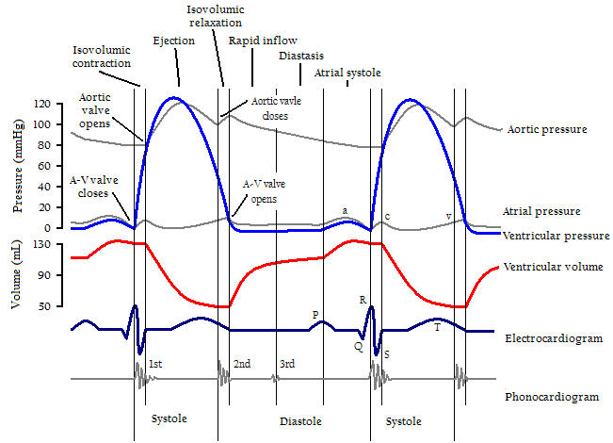
Process profiles are non-full processes
= they are processes which do not exhaust the spatiotemporal region in which they are located

Slide 35
Elucidation ?
a process_profile_of b holds when
a proper_occurrent_part_of b
& a and b spatiotemporally coincide
& a is non-full
& all temporal parts of a are non-full ?????
a instance_of process profile =Def. for some b, a process_profile_of b

Slide 36
A spinning top is simultaneously getting warmer
Two distinguishable (indeed separately measurable process profiles) in a single region of spacetime
Notes:
http://www.notcot.org/page/734/

Slide 37
Process profiles and the Davidsonian theory of events
There is a certain full process, which can be described in three ways:
pulling the trigger
shooting
killing
Or in other words, we can cognitively selective three different process profiles within a single process whole

Slide 38
Process profiles and the role of standardized notations
music
chess
choreography
ship stow planning
military manoeuvres
language

Slide 39
Process profiles and linguistics
Phonetics deals with the production of speech sounds by humans, often without prior knowledge of the language being spoken.
Phonology is about patterns of sounds in all spoken languages
Notes:
http://www.phon.ox.ac.uk/jcoleman/PHONOLOGY1.htm

Slide 40
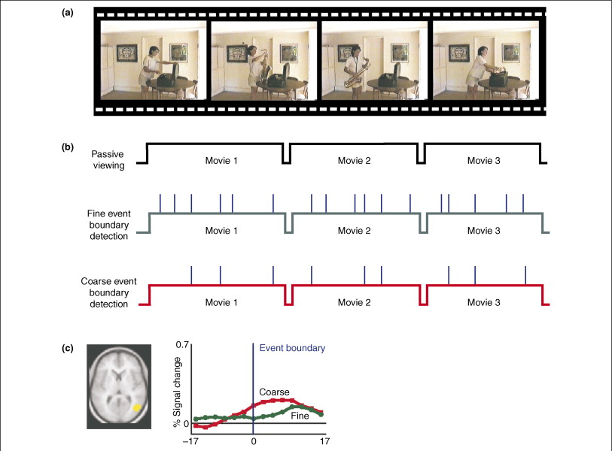
Are mental processes process profiles?
Notes:
http://www.sciencedirect.com/science/article/pii/S1364661307001519

Slide 41
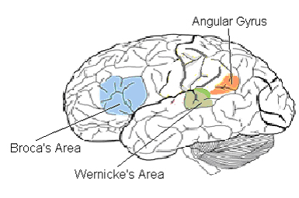
Q: What is the measuring process by mental process profiles are measured?
A: speech
Notes:
http://www.brainbehavioroptimization.com/simple.php?f=_spec_Language.php&t=Language

Slide 42
Process profiles and Zeno Vendler’s theory of actions
Accomplishment: = process which has an endpoint and involves a incremental reaching of this endpoint (e.g. painting a picture, building a house)
Achievements: processes which occur instantaneously (recognizing, noticing)

Slide 43
Hutchinsonion niche
(niche as volume in a functionally defined hyperspace)
=def. an n-dimensional hyper-volume whose dimensions correspond to resource gradients over which species are distributed
degree of slope, exposure to sunlight, soil fertility, foliage density, salinity...
Notes:
http://www.geobabble.org/~hnw/esri99/

Slide 44
G.E. Hutchinson (1957, 1965)
Notes:
http://www.geobabble.org/~hnw/esri99/

Slide 45
Hutchinsonian niche dimensions
pH
evapotranspiration
turbidity
available light
predominant vegetation
predatory pressure
nutrient limitation
…

Slide 46
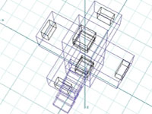
Gigantic evolutionary hotel
Notes:
http://www.stankievech.net/projectsFrame.html

Slide 47
Notes:
http://www.google.com/imgres?start=255&um=1&hl=en&rlz=1C1CHKZ_enUS440US440&biw=1366&bih=647&tbm=isch&tbnid=7rFJDWHTsLZ32M:&imgrefurl=http://www.asecular.com/forests/space.htm&docid=sklpUmVoVvTphM&imgurl=http://www.asecular.com/forests/graphics.jpg&w=400&h=449&ei=SzMwUKXZPIf50gHr1oGQCw&zoom=1&iact=hc&vpx=626&vpy=298&dur=4837&hovh=238&hovw=212&tx=145&ty=153&sig=118345220999645469437&page=11&tbnh=163&tbnw=145&ndsp=27&ved=1t:429,r:23,s:255,i:327

Slide 48
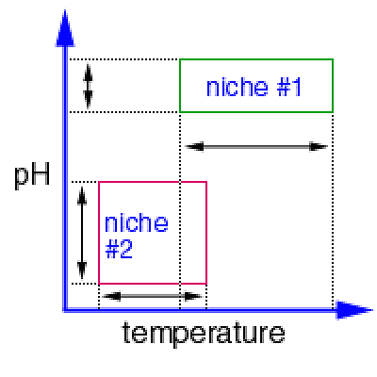
Notes:
http://www.bio.georgiasouthern.edu/bio-home/harvey/lect/lectures.html?ccode=el&mda=scrn&flnm=bgsp&ttl=Speciation%20and%20Differentiation

Slide 49
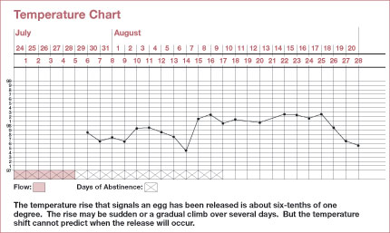
How to deal with the Hutchinsonian niche in BFO terms?
recall our treatment of the truthmakers of a time-series graph
3. quality axis – the corresponding determinable universal (e.g temperature, within some range)

Slide 50
time
Notes:
http://www.bio.georgiasouthern.edu/bio-home/harvey/lect/lectures.html?ccode=el&mda=scrn&flnm=bgsp&ttl=Speciation%20and%20Differentiation

Slide 51
time
Notes:
http://www.bio.georgiasouthern.edu/bio-home/harvey/lect/lectures.html?ccode=el&mda=scrn&flnm=bgsp&ttl=Speciation%20and%20Differentiation

Slide 52
ph ⨯ temperature ⨯ time ⨯ space
time
Notes:
http://www.bio.georgiasouthern.edu/bio-home/harvey/lect/lectures.html?ccode=el&mda=scrn&flnm=bgsp&ttl=Speciation%20and%20Differentiation

Slide 53
Needed for the future
Treatment of boundary_of and is_bounded_by relations
Treatment of relations between universals; rules for quantifying over universals.
Relations of dependence of objects on qualities (e.g. of you on your mass)
More detailed treatment of two kinds of causal relations:
(1) causal dependence, for example the reciprocal causal dependence between the pressure and temperature of a portion of gas; the causal unity of objects fits here
(2) causal triggering, where a process is the trigger for a second process which is the realization of a disposition.

