Slide 1
Neuroscience Information Framework Standard Ontologies (NIFSTD)
Fahim IMAM, Stephen LARSON, Georgio ASCOLI, Gordon SHEPHERD,
Anita BANDROWSKI, Jeffery S. GRETHE, Amarnath GUPTA, Maryann E. MARTONE
University of California, San Diego, CA
George Mason University, Fairfax, VA
Yale University, New Haven, CT
AlzForum/PRO Meeting 2011
October 5, 2011
Funded in part by the NIH Neuroscience Blueprint HHSN271200800035C via NIDA
NEUROSCIENCE INFORMATION FRAMEWORK

Slide 2
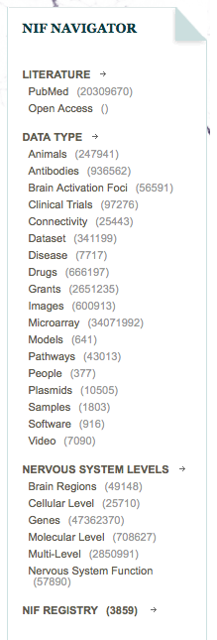
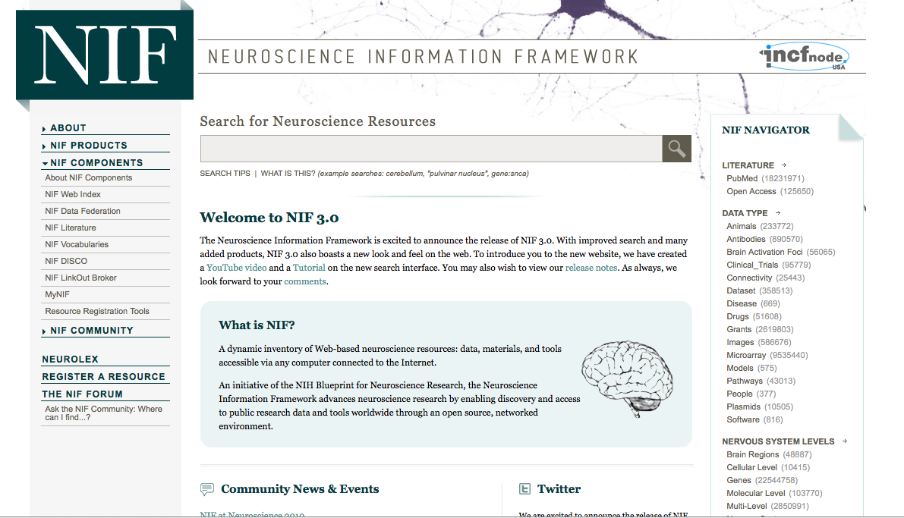
NIF: Discover and utilize web-based Neuroscience resources
A portal to finding and using neuroscience resources
A consistent framework for describing resources
Provides simultaneous search of multiple types of information, organized by category
NIFSTD Ontology, a critical component
Enables concept-based search
UCSD, Yale, Cal Tech, George Mason, Harvard MGH
Easier
Supported by NIH Blueprint
The Neuroscience Information Framework (NIF), http://neuinfo.org

Slide 3
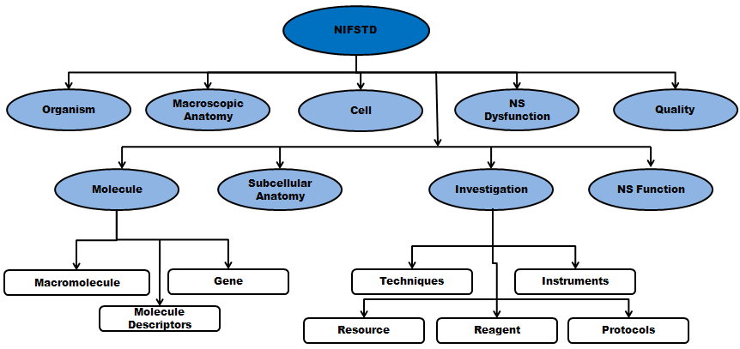
NIF Standard Ontologies (NifStd)
Set of modular ontologies
Covering neuroscience relevant terminologies
Comprehensive ~60, 000 distinct concepts + synonyms
Expressed in OWL-DL language
Supported by common DL Resoners
Closely follows OBO community best practices
Avoids duplication of efforts
Standardized to the same upper level ontologies
e.g., Basic Formal Ontology (BFO), OBO Relations Ontology (OBO-RO), Phonotypical Qualities Ontology (PATO)
Relies on existing community ontologies
e.g., CHEBI, GO, PRO, OBI etc.
Bill Bug et al.
Modules cover orthogonal domain
e.g. , Brain Regions, Cells, Molecules, Subcellular parts, Diseases, Nervous system functions, etc.

Slide 4
NIFSTD External Community Sources
Domain | External Source | Import/ Adapt | Module
Organism taxonomy | NCBI Taxonomy, GBIF, ITIS, IMSR, Jackson Labs mouse catalog | Adapt | NIF-Organism
Molecules | IUPHAR ion channels and receptors, Sequence Ontology (SO), ChEBI, and Protein Ontology (PRO); pending: NCBI Entrez Protein, NCBI RefSeq, NCBI Homologene, NIDA drug lists | Adapt IUPHAR, ChEBI;Import PRO, SO | NIF-Molecule NIF-Chemical
Sub-cellular | Sub-cellular Anatomy Ontology (SAO). Extracted cell parts and subcellular structures. Imported GO Cellular Component | Import | NIF-Subcellular
Cell | CCDB, NeuronDB, NeuroMorpho.org. Terminologies; pending: OBO Cell Ontology | Adapt | NIF-Cell
Gross Anatomy | NeuroNames extended by including terms from BIRN, SumsDB, BrainMap.org, etc; multi-scale representation of Nervous System Macroscopic anatomy | Adapt | NIF-GrossAnatomy
Nervous system function | Sensory, Behavior, Cognition terms from NIF, BIRN, BrainMap.org, MeSH, and UMLS | Adapt | NIF-Function
Nervous system dysfunction | Nervous system disease from MeSH, NINDS terminology; Disease Ontology (DO) | Adapt/Import | NIF- Dysfunction
Phenotypic qualities | PATO is Imported as part of the OBO foundry core | Import | NIF-Quality
Investigation: reagents | Overlaps with molecules above, especially RefSeq for mRNA | Import | NIF-Investigation
Investigation: instruments, protocols | Based on Ontology for Biomedical Investigation (OBI) to include entities for biomaterial transformations, assays, data transformations | Adapt | NIF-Investigation
Investigation: Resource | NIF, OBI, NITRC, Biomedical Resource Ontology (BRO) | Adapt | NIF-Resource
Biological Process | Gene Ontology’s (GO) biological process in whole | Import | NIF-BioProcess
Cognitive Paradigm | Cognitive Paradigm Ontology (CogPO) | Import | NIF-Investigation
Notes:
I included this slide just to show that wherever possible, we reuse existing available knowledge sources, terminologies and ontologies.

Slide 5
Typical Use of Ontology in NIF
Basic feature of an ontology
Organizing the concepts involved in a domain into a hierarchy and
Precisely specifying how the classes are ‘related’ with each other (i.e., logical axioms)
Explicit knowledge are asserted but implicit logical consequences can be inferred
A powerful feature of an ontology

Slide 6
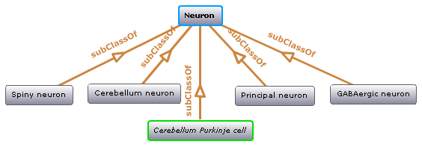
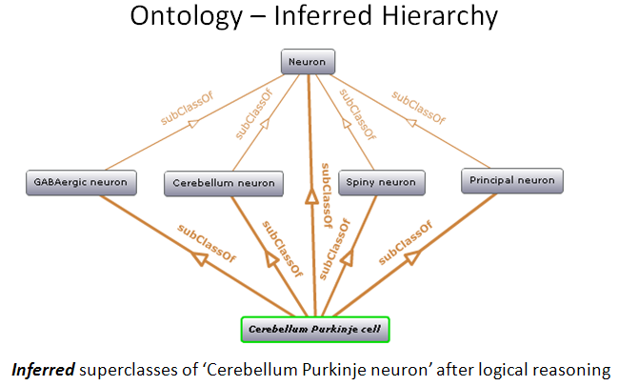
Ontology – Asserted Hierarchy
Class name | Asserted defining (necessary & sufficient) expression
Cerebellum neuron | Is a ‘Neuron’ whose soma lies in any part of the ‘Cerebellum’ or ‘Cerebellar cortex’
Principal neuron | Is a ‘Neuron’ which has ‘Projection neuron role’, i.e., a neuron whose axon projects out of the brain region in which its soma lies
GABAergic neuron | Is a ‘Neuron’ that uses ‘GABA’ as a neurotransmitter
Class name | Asserted necessary conditions
Cerebellum Purkinje cell | Is a ‘Neuron’ Its soma lies within 'Purkinje cell layer of cerebellar cortex’ It has ‘Projection neuron role’ It uses ‘GABA’ as a neurotransmitter It has ‘Spiny dendrite quality’
Notes:
Here is an example, that would hopefully illustrates the strengths and usefulness of having our ontology.
NIFSTD has various neuron types with an asserted simple hierarchy within the NIF-Cell module (here is an example with five neuron types). However, we assert various logical restrictions about these neurons.

Slide 7
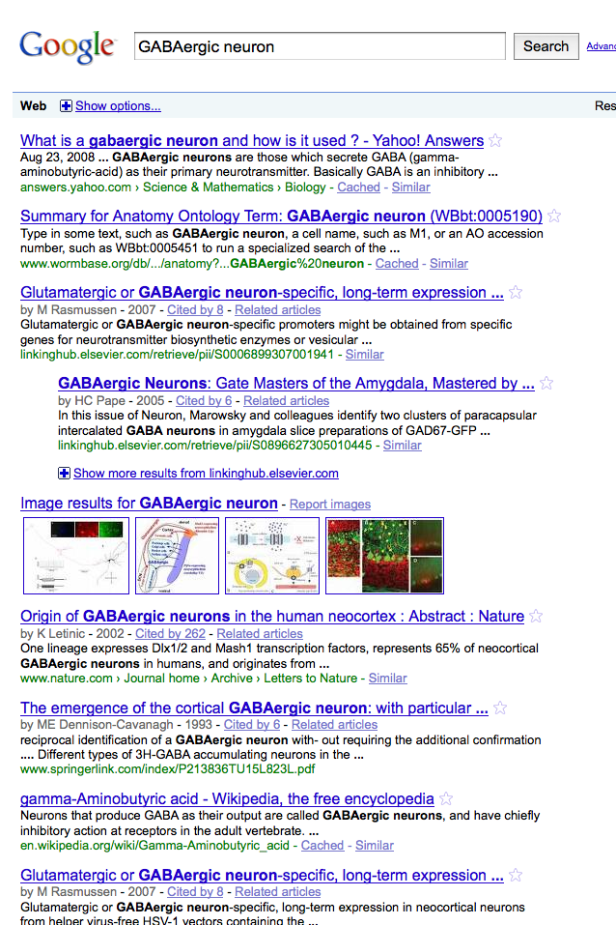
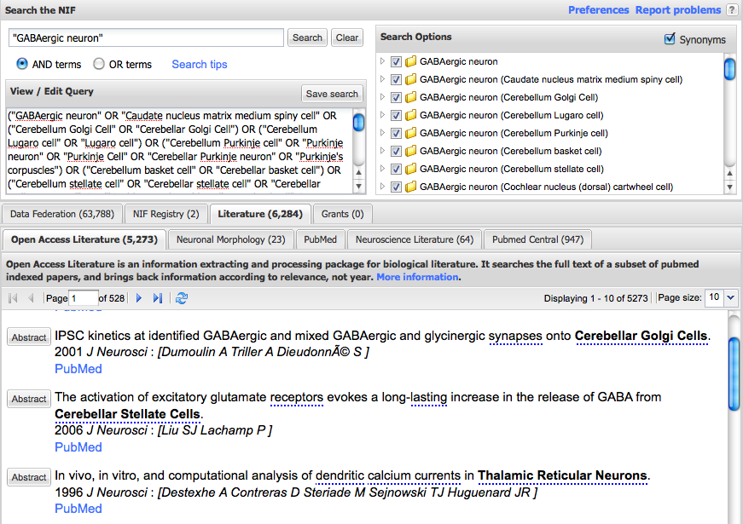
NIF Concept-Based Search
Search Google: GABAergic neuron
Search NIF: GABAergic neuron
NIF automatically searches for types of GABAergic neurons
Types of GABAergic neurons
Notes:
Having the defined classes enabled us to have useful concept-based queries through the NIF search interface.
For example, while searching for ‘GABAergic neuron’, the system recognizes the term as ‘defined’ from the ontology, and looks for any neuron that has GABA as a neurotransmitter (instead of the lexical match of the search term like in Google) and enhances the query over those inferred list of neurons.

Slide 8
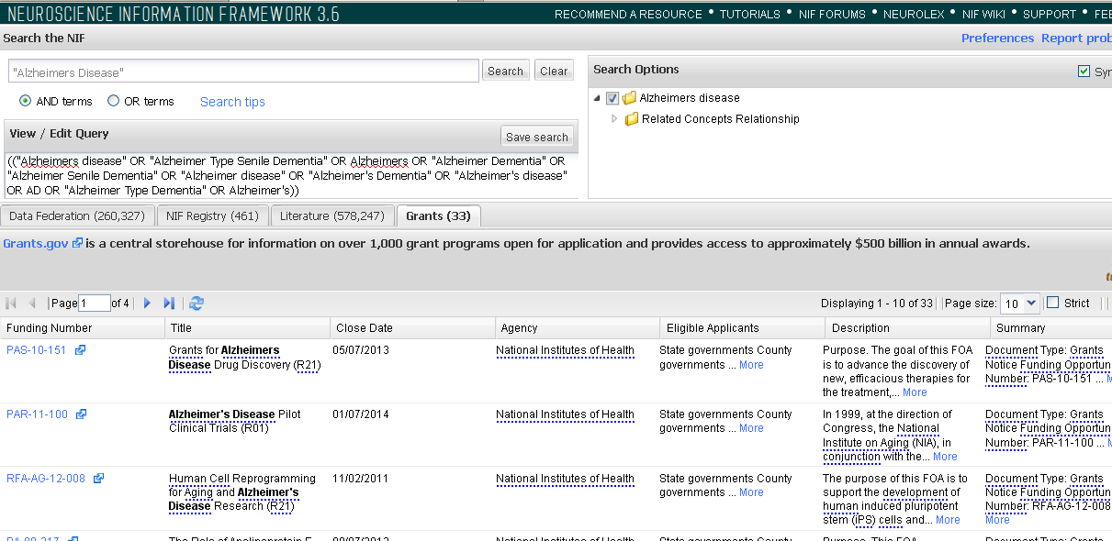

Slide 9
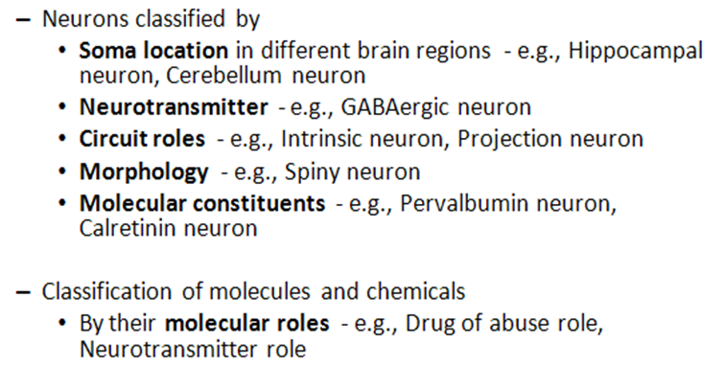
NifStd Current Version
Key feature: Includes useful defined concepts to infer useful classification
Notes:
The key feature of the current NIFSTD is the inclusion and enrichment of various set of defined classes to infer useful classification of neurons and molecules.

Slide 10
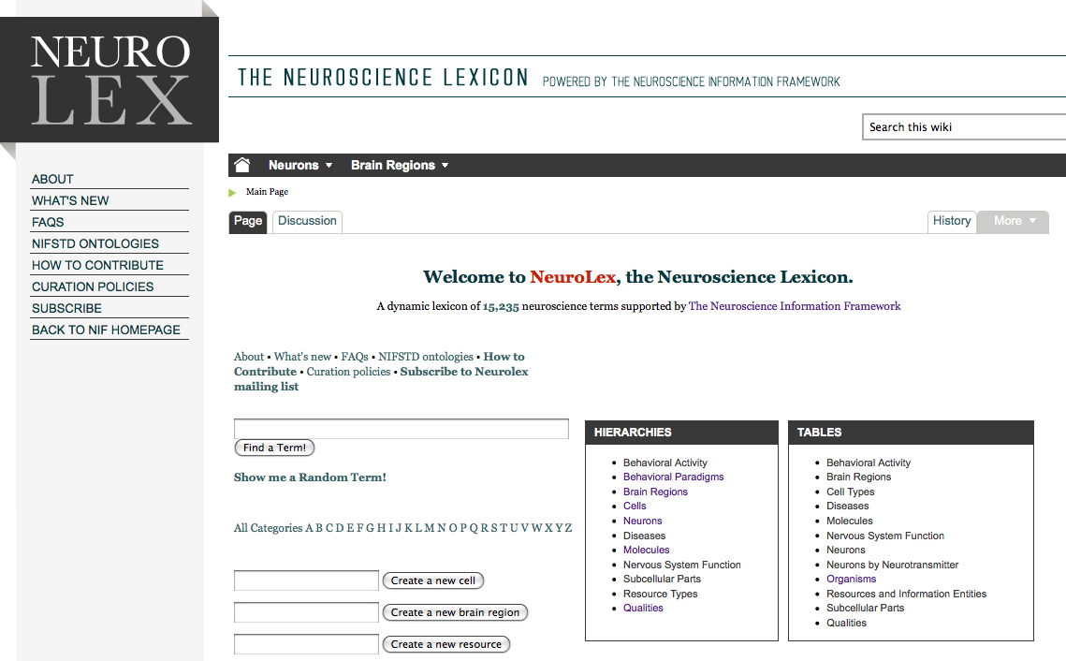
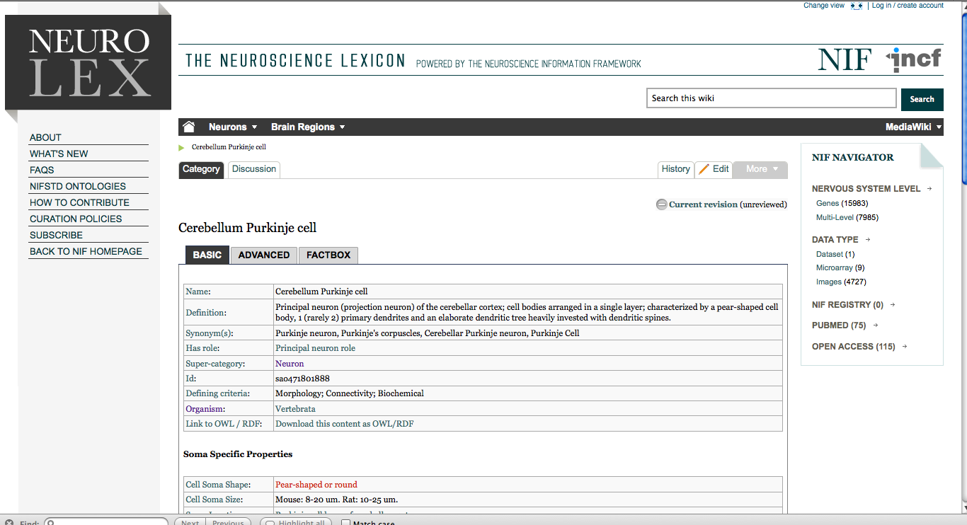
NifStd and NeuroLex Wiki
Semantic wiki platform
Provides simple forms for structured knowledge
Can add classes, properties, definitions, synonyms etc.
Generate hierarchies without having to learn complicated ontology tools
Not a replacement for top-down construction
Community can contribute
Stephen D. Larson et al.
Notes:
One of the largest roadblocks that we encountered during our ontology development was the lack of tools for domain experts to contribute their knowledge to NIFSTD.
To bridge these gaps, NIF has created NeuroLex (http://neurolex.org), a semantic wiki interface for the domain experts as an easy entry point to the NIFSTD contents. It has been extensively used in the area of neuronal cell types where NIF is working with a group of neuroscientists such as Gordon Shephard and Georgio Ascoli, to create a comprehensive list of neurons and their properties.

Slide 11
Top Down Vs. Bottom up
Top-down ontology construction
A select few authors have write privileges
Maximizes consistency of terms with each other
Making changes requires approval and re-publishing
Works best when domain to be organized has: small corpus, formal categories, stable entities, restricted entities, clear edges.
Works best with participants who are: expert catalogers, coordinated users, expert users, people with authoritative source of judgment
NIFSTD
Bottom-up ontology construction
Multiple participants can edit the ontology contents instantly
Control of content is done after edits are made based on the merit of the content
Semantics are limited to what is convenient for the domain
Not a replacement for top-down construction; sometimes necessary to increase flexibility
Necessary when domain has: large corpus, no formal categories, no clear edges
Necessary when participants are: uncoordinated users, amateur users, naïve catalogers
Neuroscience is a domain that is less formal and neuroscientists are more uncoordinated
NEUROLEX
Larson et. al
Notes:
Bottom-up ontology construction
Multiple participants can edit the ontology instantly.
Control of content is done after edits are made based on the merit of the content, rather than by blessing a select few known individuals
Semantics are limited to what is convenient for the domain.
Not a replacement for top-down construction, but sometimes necessary to increase flexibility and accessibility for non-ontologist domain experts
Necessary when domain has: large corpus, no formal categories, unstable entities, unrestricted entities, no clear edges
Necessary when participants are: uncoordinated users, amateur users, naïve catalogers, people without authoritative source of judgment.
Neuroscience is a domain that is less formal and neuroscientists are participants that are more uncoordinated

Slide 12
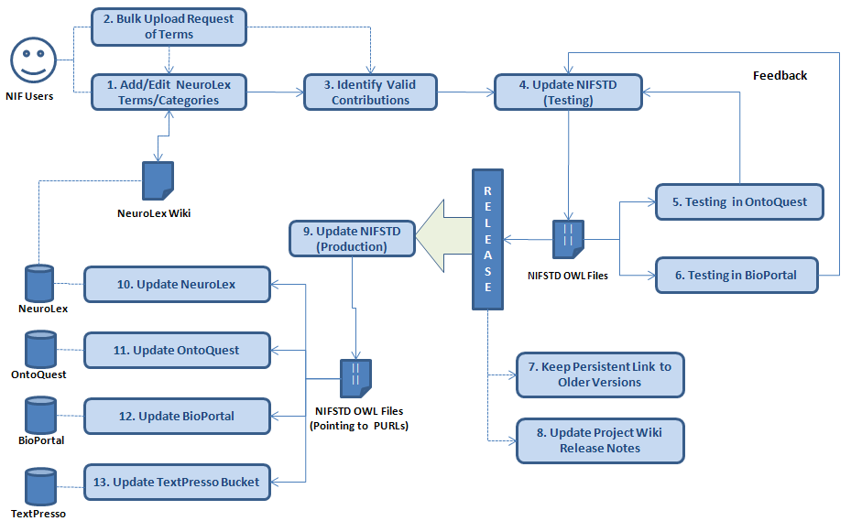
NifStd/Neurolex Curation Workflow
‘has soma location’ in NeuroLex == ‘Neuron X’ has_part some (‘Soma’ and
(part_of some ‘Brain region Y’)) in NIFSTD
Notes:
We envision NeuroLex as the main entry point for the broader community to access, annotate, edit and enhance the core NIFSTD content. The peer-reviewed contributions in the media wiki are later implanted in formal OWL modules.
While the properties in NeuroLex are meant for easier interpretation, the restrictions in NIFSTD are usually based on rigorous OBO-RO standard relations. For example, the property ‘soma located in’ is translated as ‘Neuron X’ has_part some (‘Soma’ and (part_of some ‘Brain region Y’)) in NIFSTD.

Slide 13
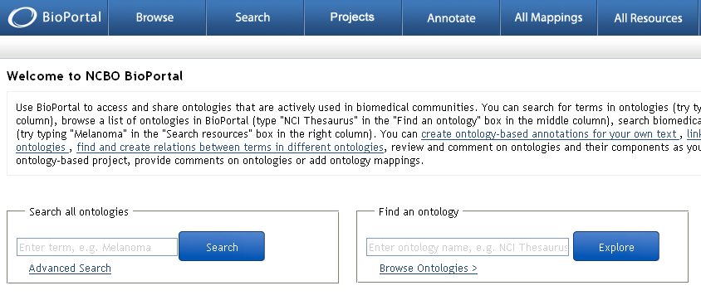
Access to NIFSTD Contents
NIFSTD is available as
OWL Format http://ontology.neuinfo.org
RDF and SPARQL Endpoint http://ontology.neuinfo.org/sparql-endpoint.html
Specific contents through web services
http://ontology.neuinfo.org/ontoquest-service.html
Available through NCBO Bioportal
Provides annotation and mapping services
http://bioportal.bioontology.org/
Notes:
NIFSTD is primarily available in OWL format and can be loaded through Protégé [7] or similar OWL editing tools. It is also viewable through NCBO BioPortal [12]. Within NIF, NIFSTD is served through an ontology management system called OntoQuest [2]. OntoQuest generates an OWL-compliant relational schema and implements various ontological graph search algorithms for navigating, term searching and expanding query terms based on their logical restrictions for the NIF search portal. It also provides web services [8] to extract ontology contents. NIFSTD is also available in RDF and has a SPARQL endpoint [9].

Slide 14
Community Involvement
NeuroPsyGrid
http://www.neuropsygrid.org
NDAR Autism Ontology
http://ndar.nih.gov
Cognitive Paradigm Ontology (CogPO)
http://wiki.cogpo.org
Neural ElectroMagnetic Ontologies (NEMO)
http://nemo.nic.uoregon.edu
Neurodegenerative Disease Phenotype Ontology
http://openccdb.org/wiki/index.php/Disease_Ontology
Notes:
Here is a list of Efforts that have used NIFSTD. They have extended their project based on Nifstd core modules and sometimes enhanced NIFTD through their contributions:
* NeuroPsyGrid: http://www.neuropsygrid.org
* NDAR: http://ndar.nih.gov
* Disease Phenotype Ontology: http://openccdb.org/wiki/index.php/Disease_Ontology

Slide 15
Neurodegenerative Disease Phenotype Ontology (NDPO)
Challenge: Matching Neurodegenerative Diseases with Animal Models
Model systems only replicate a subset of features of the disease
Related phenotypes occur across anatomical scales
Different vocabularies are used by different communities
Approach: Use ontologies to provide necessary knowledge for matching related phenotypes
Sarah M Maynard and Christopher J Mungall

Slide 16
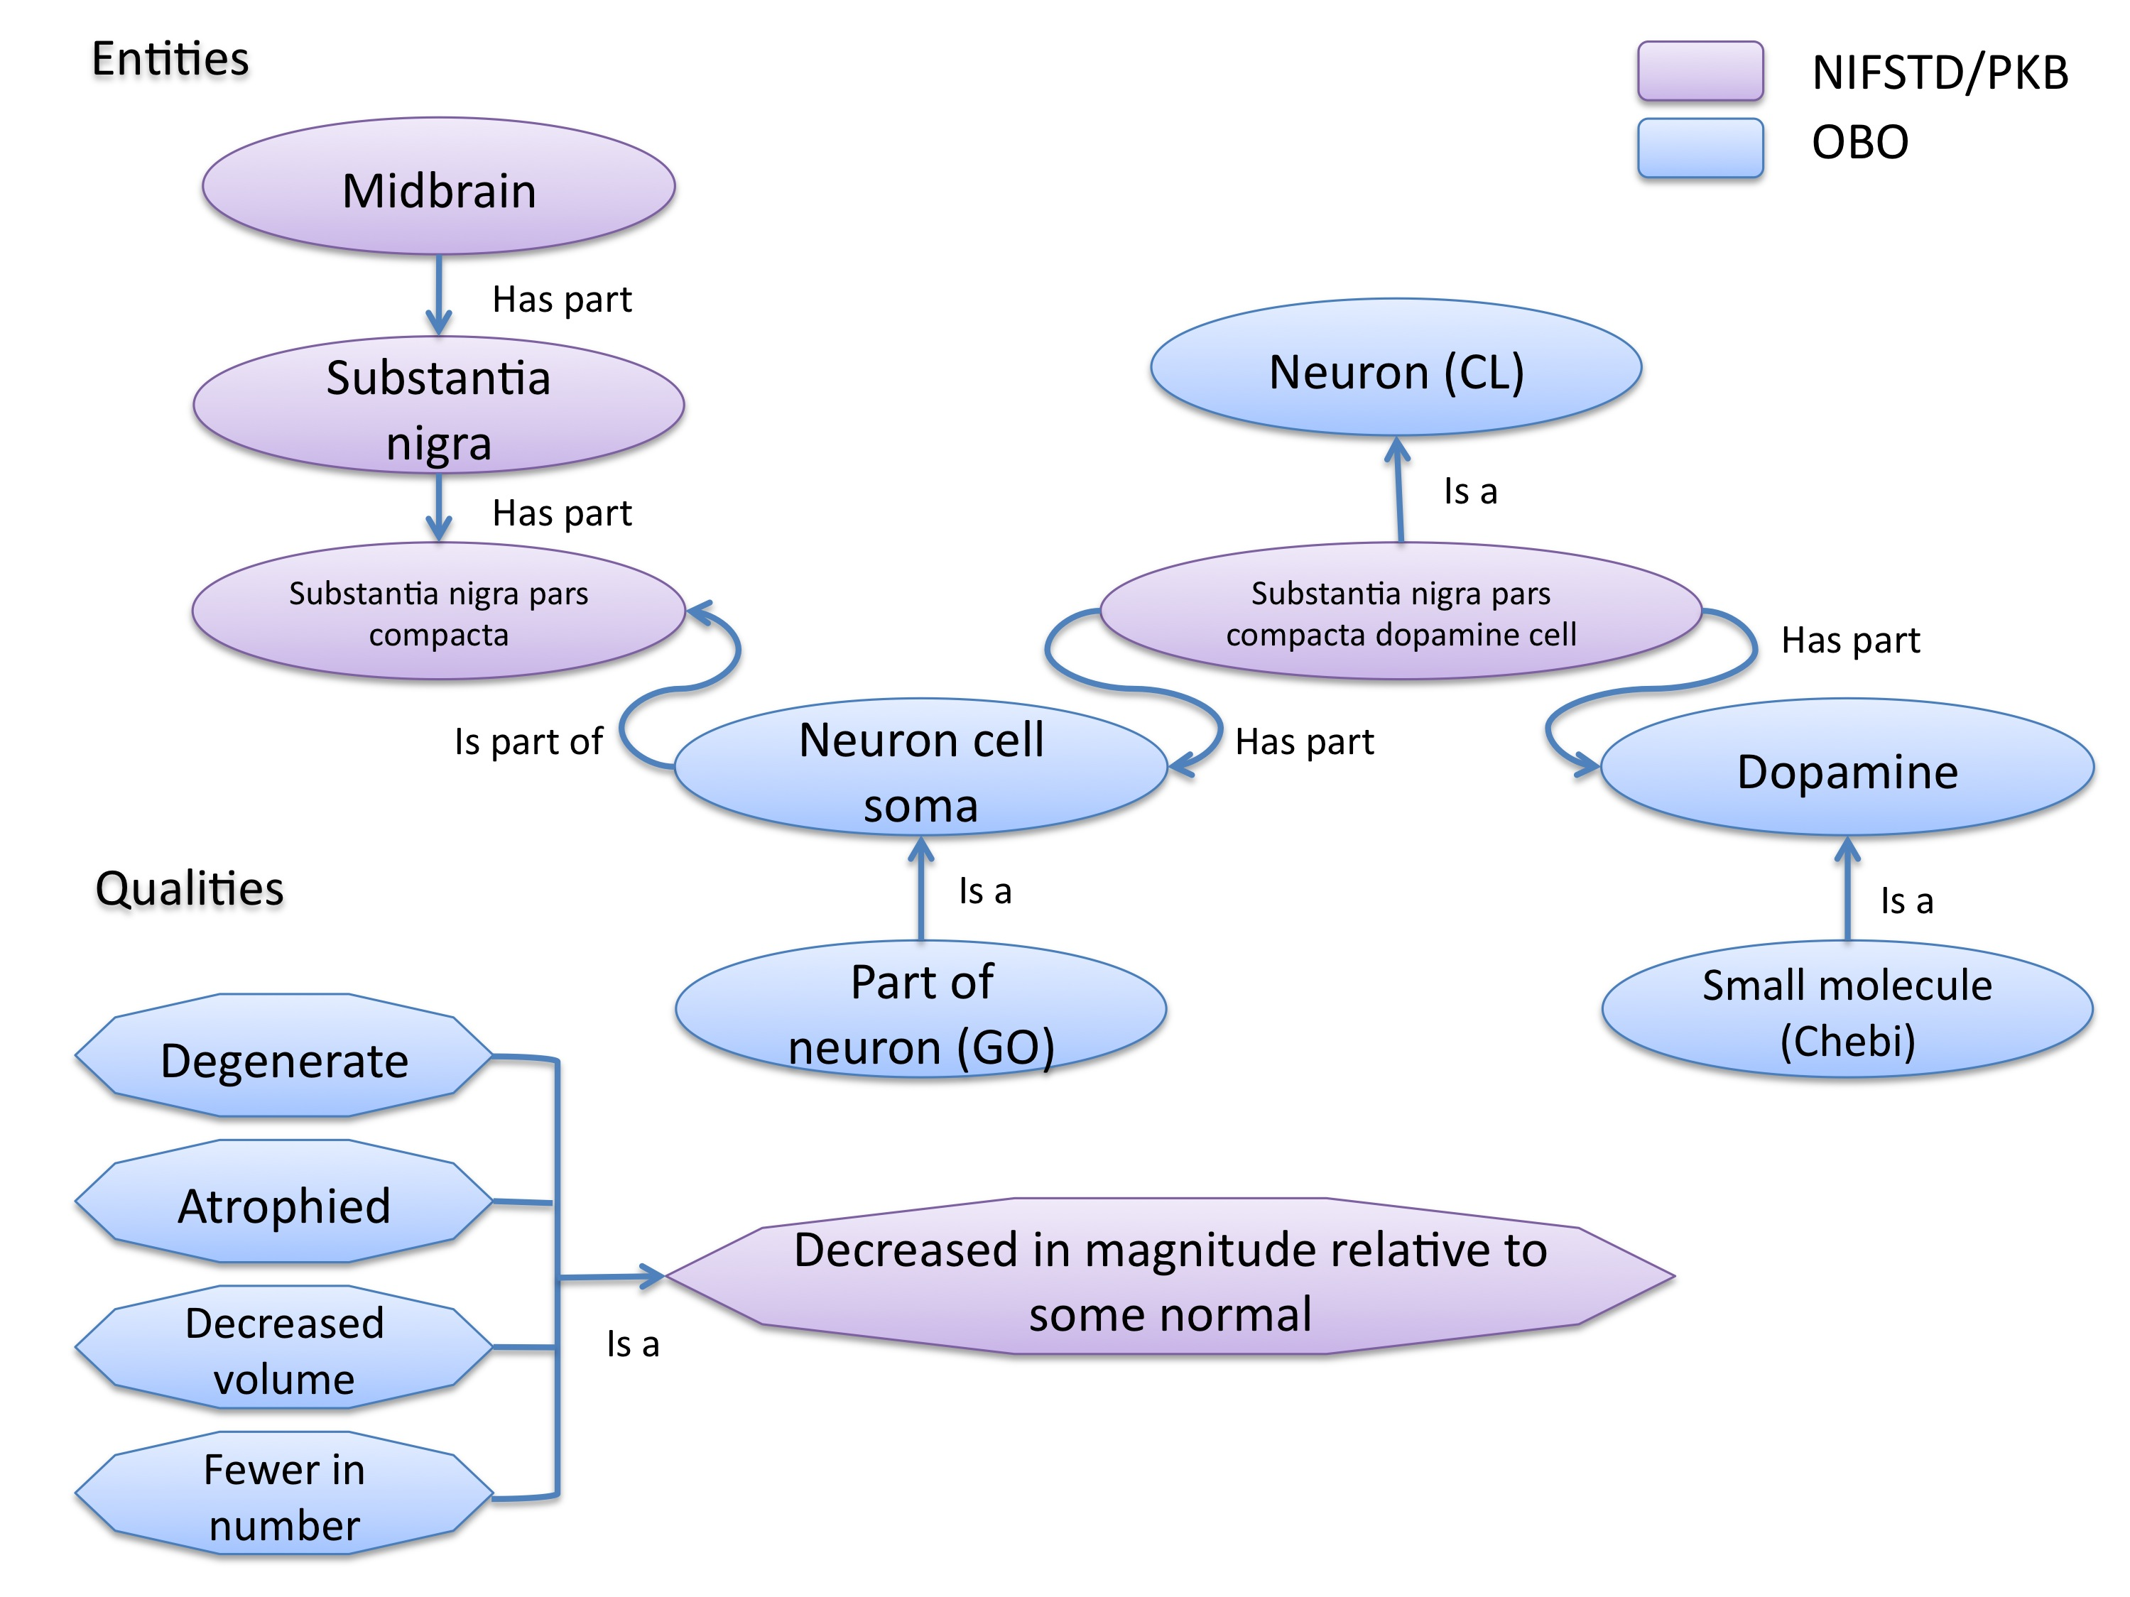
Schematic of Entity and Quality relationships
Notes:
NIFSTD and PATO ontologies served as building blocks to build a phenotype model
PATO is an ontology of qualities that can be combined with any ontological entity to provide a formal description of phenotype
these ontologies provide relationships between neuroscience related terms
provide a structure to qualities and allow related qualities to show relationships

Slide 17
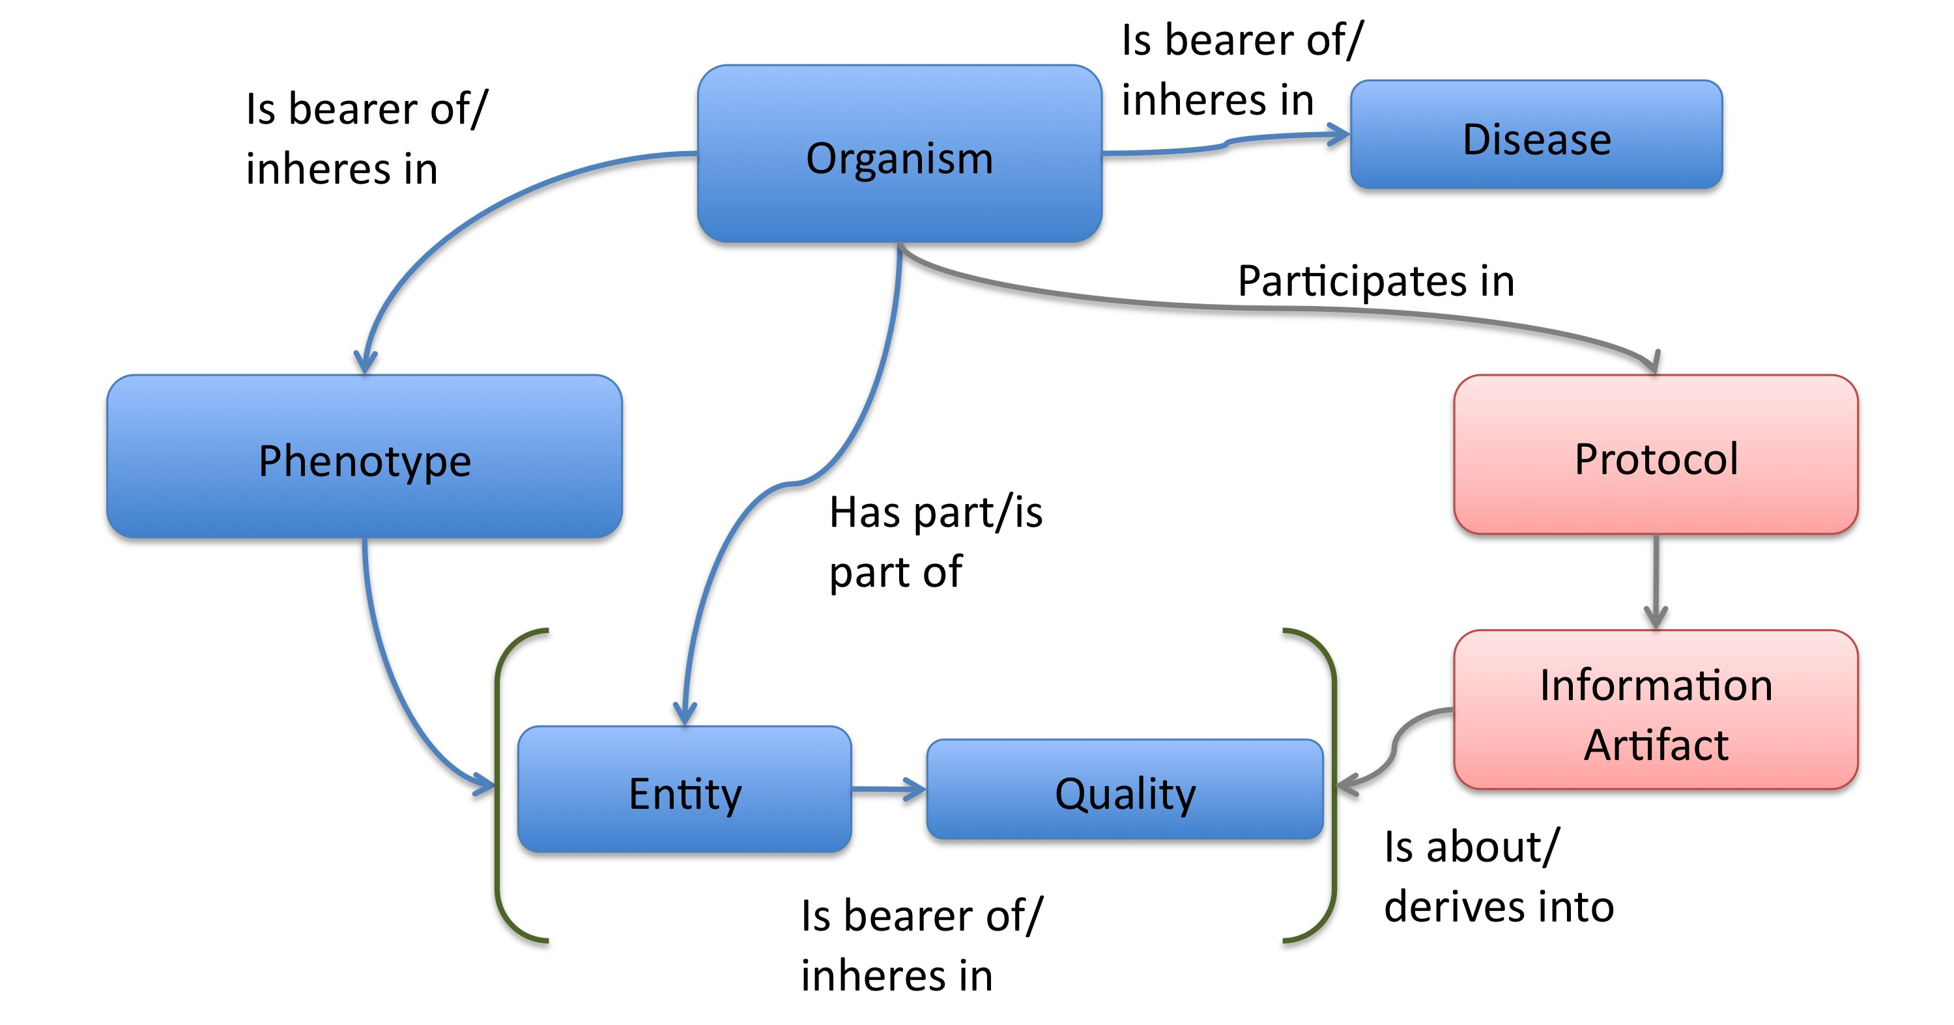
NDPO Phenotype Model
Focused on structural phenotypes
Phenotype constructed as Entity (NIFSTD) + Quality (PATO), e.g. degenerate and inheres_in some ‘Substantia nigra’ → degenerated substantia nigra
Phenotypes are assigned to an organism; organism may bear a genotype or disease diagnosis
Notes:
High level depiction of NDPO phenotype model.

Slide 18
Observation: accumulated lipofuscin in cortical pyramidal neuron from cortex of human with Alzheimer’s disease
inheres in
Human
(birnlex_516)
has part
Neocortex pyramidal neuron
Instance: Human with Alzheimer’s disease 050
inheres in
inheres in
Alzheimer’s disease
Increased number of
Phenotype birnlex_2087_56
towards
Lipofuscin
about
Information artifact: http://ccdb.ucsd.edu/sand/main?mpid=6333&event=displaySum
PKB contains phenotypes from 8 neurodegenerative diseases and phenotypes described in literature and imaging data for rat, mouse, fly, and human
Notes:
Structured phenotype description (boxes) derived from imaging data stored in the CCDB (Accession #: MP6333).
The corresponding image is shown on the left.
Each of the classes are derived from the NIFSTD ontologies.

Slide 19
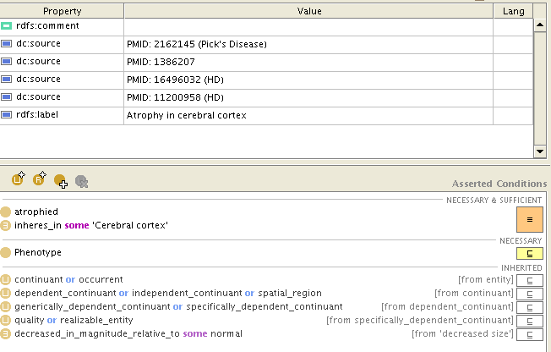
Human with Alzheimer’s disease = Human and is bearer of some Alzheimer’s disease
Atrophy in cerebral cortex =
atrophied inheres in some cerebral cortex
Notes:
The entire phenotype is recorded as a series of phenotypic statements, each depicted as a relationship between two classes.

Slide 20
Textual Phenotype Description | OWL expression | Reference
Neurons decreased in number in the substantia nigra pars compacta | (Has fewer parts of type) inheres in some substantia nigra pars compacta towards some neuron | PMID:12971891
Neurons decreased in number in the substantia nigra | (Has fewer parts of type) inheres in some substantia nigra towards some neuron | PMID: 9617789
Dopaminergic cells decreased in number in the substantia nigra | (Has fewer parts of type) toward some substantia nigra dopaminergic cell
Substantia nigra dopamine cells decreased in number | (Has fewer parts of type) toward some substantia nigra dopaminergic cell
Degeneration of substantia nigra dopaminergic cells | Degenerate inheres in some substantia nigra dopaminergic cell | PMID: 11253364
Dopaminergic cells containin neuromelanin decreased in number in the substantia nigra pars compacta | (Has fewer parts of type) toward some substantia nigra dopaminergic cell has part neuromelanin | PMID: 19086884
Substantia nigra pars compacta depigmentation | (Has fewer parts of type) inheres in substantia nigra pars compacta towards some neuromelanin | PMID: 12971891
Substantia nigra pars compacta decreased in volume | (Decreased volume) inheres in some substantia nigra pars compacta | PMID: 17978822
Substantia nigra pars compacta degenerated | Degenerate inheres in some substantia nigra pars compacta | PMID: 16772866
Substantia nigra decreased in volume | Decreased volume inheres in some substantia nigra | PMID: 18941719
Atrophy of midbrain | Atrophied inheres in some midbrain | PMID: 18941719
Midbrain degenerated | Degenerate inheres in some midbrain | PMID: 20308987

Slide 21
Summary and Conclusions
NIFSTD is an example of how ontologies can be used/re-used and practically applied to enhance search and data integration across diverse resources
NIFSTD continues to create an increasingly rich knowledgebase for neuroscience integrating with other life science community
NIF encourages the use of community ontologies
Moving towards building rich knowledgebase for Neuroscience that integrates with larger life science communities.

