Slide 1
Analytic Metaphysics
Lecture 5
Barry Smith
February 23, 2016

Slide 2
Material Entities and Process Profiles

Slide 3
BFO:material_entity

Slide 4
BFO:immaterial_entity

Slide 5
BFO:object (& its siblings)

Slide 6
BFO:object
Objects = natural units in the realm of material entities
Natural units = causal relatively isolated units, of three major kinds
organisms, cells and potentially also biological entities of certain other sorts, including organs
portions of solid matter such as rocks and lumps of iron
engineered artifacts such as watches and cars.
See Smith, “On Classifying Material Entities in Basic Formal Ontology”, http://ontology.buffalo.edu/smith/articles/material_entities.pdf

Slide 7
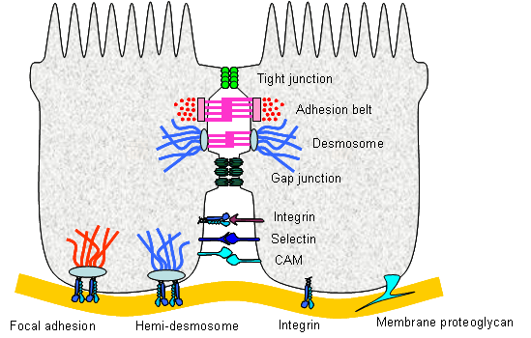
Problem case for BFO:object
cell adhesion
Notes:
http://php.med.unsw.edu.au/cellbiology/index.php?title=File:Cell_adhesion_summary.png

Slide 8
BFO:object (& its siblings)
Object, Fiat Object Part and Object Aggregate are not exhaustive of Material Entity
(see Lars Vogt, et al., “Accommodating Ontologies to Biological Reality – Top-Level Categories of Cumulative-Constitutively Organized Material Entities”, PLoS One, 2012; 7(1): e30004.

Slide 9
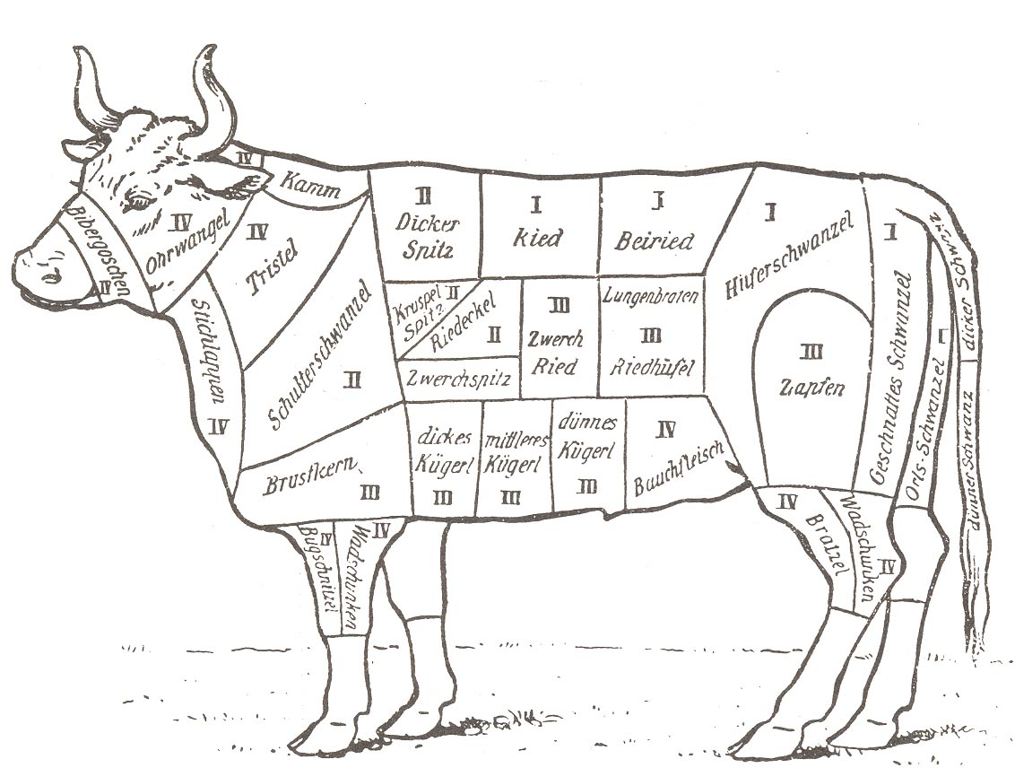
BFO: fiat_object
For BFO 2.O Object, Fiat Object Part and Object Aggregate are not intended to be exhaustive of Material Entity (see Lars Vogt)

Slide 10
... | up | down | charm | strange | ...
... | 19 K | 20 Ca | 21 Sc | 22 Tv | ...
 | John | Paul | George | Ringo

Slide 11
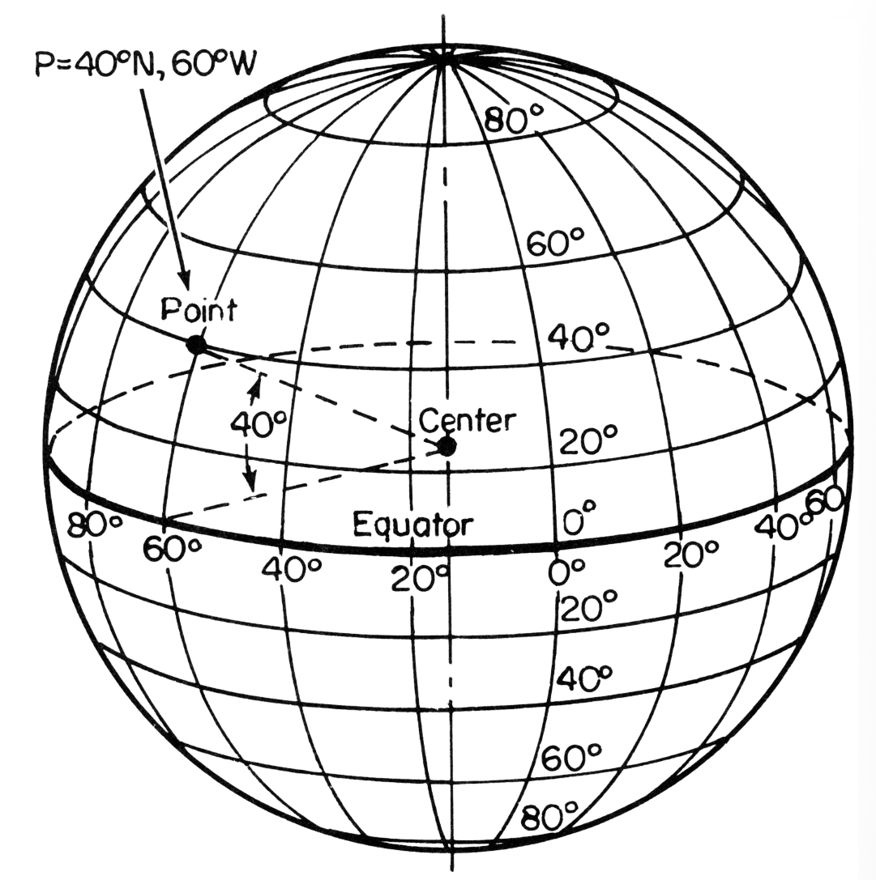
Fiat object parts reflect partitions
Notes:
http://drifters.doe.gov/track-a-yoto/track-a-drifter.html

Slide 12
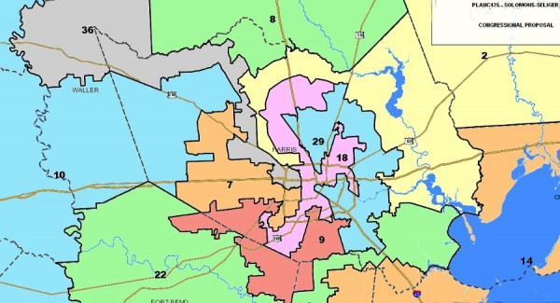
Some fiat continuants (e.g. voting districts) are the product of partitions
Notes:
Houston redistricting plan http://blog.chron.com/texaspolitics/2011/06/analysis-gop-congressional-redistricting-plan-hammers-houston-helps-republicans-in-fort-worth-east-texas/

Slide 13
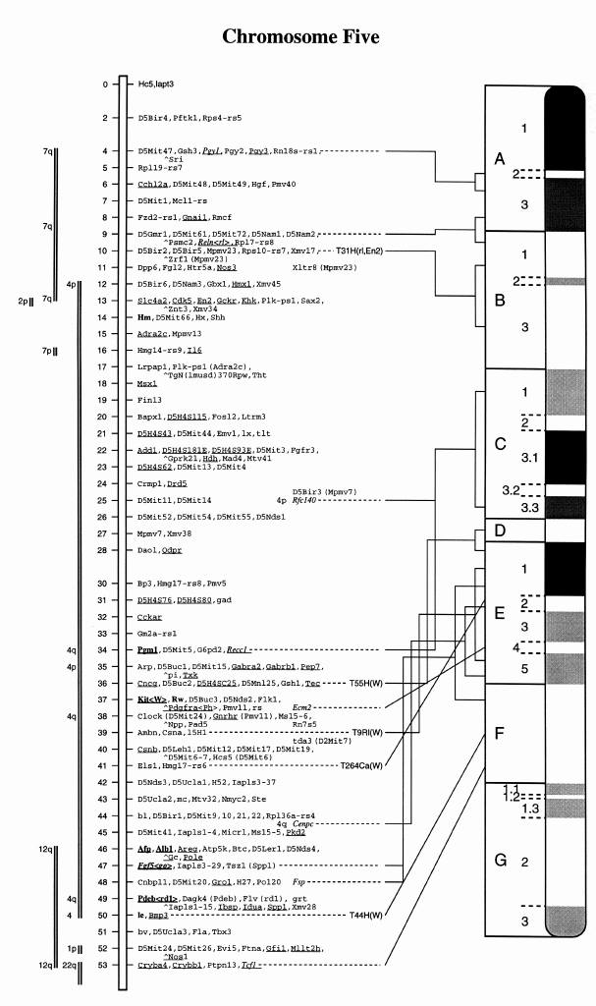
Some fiat object parts (roughly: those arising in the domain of natural science) pre-existed our creation of corresponding partitions
Mouse Chromosome 5

Slide 14
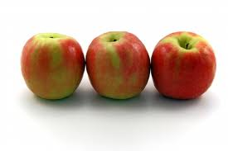
BFO:object_aggregate
not a sum of objects, but something like a set:
a certain part of material reality, picked out by a certain granular partition

Slide 15
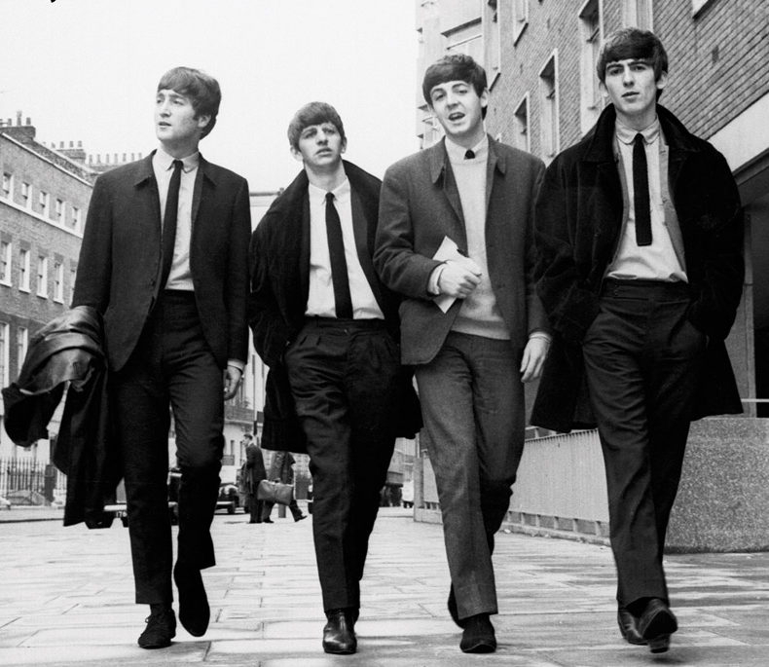
BFO:object_aggregate
not a sum of objects, but something like a set:
a part of material reality, picked out by a certain granular partition (the result of a fiat partition which involves a sort of masking)

Slide 16
The Beatles

Slide 17
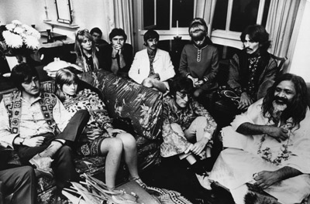
The Beatles

Slide 18
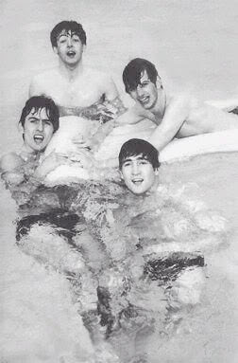
We use the partition to pick out a certain object aggregate in this particular portion of material reality, then we mask all other portions of reality, from external (the water) and internal (the cells and molecules)
John | Paul | George | Ringo

Slide 19
is a veridical partition. The Beatles truly do (did) exist
John | Paul | George | Ringo

Slide 20
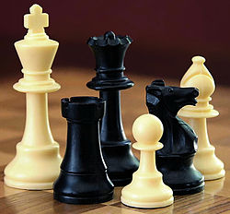
all these partitions are verdical
king | rook | queen | pawn | knight | bishop
chess pieces | table top | surrounding space
molecules

Slide 21
BFO:object_aggregate
which can however change its members over time
(e.g. the aggregate of members of the International Association for Ontology and Its Applications)
examples: populations, families, tribes, species, planetary systems – anything associated with a count, a registry, an inventory, a census

Slide 22
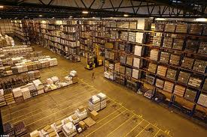
inventory

Slide 23
member_part_of
a member_part_of b at t =Def. a is an object at t
& there is at t a mutually exhaustive and pairwise disjoint partition of b into objects x₁, …, x_{n} with a = x_{i} for some natural number i.
Use this as basis for a theory of groups, organizations and other social objects

Slide 24
organizations
are object aggregates in which different members have different, specified roles (President, Secretary, Treasurer, Bandmaster, and so on)

Slide 25
Non-rigid defined classes = hold of a continuant only for a certain time in the life of the continuant
human
in nature, no sharp boundaries here
embryo
fetus
neonate
infant
child
adult
instantiates at t₁
instantiates at t₂
instantiates at t₃
instantiates at t₄
instantiates at t₅
instantiates at t₆
John

Slide 26
portion of water
Phase transitions
portion of ice
portion of liquid water
portion of gas
instantiates at t₁
instantiates at t₂
instantiates at t₃
this portion of H₂0

Slide 27
Determinable and determinate qualities
temperature
rigid
non-rigid
37ºC
37.1ºC
37.2ºC
37.3ºC
37.4ºC
37.5ºC
instantiates at t₁
instantiates at t₂
instantiates at t₃
instantiates at t₄
instantiates at t₅
instantiates at t₆
John’s temperature (a quality instance)

Slide 28
Determinable and determinate qualities
temperature
in nature, no sharp boundaries here
in nature, no sharp boundaries here
37ºC
37.1ºC
37.2ºC
37.3ºC
37.4ºC
37.5ºC
instantiates at t₁
instantiates at t₂
instantiates at t₃
instantiates at t₄
instantiates at t₅
instantiates at t₆
John’s temperature

Slide 29
Recall how we deal with phase sortals
John instance_of nurse at t =Def.
John instance_of human being at t
& for some x, x instance_of nurse role
& x inheres_in John at t

Slide 30
Role universals are rigid universals
Nurse role is_a role
(Role universals are rigid universals)
If x instance_of role at t, then x instance_of role at all times at which x exists.
Quality, disposition, region, material entity – these too are rigid universals
Is object a rigid universal?

Slide 31
is a veridical partition, too; that aggregate of cells truly did exist
 | Cells in Ringo

Slide 32
is a veridical partition, too; that aggregate of molecules truly do (did) exist
 | molecules in Ringo

Slide 33
BFO:history
history of a material entity m = sum of all the processes taking place in the spatiotemporal region occupied by m
 | Ringo’s history time
 | Spatiotemporal region occupied by Ringo

Slide 34
History
history of a material entity m = sum of processes taking place in the spatiotemporal region occupied by m

Slide 35
History
The relation between a material entity and its history is one-to-one:
for any material entity a, there is exactly one process which is the history of a,
for every history h, there is exactly one material entity which h is the history of.
Histories are additive. Thus for any two material entities a and b, the history of the sum of a and b is the sum of their histories.

Slide 36
Helmholtz’ cocktail party problem
music is playing, people are speaking, garments rustling, feet gliding, glasses clinking …
this gives rise to a system of waves which dart through the mass of air in the room, …, complicated beyond conception.

Slide 37
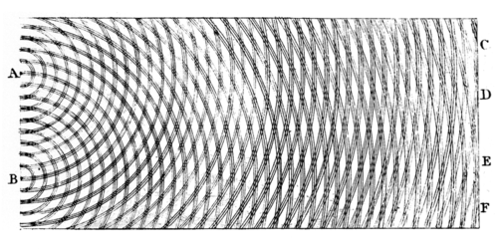
And yet ... the ear is able to distinguish all the separate constituent parts of this confused whole. (Helmholtz, 1863)

Slide 38
Auditory streams
in the mind
in reality

Slide 39
But there are also streams in external reality
What unifies these streams?
In music: temporal and spatial proximity of tones (Bozzi)
But also: common source (same voice, same instrument, same intentions …)

Slide 40
Many streamiform structures in reality
thinking
speaking
playing (music, football, chess, …)

Slide 41
Napoleon’s march to Moscow, a certain historical process profile, is a truthmaker for this map

Slide 42
Streamiform structures in reality are processes (events, happenings …)
But what sorts of entities are processes?
One view: a process is what happens within a certain region of space-time
Process a = process b if and only if a and b occupy the same region of space and time

Slide 43
Streamiform structures in reality are processes (events, happenings …)
But what sorts of entities are processes?
One view: a process is what happens within a certain region of space-time

Slide 44
We choose to describe in different ways what is going on in a given region of space and time (cognitive selection)
John is buttering the toast
John is buttering the toast gracefully
John is pulling the trigger of his revolver
John is shooting Mary

Slide 45
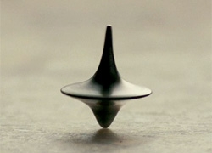
But what about this case: A top is spinning and simultaneously getting warmer
same spatiotemporal region, distinct processes
Notes:
http://www.notcot.org/page/734/

Slide 46
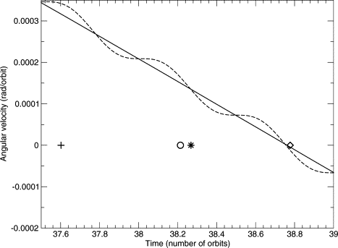
the spinning top is at the same time warming up
Notes:
http://www.sciencedirect.com/science/article/pii/S0019103505000072

Slide 47
What separates the two streamiform structures of reality here?
Answer: they belong to different measurable dimensions
Notes:
http://www.notcot.org/page/734/

Slide 48
What are you doing when you measure a process in reality?
You are focusing on a certain dimension of change within a specific bearer of change
Perhaps using a special instrument

Slide 49
As a doctor, you focus just on Ringo’s temperature
 | Ringo’s temperature
 | 37.1 | 37.2 | 37.3 | 37.4
 | Ringo

Slide 50
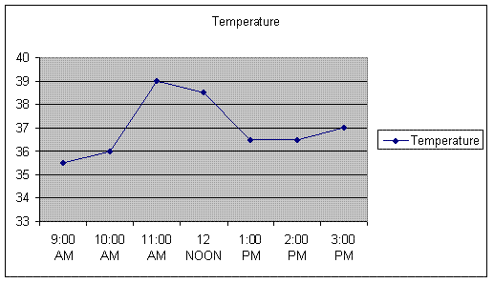
Measurable streamiform structures of reality can be represented via time-series graphs
Temperature

Slide 51
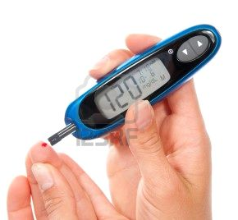
is_about
IAO:measurement datum
concretized_by
quality: John’s blood glucose level
has_specified
_output
inheres_in
quality: ‘120 mg/dL’-shaped pattern
portion of blood
OBI process:
this specific assay
participates_in
inheres_in
derived_from
participates_in
device
screen
part_of
John
Blood Glucose Level Measurement
Notes:
http://www.123rf.com/photo_9665076_diabetes-patient-measuring-glucose-level-blood-test-using-ultra-mini-glucometer-and-small-drop-of-bl.html

Slide 52
Blood glucose level (quality) assay
#1. John (BFO:object)
#2. portion of blood in John (BFO:object aggregate)
#3. volume of #2.
#4. portion of glucose in #2. (BFO:object aggregate)
#5. mass of #4.
#4. ratio of #5. to #3. (BFO:quality of #2.)
#5. the act of measuring #4. (BFO:process)
#6 the expression (IAO:information artifact): ‘125 mg/dL’ that is the output of #5

Slide 53
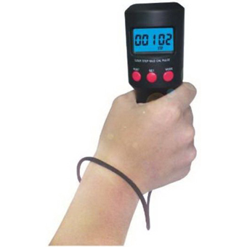
is_about
IAO:measurement datum
concretized_by
process: John’s heart beating
has_specified
_output
quality: ‘120 bpm’-shaped pattern
has_participant
OBI process:
this specific assay
has_participant
inheres_in
device
screen
has_part
has_participant
Pulse Rate Measurement
John
Notes:
http://www.123rf.com/photo_9665076_diabetes-patient-measuring-glucose-level-blood-test-using-ultra-mini-glucometer-and-small-drop-of-bl.html

Slide 54
The problem of process qualities
heart beating at constant rate:
#1. the heart (object)
#2. a sufficiently long process of #1.’s beating
#3. the temporal region occupied by #2.
#4. the spatiotemporal region that is occupied by #2. (trajectory of #2.)
#5. number of cycles in #2.
#6. the pulse rate = ratio of #5. to #3., referred to by means of
#7. an expression (information artifact, thus a BFO:generically dependent continuant) such as ‘63 beats/minute’.

Slide 55
is_about
IAO:measurement datum
concretized_by
process: John’s heart beating
has_specified
_output
quality: ‘120 bpm’-shaped pattern
has_participant
OBI process:
this specific assay
has_participant
inheres_in
device
screen
has_part
has_participant
Beat Measurement
John
Notes:
http://www.123rf.com/photo_9665076_diabetes-patient-measuring-glucose-level-blood-test-using-ultra-mini-glucometer-and-small-drop-of-bl.html

Slide 56
The problem of process qualities
heart beating at constant rate:
#1. the heart (object)
#2. a sufficiently long process of #1.’s beating
#3. the temporal region occupied by #2.
#4. the spatiotemporal region that is occupied by #2. (trajectory of #2.)
#5. number of cycles in #2.
#6. the pulse rate = ratio of #5. to #3., referred to by means of
←NOTHING IN BFO FOR WHAT THIS IS A MEASUREMENT OF
#7. an expression (information artifact, thus a BFO:generically dependent continuant) such as ‘63 beats/minute’.

Slide 57
The device
The device is in each case a reliable means of arriving at information of the relevant sort
This means:
1. it has been built according to a specified process
2. it matches the other instances of the same device type produced as outputs of this process
3. the information produced as output by other instances of this device type has been positively tested for accuracy

Slide 58
Objects have qualities which can be accepted as first class entities
Because objects can gain and lose qualities – as you can gain and lose a suntan
Processes do not have qualities which can be accepted as first class entities
Why not?
Because processes cannot change.
a beating process p goes from 63bpm to 65bpm means: p (unchangingly) has two temporal parts, the first of which is a 63bpm segment, the second a 65bpm segment

Slide 59
Intuition:
if you have 3 apples in a box, then you do not have 4 first-class entities: the 3 apples, plus the number 3.
Analogously:
if you have a process that is a 63bpm-process, then you do not have 2 first-class entities: the process, plus the 63bpm.

Slide 60
to predicate ‘has rate 63 bpm’ of a certain regular 3 minute long heart beating process
is not to assert that the process has a special quality (which the same process, in another scenario, could conceivably have lacked)
it is to assert that the process is of a certain determinate type.
process p has rate r is analogous not to:
rabbit r has weight w
but rather to:
rabbit r instance_of universal: rabbit

Slide 61
Typically, processes are very complicated
a single running process p might be an instance of multiple universals such as
3.12 m/s motion process,
9.2 calories per minute energy burning process,
30.12 liters per kilometer oxygen utilizing process,
cardiovascular exercise process of type #16
and so on.
How develop mathematical models of such complex entities? BFO can help with this.

Slide 62
Solution
focus not on ‘thick’ processes, such as runnings or hearts’ beating
but on ‘thin’ structural parts of processes
called ‘process profiles’
(event patterns, …)

Slide 63
The problem of process qualities
heart beating at constant rate, elements of an ontological analysis:
the heart (object)
the process of beating
the temporal region occupied by this process
the spatiotemporal region that is occupied by this process (trajectory of the beating process)
the heart beating, referred to by means of
a time series graph (information artifact, thus a BFO:generically dependent continuant) such as:

Slide 64
Process profile ≅ that which the output of a correct device would represent
= that which a correct time-series graph would represent
Notes:
http://www.fitnessmantra.info/fitness/wp-content/uploads/2007/09/ECG%20-%20Electro%20Cardio%20Graph.png

Slide 65
A simpler case
Call the process represented by this graph a (temperature) quality process profile

Slide 66
The graph picks out just one dimension of qualitative change within a much larger conglomerate of processes
Hence ‘quality process profile’

Slide 67
Ringo’s temperature

Slide 68
When we look at Ringo’s history through the temperature partition
we focus not on the full process which is the entire history, but rather on a partial process
called a ‘temperature quality process profile’

Slide 69
Process profile ≅ that which the output of a correct device would represent
= that which a correct time-series graph would represent
Notes:
http://www.fitnessmantra.info/fitness/wp-content/uploads/2007/09/ECG%20-%20Electro%20Cardio%20Graph.png

Slide 70
The graph picks out just one dimension of qualitative change within a much larger conglomerate of processes
Hence ‘quality process profile’

Slide 71
What did your temperature do over the last month, Ringo?
a target of a certain sort of cognitive selection, or cognitive profiling

Slide 72
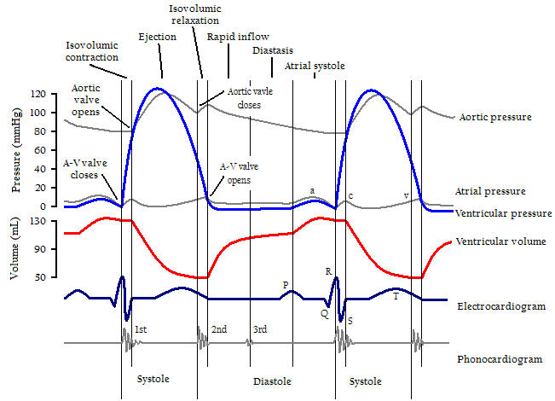
Cardiac Cycle, Left Ventricle
Notes:
http://en.wikipedia.org/wiki/Cardiac_cycle

Slide 73
Some processes can incorporate multiple quality process profiles
Cardiac Cycle, Left Ventricle
Notes:
http://en.wikipedia.org/wiki/Cardiac_cycle

Slide 74
…corresponding to the multiple different sorts of partition of the same reality involved during measurement
Cardiac Cycle, Left Ventricle
Notes:
http://en.wikipedia.org/wiki/Cardiac_cycle

Slide 75
compare inseparable parts of qualities e.g. hue, saturation and brightness of a color quality
the corresponding quality process profiles will stand in analogous relations to each other

Slide 76
just as hue, saturation, brightness are mutually dependent proper parts of a color instance
so process profiles may be mutually dependent proper parts of some larger process

Slide 77
multi-quality process profile
Cardiac Cycle, Left Ventricle
Notes:
http://en.wikipedia.org/wiki/Cardiac_cycle

Slide 78
Compare perception of polyphonic music
Cognitive selection of the cello part when you listen to a string quartet
Picking out a certain process profile within a larger body of vibrations
Ignoring sneezes, coughs, …
(sometimes focusing on sneezes and coughs for diagnostic purposes)

Slide 79
Single quality process profile
a process of the sort that can be represented by a chart plotting quality measurement results on a single dimension against a time axis
a quality process profile is a truthmaker for a time series graph of this sort

Slide 80
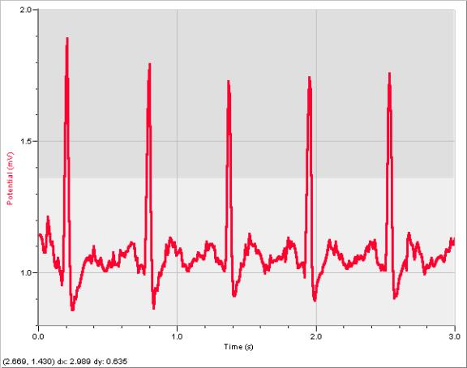
Many putative process qualities (e.g. amplitude) may better be conceived as qualities of such time series graphs
Notes:
http://tg016.k12.sd.us/inquiry_project____________cardi.htm

Slide 81
New to BFO 2.0: Introduction of mutual dependence between qualities
some specifically dependent continuants (SDCs) are reciprocally dependent on each other, for example between color hue, saturation and brightness

Slide 82
mutual dependence
a
b
c
husband role ←→ wife role
lock function ←→ key function

Slide 83
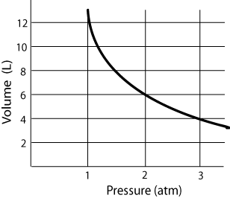
Boyle’s Law

Slide 84
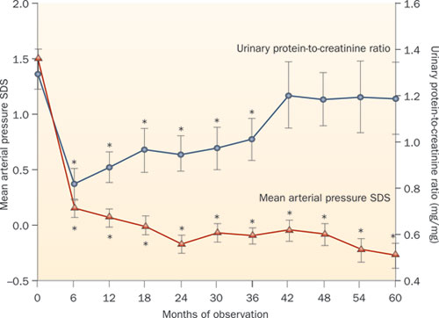
simultaneous causality

Slide 85
causal models for Virtual Physiological Human

Slide 86
Physiological models
kinetic, hydraulic, electrical or chemical …
sets of differential equations …
how to integrate these models?

Slide 87
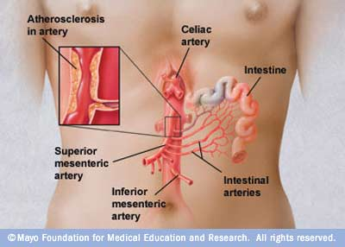

Slide 88
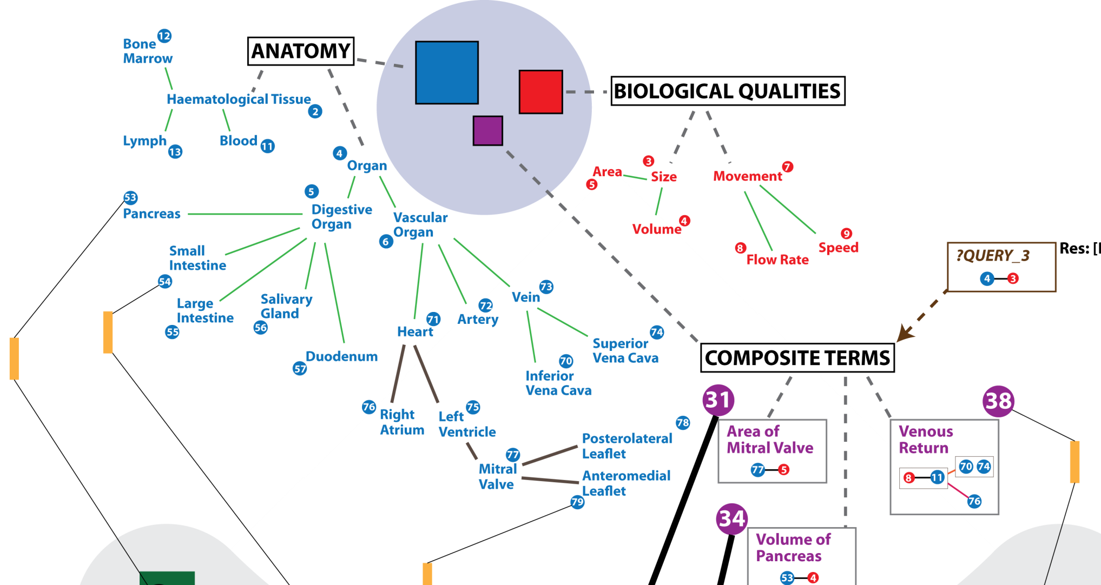
Virtual Physiological Human Ontologies
Bernard de Bono, ICBO 2011

Slide 89
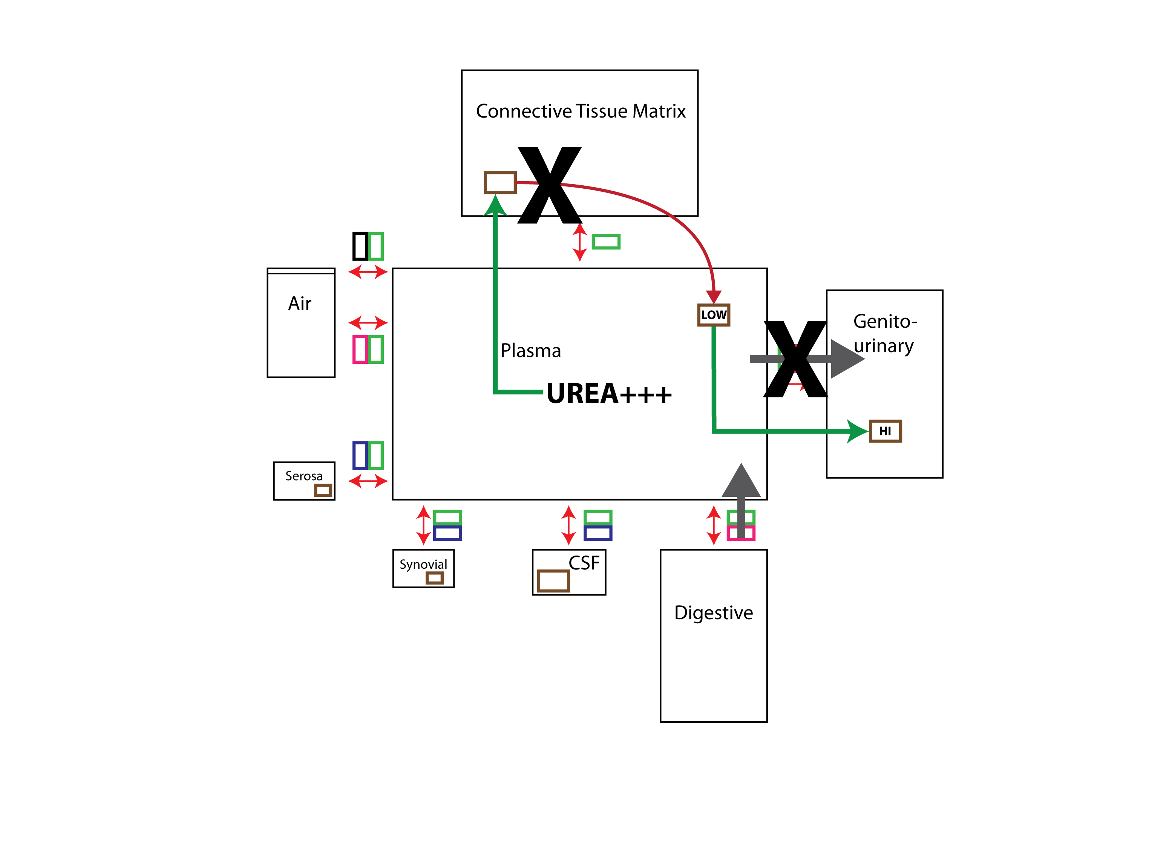
Compartments
Bernard de Bono, ICBO 2011

Slide 90
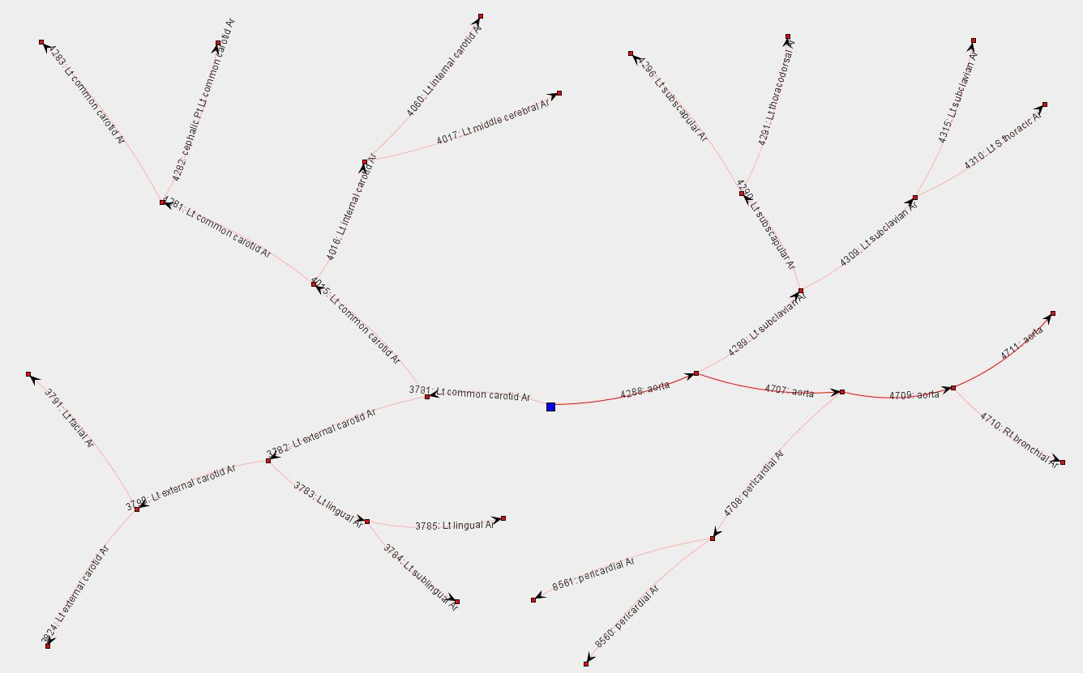
Connections Bernard de Bono, ICBO 2011

Slide 91
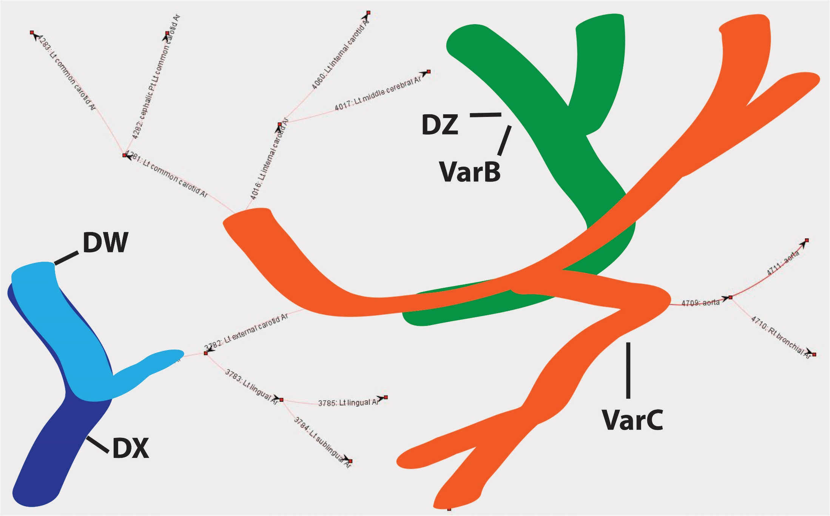
Differential equations
Bernard de Bono, ICBO 2011

Slide 92
Differential equations
Bernard de Bono, ICBO 2011

Slide 93
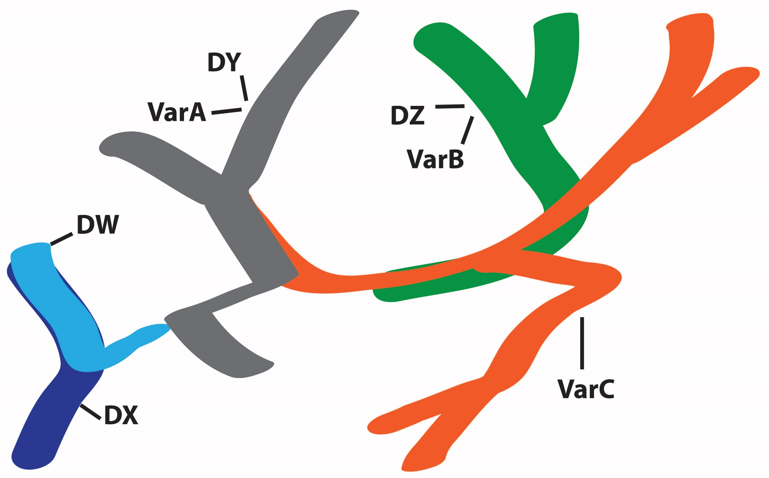
Differential equations
Bernard de Bono, ICBO 2011

Slide 94
Hypothesis
Multi-quality process profiles are the sorts of things that can be represented by corresponding differential equations; i.e. they are multiple interrelated thin slices within processes

Slide 95
Determinable and determinate qualities
temperature
37ºC
37.1ºC
37.2ºC
37.3ºC
37.4ºC
37.5ºC
instantiates at t₁
instantiates at t₂
instantiates at t₃
instantiates at t₄
instantiates at t₅
instantiates at t₆
John’s temperature (a quality instance)

Slide 96
Determinable and determinate quality universals
length
6 cm length
7 cm length
weight
1 kg weight
2 kg weight
temperature
62 degree C temperature
63 degree C temperature

Slide 97
Determinable and determinate process profile universals
speed profile
constant speed profile
2 mph constant speed profile
3 mph constant speed profile
variable speed profile
acceleration profile
constant acceleration profile
0 ft/s² constant acceleration profile
32ft/s² constant acceleration profile
33 ft/s² constant acceleration profile
variable acceleration profile
increasing acceleration profile

Slide 98
Process predications
To assert that a process has process profile type F with magnitude n as measured in unit u is to assert:
measuring technology for measuring process profiles of determinable type F in units u would yield output: n when applied under ideal conditions to this process

Slide 99
Heart beat process profile (across an interval)
Notes:
http://www.fitnessmantra.info/fitness/wp-content/uploads/2007/09/ECG%20-%20Electro%20Cardio%20Graph.png

Slide 100
How to understand: heart beat at t ?
in terms of this diagram? In first approximation, the ratio of numbers of beats to time in a sufficiently large segment of the heart beating process (profile) which includes t in its interior
Notes:
http://www.fitnessmantra.info/fitness/wp-content/uploads/2007/09/ECG%20-%20Electro%20Cardio%20Graph.png

Slide 101
How to understand: heart beat at t
in terms of this diagram? In first approximation, the ratio of number of cycles to time in a sufficiently large segment of the heart beating process which includes t in its interior (say: 2 cycles / 1.8 seconds)
t
Notes:
http://www.fitnessmantra.info/fitness/wp-content/uploads/2007/09/ECG%20-%20Electro%20Cardio%20Graph.png

Slide 102
Compare: John is moving with speed v at time instant t
roughly: there is some temporal interval (t₁, t₂), including t in its interior, in which the constant speed v process profile is instantiated
more precisely: Given any ε, however small, we can find some interval (t₁, t₂), including t in its interior, which is such that the ratio of d (the distance traveled) to |t₂-t₁| differs from v by less than ε.

Slide 103
Note the difference between
this moving m has speed v at time instant t
this person j has temperature 36°C at time t
j might have had a different temperature at t
m could not have had a different speed at t
m could not have been different in any way

Slide 104
Process predications
‘p has F of value n as measured in unit u’
abbreviates:
there is some process profile p_{o} such that
p_{o} process_profile_of p
& p_{o} instance_of the determinate process profile type: F with magnitude n as measured in unit u.

Slide 105
Relative process predications
Every process is embedded within a series of larger process wholes, each nested within yet larger process wholes.
When a billiard ball is moving across a table, we can focus
on the ball’s motion relative to the table,
on the larger process which is the motion of the body-table system relative to the motion of the earth,
on the motion of the body-table-earth system relative to the movement of the sun

Slide 106
Relative physiological process predications
When studying the kidney physiologists may investigate
processes within the interior of the kidney, interactions between the kidney and other parts of the urogenital system,
interactions between this system and other bodily systems
and so on.

Slide 107
Relative physiological process predications
A physiologist may be interested in
processes in a single organism,
processes in this single organism as part of a larger whole which includes an entire population of organisms of a relevant similar type (all humans, all human babies of a given birthweight, all athletes, …).
Normal processes are defined for this larger population, and deviations from this norm are defined for the single organism relative thereto.

Slide 108
Relative physiological process predications
The physiologist may study kinetic, hydraulic, electrical or chemical processes extending across smaller and larger wholes, for example when investigating pharmacokinetic interactions between the kidney and drug molecules within its compartments, or when investigating photodermatological interactions which occur when the epidermis is exposed to sunlight.

Slide 109
Relative physical process predications
Predications of processes are always relative to the entirety of spacetime
(relative to frames?)

Slide 110
Most process predications look like this
They do not look like this (which would make them analogous to qualities):
Should we recognize States as Static Process Profiles?

Slide 111
Spinoza: States of motion and rest
4 m/s speed profile
0 m/s speed profile
state of pregnancy

