Slide 1
Epidemics and intervention through the lens of ontology

Slide 2
Public Health View (Epidemics)
Public health surveillance has played an instrumental role in disease identification and prioritization
Has origins in the discovery of the source of a cholera outbreak in London
Notes:
HIV/AIDS, diabetes, waterborne diseases, zoonotic diseases, antibiotic risistance
Next slide mention john snow’s cholera dot map of london outbrerak

Slide 3
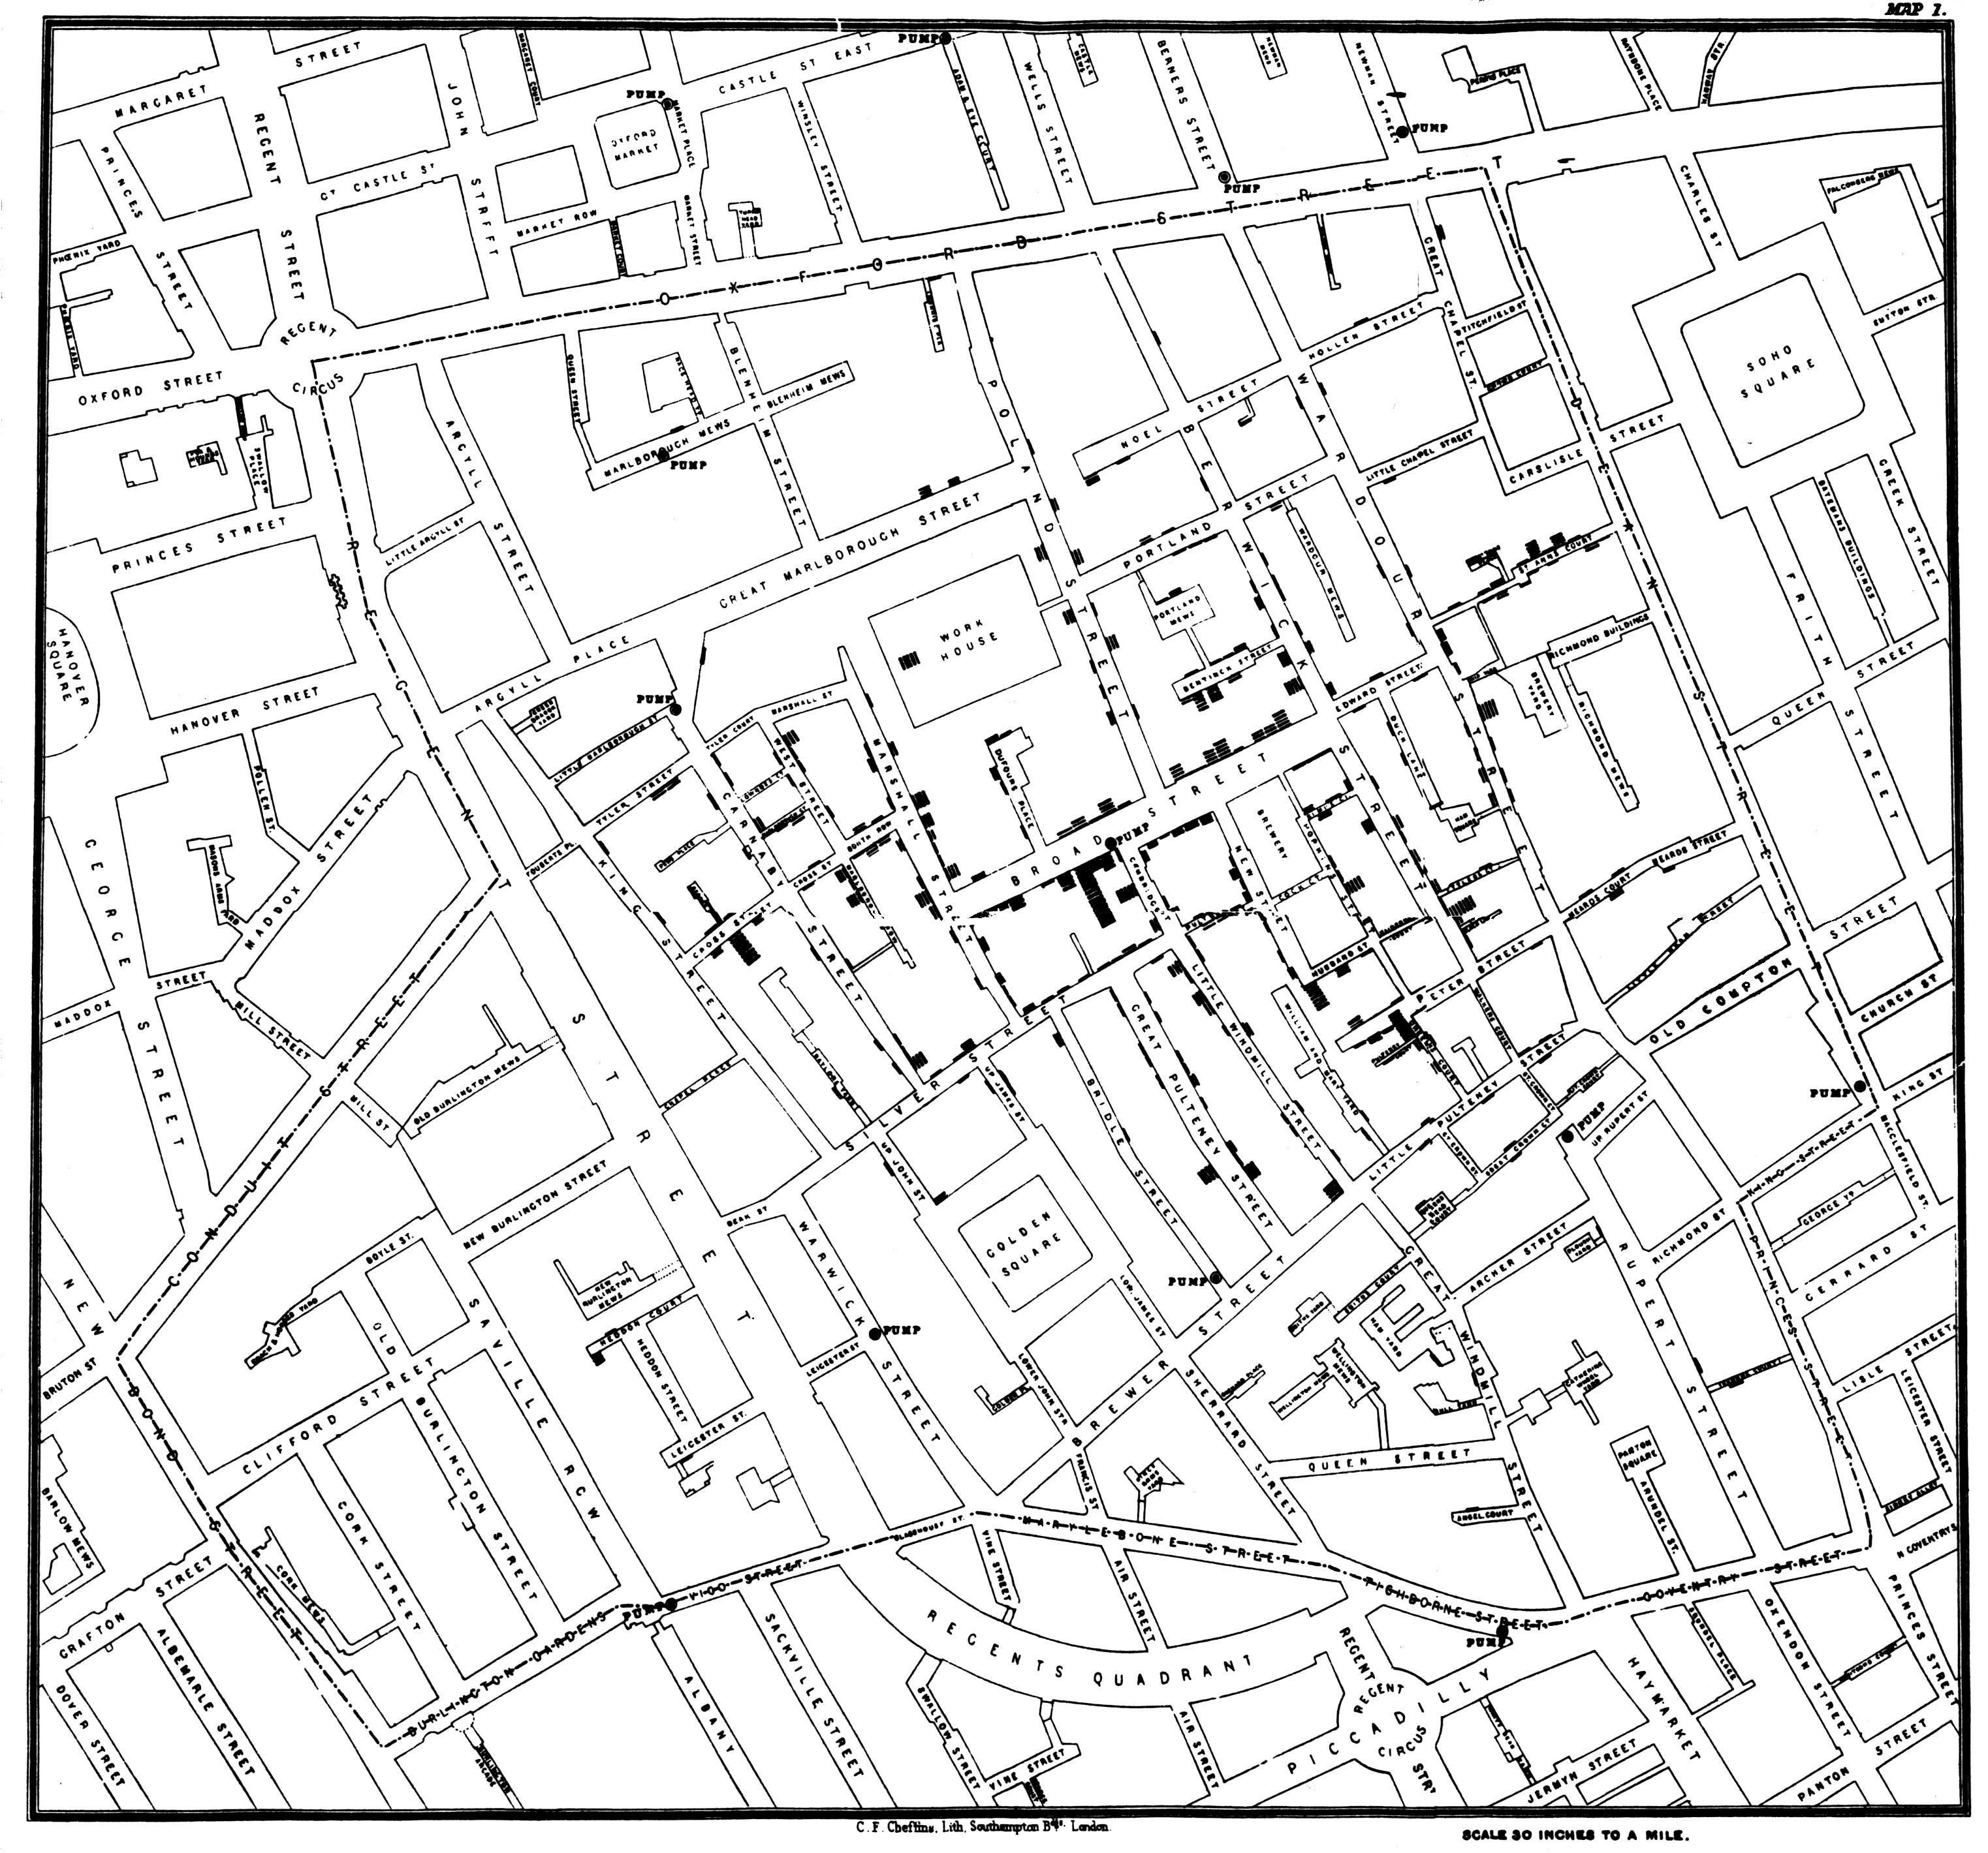
John Snow’s dot map of the 1854 cholera outbreak. The dots represent clusters of outbreaks.

Slide 4
Public Health View
CDC: Epidemic refers to an increase, often sudden, in the number of cases of a disease above what is normally expected in that population in that area.
Notes:
Disease epidemics and pandemics are multistage events that encompass levels of granularity ranging from molecular to population levels, persist over wide ranging geospatial and temporal regions. Examples of epidemics and pandemics include (among too many): 1918 flu, HIV/AIDS, Haiti Cholera outbreak, and the West African Ebola Epidemic of 2013-2016 (which I will attempt to use as a case study.)
Epidemics involve occasionally easy to recognize entities like pathogens, symptoms, medical workers, and drugs or vaccines of varying efficacy. Yet, like the fog of war, it is less clear how precisely entities at particular levels of granularity influence others at different levels of granularity.

Slide 5
Medical Relevance
Now is the time to double down on building better Health Info. Sys.
-> convergence of several techs: network, gene, semantic, and commodity compute
Proliferation of internet connected devices
-> particularly mobile devices in developing countries
Cost of sequencing dropping exponentially, devices smaller and better -> within decades pervasive sequencing
Epidemics and pandemics are existential threats
Notes:
Epidemics are most devastating in developing regions

Slide 6
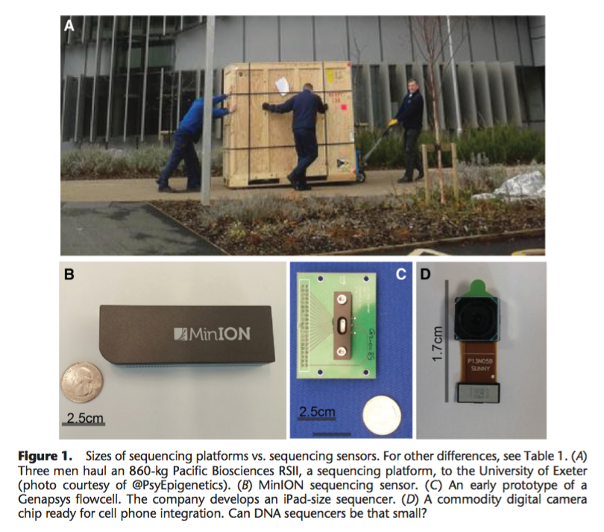
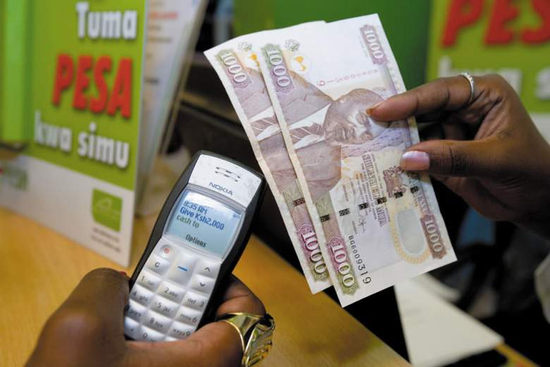
Erlich, Yaniv. "A vision for ubiquitous sequencing." Genome research 25.10 (2015): 1411-1416.
Notes:
Gene sequencing platforms vs sequencing sensors

Slide 7
Contribution of informatics to epidemics monitoring
BioCaster internet health surveillance system
tremendous adoption of EHRS systems in clinics, hospitals, research facilities + networking
These systems allow (in theory) pairing of genotypic/proteomic data with other traditional clinical information.
Global Public Health Intelligence Network (GPHIN) Canada/WHO
Notes:
major technological forces are reshaping public health and computation, biology: proliferation of electronic health record/surveillance systems, as well as, cheap/pervasive gene sequencing.
As gene sequencing falls quickly in price (and the miniaturization of sequencing technology continues) truly pervasive gene sequencing becomes plausible in many contexts: home sequencing (faucet, food storage, gardens, toilets, self-tracking), urban genomics/metagenomics (security checkpoint IDs, public transport public health / bio threat surveillance, water sources, waste treatment plants, etc), industrial quality control (agribusiness, food-supply chains, etc).
4) GLOBAL PUBLIC HEALTH INT a secure Internet-based multilingual early-warning tool that continuously searches global media sources such as news wires and web sites to identify information about disease outbreaks and other events of potential international public health concern. GPHIN is one of the most important sources of informal information related to

Slide 8
Contribution of Ontology to Information Systems
Semantic annotation and linking of medical literature, heterogeneous health data
Ontological engineering: natural-language case notes parsing, referent tracking systems in EHR/HIS
Autonomous Agents, progress in certain AI domains

Slide 9
Snapshots of an epidemic
Case study: West African Ebola epidemic 2013-2016
At least 11,000 people died
About 17,000 more were left w/Post-Ebola Syndromes
Liberia, Sierra Leone, Guinea most casualties

Slide 10
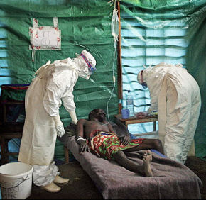
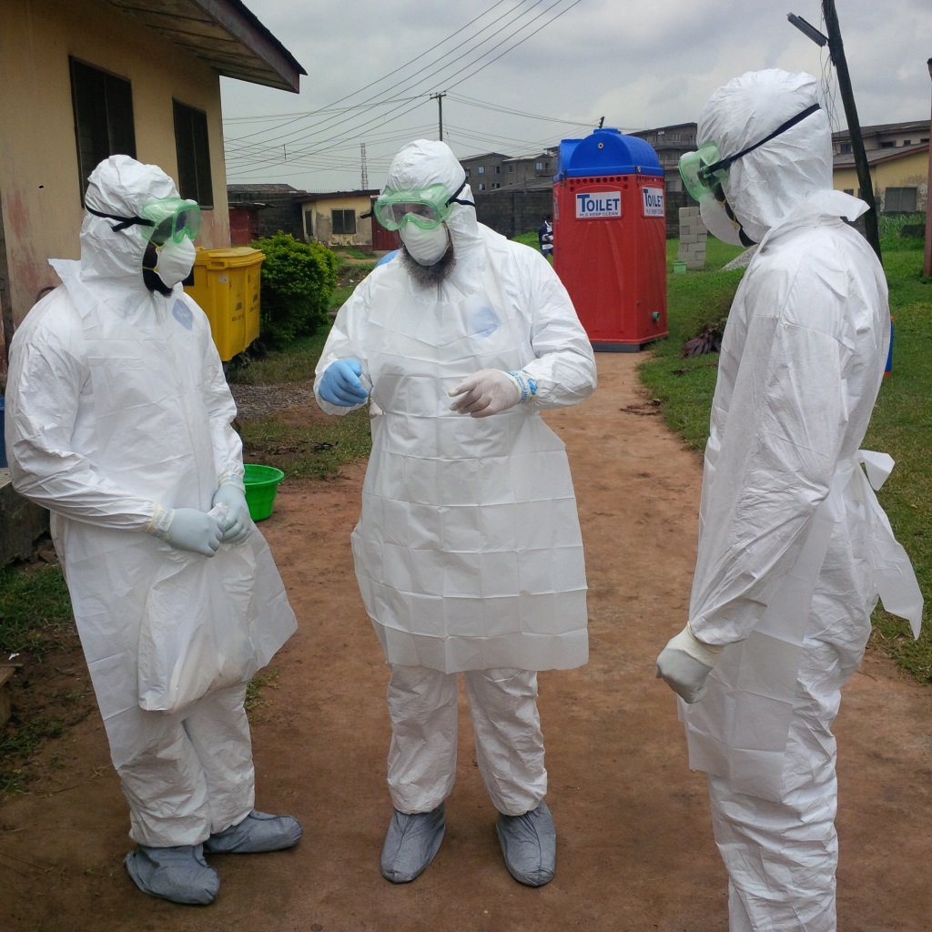
Simplistic Assertions
training_process has_participant collection_of_humans
Ghanaian man bearer of Patient role at t₁₄
Infection_disorder_prevention has_participant protective_clothing at t₁

Slide 11
Some T_{n} Later
Trainee
Coordinator
Trainee
*1*
*2*
*3*
*3*
*2*
*4*
*6*
*7*
containment site
Patient
*9*
*5*
*6*
Instance of training process
*4*
protective_clothing
protective_clothing
protective_clothing
*8*

Slide 12
Universals
Protective suit has_function infectious disease protection #2
“
Continuants
Protective suit #2
Protective suit
Doctor #2
IV-Equipment #2
Patient #2
Doctor
Protective suit has_function infectious disease protection #1
IV-Equipment
Protective suit #1
Doctor #1
Patient
IV-Equipment #1
Patient #1
Arrow of Time
Some Occurents
Process-Boundary: organism death – Patient 1
Process-Boundary: organism death – Doctor 2
12
Notes: GO, experimental factor ontology

Slide 13
Ontological Analysis and Referent Tracking
(Interpreted from Hogan and Ceusters, 2016)
Systematically ID all relevant particulars that must exist for scenario to be true (Even if not mentioned, or only implied)
Assign each particular an instance unique identifier
ID each particular for the type it instantiates and the temporal interval in which it exists
ID the relationships that hold between particulars as well as all relevant relations (…)
Notes:
…as well as all relevant relations particulars have to universals other than instantiation, in cluding situations where a particular lacks a given relation to any instance of a certain type

Slide 14
Essential Universals and Defined Classes
TYPE | DEFINITION
Infectious Disease Course | [D] A disease course that is the realization of an infectious disease. [IDO]
Infectious Disease Epidemic | [D] A process of infectious disease realizations and for which there is a statistically significant increase in the infectious disease incidence of a population. [IDO]
Infectious agent vector | [D] An organism bearing an infectious agent vector role. [IDO]
Homo Sapiens | [D] Human, mammal. [E] An organism. [OBI]
Patient Role | A role which inheres in a person and is realized by the process of being under the care of a physician or health care provider [OBI]
Physician Role | A health care role borne by a human being and realized by promoting, maintaining or restoring human health through the study, diagnosis, and treatment of disease, injury and other physical and mental impairments.[OMRSE]
Diagnosis | The representation of a conclusion of a diagnostic process. [OGMS]
Intravenous Injection | [D] Is the injection of a material entity (bearing the administered substance role) into the vein (bearing the target role) of an organism using a syringe. [OBI]

Slide 15
TYPE | DEFINITION
Grade 2 dehydration AE | A dehydration AE that requires IIV fluids indicated <24 hrs [OAE]
life-death temporal boundary | A life cycle temporal boundary that marks the end of the life cycle of the organism. [UMSAO]
Vomiting | [E] The reflex act of ejecting the contents of the stomach through the mouth. [AERO]
Fever | [E] A rise in body temperature above the normal, often as a response to infection. [AERO]
Diarrhea | [E] Loose and/or watery stool which may occur more frequently than usual. [AERO]
Diagnostic Process | [E] An interpretive process that has as input a clinical picture of a given patient and as output an assertion to the effect that the patient has a disease, disorder, or syndrome of a certain type, or none of these. [OGMS]
Adding a material entity to a target | [D] Is a process with the objective to place a material entity bearing the 'material to be added role' into a material bearing the 'target of material addition role [OBI]
Object Aggregate | [E] b is an object aggregate means: b is a material entity consisting exactly of a plurality of objects as member_parts at all times at which b exists.
Material Entity | [E] A material entity is an independent continuant that has some portion of matter as proper or improper continuant part.

Slide 16
IUI | ENTITY | TIME STEP | TYPE | ONTOLOGY | ANNOTATION
#1 | West African Population | T1 | Object Aggregate | BFO
#2 | Ebola Virus | T2 | Viruses | OBI | This term was imported from ncbi taxonomy
#3 | Subpopulation of #1 infected with #2 | T3 | Object Aggregate | BFO
#4 | Infection case increase process occurring between #3 and #1 |  | Process | BFO
#5 | West African Ebola Epidemic, a process that is a result of #4 not ending |  | Infectious Disease Epidemic | Infectious Disease Ontology (IDO) | It is likely that #5 began at some point during T4, but there is some ambiguity in overall case reporting
Notes:
Werner, virus’ are smaller than cellular nuclei, are they material entities?

Slide 17
IUI | ENTITY | TIME STEP | TYPE | ONTOLOGY | ANNOTATION
#6 | Person E.O. | T4 | Homo sapiens
#7 | #6’s moderately advanced Ebola infection | T5 | Infectious Disease Course | IDO
#8 | #6’s symptom: vomiting | T6 | Vomiting | Adverse Event Reporting Ontology (AERO)
#9 | #6’s symptom: fever | T7 | Fever | AERO
#10 | #6’s symptom: diarrhea | T8 | Diarrhea | AERO
#11 | #7, #8, #9, #10 make #6 highly contagious symptom expression | T9 | Infectious Agent Vector | IDO
#12 | #6’s Patient role | T10 | Patient Role | OBI

Slide 18
IUI | ENTITY | TIME STEP | TYPE | ONTOLOGY
#13 | Volunteer Physician M.S. | T8 | Homo Sapiens | OBI
#14 | #13’s Physician role | T9 | Physician Role | OBI
#15 | #13’s process of making a diagnosis for #6 |  | Diagnostic Process | Ontology of General Medical Science (OGMS)
#16 | #13’s diagnosis | T11 | Diagnosis | OGMS
#17 | #6’s symptom: severe dehydration | T12 | Grade 2 dehydration AE | Ontology of Adverse Events
#18 | IV Solution | T13 | Material Entity | BFO
#19 | IV Device | T13 | Material Entity | BFO
#20 | #13 fills #18 with #19 to prepare #21 |  | Adding a material entity into a target | OBI
#21 | Filled and Prepared IV Device | T14 | Object Aggregate | BFO
#22 | #13 administers IV solution injection to #6 using #21 |  | Intravenous Injection | OBI
#23 | #6’s Death | T15 | Life-death temporal boundary | UMSAO

Slide 19
IUI | RELATION | IUI | Time When Relation Holds in Reality | Annotation
#2 | Inheres in | #6 | T4 | Ebola virus inheres in Person E.O.
#2 | Inheres in | #3 | T3 | Ebola virus inheres in subpopulation of West Africa
#23 | has_participant | #6 | T15 | Death has_participant Person E.O.
#4 | preceded by | #3 | T3
#6 | bearer_of | #12 | T10 | Ends at death T15
#4 | Part_of | #5 | T4 | The rapidly increasing infection rate is part of the eventual epidemic
#18 | Part of | #21 | T15 | IV solution forms part of the filled and prepared IV device
#19 | Part of | #21 | T15 | IV device forms part of the filled and prepared IV device
#13 | Bearer of | #14 | T9 | Volunteer M.S. is bearer of physician role
#13 | Agent of | #15 | T11? | Does the relation hold after the process (which isn’t time indexed) is complete?
#6 | Bearer of | #12 | T10 | Patient E.O. is bearer of patient role

Slide 20
Closing thoughts
Extremely complex portion of reality
Infrastructure, social norms, institutions, mixed international response compounded situation
In retrospect, I would’ve liked to use only BFO/realist ontologies
Still need basics in developing countries: sterile equip, food + water shortages

