Slide 1
Biomedical Ontology PHI 548 / BMI 508
Werner Ceusters and Barry Smith

Slide 2
Lecture 3 Part 1: Ontology of Clinical Practice (continued) Werner Ceusters Part 2: Ontology of Experiments Barry Smith

Slide 3
Ontology of Clinical Practice (continued from Lecture 2)
Werner Ceusters

Slide 4
Schedule
Lecture 2:
The diagnostic process
The Ontology for General Medical Science (OGMS)
Entities on the side of the patient
Lecture 3:
The Ontology for General Medical Science (OGMS)
Representations
Application to medical documentation

Slide 5
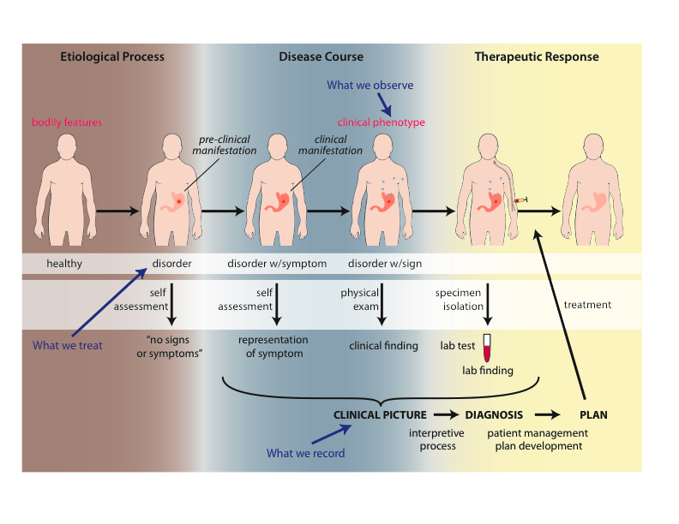
Big Picture

Slide 6
‘Findings’ / ‘observations’
On the side of the patient
Bodily features
Symptoms
Signs
Observed through physical examination
Observed through lab test

Slide 7
‘Findings’ / ‘observations’
On the side of the patient
Bodily features
Symptoms
Signs
Observed through physical examination
Observed through lab test
Phenotype =def. – A (combination of) bodily
feature(s) of an organism determined by the
interaction of its genetic make-up and environment.
Clinical Phenotype =def. – A clinically abnormal
phenotype.

Slide 8
‘Findings’ / ‘observations’
On the side of the patient
Bodily features
Symptoms
Signs
Observed through physical examination
Observed through lab test
Representations
Findings
Anamnestic findings
Clinical findings
Laboratory findings

Slide 9
‘Findings’ / ‘observations’
On the side of the patient
Bodily features
Symptoms
Signs
Observed through physical examination
Observed through lab test
Clinical phenotype
Representations
Findings
Anamnestic findings
Clinical findings
Laboratory findings
Clinical picture

Slide 10
Clinical picture
Clinical Picture =def. – A representation of a clinical phenotype that is inferred from the combination of laboratory, image and clinical findings about a given patient.

Slide 11
‘Findings’ / ‘observations’
On the side of the patient
Bodily features
Symptoms
Signs
Observed through physical examination
Observed through lab test
Diseases
Representations
Findings
Anamnestic findings
Clinical findings
Laboratory findings
Diagnoses

Slide 12
Diagnosis
Clinical Picture =def. – A representation of a clinical phenotype that is inferred from the combination of laboratory, image and clinical findings about a given patient.
Diagnosis =def. – A conclusion of an interpretive process that has as input a clinical picture of a given patient and as output an assertion to the effect that the patient has a disease of such and such a type.

Slide 13
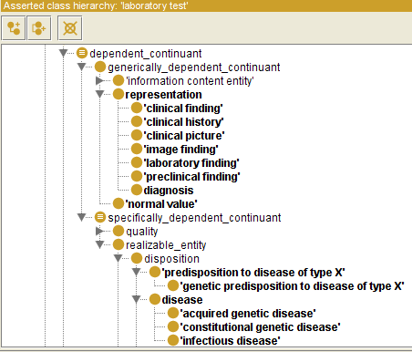

Slide 14
Generically Dependent Continuants
Generically
Dependent
Continuant
if one bearer ceases to exist, then the entity can survive, because there are other bearers
(copyability)
the pdf file on my laptop
the DNA (sequence) in this chromosome
Information
Object
Gene
Sequence

Slide 15
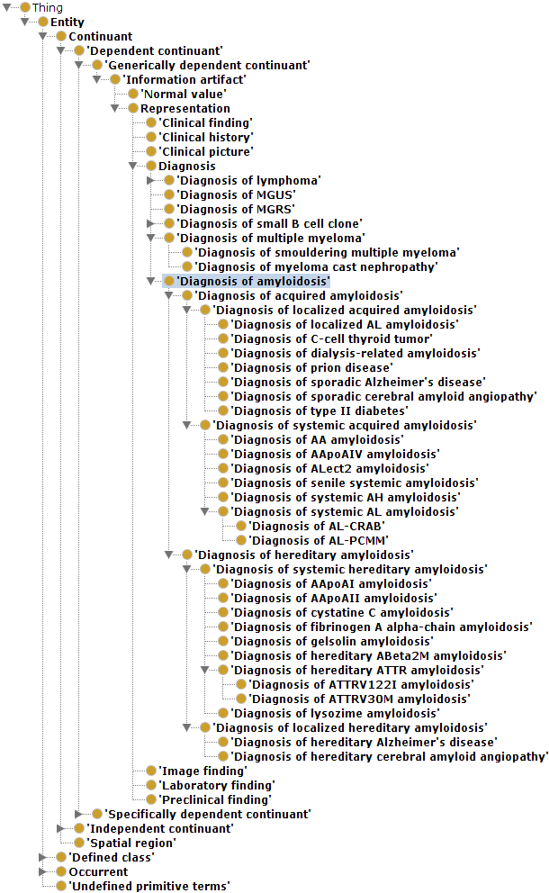

Slide 16
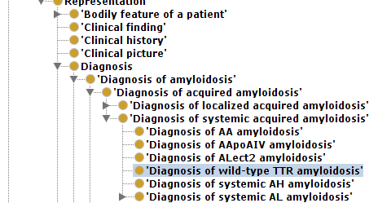

Slide 17
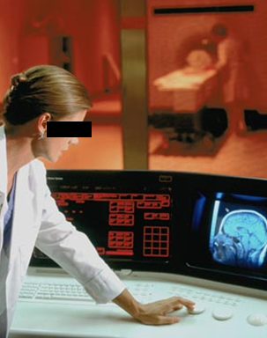
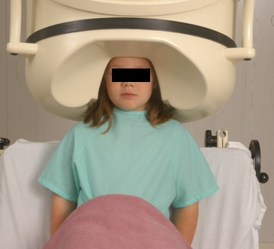
No conflation of diagnosis, disease, and disorder
The diagnosis is here
The disorder is there
The disease is there

Slide 18
No conflation of diagnosis, disease, and disorder
produces
bears
realized_in
etiological process
disorder
disease
pathological process
produces
diagnosis
interpretive process
signs & symptoms
abnormal bodily features
produces
participates_in
recognized_as
Notes:
font was too small, color inside green boxes was hardly readable

Slide 19
Application of OGMS in medical documentation

Slide 20
Key OGMS definitions
DISORDER
DISEASE
DISEASE COURSE
DIAGNOSIS
Scheuermann R, Ceusters W, Smith B. Toward an Ontological Treatment of Disease and Diagnosis. 2009 AMIA Summit on Translational Bioinformatics, San Francisco, California, March 15-17, 2009;: 116-120. Omnipress ISBN:0-9647743-7-2

Slide 21
Key OGMS definitions
DISORDER | A causally relatively isolated combination of physical components that is (a) clinically abnormal and (b) maximal, in the sense that it is not a part of some larger such combination.
DISEASE
DISEASE COURSE
DIAGNOSIS
Scheuermann R, Ceusters W, Smith B. Toward an Ontological Treatment of Disease and Diagnosis. 2009 AMIA Summit on Translational Bioinformatics, San Francisco, California, March 15-17, 2009;: 116-120. Omnipress ISBN:0-9647743-7-2

Slide 22
Key OGMS definitions
DISORDER | A causally relatively isolated combination of physical components that is (a) clinically abnormal and (b) maximal, in the sense that it is not a part of some larger such combination.
DISEASE | A DISPOSITION (i) to undergo PATHOLOGICAL PROCESSes that (ii) exists in an ORGANISM because of one or more DISORDERs in that ORGANISM.
DISEASE COURSE
DIAGNOSIS
Scheuermann R, Ceusters W, Smith B. Toward an Ontological Treatment of Disease and Diagnosis. 2009 AMIA Summit on Translational Bioinformatics, San Francisco, California, March 15-17, 2009;: 116-120. Omnipress ISBN:0-9647743-7-2

Slide 23
Key OGMS definitions
DISORDER | A causally relatively isolated combination of physical components that is (a) clinically abnormal and (b) maximal, in the sense that it is not a part of some larger such combination.
DISEASE | A DISPOSITION (i) to undergo PATHOLOGICAL PROCESSes that (ii) exists in an ORGANISM because of one or more DISORDERs in that ORGANISM.
DISEASE COURSE | The totality of all PROCESSes through which a given DISEASE instance is realized.
DIAGNOSIS
Scheuermann R, Ceusters W, Smith B. Toward an Ontological Treatment of Disease and Diagnosis. 2009 AMIA Summit on Translational Bioinformatics, San Francisco, California, March 15-17, 2009;: 116-120. Omnipress ISBN:0-9647743-7-2

Slide 24
Key OGMS definitions
DISORDER | A causally relatively isolated combination of physical components that is (a) clinically abnormal and (b) maximal, in the sense that it is not a part of some larger such combination.
DISEASE | A DISPOSITION (i) to undergo PATHOLOGICAL PROCESSes that (ii) exists in an ORGANISM because of one or more DISORDERs in that ORGANISM.
DISEASE COURSE | The totality of all PROCESSes through which a given DISEASE instance is realized.
DIAGNOSIS | A conclusion of an interpretive PROCESS that has as input a CLINICAL PICTURE of a given patient and as output an assertion (diagnostic statement) to the effect that the patient has a DISEASE of such and such a type.
Scheuermann R, Ceusters W, Smith B. Toward an Ontological Treatment of Disease and Diagnosis. 2009 AMIA Summit on Translational Bioinformatics, San Francisco, California, March 15-17, 2009;: 116-120. Omnipress ISBN:0-9647743-7-2

Slide 25
Disorder related configurations
No disorder instance → no disease instance,
→ no pathological processes;
A disorder instance can eliminate the range of circumstances under which another disorder instance can lead to pathological processes → no disease instance;
Disorders of the same type in distinct patients, or in the same patient at distinct times, may lead to diseases of distinct types;
Diseases of the same type may unfold themselves in disease courses of distinct types;
Diseases of distinct types may unfold themselves in disease courses of the same type;
…

Slide 26
What are diagnoses in EHRs about? (What are the options?)
DISORDER | A causally relatively isolated combination of physical components that is (a) clinically abnormal and (b) maximal, in the sense that it is not a part of some larger such combination.
DISEASE | A DISPOSITION (i) to undergo PATHOLOGICAL PROCESSes that (ii) exists in an ORGANISM because of one or more DISORDERs in that ORGANISM.
DISEASE COURSE | The totality of all PROCESSes through which a given DISEASE instance is realized.
DIAGNOSIS | A conclusion of an interpretive PROCESS that has as input a CLINICAL PICTURE of a given patient and as output an assertion (diagnostic statement) to the effect that the patient has a DISEASE of such and such a type.
Scheuermann R, Ceusters W, Smith B. Toward an Ontological Treatment of Disease and Diagnosis. 2009 AMIA Summit on Translational Bioinformatics, San Francisco, California, March 15-17, 2009;: 116-120. Omnipress ISBN:0-9647743-7-2

Slide 27
What are diagnoses in EHRs about? (What are the options?)
DISORDER | A causally relatively isolated combination of physical components that is (a) clinically abnormal and (b) maximal, in the sense that it is not a part of some larger such combination.
DISEASE | A DISPOSITION (i) to undergo PATHOLOGICAL PROCESSes that (ii) exists in an ORGANISM because of one or more DISORDERs in that ORGANISM.
DISEASE COURSE | The totality of all PROCESSes through which a given DISEASE instance is realized.
DIAGNOSIS | A conclusion of an interpretive PROCESS that has as input a CLINICAL PICTURE of a given patient and as output an assertion (diagnostic statement) to the effect that the patient has a DISEASE of such and such a type.
781.2 Abnormality of gait

Slide 28
What are diagnoses in EHRs about? (What are the options?)
DISORDER | A causally relatively isolated combination of physical components that is (a) clinically abnormal and (b) maximal, in the sense that it is not a part of some larger such combination.
DISEASE | A DISPOSITION (i) to undergo PATHOLOGICAL PROCESSes that (ii) exists in an ORGANISM because of one or more DISORDERs in that ORGANISM.
DISEASE COURSE | The totality of all PROCESSes through which a given DISEASE instance is realized.
DIAGNOSIS | A conclusion of an interpretive PROCESS that has as input a CLINICAL PICTURE of a given patient and as output an assertion (diagnostic statement) to the effect that the patient has a DISEASE of such and such a type.
781.2 Abnormality of gait

Slide 29
What are diagnoses in EHRs about? (What are the options?)
DISORDER | A causally relatively isolated combination of physical components that is (a) clinically abnormal and (b) maximal, in the sense that it is not a part of some larger such combination.
DISEASE | A DISPOSITION (i) to undergo PATHOLOGICAL PROCESSes that (ii) exists in an ORGANISM because of one or more DISORDERs in that ORGANISM.
DISEASE COURSE | The totality of all PROCESSes through which a given DISEASE instance is realized.
DIAGNOSIS | A conclusion of an interpretive PROCESS that has as input a CLINICAL PICTURE of a given patient and as output an assertion (diagnostic statement) to the effect that the patient has a DISEASE of such and such a type.
256.0 - Hyperestrogenism

Slide 30
What are diagnoses in EHRs about? (What are the options?)
DISORDER | A causally relatively isolated combination of physical components that is (a) clinically abnormal and (b) maximal, in the sense that it is not a part of some larger such combination.
DISEASE | A DISPOSITION (i) to undergo PATHOLOGICAL PROCESSes that (ii) exists in an ORGANISM because of one or more DISORDERs in that ORGANISM.
DISEASE COURSE | The totality of all PROCESSes through which a given DISEASE instance is realized.
DIAGNOSIS | A conclusion of an interpretive PROCESS that has as input a CLINICAL PICTURE of a given patient and as output an assertion (diagnostic statement) to the effect that the patient has a DISEASE of such and such a type.
256.0 - Hyperestrogenism

Slide 31
What are diagnoses in EHRs about? (What are the options?)
DISORDER | A causally relatively isolated combination of physical components that is (a) clinically abnormal and (b) maximal, in the sense that it is not a part of some larger such combination.
DISEASE | A DISPOSITION (i) to undergo PATHOLOGICAL PROCESSes that (ii) exists in an ORGANISM because of one or more DISORDERs in that ORGANISM.
DISEASE COURSE | The totality of all PROCESSes through which a given DISEASE instance is realized.
DIAGNOSIS | A conclusion of an interpretive PROCESS that has as input a CLINICAL PICTURE of a given patient and as output an assertion (diagnostic statement) to the effect that the patient has a DISEASE of such and such a type.
250.23 Diabetes with hyperosmolarity, type I, uncontrolled

Slide 32
What are diagnoses in EHRs about? (What are the options?)
DISORDER | A causally relatively isolated combination of physical components that is (a) clinically abnormal and (b) maximal, in the sense that it is not a part of some larger such combination.
DISEASE | A DISPOSITION (i) to undergo PATHOLOGICAL PROCESSes that (ii) exists in an ORGANISM because of one or more DISORDERs in that ORGANISM.
DISEASE COURSE | The totality of all PROCESSes through which a given DISEASE instance is realized.
DIAGNOSIS | A conclusion of an interpretive PROCESS that has as input a CLINICAL PICTURE of a given patient and as output an assertion (diagnostic statement) to the effect that the patient has a DISEASE of such and such a type.
250.23 Diabetes with hyperosmolarity, type I, uncontrolled

Slide 33
What are diagnoses in EHRs about? (What are the options?)
DISORDER | A causally relatively isolated combination of physical components that is (a) clinically abnormal and (b) maximal, in the sense that it is not a part of some larger such combination.
DISEASE | A DISPOSITION (i) to undergo PATHOLOGICAL PROCESSes that (ii) exists in an ORGANISM because of one or more DISORDERs in that ORGANISM.
DISEASE COURSE | The totality of all PROCESSes through which a given DISEASE instance is realized.
DIAGNOSIS | A conclusion of an interpretive PROCESS that has as input a CLINICAL PICTURE of a given patient and as output an assertion (diagnostic statement) to the effect that the patient has a DISEASE of such and such a type.
749.01 - Cleft palate, unilateral, complete

Slide 34
What are diagnoses in EHRs about? (What are the options?)
DISORDER | A causally relatively isolated combination of physical components that is (a) clinically abnormal and (b) maximal, in the sense that it is not a part of some larger such combination.
DISEASE | A DISPOSITION (i) to undergo PATHOLOGICAL PROCESSes that (ii) exists in an ORGANISM because of one or more DISORDERs in that ORGANISM.
DISEASE COURSE | The totality of all PROCESSes through which a given DISEASE instance is realized.
DIAGNOSIS | A conclusion of an interpretive PROCESS that has as input a CLINICAL PICTURE of a given patient and as output an assertion (diagnostic statement) to the effect that the patient has a DISEASE of such and such a type.
749.01 - Cleft palate, unilateral, complete

Slide 35
What are diagnoses in EHRs about? (What are the options?)
DISORDER | A causally relatively isolated combination of physical components that is (a) clinically abnormal and (b) maximal, in the sense that it is not a part of some larger such combination.
DISEASE | A DISPOSITION (i) to undergo PATHOLOGICAL PROCESSes that (ii) exists in an ORGANISM because of one or more DISORDERs in that ORGANISM.
DISEASE COURSE | The totality of all PROCESSes through which a given DISEASE instance is realized.
DIAGNOSIS | A conclusion of an interpretive PROCESS that has as input a CLINICAL PICTURE of a given patient and as output an assertion (diagnostic statement) to the effect that the patient has a DISEASE of such and such a type.
V65.5 - Person with feared complaint in whom no diagnosis was made

Slide 36
What are diagnoses in EHRs about? (What are the options?)
DISORDER | A causally relatively isolated combination of physical components that is (a) clinically abnormal and (b) maximal, in the sense that it is not a part of some larger such combination.
DISEASE | A DISPOSITION (i) to undergo PATHOLOGICAL PROCESSes that (ii) exists in an ORGANISM because of one or more DISORDERs in that ORGANISM.
DISEASE COURSE | The totality of all PROCESSes through which a given DISEASE instance is realized.
DIAGNOSIS | A conclusion of an interpretive PROCESS that has as input a CLINICAL PICTURE of a given patient and as output an assertion (diagnostic statement) to the effect that the patient has a DISEASE of such and such a type.
V65.5 - Person with feared complaint in whom no diagnosis was made

