Slide 1
Lecture 6
Part 1: Building Ontologies
Barry Smith

Slide 2
Building ontologies
Barry Smith

Slide 3
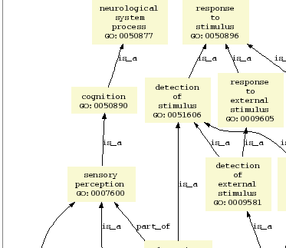
Gene Ontology
Hierarchical view representing relations between represented types

Slide 4
Anatomical Space
Anatomical
Structure
Organ Cavity
Subdivision
Organ
Cavity
Organ
Organ Part
Serous Sac
Cavity
Subdivision
Serous Sac
Cavity
Serous Sac
Organ
Component
Organ
Subdivision
Tissue
is_a
Pleural Sac
Pleura(Wall
of Sac)
Pleural
Cavity
part_of
Parietal
Pleura
Visceral
Pleura
Interlobar
recess
Foundational Model of Anatomy Ontology
Mediastinal
Pleura
Mesothelium
of Pleura

Slide 5
BFO Top-Level Ontology
Continuant
Occurrent
(always dependent
on one or more
independent
continuants)
Independent
Continuant
Dependent
Continuant
Basic Formal Ontology

Slide 6
 | CONTINUANT |  |  |  | OCCURRENT
 | INDEPENDENT |  | DEPENDENT
ORGAN AND ORGANISM | Organism (NCBI Taxonomy) | Anatomical Entity (FMA, CARO) | Organ Function (FMP, CPRO) | Phenotypic Quality (PaTO) | Organism-Level Process (GO)
CELL AND CELLULAR COMPONENT | Cell (CL) | Cellular Component (FMA, GO) | Cellular Function (GO) |  | Cellular Process (GO)
MOLECULE | Molecule (ChEBI, SO, RnaO, PrO) |  | Molecular Function (GO) |  | Molecular Process (GO)
RELATION TO TIME
GRANULARITY
OBO Foundry

Slide 7
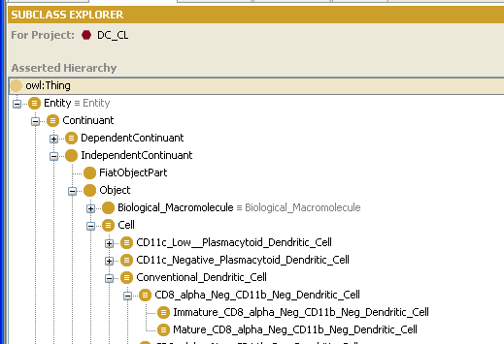
Example: The Cell Ontology

Slide 8
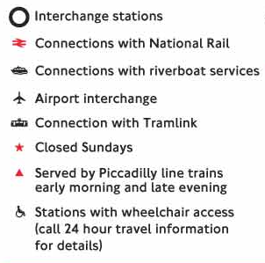
names of types

Slide 9
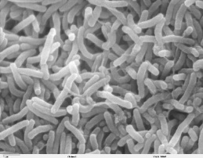
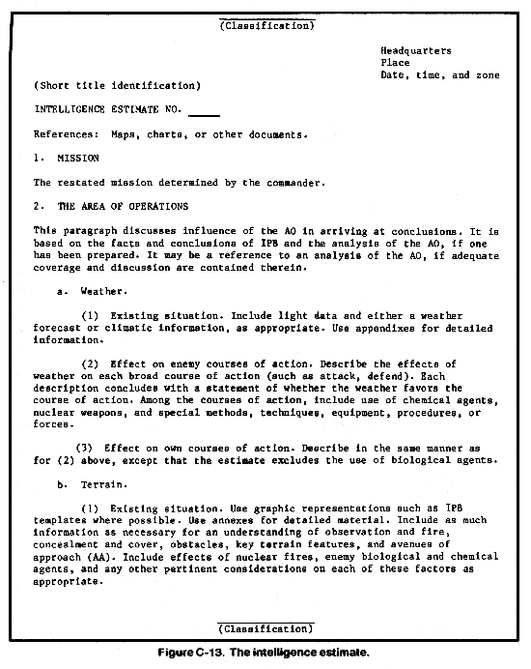
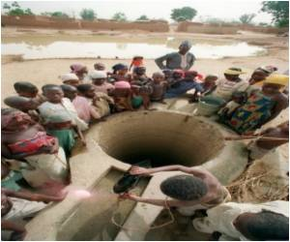
Region.water.fecalOrOralTransmittedDiseases
Cholera Epidemic
cause_of
Cholera
cause_of
Collection of Bacterium
Report Date Time Group
Well
Bacterial
Pathogen Role
Village Assessment
instance_of
instance_of
instance_of
instance_of
instance_of
150029OCT2010
Particular Bacterial Pathogen Role
has role
stamps
describes
located in

Slide 10
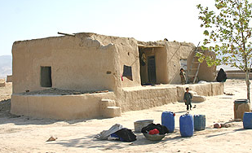
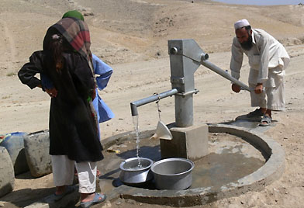
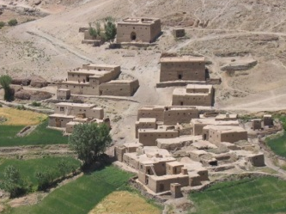
Unpacking: Region.water.distanceBetweenLatrinesAndWaterSource
Geographic
Coordinates Set
designates
Geopolitical
Entity
instance_of
Spatial Region
has location
Village Name
is_a
has location
Distance Measurement Result
designates
Well
Village
Latrine
instance_of
instance_of
instance_of
instance_of
instance_of
’16 meters’
‘VT 334 569’
measurement_of
‘Khanabad Village’
located near
located in

Slide 11
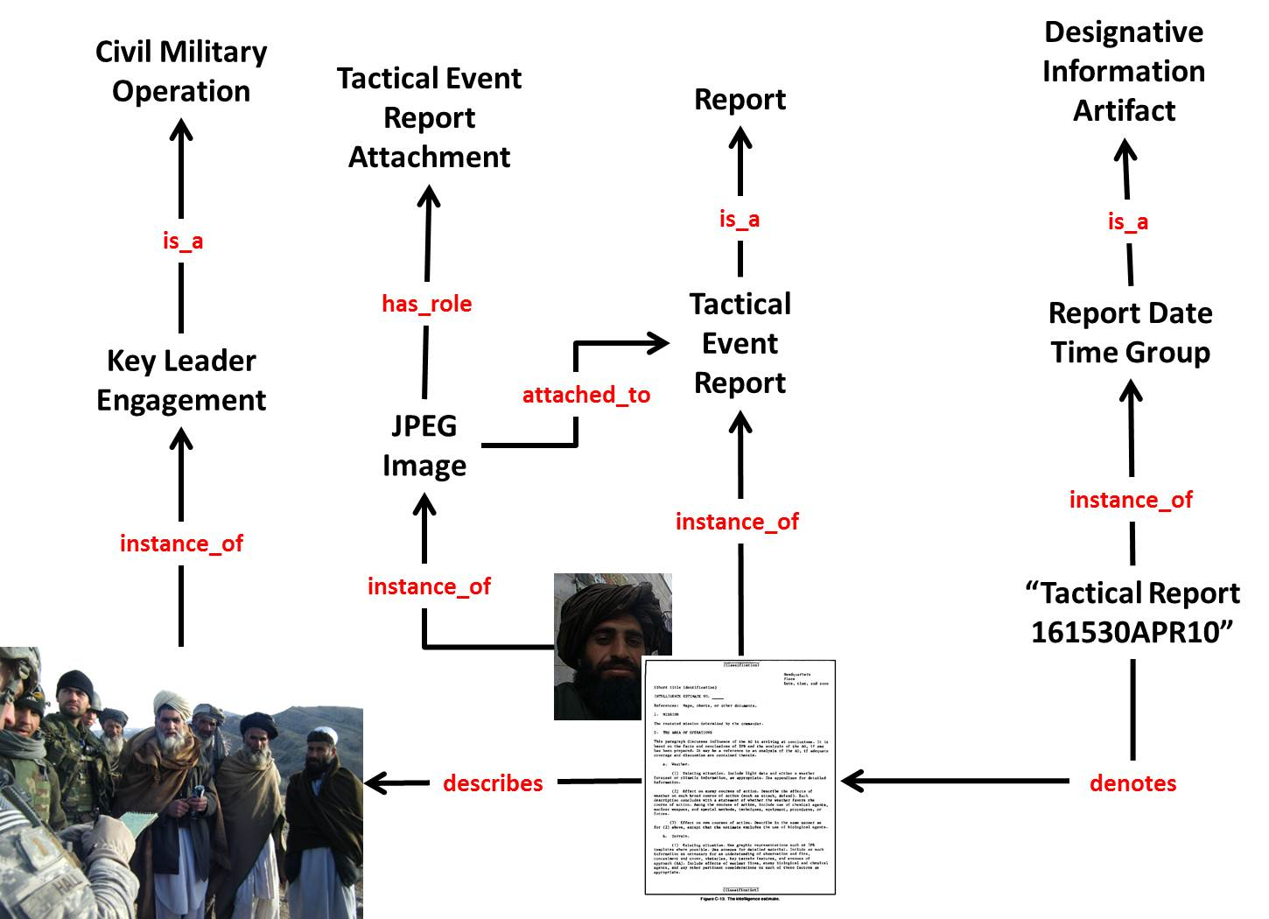

Slide 12
BFO Top-Level Ontology
Continuant
Occurrent
(always dependent
on one or more
independent
continuants)
Independent
Continuant
Dependent
Continuant

Slide 13
top level
mid-level
domain level
Basic Formal Ontology (BFO)
Information Artifact Ontology (IAO) | Ontology for Biomedical Investigations (OBI) | Ontology for General Medical Science (OGMS)
Anatomy Ontology (FMA*, CARO) |  | Environment Ontology (EnvO) | Infectious Disease Ontology (IDO*) | Biological Process Ontology (GO*)
Cell Ontology (CL) | Cellular Component Ontology (FMA*, GO*)
 |  |  | Phenotypic Quality Ontology (PaTO)
Subcellular Anatomy Ontology (SAO)
Sequence Ontology (SO*) |  |  | Molecular Function (GO*)
Protein Ontology (PRO*)
Extension Strategy + Modular Organization
Notes:
* = dedicated NIH funding

Slide 14
Two kinds of entities
occurrents (processes, events, happenings)
continuants (objects, qualities, states...)

Slide 15
You are a continuant
Your life is an occurrent
You are 3-dimensional
Your life is 4-dimensional

Slide 16
BFO Top-Level Ontology
Continuant
Occurrent
(always dependent
on one or more
independent
continuants)
Independent
Continuant
Dependent
Continuant

Slide 17
Dependent entities
require independent continuants as their bearers
There is no run without a runner
There is no grin without a cat

Slide 18
Dependent vs. independent continuants
Independent continuants (organisms, buildings, environments)
Dependent continuants (quality, shape, role, propensity, function, status, power, right)

Slide 19
All occurrents are dependent entities
They are dependent on those independent continuants which are their participants (agents, patients, media ...)

Slide 20

Principle of Low Hanging Fruit
Include even absolutely trivial assertions (assertions you know to be universally true)
pneumococcal bacterium is_a bacterium
Computers need to be led by the hand

Slide 21
Principle of singular nouns
Terms in ontologies represent types
Goal: Each term in an ontology should represent exactly one type
Thus every term should be a singular noun

Slide 22
Principle: Avoid mass nouns
Brenda Tissue Ontology
blood is_a hematopoietic system
hematopoietic system is_a whole body
whole_body is_a animal

Slide 23
Count vs. mass nouns
Count
suitcase
cow
datum
Mass
luggage
beef
information

Slide 24
Principle of definitions
Supply definitions for every term
human-understandable natural language definition
an equivalent formal definition

Slide 25
Principle: definitions must be unique
Each term should have exactly one definition
it may have both natural-language and formal versions
(issue with ontologies which exist with different levels of expressivity)

Slide 26
Principle of Aristotelian definitions
Use Aristotelian definitions
An A is a B which C’s.
A human being is an animal which is rational

Slide 27
Principle of increase in understandability
A definition should use only terms which are easier to understand than the term defined
Definitions should not make simple things more difficult than they are

Slide 28
Principle of Ontology Term Re-Use
Ontology Lookup Service
http://www.ebi.ac.uk/ols/index
OntoBee
http://www.ontobee.org/
Bioportal
https://bioportal.bioontology.org/

Slide 29
Exercise Text
Mary Ceusters, a 54 year old non-smoking female, arrives at a Buffalo General Hospital on August 12th, 2007 and Nurse Smith takes her blood pressure and records 160/90mmHg. Based on this reading, Nurse Smith concludes Mary has high blood pressure and prescribes the drug Bumetanide. On July 11, 2009, Mary Ceusters arrives at Erie CountyMedical Center complaining of sudden chest pains and Doctor Searle conducts an external examination and concludes Mary has suffered a heart-attack, which he suspects is likely the result of coronary artery disease exacerbated by hypertension.

