Slide 1
Building Ontologies with Basic Formal Ontology
Barry Smith
May 27, 2015

Slide 2
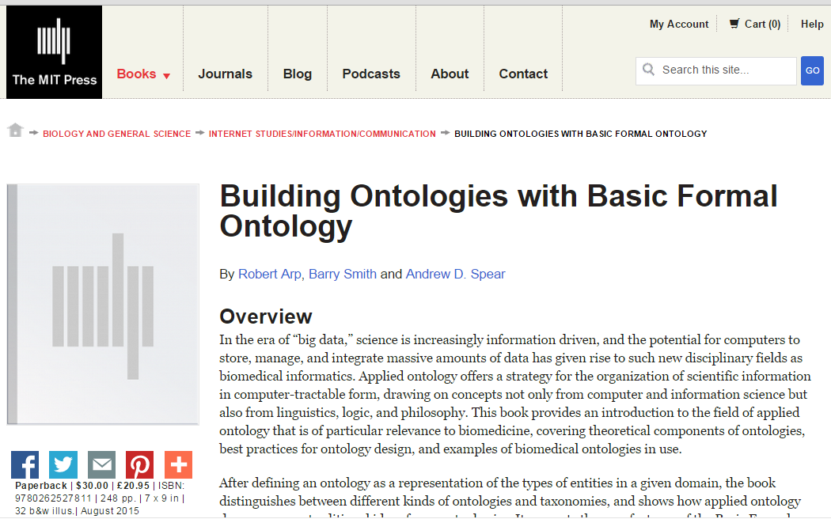
http://ontology.buffalo.edu/BOBFO

Slide 3
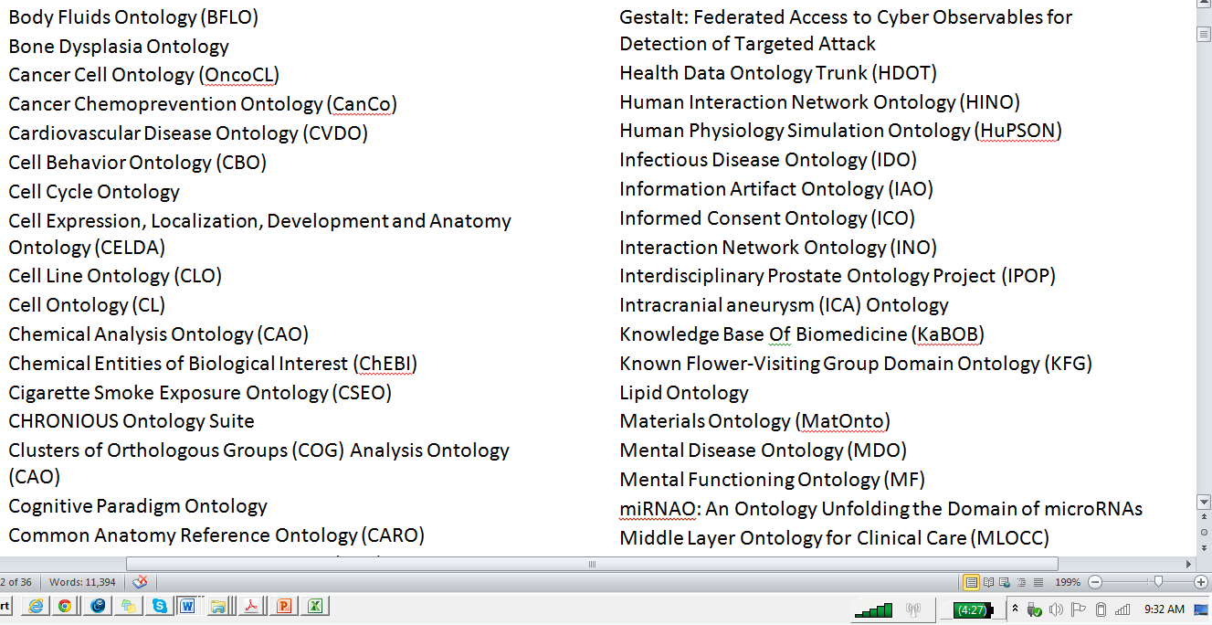

Slide 4
John Fox (Director, OpenClinical)
As a user and teacher of ontological methods in medicine and engineering I have for years warned my students that the design of domain ontologies is a black art with no theoretical foundations and few practical principles.

Slide 5
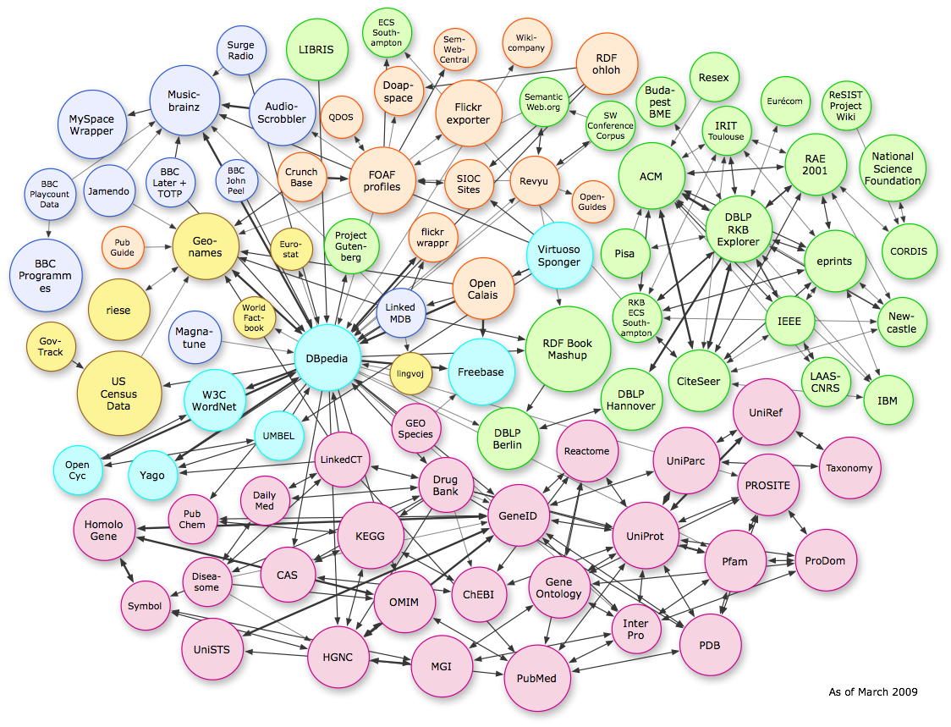
Ontology success stories, and some reasons for failure
Linked Open Data, from Musicbrainz to Mouse Genome Informatics
Notes:
http://dbpedia.org/fct/images/lod-datasets_2009-03-27_colored.png

Slide 6
John Fox, OpenClinical
As a user and teacher of ontological methods in medicine and engineering I have for years warned my students that the design of domain ontologies is a black art with no theoretical foundations and few practical principles. … I now have a much more positive story for my students. …

Slide 7
RELATION TO TIME GRANULARITY | CONTINUANT |  |  |  | OCCURRENT
 | INDEPENDENT |  | DEPENDENT
ORGAN AND ORGANISM | Organism (NCBI Taxonomy) | Anatomical Entity (FMA, CARO) | Organ Function (FMP, CPRO) | Phenotypic Quality (PaTO) | Biological Process (GO)
CELL AND CELLULAR COMPONENT | Cell (CL) | Cellular Component (FMA, GO) | Cellular Function (GO)
MOLECULE | Molecule (ChEBI, SO, RnaO, PrO) |  | Molecular Function (GO) |  | Molecular Process (GO)
Original OBO Foundry ontologies
(Gene Ontology in yellow)

Slide 8
 | CONTINUANT |  |  |  | OCCURRENT
 | INDEPENDENT |  | DEPENDENT
ORGAN AND ORGANISM | Organism (NCBI Taxonomy) | Anatomical Entity (FMA, CARO) | Organ Function (FMP, CPRO) | Phenotypic Quality (PaTO) | Organism-Level Process (GO)
CELL AND CELLULAR COMPONENT | Cell (CL) | Cellular Component (FMA, GO) | Cellular Function (GO) |  | Cellular Process (GO)
MOLECULE | Molecule (ChEBI, SO, RNAO, PRO) |  | Molecular Function (GO) |  | Molecular Process (GO)
RELATION TO TIME
GRANULARITY
rationale of OBO Foundry coverage

Slide 9
RELATION TO TIME GRANULARITY | CONTINUANT |  |  |  |  | OCCURRENT
 | INDEPENDENT |  |  | DEPENDENT
ORGAN AND ORGANISM | Organism (NCBI Taxonomy) | Anatomical Entity (FMA, CARO) |  | Organ Function (FMP, CPRO) | Phenotypic Quality (PaTO) | Biological Process (GO)
CELL AND CELLULAR COMPONENT | Cell (CL) | Cellular Component (FMA, GO) |  | Cellular Function (GO)
MOLECULE | Molecule (ChEBI, SO, RnaO, PrO) |  |  | Molecular Function (GO) |  | Molecular Process (GO)
Environments
Environment Ontology (EnvO)

Slide 10
RELATION TO TIME | CONTINUANT |  |  |  |  | OCCURRENT
GRANULARITY | INDEPENDENT CONTINUANT |  |  | DEPENDENT CONTINUANT
ORGAN AND ORGANISM | Organism NCBI Taxonomy | Anatomical Entity (FMA, CARO) |  | Organ Function (FMP, CPRO) |  | Biological Process (GO) | Ontology for Biomedical Investigations (OBI)
CELL AND CELLULAR COMPONENT | Cell (CL) | Cellular Component (FMA, GO) |  | Cellular Function (GO)
MOLECULE | Molecule (ChEBI, SO, RnaO, PrO) |  |  | Molecular Function (GO) |  | Molecular Process (GO)
Phenotypic Quality (PATO)
Environment Ontology (ENVO)
Recognizing a new family of protocol-driven processes (investigation, assay, clinical trial …)

Slide 11
RELATION TO TIME | CONTINUANT |  |  |  |  |  | OCCURRENT
GRANULARITY | INDEPENDENT CONTINUANT |  |  | DEPENDENT CONTINUANT |  | INFORMATION ARTIFACT
ORGAN AND ORGANISM | Organism NCBI Taxonomy | Anatomical Entity (FMA, CARO) |  | Organ Function (FMP, CPRO) |  | IAO Software, Algorithms, … Sequence Data, EHR Data … | Biological Process (GO) | OBI
CELL AND CELLULAR COMPONENT | Cell (CL) | Cellular Component (FMA, GO) |  | Cellular Function (GO)
MOLECULE | Molecule (ChEBI, SO, RnaO, PrO) |  |  | Molecular Function (GO) |  | Images, Image Data, Flow Cytometry Data, … | Molecular Process (GO) | OBI: Imaging
Phenotypic Quality (PATO)
Environment Ontology (ENVO)
Recognizing a new family of information entities: data, publications, images, algorithms …

Slide 12
examples of BFO/OBO Foundry approach extended into other domains
NIF Standard | Neuroscience Information Framework
UNEP Ontology Framework | United Nations Environment Program Ontologies
IDO Consortium | Infectious Disease Ontology Suite
MilPortal | Intelligence and Information Warfare Directorate, US Army
cROP | Common Reference Ontologies for Plants

Slide 13
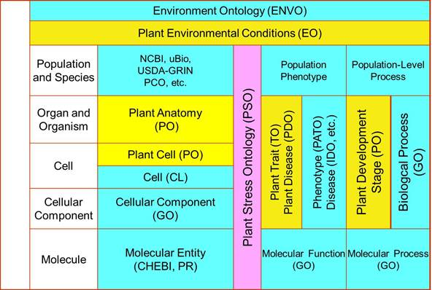
Common Reference Ontologies for Plants (cROP)

