Slide 1
The Glory and Misery of Electronic Health Records
Barry Smith
University of Pennsylvania
March 23, 2016

Slide 2
Electronic Health Records – the Glory
no more redundant tests
continuity of care improved
quality of information improved
no more lost charts
no more illegible handwriting
no more non-standard codes
Notes:
Jonathan Cohn, The New Republic, (January 21, 2011); http://www.healthcare.gov/law/resources/reports/nationalqualitystrategy032011.pdf

Slide 3
More Glory
charts are accessible from multiple sites simultaneously
efficient transfer of lab and patient demographics information
e-prescribing
recording accountability
finding candidate subjects for trials
Notes:
http://www.annemergmed.com/article/S0196-0644(13)00506-4/fulltext

Slide 4
and potential future glory
patients can see their own data
evidence-based medicine
diagnostic decision support
… and come the day, when every patient’s genome is sequenced as they walk through the door …

Slide 5
But still more gloriously (they said, 2005) money will be saved
if patients’ information were shared across health care settings so that personal health information seamlessly followed any patient through various settings of care—$77 billion would be saved annually
– David Brailer (first U.S. National Coordinator for Health IT), “Economic Perspectives on Health Information Technology”, 2005
Notes:
http://www.bos.frb.org/economic/conf/conf50/conf50i.pdf, citing the Center for Information Technology Leadership in Boston.
This paper draws on David Brailer, Economic perspectives on health information technology: aggressive adoption will reduce costs and improve quality in health care, Business Economics. 40.3 (July 2005)

Slide 6
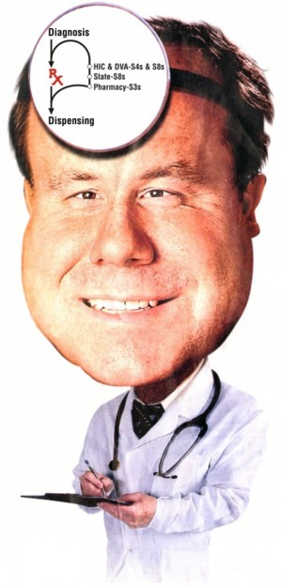
$77 billion

Slide 7
annually

Slide 8
The problem
to obtain the data we first have to get the data inside the computer and in a form that allows it to be shared

Slide 9
The misery: two issues
Interoperability
Costs (of getting the data inside the computer, safely)

Slide 10
The Misery 1. Interoperability
Interoperability =Def. Two systems A and B are interoperable if the system A-data can be used by system B in the same way that it is used by system A and vice versa
As even David Brailer recognized, most of the glories will be realized only if EHR systems are interoperable – and in the US (at least) they still (2016) mostly aren’t

Slide 11
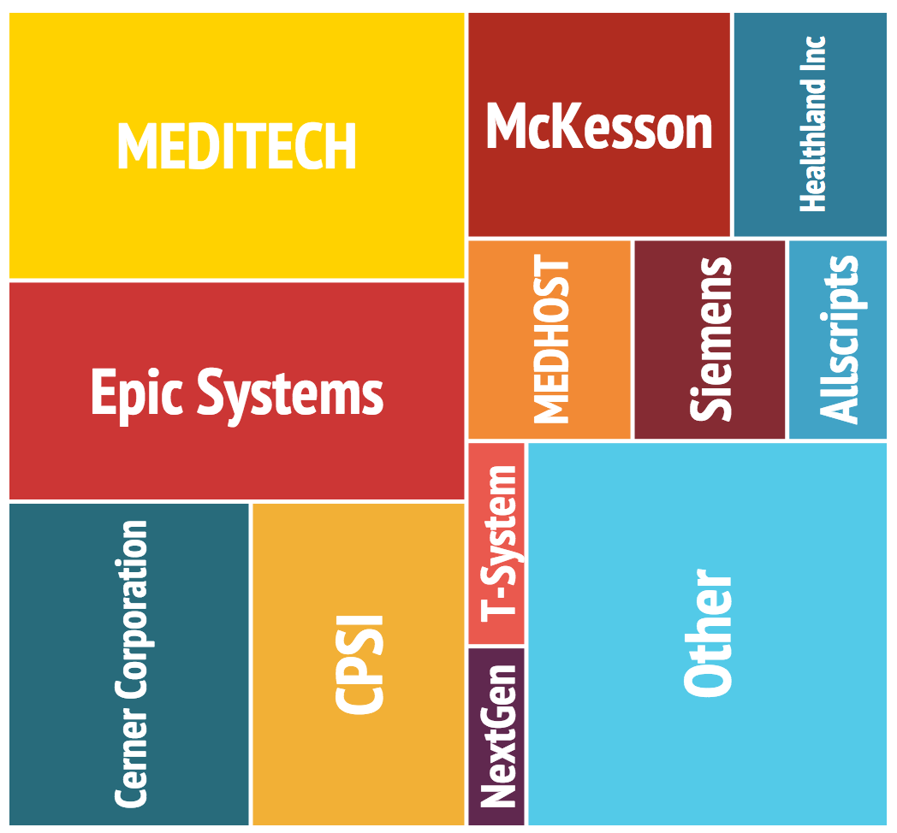
Notes:
http://ehr.softwareinsider.com/

Slide 12
Perhaps Epic (Prop: Judy Faulkner) will solve the problem

Slide 13
slowly, but surely, everyone will use Epic

Slide 14
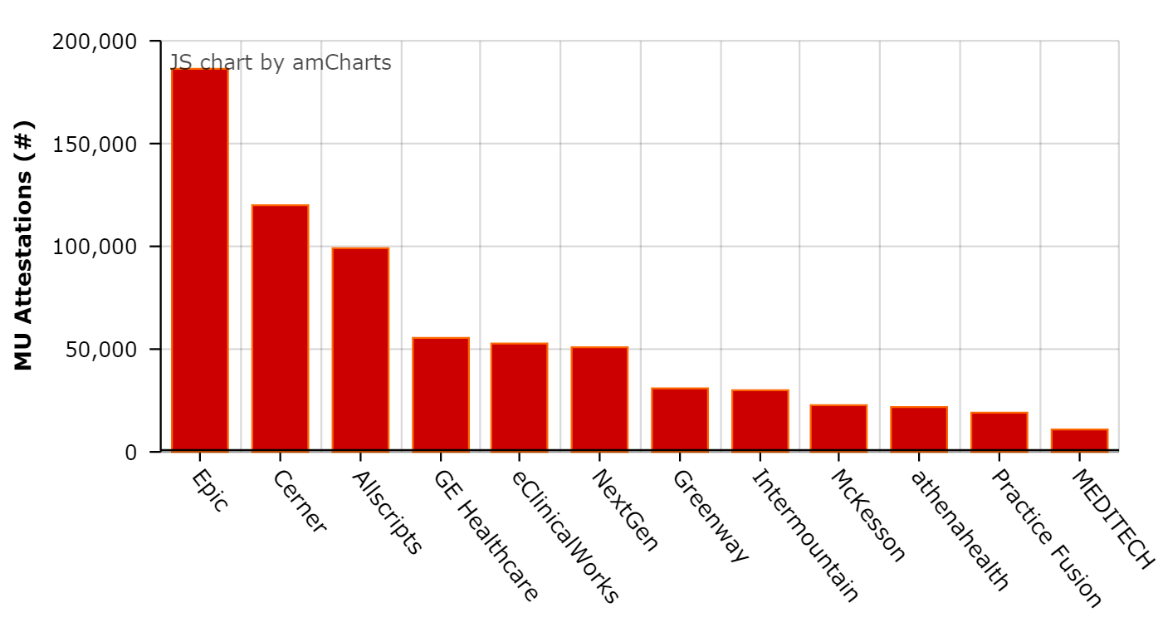
start with the US

Slide 16
tomorrow, the galaxy

Slide 17
even total victory of Epic would not imply interoperability
RAND Corporation: Epic is a “closed system” that makes it “challenging and costly” for hospitals to interconnect. (New York Times, September 13, 2014)
Notes:
http://www.healthcareitnews.com/blog/vista-epic-tale-two-systems

Slide 18
Epic is in some respects the best thing there is
The Epic bundle provides for all your needs; you do not need to glue together software items from different vendors …

Slide 20
The problem: “Best” does not imply good
Notes:
http://www.healthcareitnews.com/blog/vista-epic-tale-two-systems

Slide 22
Cambridge University (Addenbrooks) Hospitals
2014: first installation of an Epic system in the UK (£200 million)
https://en.wikipedia.org/wiki/Epic_Systems

Slide 24
December 2014

Slide 25
Cambridge University Hospitals
After 2.1 million records were transferred to … system developed serious problems and became unstable. Ambulances were diverted to other hospitals for five hours … hospital consultants noted issues with blood transfusion and pathology services. …
https://en.wikipedia.org/wiki/Epic_Systems

Slide 26
July 2015
… the finances of Cambridge University Hospitals are being investigated. Problems with the Epic system were held to be contributory factors in the organisation's sudden failure.
https://en.wikipedia.org/wiki/Epic_Systems

Slide 27
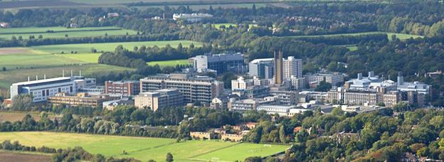
Honey, the EHR system crashed my hospital!

Slide 28
… I interviewed Boeing’s top cockpit designers, who wouldn’t dream of green-lighting a new plane until they had spent thousands of hours watching pilots in simulators and on test flights. This principle of user-centered design is part of aviation’s DNA, yet has been woefully lacking in health care software design.

Slide 29
More misery: The costs
cost of updating, retraining, recovery after crashes
cost of training
cost of adoption of new working practices
cost of time that could otherwise go to patient care
cost of (never-ending?) local tweaks
cost of trying to get at the data for secondary uses
cost of alerts
disruption of workflows
alert fatigue from clinically insignificant alerts

Slide 30
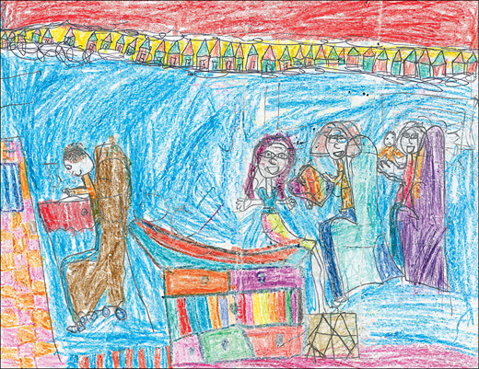
the computer becomes the conduit for all aspects of patient care
Notes:
© 2011 Thomas G. Murphy, MD. http://jama.jamanetwork.com/article.aspx?articleid=1187932

Slide 31
“The Cost of Technology”, Journal of the American Medical Association, June 20, 2012, Vol 307, No. 23
Notes:
© 2011 Thomas G. Murphy, MD. http://jama.jamanetwork.com/article.aspx?articleid=1187932

Slide 32
Epic, again
Kaiser: Epic led to “a persistent two-minute increase in the length of time of an average patient encounter”

Slide 33
In some ways, paper is better
cost of security protections
digitalized records can be stolen in gigantic quantities

Slide 34
American Medical Association cry for help

Slide 35
Why is the US stuck with EHR systems which are so clunky and distracting?
the “rush to capitalize on the huge federal investment of $30 billion for the adoption of electronic medical records led to some unfortunate and unintended consequences” tied to “communication failure, poor data display, wrong order/wrong patient errors and alert fatigue.”
Annals of Emergency Medicine, June 2013
Notes:
http://newsroom.acep.org/Hello-Electronic-Medical-Records-It-s-Me-Unintended-Consequences

Slide 36
Question: Why do it so quickly, when there are so few talented, trained personnel, and when EHR systems are so bad, and when there are so many systems, and when the systems are not interoperable?
Answer: Magical thinking*
*What, after all, could go wrong?

Slide 37
Answer:
e-iatrogenesis
(diseases caused by health IT)
Notes:
http://blog.westandfirm.org/2013/10/electronic-medical-mess.html

Slide 38
Health IT and Patient Safety: Building Safer Systems for Better Care Institute of Medicine Report, 2011
Recommendations
Current market forces are not adequately addressing the potential risks associated with use of health IT. All stakeholders must coordinate efforts to identify and understand patient safety risks associated with health IT by … creating a reporting and investigating system for health IT-related deaths, serious injuries, or unsafe conditions
Notes:
http://informaticsprofessor.blogspot.com/2012/10/improving-patient-safety-through.html; Health IT and Patient Safety: Building Safer Systems for Better Care

Slide 39
HITECH Act (2009): let’s bribe physicians to adopt these mumpsy EHR systems quickly, and then penalize them if they fail to do so
Eligible health care professionals and hospitals can qualify for more than $27 billion in Medicare and Medicaid incentive payments available to eligible providers and hospitals
https://www.cms.gov/ehrincentiveprograms/.
Notes:
http://www.healthcare.gov/law/resources/reports/nationalqualitystrategy032011.pdf

Slide 40
EHR incentive payments to Medicare providers
 | 2011 | 2012 | 2013 | 2014 | 2015 | 2016 | 2017 | TOTAL
Adopt 2011 | $18,000 | $12,000 | $8,000 | $4,000 | $2,000 | $0 | $0 | $44,000
Adopt 2012 | ---------- | $18,000 | $12,000 | $8,000 | $4,000 | $2,000 | $0 | $44,000
Adopt 2013 | ---------- | ----------- | $15,000 | $12,000 | $8,000 | $4,000 | $0 | $39,000
Adopt 2014 | ---------- | ----------- | ----------- | $12,000 | $8,000 | $4,000 | $0 | $24,000
Adopt 2015 + | ---------- | ----------- | ----------- | ---------- | $0 | $0 | $0 | $0
After ~2018 | penalties, in the form of reduced Medicare reimbursements

Slide 41
COMPUTECH Act 1959
Let’s bribe computer users to use only this new-fangled COBOL language in all the work they do … and then penalize them with bigger and bigger fines each year until they all do so, forever and ever

Slide 42
To get paid under the Hitech act, you must show “Meaningful Use”
Stage 1: 2011-2012 | Stage 2: 2014 | Stage 3: 2016
Capturing health information in a coded format Using the information to track key clinical conditions Communicating captured information for care coordination purposes Reporting of clinical quality measures and public health information | Disease management, clinical decision support Medication management Support for patient access to their health information Transitions in care Quality measurement Research Bi-directional communi-cation with public health agencies | Achieving improvements in quality, safety and efficiency Focusing on decision support for national high priority conditions Patient access to self-management tools Access to comprehensive patient data Improving population health outcomes
Data capture and sharing | Advance clinical processes | Leverage information to improve outcomes

Slide 43
“Pressure on hospitals to receive meaningful use payments will cost lives”
Sam Bierstock, MD (2015)
hospital EHRs “are simply not yet adequately intuitive to meet the needs of clinicians.”
“Most EHRs result in a 20-30 percent decrease in efficiency of emergency room doctors and an increase in the people who leave without being seen due to extended wait times.
Notes:
http://www.govhealthit.com/news/obama-reelection-doesn%E2%80%99t-alter-complexity-ehr-adoption

Slide 44
One doctor abandoned the Obamacare EHR “incentive” program
when he realized that he “spent the first two to five minutes of each visit endlessly clicking a bunch of garbage to make all the green lights show up on the [meaningful use] meter, … : ‘I’m not wasting precious seconds of my life and my patients’ time to ensure some database gets filled with data. I didn’t go into medicine for this.’” (Dr. Michael Laidlaw of Rocklin, CA)
Notes:
http://blog.westandfirm.org/2013/10/electronic-medical-mess.html

Slide 45
Meaningful Use and Interoperability
Stage 1: 2011-2012 | Stage 2: 2014 | Stage 3: 2016
Capturing health information in a coded format Using the information to track key clinical conditions Communicating captured information for care coordination purposes Reporting of clinical quality measures and public health information | Problem lists must be “stored” using codes from SNOMED-CT | Achieving improvements in quality, safety and efficiency Focusing on decision support for national high priority conditions Patient access to self-management tools Access to comprehensive patient data Improving population health outcomes
Data capture and sharing | Advance clinical processes | Leverage information to improve outcomes
https://www.healthit.gov/sites/default/files/meaningfulusetablesseries2_110112.pdf

Slide 46
Problems with Problem Lists
What is a problem?
Will generating a problem list really provide the sort of interoperability that is needed for the EHR to support (for instance) continuity of care?
Why SNOMED CT* ?
*Systematized Nomenclature of Medicine – Clinical Terms

Slide 47
SNOMED CT
Coding with SNOMED-CT still not standard practice among physicians in US
Human coding with SNOMED-CT is unreliable and inconsistent
The organization of SNOMED-CT allows many alternative ways of coding what is medically the same phenomenon

Slide 48
http://www.snomedbrowser.com/Codes/Details/254769006 http://www.snomedbrowser.com/Codes/Details/44598004
Example: Two problems or one?
SNOMED: Solitary leiomyoma (disorder)
Concept ID: 254769006
SNOMED: Leiomyoma (morphologic abnormality)
Concept ID: 44598004

Slide 49
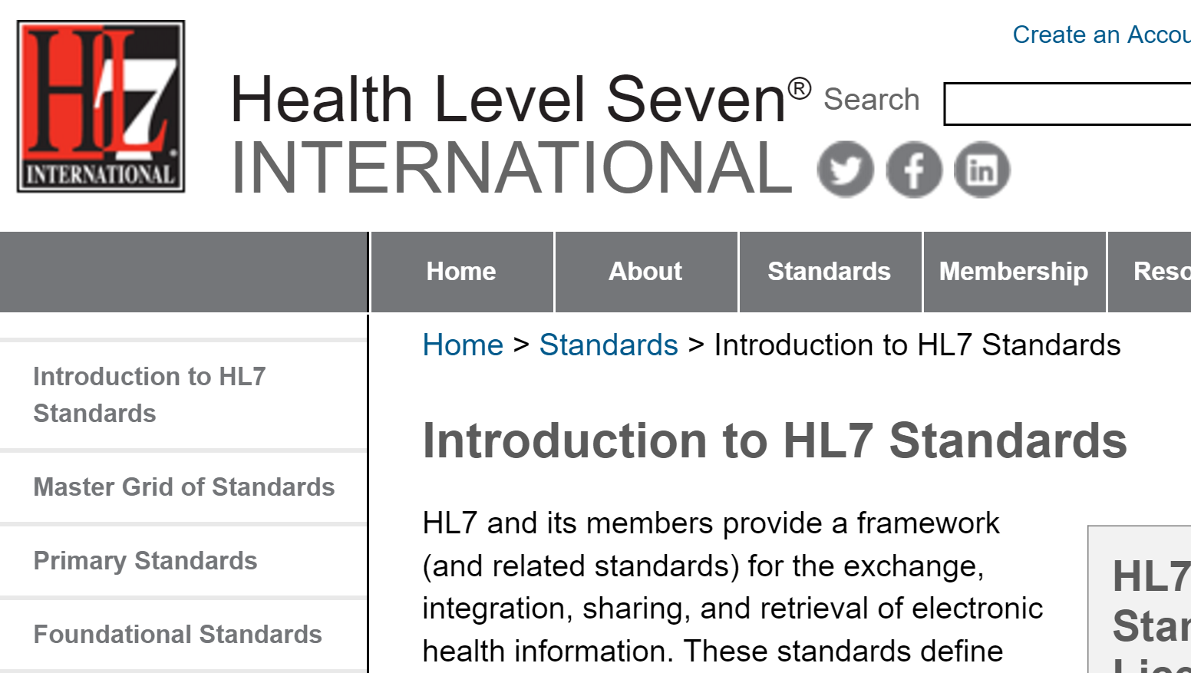
Where do we go for help?

Slide 50
What is a problem?
HL7 Glossary
Problem =Def. a clinical statement that a clinician chooses to add to a problem list.
‘Clinical statement’ is not defined

Slide 51
HL7 Glossary
Concept =Def. A clinical concept to which a unique ConceptID has been assigned
wiki.hl7.org/images/f/f0/TermInfo_Jan2014_Glossary.docx

Slide 52
Ontological incoherence
People don’t know what ‘problem’ means
Machines will not know what ‘problem’ means either
And so they will fail to auto-generate SNOMED-conformant problem lists from EHRs in a way that promotes interoperability

Slide 53
FHIR: Fast Healthcare Interoperability Resources

Slide 55
FHIR: Condition
=Def. Use to record detailed information about conditions, problems or diagnoses recognized by a clinician. There are many uses including: recording a diagnosis during an encounter; populating a problem list or a summary statement, such as a discharge summary.

Slide 56
fhir:ElementDefinitionBaseComponent
=Def. Information about the base definition of the element, provided to make it unncessary for tools to trace the deviation* of the element through the derived and related profiles. This information is only provided where the element definition represents a constraint on another element definition, and must be present if there is a base element definition.
“deviation” – or “derivation”

Slide 57
come the day when every patient’s genome is sequenced as they walk through the hospital door …

Slide 58
How ensure that we will have in digital form the needed clinical information onto which this sequence information can smoothly dock?
clinic
computational bioscience

Slide 59
Personalized medicine needs large cohorts with rich phenotypic data conforming to common standards. How to get there?
1. Everyone uses Epic
2. Government enforces common standards
3.

Slide 60
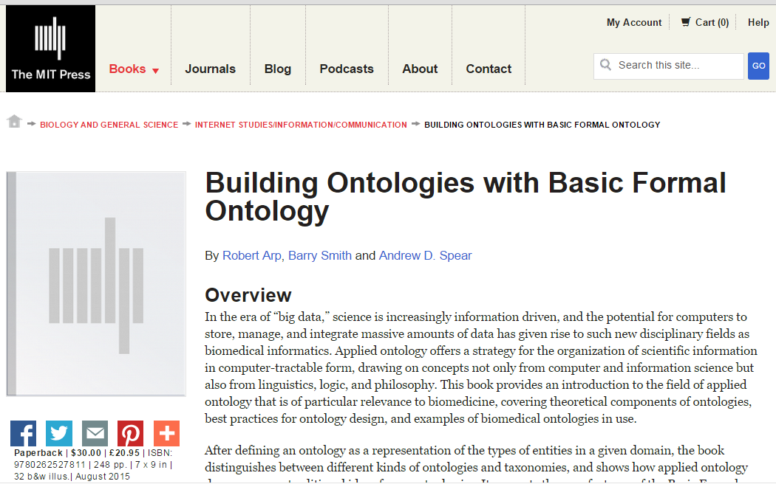
http://ontology.buffalo.edu/BOBFO

Slide 61
Users of BFO
PharmaOntology (W3C HCLS SIG)
MediCognos / Microsoft Healthvault
Cleveland Clinic Semantic Database in Cardiothoracic Surgery
Major Histocompatibility Complex (MHC) Ontology (NIAID)
Neuroscience Information Framework Standard (NIFSTD) and Constituent Ontologies
Interdisciplinary Prostate Ontology (IPO)
Nanoparticle Ontology (NPO): Ontology for Cancer Nanotechnology Research
Neural Electromagnetic Ontologies (NEMO)
ChemAxiom – Ontology for Chemistry

Slide 62
RELATION TO TIME GRANULARITY | CONTINUANT |  |  |  |  | OCCURRENT
 | INDEPENDENT |  |  | DEPENDENT
COMPLEX OF ORGANISMS | Family, Community, Deme, Population |  |  | Organ Function (FMP, CPRO) | Population Phenotype | Population Process
ORGAN AND ORGANISM | Organism (NCBI Taxonomy) | Anatomical Entity (FMA, CARO) |  |  | Phenotypic Quality (PaTO) | Biological Process (GO)
CELL AND CELLULAR COMPONENT | Cell (CL) | Cellular Component (FMA, GO) |  | Cellular Function (GO)
MOLECULE | Molecule (CHEBI, SO, RNAO, PRO) |  |  | Molecular Function (GO) |  | Molecular Process (GO)
Environment (EnvO)
OBO Foundry (Gene Ontology in yellow)

Slide 63
Disposition
- of a glass vase, to shatter if dropped
- of a human, to eat
- of a banana, to ripen
- of John, to lose hair
Diseases are dispositions

Slide 64
Physical Disorder

Slide 65
Physical Disorder
– independent continuant (part of the extended organism)
A causally linked combination of physical components that is clinically abnormal.

Slide 66
Clinically abnormal
(1) not part of the life plan for an organism of the relevant type (unlike aging or pregnancy),
(2) causally linked to an elevated risk either of pain or other feelings of illness, or of death or dysfunction, and
(3) such that the elevated risk exceeds a certain threshold level.*
*Compare: baldness

Slide 67
Big Picture

Slide 68
Pathological Process
=def. A bodily process that is a manifestation of a disorder and is clinically abnormal.
Disease =def. – A disposition to undergo pathological processes that exists in an organism because of one or more disorders in that organism.

Slide 69
Cirrhosis - environmental exposure
Etiological process - phenobarbitol-induced hepatic cell death
produces
Disorder - necrotic liver
bears
Disposition (disease) - cirrhosis
realized_in
Pathological process - abnormal tissue repair with cell proliferation and fibrosis that exceed a certain threshold; hypoxia-induced cell death
produces
Abnormal bodily features
recognized_as
Symptoms - fatigue, anorexia
Signs - jaundice, enlarged spleen

Slide 70
Influenza - infectious
Etiological process - infection of airway epithelial cells with influenza virus
produces
Disorder - viable cells with influenza virus
bears
Disposition (disease) - flu
realized_in
Pathological process - acute inflammation
produces
Abnormal bodily features
recognized_as
Symptoms - weakness, dizziness
Signs - fever

Slide 71
Dispositions and Predispositions
All diseases are dispositions; not all dispositions are diseases.
Predisposition to Disease
=def. – A disposition in an organism that constitutes an increased risk of the organism’s subsequently developing some disease.

Slide 72
Huntington’s Disease – genetic
Etiological process - inheritance of >39 CAG repeats in the HTT gene
produces
Disorder - chromosome 4 with abnormal mHTT
bears
Disposition (disease) - Huntington’s disease
realized_in
Pathological process - accumulation of mHTT protein fragments, abnormal transcription regulation, neuronal cell death in striatum
produces
Abnormal bodily features
recognized_as
Symptoms - anxiety, depression
Signs - difficulties in speaking and swallowing

Slide 73
HNPCC - genetic pre-disposition
Etiological process - inheritance of a mutant mismatch repair gene
produces
Disorder - chromosome 3 with abnormal hMLH1
bears
Disposition (disease) - Lynch syndrome
realized_in
Pathological process - abnormal repair of DNA mismatches
produces
Disorder - mutations in proto-oncogenes and tumor suppressor genes with microsatellite repeats (e.g. TGF-beta R2)
bears
Disposition (disease) - non-polyposis colon cancer
realized in
Symptoms (including pain)

Slide 74
Clinical Terminology Shock and Awe (CTSA)
Fifth Annual Workshop of the Clinical and Translational Science Ontology Group
Date: September 7-8, 2016
Venue: Ramada Hotel, Amherst, NY
Goals: The Clinical and Translational Science Ontology Group was established in 2012 to leverage the use of common ontologies to support different aspects of information-driven clinical and translational research. The focus of this meeting is to explore new and existing uses of common ontologies to support sharing and discovery of data and resources, researcher networking, and particularly to support the evaluation of research.

