Slide 1
An Ontology Ecosystem Approach to Electronic Health Record Interoperability
Barry Smith
Ontology Summit
April 7, 2016

Slide 2
Electronic Health Records – pro
no more redundant tests
continuity of care improved
quality of information improved
no more lost charts
no more illegible handwriting
no more non-standard codes
charts are accessible from multiple sites simultaneously
Notes:
Jonathan Cohn, The New Republic, (January 21, 2011); http://www.healthcare.gov/law/resources/reports/nationalqualitystrategy032011.pdf

Slide 3
Electronic Health Records – con
to reep these benefits we have to get the data inside the computer
in a form that allows it to be shared
Addressing 1. brings costs/risks in areas such as privacy, safety, clinician distraction,
Addressing 2. requires EHR system interoperability

Slide 4
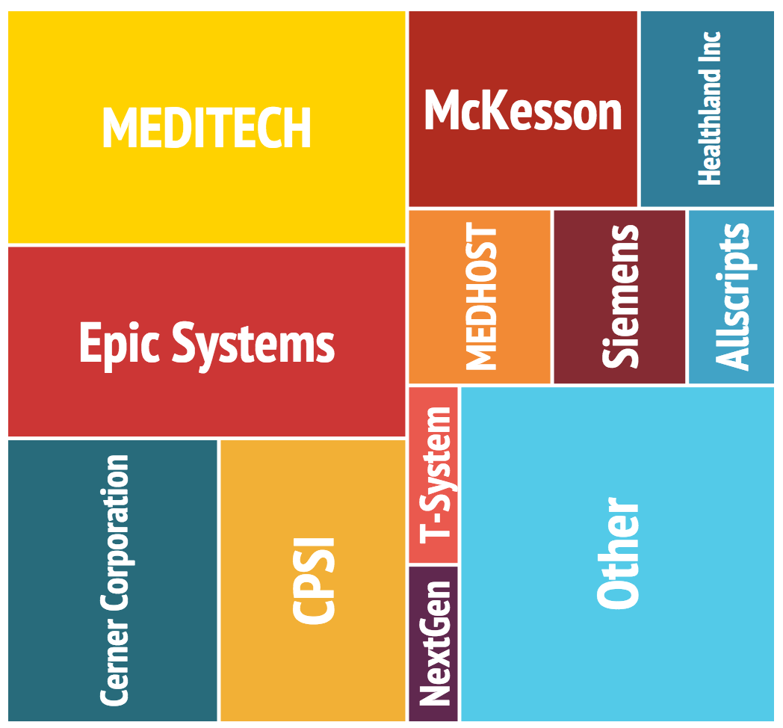
Interoperability
Definition: Two systems A and B are interoperable if the system A-data can be used by system B in the same way that it is used by system A and vice versa
EHR systems in the US (at least) are still (2016) a long way from interoperability
Notes:
http://ehr.softwareinsider.com/

Slide 5
Perhaps Epic (Prop: Judy Faulkner) will solve the problem

Slide 6
slowly, but surely, everyone will use Epic

Slide 7
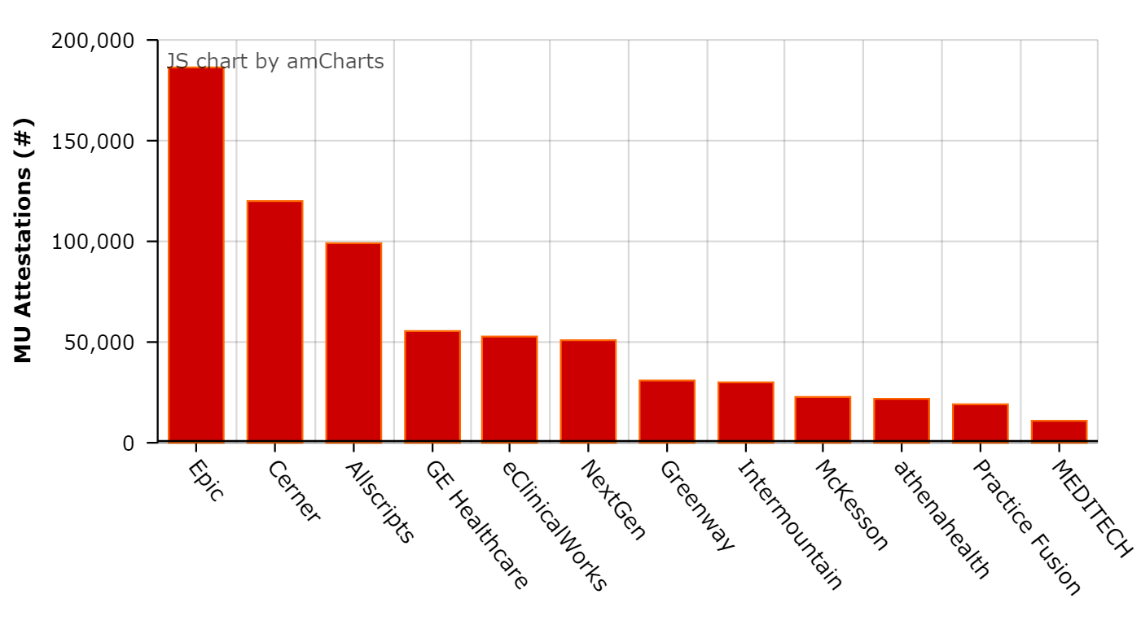
start with the US

Slide 8
tomorrow, the galaxy

Slide 9
even total victory of Epic would not imply interoperability
RAND Corporation: Epic is a “closed system” that makes it “challenging and costly” for hospitals to interconnect. (New York Times, September 13, 2014)
Notes:
http://www.healthcareitnews.com/blog/vista-epic-tale-two-systems

Slide 11
… I interviewed Boeing’s top cockpit designers, who wouldn’t dream of green-lighting a new plane until they had spent thousands of hours watching pilots in simulators and on test flights. This principle of user-centered design is part of aviation’s DNA, yet has been woefully lacking in health care software design.

Slide 12
Why is the US stuck with EHR systems which are so clunky and distracting, and which address hardly at all the issue of interoperability?
Why was it all done so quickly, when there were so few talented, trained personnel, with the needed sorts of expertise?
Answer: the HITECH Act (2009): let’s bribe physicians to adopt these Mumps-based EHR systems quickly, and then penalize them if they fail to do so
Notes:
http://newsroom.acep.org/Hello-Electronic-Medical-Records-It-s-Me-Unintended-Consequences

Slide 13
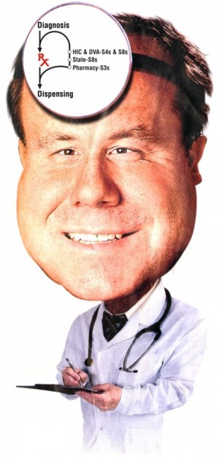
Compare: the COMPUTECH Act (1959)
Let’s bribe computer users to use only this new-fangled COBOL language in all the work they do … and then penalize them with bigger and bigger fines each year until they all do so, forever and ever

Slide 14
To get paid under the Hitech act, you must show “Meaningful Use”
Stage 1: 2011-2012 | Stage 2: 2014 | Stage 3: 2016
Capturing health information in a coded format Using the information to track key clinical conditions Communicating captured information for care coordination purposes Reporting of clinical quality measures and public health information | Disease management, clinical decision support Medication management Support for patient access to their health information Transitions in care Quality measurement Research Bi-directional communi-cation with public health agencies | Achieving improvements in quality, safety and efficiency Focusing on decision support for national high priority conditions Patient access to self-management tools Access to comprehensive patient data Improving population health outcomes
Data capture and sharing | Advance clinical processes | Leverage information to improve outcomes

Slide 15
Meaningful Use and Interoperability
Stage 1: 2011-2012 | Stage 2: 2014 | Stage 3: 2016
Capturing health information in a coded format Using the information to track key clinical conditions Communicating captured information for care coordination purposes Reporting of clinical quality measures and public health information | Problem lists must be “stored” using codes from SNOMED-CT* *Systematized Nomenclature of Medicine – Clinical Terms | Achieving improvements in quality, safety and efficiency Focusing on decision support for national high priority conditions Patient access to self-management tools Access to comprehensive patient data Improving population health outcomes
Data capture and sharing | Advance clinical processes | Leverage information to improve outcomes
https://www.healthit.gov/sites/default/files/meaningfulusetablesseries2_110112.pdf

Slide 16
SNOMED CT
Coding with SNOMED-CT still not standard practice among physicians in US
Human coding with SNOMED-CT is unreliable and inconsistent
The organization of SNOMED-CT allows many alternative ways of coding what is medically the same phenomenon

Slide 17
An example of a problem list
No Allergies
No Known Allergies
Two problems ?
Or one ?
Or zero ?

Slide 18
http://www.snomedbrowser.com/Codes/Details/254769006 http://www.snomedbrowser.com/Codes/Details/44598004
What is a problem?
SNOMED: Solitary leiomyoma (disorder)
Concept ID: 254769006
SNOMED: Leiomyoma (morphologic abnormality)
Concept ID: 44598004
Two problems or one?

Slide 19
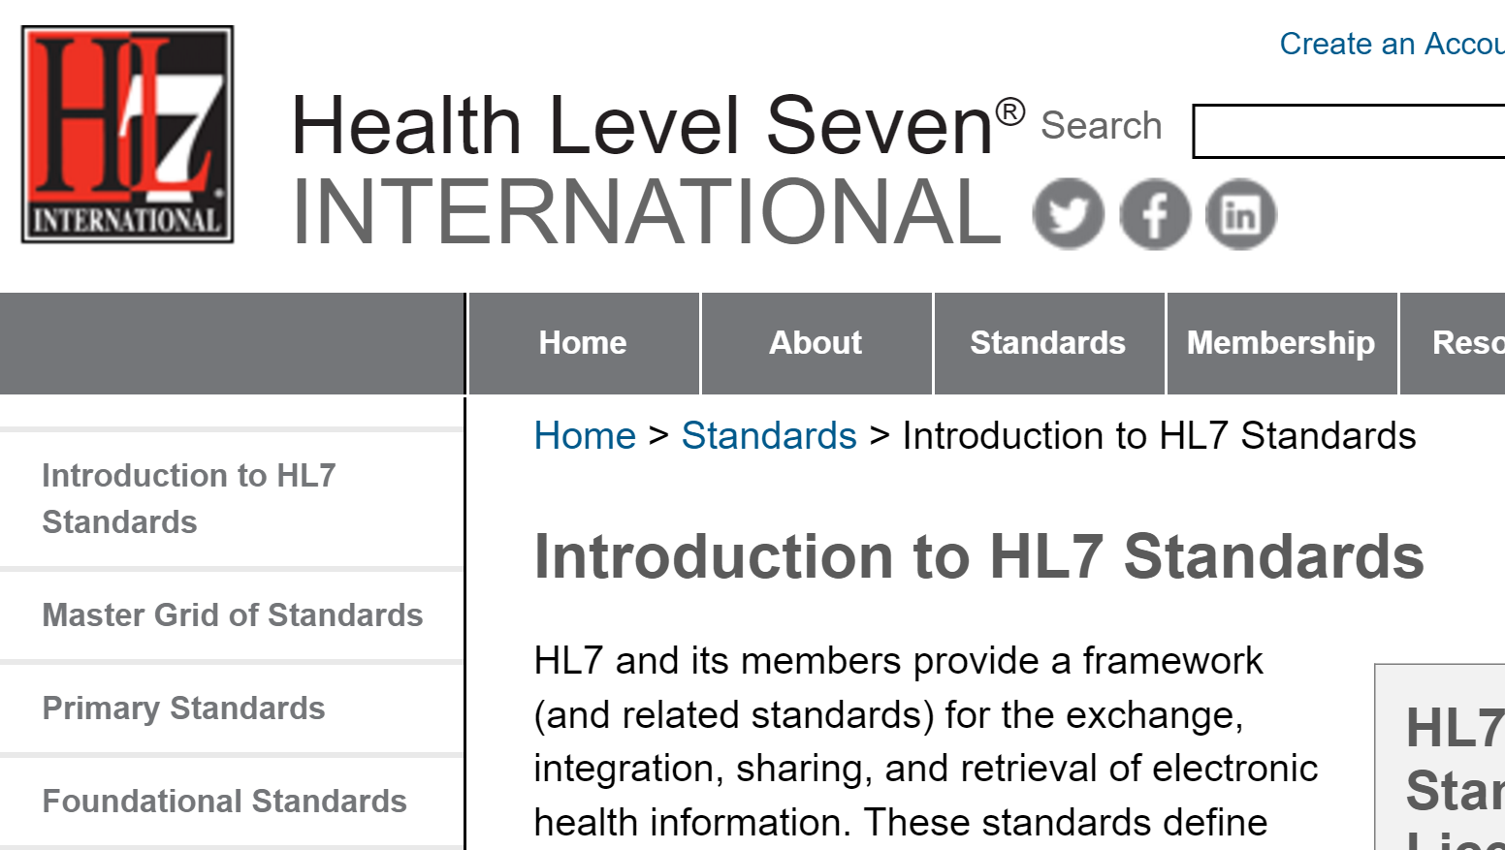
Where do we go for help?

Slide 20
What is a problem?
HL7 Glossary
Problem =Def. a clinical statement that a clinician chooses to add to a problem list.
‘Clinical statement’ is not defined

Slide 21
Ontological incoherence
People don’t know what ‘problem’ means
Machines will not know what ‘problem’ means either
And so they will fail to auto-generate SNOMED-conformant problem lists from EHRs in a way that promotes interoperability

Slide 22
FHIR: Fast Healthcare Interoperability Resources
Perhaps
can help

Slide 24
FHIR: Condition
=Def. Use to record detailed information about conditions, problems or diagnoses recognized by a clinician. There are many uses including: recording a diagnosis during an encounter; populating a problem list or a summary statement, such as a discharge summary.

Slide 25
Something like FHIR will be needed
… come the day when every patient’s genome is sequenced as they walk through the hospital door …

Slide 26
How ensure that we will have in digital form the needed clinical information onto which this sequence information can smoothly and securely dock?
clinic
computational bioscience

Slide 27
Personalized medicine needs large cohorts with rich phenotypic data conforming to common standards. How to get there?
1. Everyone uses Epic
2. Government enforces common standards
3. Let’s start again from scratch, using the same approach we should have used from the beginning: rigorous testing-based development of EHRs by leading medical research institutions until we see what technologies will work

Slide 29
RELATION TO TIME GRANULARITY | CONTINUANT |  |  |  |  | OCCURRENT
 | INDEPENDENT |  |  | DEPENDENT
COMPLEX OF ORGANISMS | Family, Community, Deme, Population |  |  | Organ Function (FMP, CPRO) | Population Phenotype | Population Process
ORGAN AND ORGANISM | Organism (NCBI Taxonomy) | Anatomical Entity (FMA, CARO) |  |  | Phenotypic Quality (PaTO) | Biological Process (GO)
CELL AND CELLULAR COMPONENT | Cell (CL) | Cellular Component (FMA, GO) |  | Cellular Function (GO)
MOLECULE | Molecule (CHEBI, SO, RNAO, PRO) |  |  | Molecular Function (GO) |  | Molecular Process (GO)
Environment (EnvO)
OBO Foundry (Gene Ontology in yellow)

Slide 30
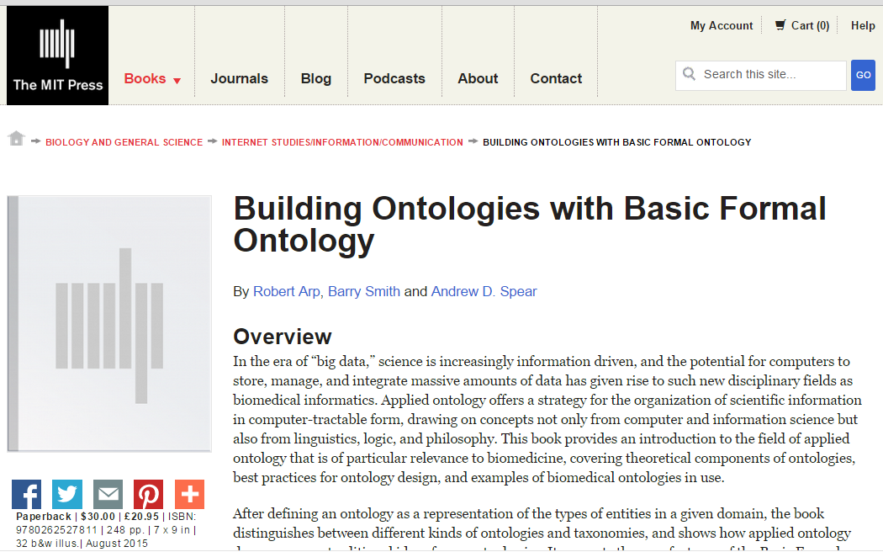
http://ontology.buffalo.edu/BOBFO

Slide 31
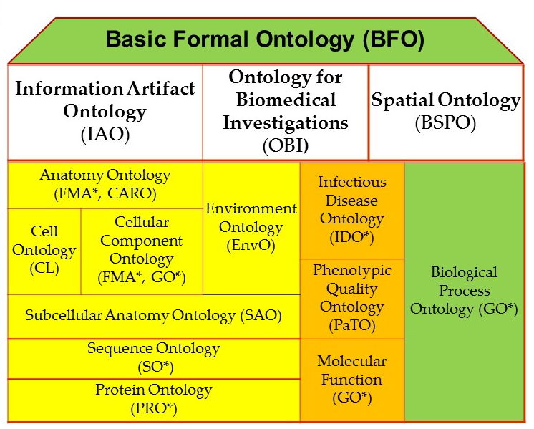
BFO-based hub and spokes strategy for developing interoperable ontology modules

Slide 32
examples of the BFO/OBO Foundry ontology ecosystem approach extended to other domains
NIF Standard | Neuroscience Information Framework
eagle-I / VIVO Core | Integrated Semantic Framework / CTSA Connect
IDO Core / IDO extensions | Infectious Disease Ontology Suite
cROP / Planteome | Common Reference Ontologies for Plants

Slide 33
Examples of BFO/OBO Foundry approach extended into yet further domains
UNEP Ontology Framework | United Nations Environment Programme
USGS National Map Ontologies | United States Geological Survey
Joint Doctrine Ontologies | US Air Force Research Labs / Training and Doctrine Command (TRADOC)
TRIP Ontologies | Federal Highway Administration (FHWA) Transportation Research Informatics Platform (TRIP)
Notes:
http://cegis.usgs.gov/ontology.html

Slide 34
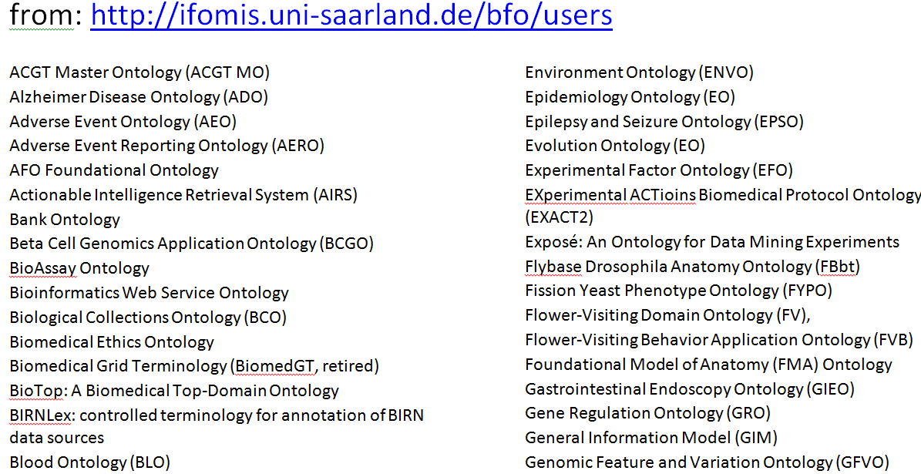
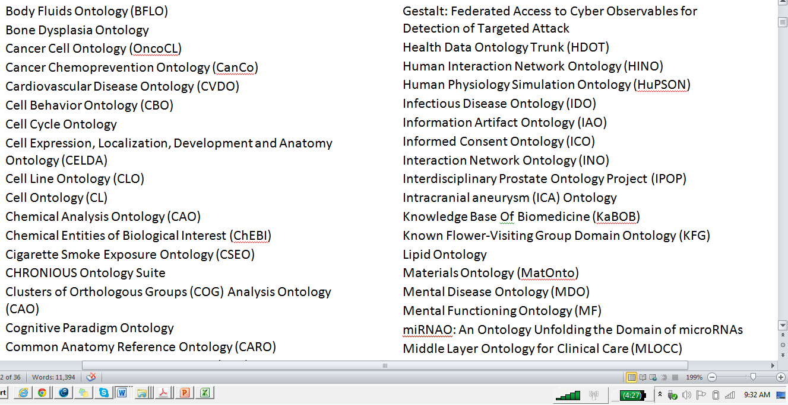
165+ ontologies re-using BFO

Slide 35
BFO
Ontology for General Medical Science (OGMS)
Cardiovascular Disease Ontology
Genetic Disease Ontology
Cancer Disease Ontology
Genetic Disease Ontology
Immune Disease Ontology
Environmental Disease Ontology
Oral Disease Ontology
Infectious Disease Ontology
IDO Staph Aureus
IDO MRSA
IDO Australian MRSA
IDO Australian Hospital MRSA
…

Slide 36
IDO Core and IDO Extensions
IDO | Infectious Disease Ontology
IDO-BRU | Brucellosis Ontology
IDO-HIV | HIV Ontology
IDO-FLU | Influenza Ontology
IDO-DENGUE | Dengue Ontology
IDO-STAPH | Staph. Aureus Ontology
IDO-PLANT | Plant Infectious Disease Ontology
IDO-MRSA | Methicillin-Resistant Staph. Aureus Ontology
IDO-Vector | Vector-Borne Infectious Disease Ontology
IDO-MAL | Malaria Ontology

Slide 37
How IDO evolves
IDOMAL
IDOCore
IDOHIV
CORE and
SPOKES:
Domain
ontologies
IDOFLU
IDORatSa
IDORatStrep
IDOSa
IDOStrep
IDOMRSA
IDOAntibioticResistant
SEMI-LATTICE:
By subject matter experts in different communities of interest.
IDOHumanSa
IDOHumanStrep
IDOHumanBacterial
Notes:
Growth
Micro ontologies for particular diseases that inherit terms and axioms about host-pathogen interaction. Evolve in a cross-producty way…so if you are interested in frog pneumonia, IDO Core has you covered.

Slide 38
How IDO STAPH evolves
IDOMAL
IDOCore
IDOHIV
IDOFLU
IDORatSa
IDORatStrep
IDO STAPH
IDOStrep
IDOMRSa
IDOAntibioticResistant
IDOHumanSa
IDOHumanStrep
IDOHumanBacterial
Notes:
Growth
Micro ontologies for particular diseases that inherit terms and axioms about host-pathogen interaction. Evolve in a cross-producty way…so if you are interested in frog pneumonia, IDO Core has you covered.

Slide 39
Clinical Terminology Shock and Awe (CTSA)
Fifth Annual Workshop of the Clinical and Translational Science Ontology Group
Date: September 7-8, 2016
Venue: Ramada Hotel, Amherst, NY
Goals: To explore uses of common ontologies to support sharing and discovery of clinical data

