Slide 1
Enhancing the Quality of ImmPort Data
Barry Smith
ImmPort Science Meeting, February 27, 2014
With thanks to Anna Maria Masci

Slide 2
Example of a data submission template to
https://immport.niaid.nih.gov/

Slide 4
What kind of artifact is this list?

Slide 5
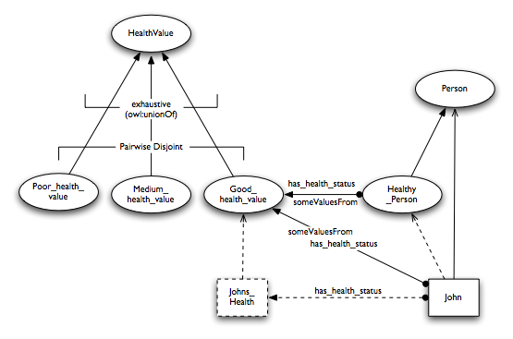
Alan Rector, Representing Specified Values in OWL: "value partitions" and "value sets“ (2005), http://www.w3.org/TR/swbp-specified-values/

Slide 6
Value set
=def. a list of subtypes partitioning a given type

Slide 7
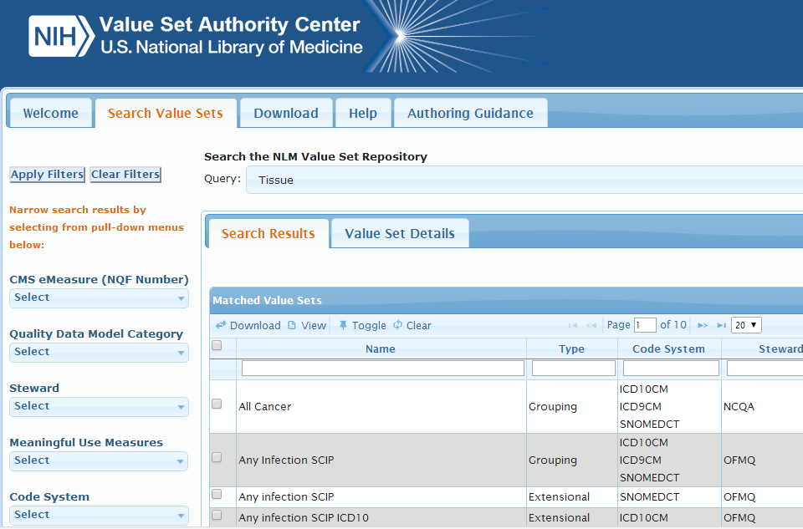
https://vsac.nlm.nih.gov/

Slide 8
Value set (according to the VSAC)
=def.
a list of specific values (terms and their codes) derived from standard vocabularies or code systems used to define clinical concepts (e.g. patients with diabetes, clinical visit, reportable diseases).

Slide 9
https://vsac.nlm.nih.gov/

Slide 12
For VSAC each value set involves:
natural language noun phrases from a controlled vocabulary (can in principle vary between communities / disciplines)
official name for code system / ontology / version
alphanumeric IDs
URLs

Slide 14
Basic assumptions
Step by step, ImmPort should move away from use of free text fields
Use of common value sets increases discoverability and comparability by third-party users
Ideally these value sets should be used also by clinicians, researchers and literature curators in neighboring fields
ImmPort and its users will benefit if value sets are well-maintained in light of scientific advance

Slide 15
Which controlled vocabularies + code systems should we use when composing value sets for use as ImmPort templates?
VSAC Coding Systems
FDA mandated terminologies (CDICSC, MedDRA)
OBO Foundry ontologies

Slide 16
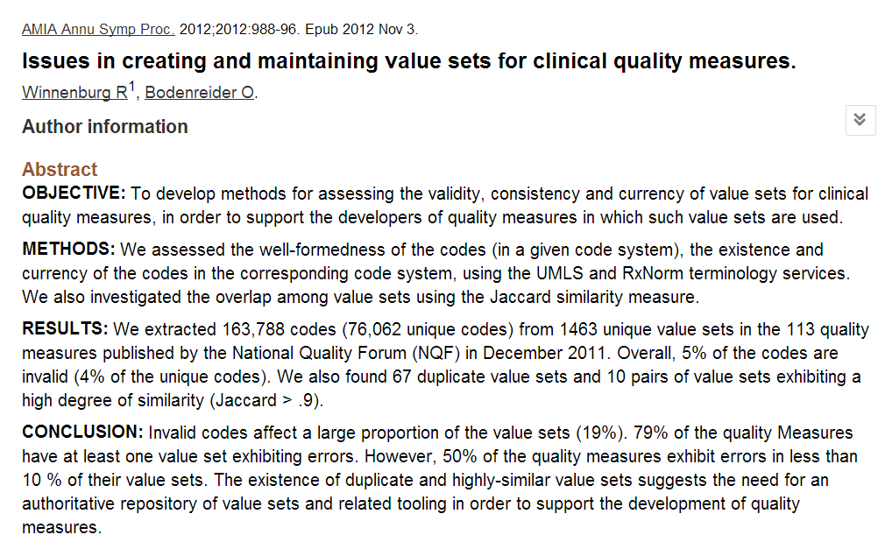

Slide 17
Figure 3: Typical examples for code lists with multiple names
http://www.ncbi.nlm.nih.gov/pmc/articles/PMC3540585

Slide 18
Invalid codes affect a large proportion of the value sets (19%).
The existence of duplicate and highly-similar value sets suggests the need for an authoritative repository of value sets and related tooling in order to support the development of quality measures.

Slide 19
Invalid codes affect a large proportion of the value sets (19%).
The existence of duplicate and highly-similar value sets suggests the need for an authoritative repository of value sets and related tooling in order to support the development of quality measures.

Slide 20
http://www.ncbi.nlm.nih.gov/pmc/articles/PMC3540585

Slide 21
Figure 3: Typical examples for code lists with multiple names
http://www.ncbi.nlm.nih.gov/pmc/articles/PMC3540585

Slide 22
http://www.ncbi.nlm.nih.gov/pmc/articles/PMC3540585

Slide 23
Should (can) ImmPort adopt SNOMED CT as a source for value sets?

Slide 24
SNOMED CT (Clinical Terms): Pro
> 311,000 concepts; 1,360,000 relationships
DHHS / NLM mandated use as core exchange terminology for all US electronic health records
international standard; multi-language
perpetual guaranteed funding from > 15 countries
agreement with LOINC to coordinate on mappings (albeit after 10 years of negotiation)
similar agreement with ICD

Slide 28
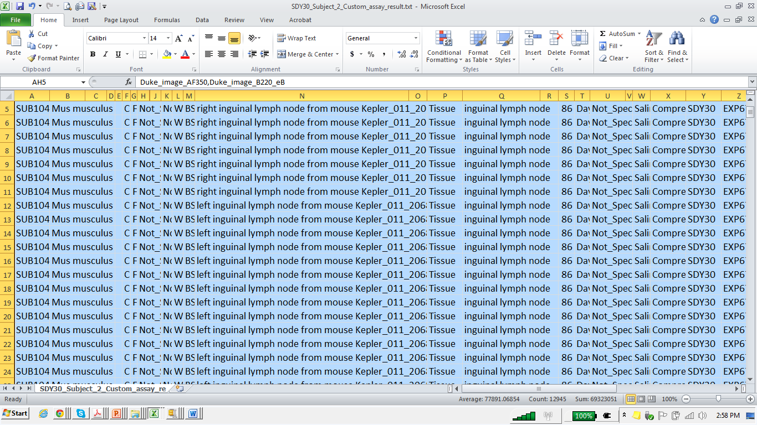
SDY 30 Comprehensive study of germinal center development and antibody response (Kepler) - Masci

Slide 29
Hypothesis
SDY30: Comprehensive study of germinal center development and antibody response
inguinal lymph node

Slide 30
Hypothesis
inguinal lymph node
right inguinal lymph node from mouse Kepler_011_206
left inguinal lymph node from mouse Kepler_011_206

Slide 31
https://uts.nlm.nih.gov/snomedctBrowser.html

Slide 32
Search Results (16)
65266007 Structure of deep inguinal lymph node
113340006 Structure of superficial inguinal lymph node
85380009 Structure of inferior inguinal lymph node
8928004 Inguinal lymph node structure
181762005 Entire inguinal lymph node
279158001 Entire femoral lymph node
303269009 Entire inferior inguinal lymph node
245312007 Inguinal lymph node group
245317001 Deep inguinal lymph node group
245313002 Superficial inguinal lymph node group
52554005 Superior medial inguinal lymph node
76704003 Superior lateral inguinal lymph node
245370007 Entire superficial inguinal lymph node
245315009 Superolateral superficial inguinal lymph node group
245316005 Inferior superficial inguinal lymph node group
245314008 Superomedial superficial inguinal lymph node group

Slide 33
Search Results (16)
8928004 Inguinal lymph node structure
181762005 Entire inguinal lymph node
245312007 Inguinal lymph node group
Why no term: ‘inguinal lymph node’ ?
Well-intended but mistaken ontological design
Major fix to address an inference problem, now hard to undo

Slide 34
Problems with SNOMED
Massive committee structure
Means: slow reaction time for needed changes
Causes problems for information-driven translational science
Not quite open (license problems)
Problems for treatment of non-human subjects

Slide 35
Animal subjects
chicken
duck
fly
macaque
mouse
pig
rat

Slide 36
Do we want a different value set here for each different species?

Slide 37
Whatever answer we give to questions like this, we should never abandon considerations of feasibility
What can NG cope with?
What can the data processing software cope with?
Note: only small selections from big lists will be needed
What can data providers cope with?
Action item under 3.: Explore potential of LIMS system-generated mappings

Slide 38
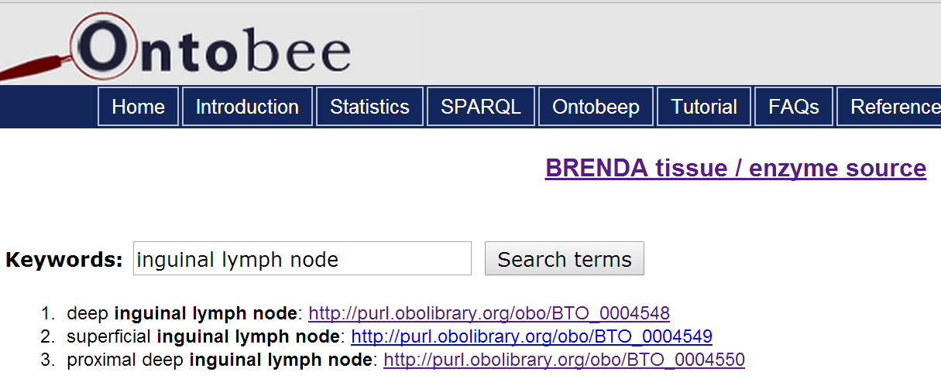
Brenda Tissue Ontology
http://www.ontobee.org/browser/index.php?o=BTO‎

Slide 39
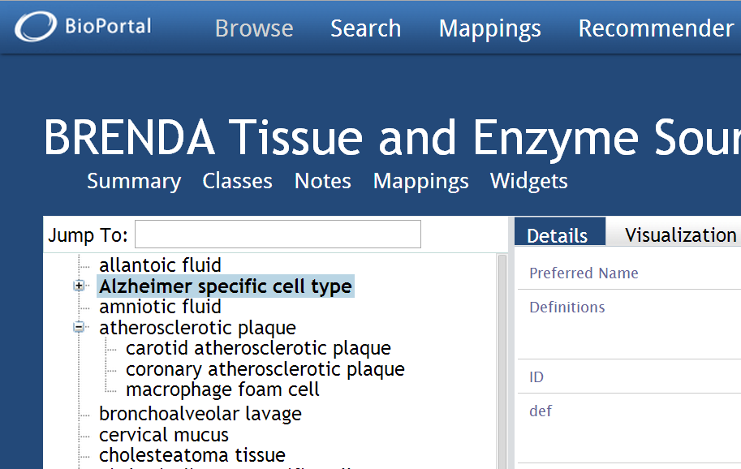
http://bioportal.bioontology.org/ontologies/BTO/

Slide 40
disease-specific cell types
NOT: cell type is_a tissue

Slide 41
mollusk terms in Brenda

Slide 42
anatomical structures mixed with cell types
Notes:
http://bioportal.bioontology.org/ontologies/BTO

Slide 43
Brenda Tissue and Enzyme Source Ontology
Confuses type of tissue vs. source of tissue
Too little structure
Primary hierarchy is a partonomy
No clear treatment of species-specificity
‘Source of enzyme’ is not a coherent way to specify an ontology domain
Confused definitions (for example the definition provided for “Alzheimer-specific cell” is in fact a definition for Alzheimer’s Disease
Too little attention to developments in ontology in last 5 years

Slide 44
Action item
Explore alternatives to Brenda for Tissue Subtypes, including
Foundational Model of Anatomy Ontology
Uberon
broadly compatible with OBO Foundry principles

Slide 45
why go for OBO Foundry ontologies (GO, PRO, CL, …)
discoverability (open)
allows different value sets (and values) to be compared, logically composed
versioning, update, scientific basis
huge established annotation resources
clearly determined domains ensure consistent annotation and division of labor
management, trackers
quick response (vs. multi-year timelines for some VSAC systems)

Slide 46
Principal reason for using OBO Foundry ontologies
quick response provides an opportunity to use the ImmPort workflow to do real science

Slide 47
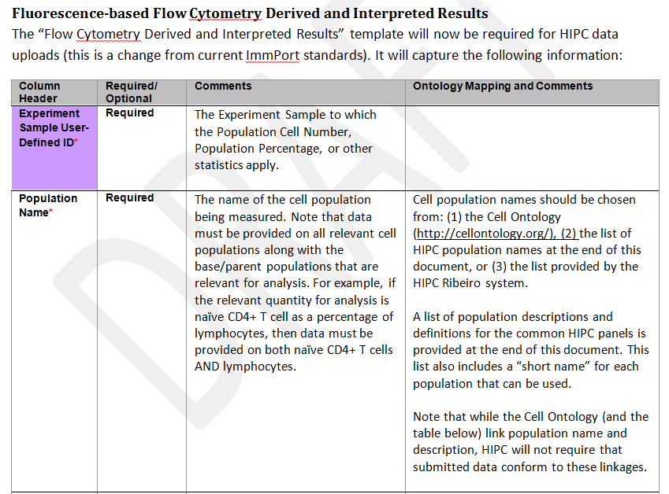

Slide 48
What is proposed: one column with options
Better: HIPC data providers should include entries (ideally with URIs) under more than one of B, C, D, E (primarily B and E)
The results can then be used e.g. to identify issues identified through CL definitions, and thereby advance the quality of CL over time and also advance consistency of immunology terminology

Slide 49
More action items
Evaluate SNOMED CT as a potential source for the Subject Phenotype template
Evaluate the VSAC Value Set Authoring Tool (released in October 2013)
Explore developing facility such as
http://neurocommons.org/page/Ontological_term_broker
to scoop up the terms used in free text fields for review regarding submission to value sets: replace ‘Other’ in existing templates with a ‘request for new term’ submission field

Slide 50
Yet more action items
Create catalog of all templates we have
Allow template-focused search across all studies
Prioritize templates that need to be created
Prioritize existing templates that need work
Explore LIMS collaborations to allow automatic input into templates

